Slide 1
Embedded Librarians in Course Management Systems:
Jumping in Feet First
Lorin Fisher
Information Literacy Coordinator, Texas State University-San Marcos
Arlene Salazar
Reference & Instruction Librarian, Texas State University-San Marcos

Slide 2
Statistics

Slide 3
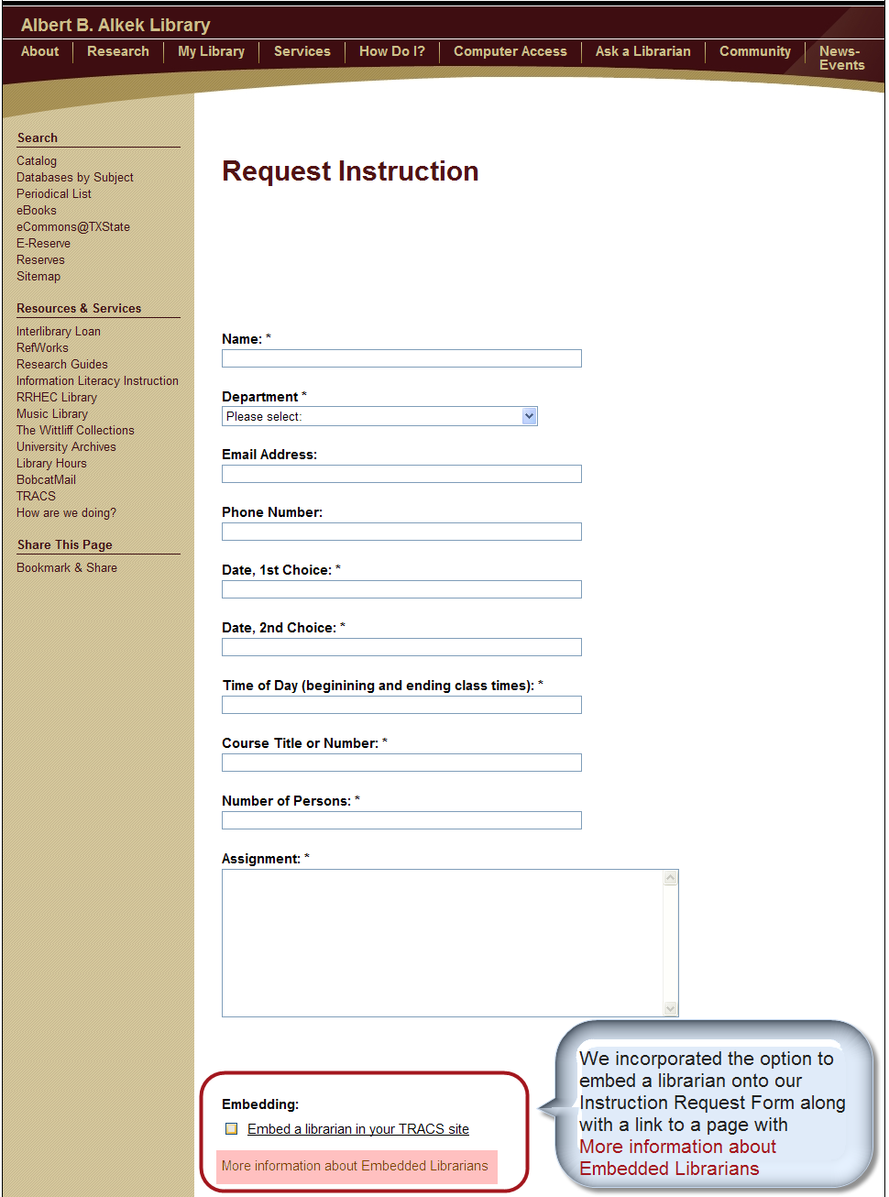

Slide 4
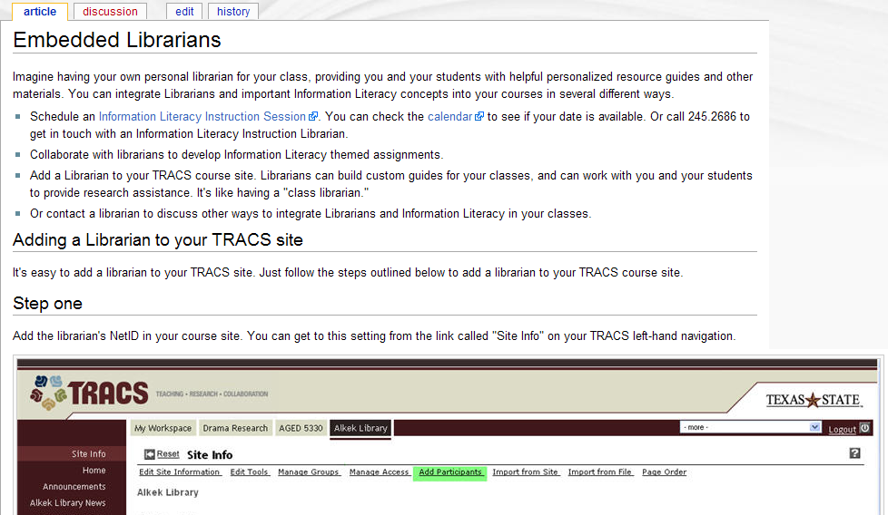
More Information about Embedded Librarians

Slide 5
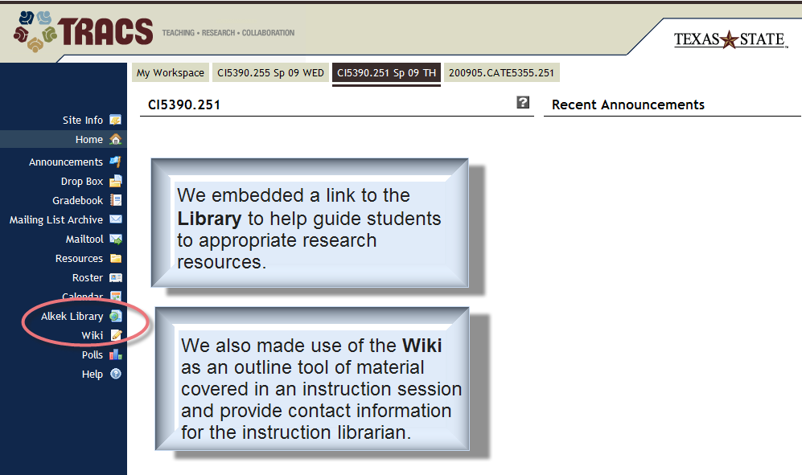
Library components in TRACS

Slide 6
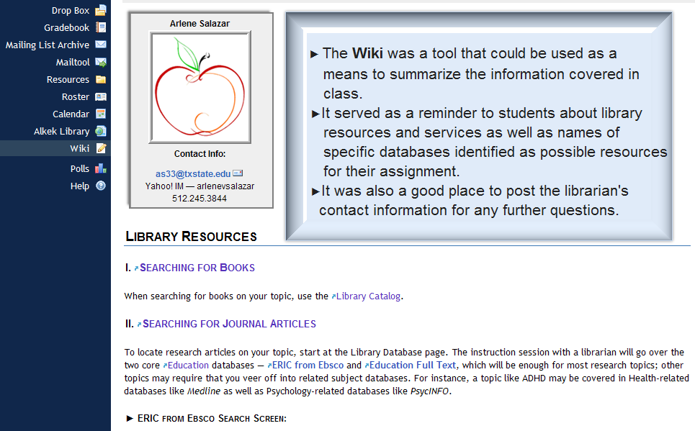
Wiki Tool

Slide 7
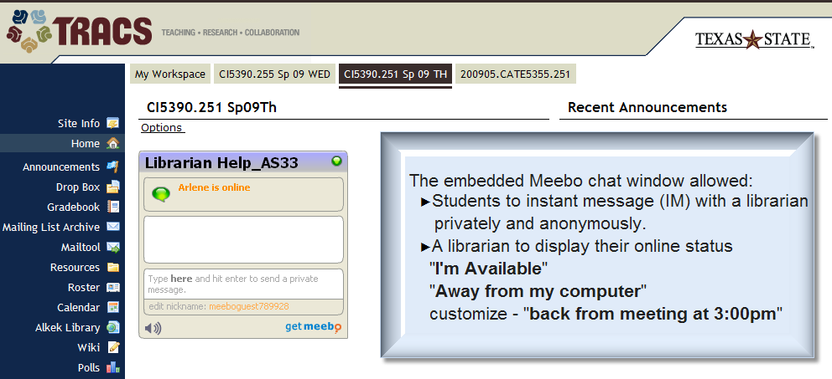
Instant Messaging

Slide 8
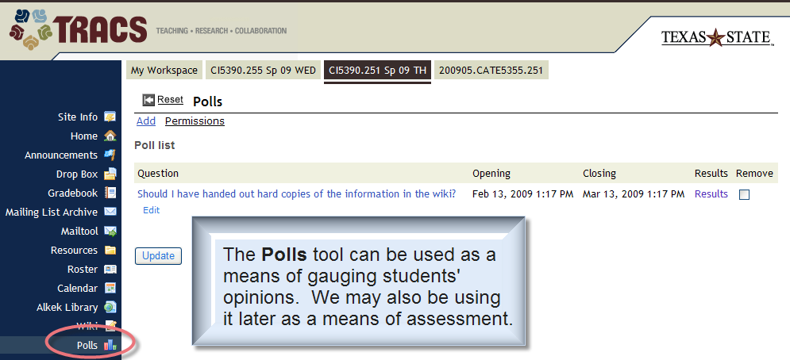
Assessment

