Slide 1
Designing and Implementing a
5-Nines Strategy
Link Alander,
Executive Director, Campus Technology Services
Shah Ardalan,
Vice Chancellor Technology Services / CIO

Slide 2
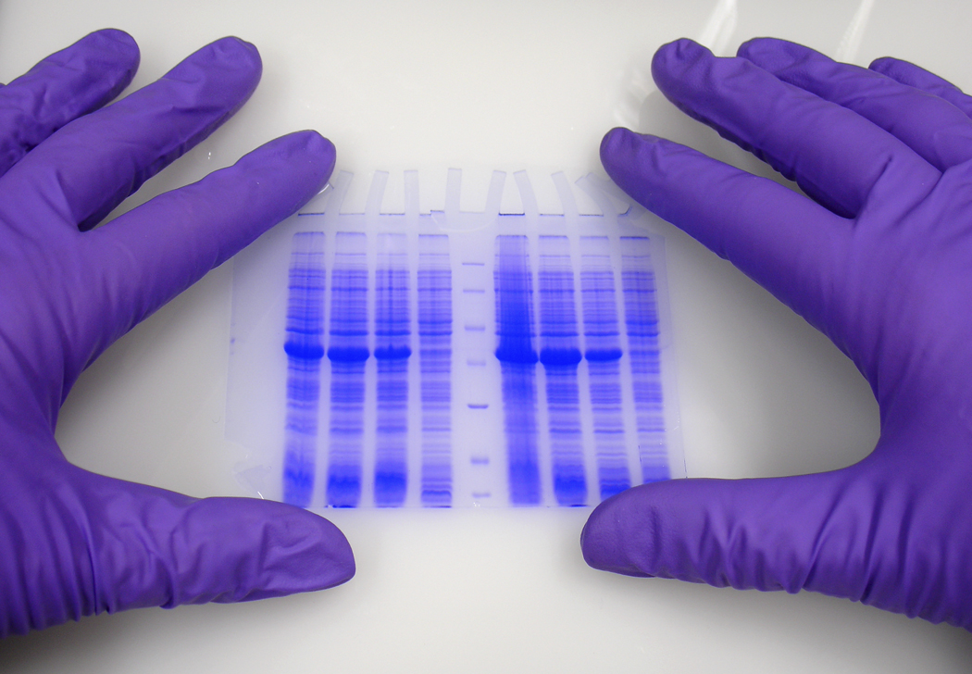
The DNA of 5-Nines
Design
IT Service Management
Measuring
Foundation
Background
10,000 foot
Overview

Slide 3
Background
Lone Star College System
Over 65,000 students
13 Geographic locations across North Houston
Office of Technology Services
  119 staff members
  12,000 desktop systems
  4,800 network devices
  475 file servers

Slide 4
Background
Challenge
How do you define 5-nines
System or Service?

Slide 5
The Marvelous Efficiency of Dabbawallahas
CBS News Clip – The Marvelous Efficiency of Dabbawallahas
Video Clip from the CBS Evening News 2/19/2009

Slide 6
The DNA of 5-Nines
WAN
Foundation
Directory Services
Storage

Slide 7
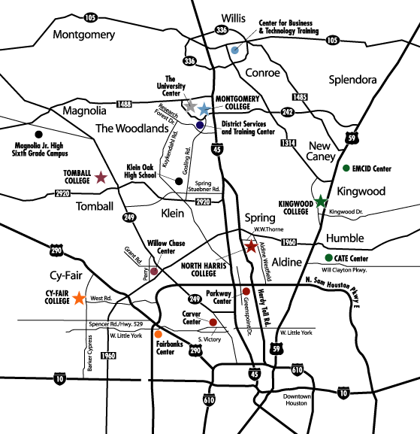
Foundation – WAN and Directory Services
WAN Redundancy
13 locations connected
with 1,157 miles of fiber

Slide 8
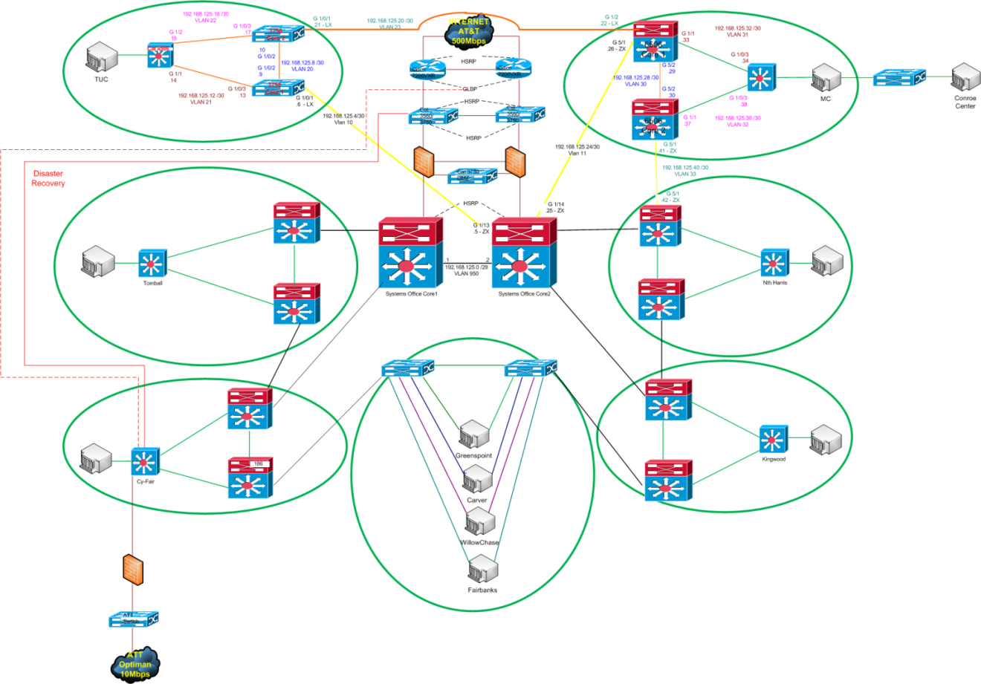
Foundation – WAN and Directory Services
WAN Redundancy
  Remove any single points of failure!

Slide 9
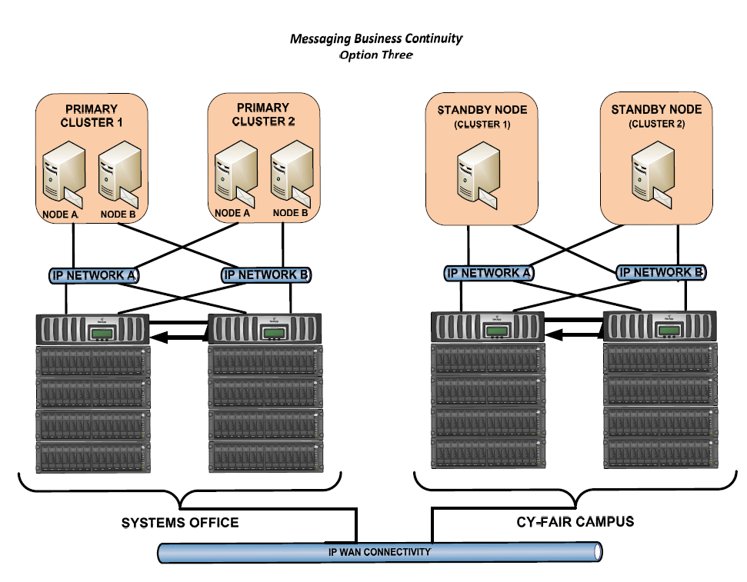
Foundation – WAN and Directory Services
Directory Services
The Tools
  Microsoft Directory Services
    Server 2008
    Exchange 2007
  EMC
    Clarion
    Rainfinity FMA
    Centra
    Avamar
    Brocade Infrastructure

Slide 10
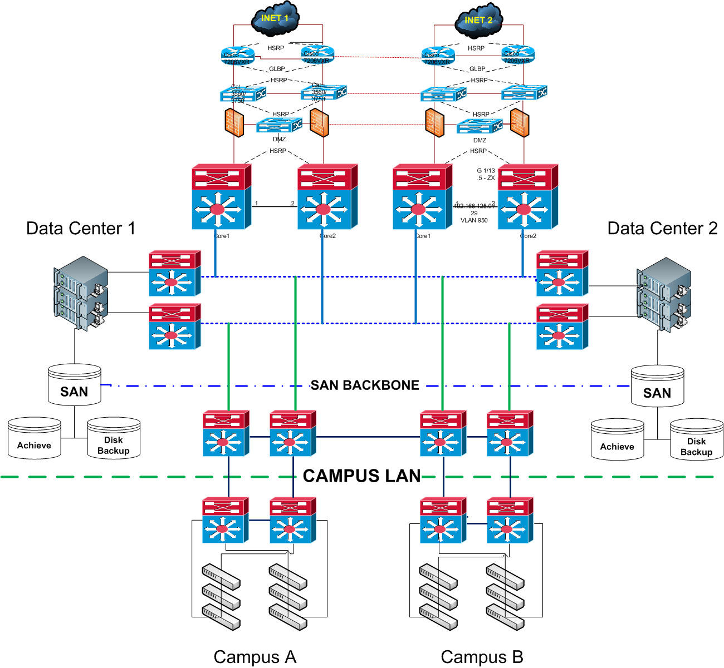

Foundation – WAN and Directory Services
Bringing it all together – Our Foundation
Internet Redundancy
WAN Redundancy
Data Center Co-Location
Storage Redundancy
LAN Redundancy

Slide 11
The DNA of 5-Nines
WAN
Design
Application Classification
Foundation
Directory Services
Storage
Virtualization

Slide 12
Design - Application Classification and Virtualization
  Business Continuity Plan - Alignment
IT Service Continuity - Application Classification
  What are your core services?
    Tier I services – Mission Critical
    Tier II services - Important
    Tier III services – Nice to have
  What is your
    Recovery Time Objective (RTO)
    Recovery Point Objective (RPO)
  What weaknesses do your applications present?
    Standardization – Hardware and Software

Slide 13
Design - Application Classification and Virtualization
Application Classification – IT Service Continuity
OTS - IT Service Continuity |  |  |  |  |  |  | Last Update: |  |  | 11/5/2008
Item ID | LSCS - Core IT services | Restore Priority | Dependency | Location | Today | Planned | Weakness | RTO | RPO | Comments
Critical Infrastructure
A | Internet | 1 | AT&T | SO CF | 500MB at SO 10MB at CF | Dual leg network with auto failover | Limited bandwidth at the DR location
B | Fiber Network | 2 | Phonoscope |  |  |  | 70% above ground
C | WAN/LAN | 3 | A,B,C | All Locations | ONS - SPF | 2 - 1GB direct at each location with ONS as a backup | Single Core at campus locations
D | Active Directory - DNS WINS | 4 | C | All Locations | Domain controllers at each location with WINS and DNS | Domain controllers at each location. WINS and DNS only at Demark locations |  | 2 Hour | 1 Hour
E | SAN | 5 |  | SO CF |  |  | Capacity? | 2 Hour | 1 Hour
F | VoIP | 6 | B,C | SO | Call managers at SO | Call managers at SO and CF |  | 4 Hour | 4 Hour
G | VPN | 7 | A,B,C,D | SO | SPF VPN |  | SPF VPN | 2 Hour | 1 Hour
H | CAS | 8 | A,B,C,D | SO | CAS server at SO |  | SPF CAS Server | 2 Hour | 1 Hour
Primary Services
1 | WEB | 1 | A,B,C,D,E | SO |  |  |  | 4 Hour | 2 Hour
2 | E-Mail | 2 | A,B,C,D,E | SO | All systems at SO | Exchange split between SO and CF |  | 4 Hour | 4 Hour
3 | E-campus | 3 | A,B,C,D,H | SO Off-Site | SPF - CAS Server |  |  | 4 Hour | 2 Hour
4 | ERP - Registration Finance Payroll | 4 | A,B,C, E | SO CF | Tape backup of ADM onsite by 3:30 am and Nightly Copy of Live on DR_ADM a | SAN Copy and SNAP copies to CyFair for DR_ADM | DR_ADM not fully tested | 8 - 16hr | 8 - 16hr | UI - WEB ACCESS ONLY

Slide 14
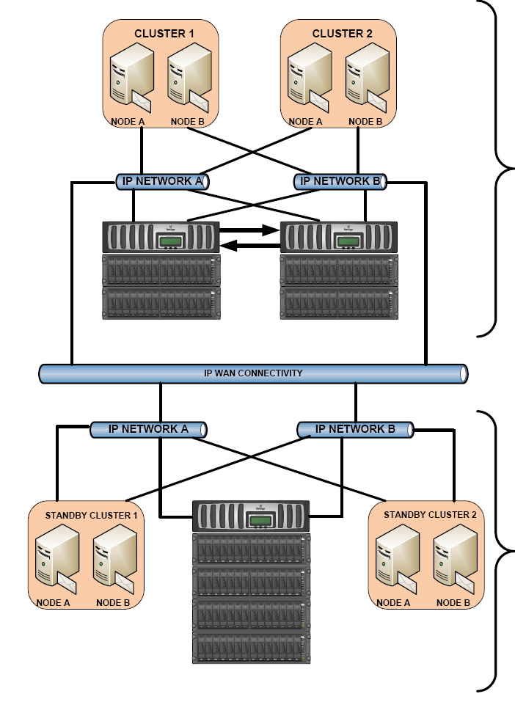
Design - Application Classification and Virtualization
Virtualization
VM First Policy
  Significant benefits in both cost and availability
  Site and Disaster Recovery
Storage Virtualization
  Leverage your storage network availability and capacity
ACTIVE - ACTIVE or ACTIVE - PASSIVE

Slide 15
The DNA of 5-Nines
WAN and Directory Services
Design
Application Classification
IT Service Management
Change and Problem Management
Foundation
Virtualization

Slide 16
IT Service Management – Change/Problem Management
The quickest way to fail with a 5-Nines strategy is the lack of formal processes
ITIL Practices at LSCS
  Change Management
  Problem Management
  Release Management
  Configuration Management
Training
99.999 % = 5.26 minutes
99.99 % = 52.56 minutes
99.9 % = 525.6 minutes

Slide 17
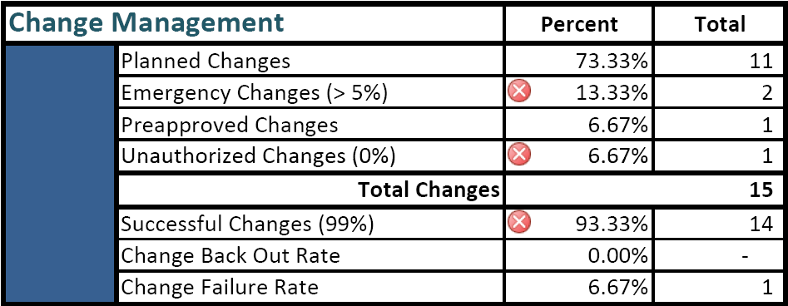
IT Service Management – Change/Problem Management
Best Practices in Change Management
  Keep it simple
  Make sure it is inclusive – Business Owners
Weekly Change Management Meeting
  De-Geek the Change Management Request form
Public - Blackout and Change Calendar
99.999 % = 5.26 minutes
99.99 % = 52.56 minutes
99.9 % = 525.6 minutes

Slide 18
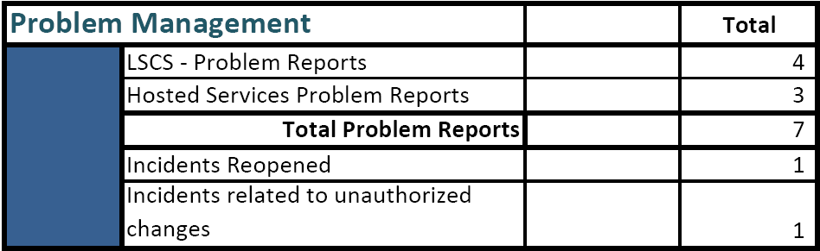
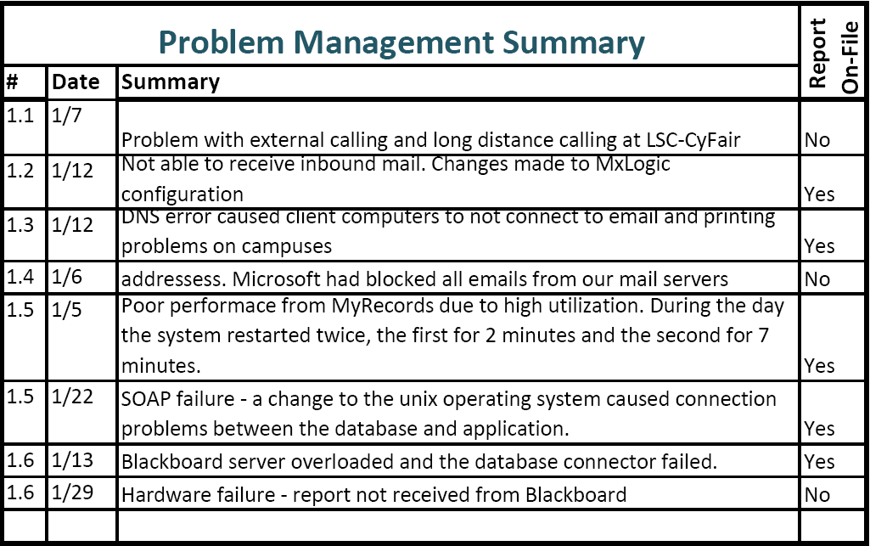
IT Service Management – Change/Problem Management
99.999 % = 5.26 minutes
99.99 % = 52.56 minutes
99.9 % = 525.6 minutes
Best Practices in Problem Management
  Keep it simple
  It’s not a punishment! It’s a Proactive Process
Have a predefined process for responding to problems
Review Problem Reports during each Change Management Meeting

Slide 19
The DNA of 5-Nines
WAN
Design
Application Classification
IT Service Management
Change and Problem Management
Measuring
Monitoring
Foundation
Reporting –KPI’s
Directory Services
Storage
Virtualization

Slide 20
Measuring- Monitoring and Reporting
Monitoring
Proactive monitoring prevents service interruptions
Don’t focus on a single tool
Have a response plan
  Team Action Plan
  Communication Plan
    Internal
    External
Tools we are using
  Quest
    Windows management
    Application management
    Virtualization management
    Database management
  Solar winds
  Alertbot – external service monitoring (WEB)
  What’s Up Gold
  Servers Alive

Slide 21
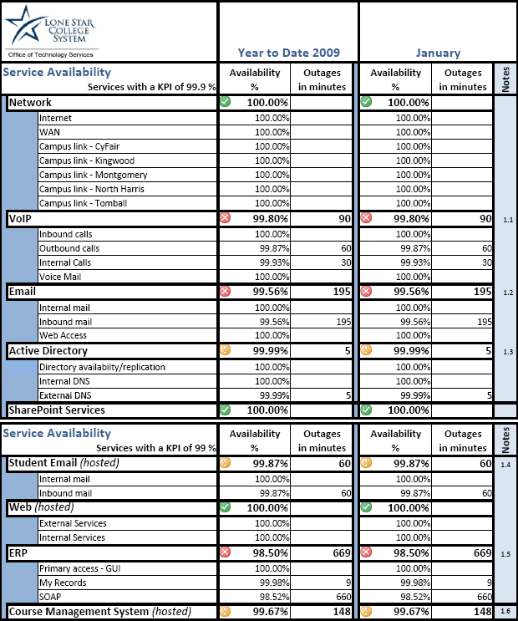
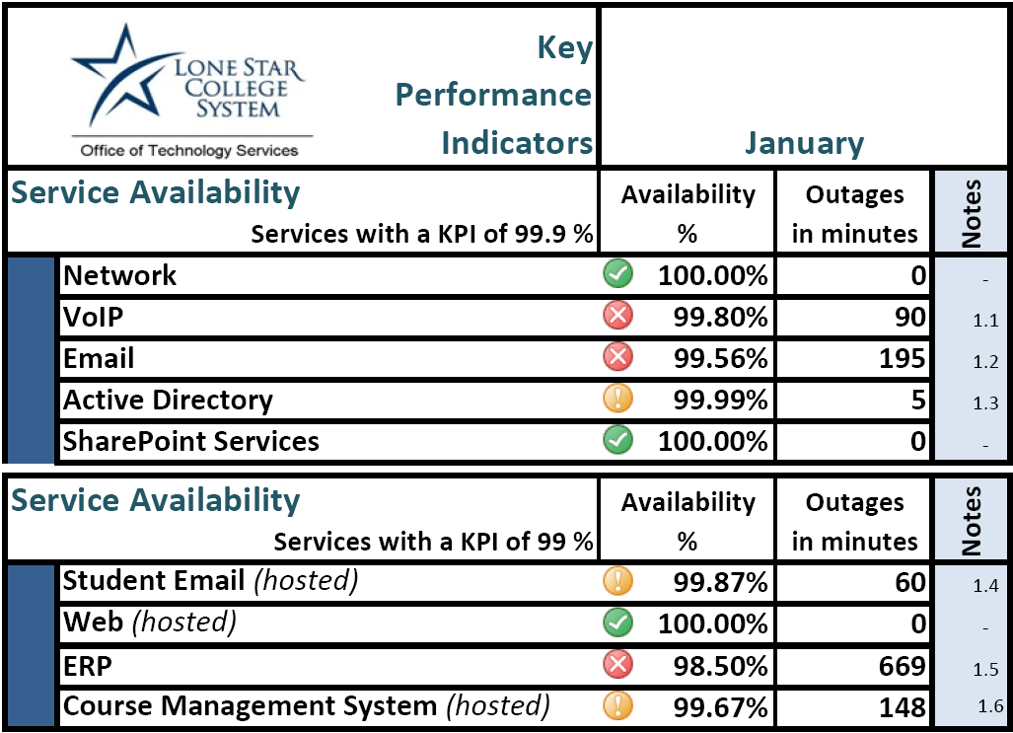
Measuring- Monitoring and Reporting
Reporting
Key Performance Indicators
  Internal
  External
Regular reports to stakeholders

Slide 22
The Marvelous Efficiency of Dabbawallahas
What do the Dabbawallahs have to do with this presentation?
  The Review by Forbes identified:
    Redundancy
    Simple Repeatable Processes
    Motivation – Enthusiasm and Dedication can overcome Skill and Resources
Over 1 million deliveries per week.
Only 4 errors per month
99.999 % Rating

Slide 23
It takes a Team, Vision, and Commitment to Achieve 5-Nines
  Executive Management
  Financial Resources
Our Project Team
  27 core team members
  Vendor partnerships
WAN
Design
Application Classification
IT Service Management
Change and Problem Management
Measuring
Monitoring
Foundation
Directory Services
Virtualization
Reporting
Storage

Slide 24
Thank You
WAN
Design
Application Classification
IT Service Management
Change and Problem Management
Measuring
Monitoring
Foundation
Directory Services
Virtualization
Reporting
Storage
99.999 % = 5.26 minutes
99.99 % = 52.56 minutes
99.9 % = 525.6 minutes

