Slide 1
Knowledge as a Service:
Texas Woman’s University
Enterprise Knowledge Base Project
February 25, 2009
Kim Grover-Haskin, Ph. D.
Director of Instructional Operations
Karl Pienkoss, I.T. Help Desk
Help Desk Analyst III
Copyright Kim Grover-Haskin and Karl Pienkoss, 2009. This work is the intellectual property of the authors. Permission is granted for this material to be shared for non-commercial, educational purposes, provided that this copyright statement appears on the reproduced materials and notice is given that the copying is by permission of the authors. To disseminate otherwise or to republish requires written permission from the authors.

Slide 2
TWU History
An act of the 27th Legislature in 1901 founded the Girls Industrial College, the school that would become Texas Woman's University in 1957. The school had then and has now a dual mission: to provide a liberal education and to prepare young women "for the practical industries of the age" with a specialized education.
TWU today offers a comprehensive catalog of academic studies, including baccalaureate, master's and doctoral degrees. Now in its tenth decade, the University has grown from a small college to a major university. TWU is the largest university primarily for women in the United States, with the main campus in Denton and health science centers in Dallas and Houston.
http://www.twu.edu/administration/brief-history.asp

Slide 3
TWU Facts
Texas Woman’s University occupies a notable position in higher education as the nation’s largest university primarily for women.
Its four campuses in Denton, Dallas and Houston are joined by a fifth “e-Learning” campus that offers innovative online degree programs in business, education, and general studies.
Record enrollment of 11,353 students.
http://www.twu.edu/aboutTWU.htm

Slide 4
Knowledge Management
Knowledge Management approach at TWU emerged out of the Information Technology Help Desk.
The goal of the I.T. Help Desk is to provide service and support to the TWU community for their information technology needs. This includes hardware, software, and assistance with I.T. services provided by our organization.
The I. T. Help Desk utilizes chat, email, knowledge management, and remote support for its customers.

Slide 5
I.T. Help Desk Statistics
The I.T. Help Desk, 2005-2006, logged an average of 478 work orders a month but this was not a true reflection of call volume.
In March 2006, Automated Call Distribution (ACD) was implemented. ACD statistics for July 2006-June 2007 show call volume average of 2400 calls a month.
Furthermore, the customer base of the I.T. Help Desk had grown to include the more than 11,344 students as well as 900 Staff and Faculty.
Average of 2155 FTE per HD analyst (6)

Slide 6
I.T. Help Desk Statistics Revelations
Increasing student customer base with online classes.
Customers needed soft technology skills help with their Learning Management System- Blackboard, email packages, and word processing or spreadsheets.
Increasing faculty/staff customer base was asking for help with TWU specific applications and technology services.
Increasing resolution on the call. A passive work order system was no longer efficient or effective in meeting the growing need for supporting a variety of customer technology experiences.

Slide 7
Why Knowledge Management?
Increase in customer need for help with soft technology skills related to software applications and services.
Additional volume was experienced with students calling regarding their registration, financial aid, payments, housing, etc. because these processes were occurring more and more through technology solutions.
In order to address repetitive common technology questions such as TWU portal accounts, Blackboard, email, application questions, and technology services, the I. T. Help Desk began to search for a knowledgebase solution.

Slide 8
Knowledge Management Solutions
Reviewed Open Source packages.
Reviewed Call Tracking packages which incorporated asset management and knowledgebase components.
Reviewed Market Products solely focusing on knowledgebase solutions.
Cost, resources, ease of use, and administration were all factors in the decision making process.
Beginning of a self-service environment.

Slide 9

I.T. Help Desk Knowledge Base
Powered by Comtex’s IntelliResponse
Launched July 17, 2006
First year question total was 8029

Slide 10
Revelations
Just Ask I.T. , the technology knowledge base, identified students’ challenges with technologies they were bringing to campus.
Just Ask I.T. revealed how software such as Vista and Microsoft Office 2007 was emerging on our campus through student and faculty questions.
Expectation of self-service tools. I call this the My experience: customized portals, high personalization. Students expect self-service tools. Just Ask I.T. was a self-service tool.

Slide 11
Moving Beyond I.T.
Just Ask I.T. captured every question. Non IT questions made up about 15% (14.83% exactly) of all questions received that first year.
Expectation of the knowledgebase was that Just Ask I.T. would answer broader questions related to admissions, enrollment, registration, housing, etc.
Customer base of student driven need for information was growing.
The I.T. knowledge base solution reflected a need for broader application.

Slide 12
Next Developments
Our Chancellor and President of the University, Dr. Ann Stuart created an Enrollment Forecasting series of meetings discussing recruitment and retention, finance, customer service, and instructional program development.
Key to customer service needs was the identification of departments overwhelmed with email and phone calls often pertaining to common core inquiries.
The I.T. knowledgebase solution was presented as a possible customer service solution for current and prospective student information access.

Slide 13
Gathering Stakeholders
Invited groups identified from the Chancellor’s Customer Service meetings to review a demonstration of Just Ask I.T. software.
Shared the report of questions logged in the KB. These questions helped the content group develop their core content.
The knowledge base concept had already been investigated within other Departments. Financial Aid had been looking for a KB product.
Support for the solution from the V.P. for Technology and Information Services.

Slide 14
Knowledge-Content and Contact
Uniting people with the concept and process.
Identifying Super Administrators of the KB from the I.T. Help Desk.
Content experts were divided between the Super Administrators.
Super Administrators developed relationships with the content group supporting their efforts and development.
IntelliResponse Quik Start Option selected.
Launch date of August 1, 2007 selected.

Slide 15
Marketing Approach
Reached out to Student Government for naming feedback.
Worked with Marketing and Communications Web Master.
Developed student marketing campaign closer to first class day August 27, 2007.
Distributed tent flyers for first class day.

Slide 16

Table Tent Design

Slide 17
The Enterprise Solution
Ask TWU emerges
Target audience-Current and Future Students
Implemented August 1, 2007 with approximately 250 core questions.
First day with little advertising Ask TWU generated 251 question hits.

Slide 18
Building the Knowledge Base:
Focus Testing
Held for 4 hours, using the Quik Start Questions
During that time period, we recorded 968 queries.
There was a 20% accurate response rate.
  IntelliResponse says a healthy knowledgebase returns an accurate response approximately 80% of the time
Used data gathered from the Focus Testing to modify the criteria for the responses.

Slide 19
Ask TWU Month One
3017 Questions asked within the first month
Knowledge base answered approximately 55% of the questions correctly.
Noticed that many of the students were entering information in the incorrect interface.

Slide 20
Ask TWU Year One
The knowledgebase averaged 2247 questions per month in the first year.
The knowledgebase returned an accurate response approximately 65% of the time.
In mid-March, both the Current and Prospective interfaces were combined into one to simplify the process for students.
On May 16th, 2008 the entry box was moved to the home page. Now a permanent part of the TWU template.

Slide 21
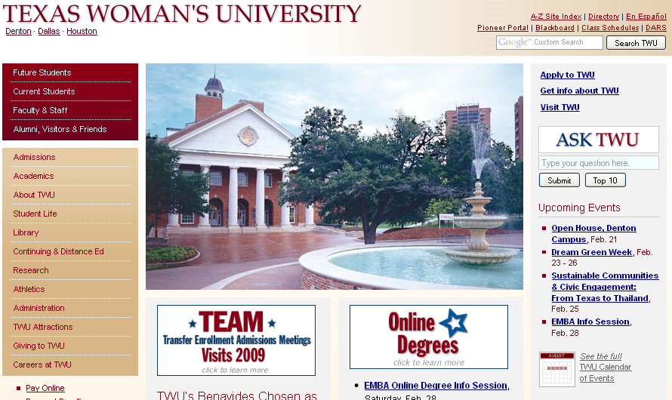

Slide 22
Ask TWU Year One
Merging the two interfaces provided an immediate boost to the accurate response return rate of about 7-8%.
  Students could no longer enter questions in the wrong interface.
Moving the entry box to the home page immediately doubled the number of queries.
Also dropped the accurate response rate by approximately 10-12%.
  The prominence of the entry box increased its misuse.

Slide 23
Question Volume

Slide 24
Interfaces
Current Students
Prospective Students

Slide 25
Ask TWU Year Two
Knowledgebase has averaged about 4773 questions a month to date.
Returns an accurate response approximately 70% of the time.
Averages about 250-300 questions per day.

Slide 26
Managing the Knowledgebase
Daily Reports
  Scan for questions that should have been answered
  Make note of frequently appearing questions
Respond and sort e-mails.
Weekly Reports
  Send reports to the different content areas
  Input new questions when received

Slide 27
Challenges
Using the knowledgebase as a directory.
Using the knowledgebase as a class catalog.
Using only one or two word searches.
Using the knowledgebase in place of a person.
Using the knowledgebase as a homework research tool.

Slide 28
Knowledge as a Service
Future student contacts, higher first touch success and stronger impression.
Ask TWU Prospective KB showed a high response rate which tells us the core questions asked were successfully answered enhancing the prospective student’s experience of TWU.
Current student self-service options expanded.
Online student access to information. Self informing.
Extensions for other knowledge management solutions.

Slide 29
With Knowledge as a Service, we gain insight into what is evident, what is missing, and what needs to be developed.
Knowledge Management leads us beyond the answers for strategic purposes.
Why Knowledge Management?

Slide 30
Thank You!
Kim Grover-Haskin and Karl Pienkoss
Texas Woman’s University
Feb 25, 2009

