Slide 1

EDUCAUSE
Southwest 2009
"Copyright Mario Berry and Shah Ardalan - 2009. This work is the intellectual property of the author. Permission is granted for this material to be shared for non-commercial, educational purposes, provided that this copyright statement appears on the reproduced materials and notice is given that the copying is by permission of the author. To disseminate otherwise or to republish requires written permission from the author."
Mario Berry
Campus Director of Technology Services
and
Shah Ardalan
CIO/Vice Chancellor of Information Technology

Slide 2
EDUCAUSE
Southwest 2009
The (K.I.S.S.) Is All You Need
Making Governance Personal
Mario Berry
Campus Director of Technology Services
and
Shah Ardalan
CIO/Vice Chancellor of Information Technology

Slide 3
EDUCAUSE
Southwest 2009
Background
Largest Higher Education Institution in Houston Area
5 College Campuses, 6 Satellite Centers, and System Office
Over 65,000 Students in Credit and Non-Credit Courses
Average growth from 2003 thru 2009 Fall to Fall – 7%
“Just like you, we needed answers!”

Slide 4
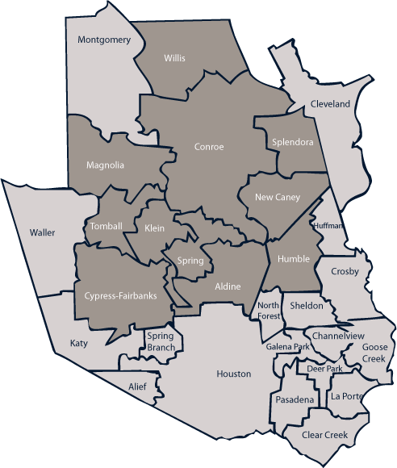
EDUCAUSE
Southwest 2009
Service Area
LSC – Conroe Ctr.
College
LSC – University Ctr.
LSC - Montgomery
Center
LSC – System Office
System Office
LSC - Tomball
LSC – Kingwood
LSC – Willow Chase Ctr.
LSC – North Harris
LSC – Greenspoint Ctr.
LSC - CyFair
LSC – Carver Ctr.
LSC – Fairbanks Ctr.

Slide 5
EDUCAUSE
Southwest 2009
Agenda
Results – What We Realized and Are Realizing
Governance – What, Why, How, and Who
K.I.S.S. – Keys for IT Service Success
Answers – You Will Hopefully Get Some
Talk To Me and Share Throughout

Slide 6
EDUCAUSE
Southwest 2009
Results
(Firsts 90 Days)
Reorganized Technology Department (Office of Technology Services)
Saved $750K in Administrative Costs
Standardized Equipment and Resources
Saved over $2Mil. in System Replacement Cycle
Increased Capacity and Uptime of ERP System (From 19 to 22.5 Hrs/Day)
Saved $650K in Back-end Infrastructure
Created a Shared Vision with Measurable Outcomes
Priceless!!!

Slide 7
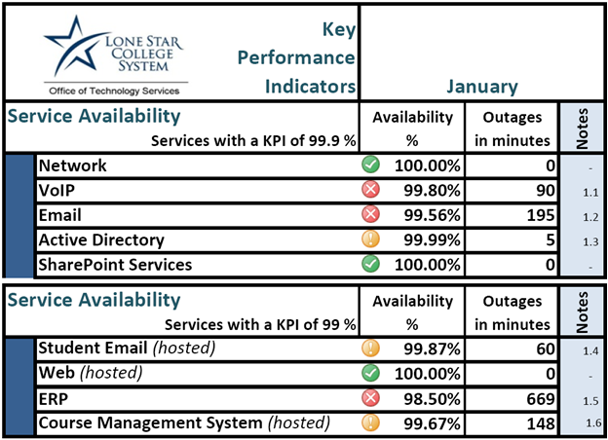
EDUCAUSE
Southwest 2009
Results
(Ongoing)
Key Performance Indicators- KPIs
  Financial
  Cost Reduction
  % of Overall Budget
  Operational
  Service Availability
  Project Completion
  Strategic
  Customer Satisfaction
  Partnership Development

Slide 8
EDUCAUSE
Southwest 2009
Governance
What – A Framework designed to achieve a partnership between the colleges
and the Office of Technology Services, established to enhance strategic
alignment, standardization and consistency, inclusion, collaboration,
and communication.
Why – Chief Information Officers and Technology Departments have the
responsibility for ensuring their organizations spend wisely and
maximize their return on investments. Governance addresses how
decisions are made with regard to the identification, acquisition,
deployment, and support of strategic technology initiatives.

Slide 9
EDUCAUSE
Southwest 2009
Governance
How – Establish technology policies and procedures; identify Key
Performance Indicators (KPIs); determine alternative funding resources
and allocations for technology initiatives; oversee policy and procedure
compliance; analyze, measure and report on KPIs; provide System-wide
collaboration and communication; and integrate technology into teaching
learning, administration and business processes.
Who – Advisory Councils (6) and Ad-Hoc Committees
  Leadership Technology Advisory Council (Budgeting, Standards, Procedures)
  Academic Technology Advisory Council (Pedagogical Issues – Use of Technology)
  Student Technology Advisory Council (Student Engagement – Innovation)
  Tactical Technology Advisory Council (Analysis of Strategic Initiatives – Impact)
  Campus Technology Advisory Council (Campus Priorities – Awareness)
  System Technology Advisory Council (Overall Forum for System-wide Initiatives)

Slide 10





EDUCAUSE
Southwest 2009
K.I.S.S.
(Keys for IT Service Success)
Disclaimer – Due to the nature of this part of the presentation, it is highly
recommended that the audience is over 18, received permission
from their supervisor or immediate significant other to participate,
and has kissed at least one other person not related to them.
If any person remaining in the room at this time does not meet
the above criteria, please exit the room quietly so that others are
able to enjoy themselves and not get you in trouble.
Thank You and Enjoy the Rest of the Presentation !

Slide 11
EDUCAUSE
Southwest 2009
K.I.S.S.
(Keys for IT Service Success)
Your First Kiss – “Symptoms”
  Loss of Sleep, Anxiety, Stress, Confusion, Excitement, and Tell Everybody
Your First Governance Framework – “Symptoms”
  Loss of Sleep, Anxiety, Stress, Confusion, Excitement, and Tell Everybody
  Anything Look Familiar?

Slide 12
EDUCAUSE
Southwest 2009
K.I.S.S.
(Keys for IT Service Success)
Establish a Shared Vision and Governance Framework
Professional Development (D.I.S.C; Strengths Quest, Crucial Conversations)
Clear, Consistent, Communication (3 C’s)
Centralize, Standardize, Commoditize and Virtualize (Where Possible)
Collaborate and Partner with Stakeholders
Education + Identification + Modification = Production (EIM=P)
Deliver Value Through Measurements and Reports (KPIs)
Financial, Operational and Strategic

Slide 13
EDUCAUSE
Southwest 2009
What We Covered
Results – What We Realized and Are Realizing
Governance – What, Why, How, and Who
K.I.S.S. – Keys for IT Service Success
Answers – I Know You Got Some

Slide 14
EDUCAUSE
Southwest 2009
Contact Information
Questions
Mario Berry
Campus Director
Mario.Berry@lonestar.edu
Shah Ardalan
CIO/Vice Chancellor of Information Technology
Shah.Ardalan@lonestar.edu

