Slide 1

Phil Youngblood (SL: Vic Michalak)
Does Your Campus Need a Second Life? Take Two…
“How do you convert the success of three multidisciplinary, multi-university, and multinational courses in Second Life into full-fledged, university-wide commitment to this virtual world?”
“Experience for yourself how teaching and learning is conducted there and how our university has learned to exploit the many potentials of this exciting new technology.”

Slide 2
We all live every day in virtual environments, defined by our ideas…
Michael Crichton (1942-2008)
(Andromeda Strain, West World, Jurassic Park,
Disclosure, Timeline, Twister, Creator of “ER”)

Slide 3
Does Your Campus Need a Second Life? Take Two…
What I would like to accomplish in this presentation:
“Share what we have done so you can envision doing it as well!"
What I hope you take away:
Contact me ---- seriously! Phil Youngblood youngblo@uiwtx.edu
In Second Life: Vic Michalak
Hype vs. reality; personal vs. organizational cycles
Second Life can greatly enhance your First Life!
Teaching, learning, and more in Second Life…
Tell them what you are going to tell them…

Slide 4
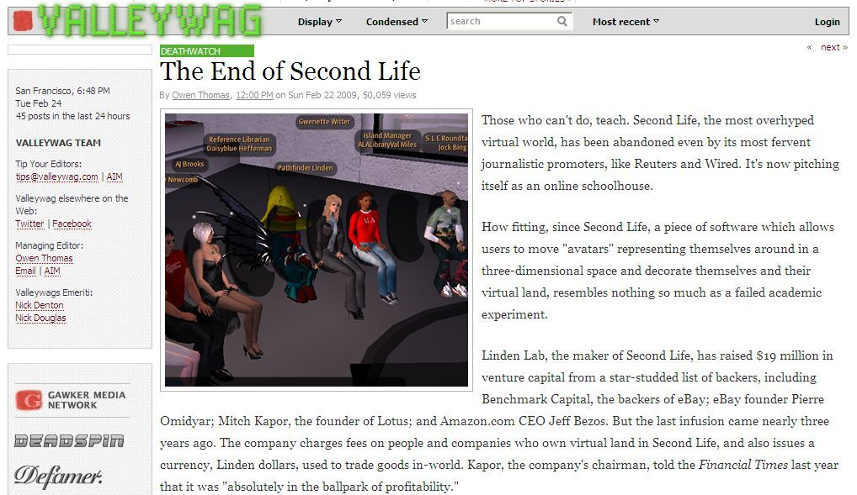
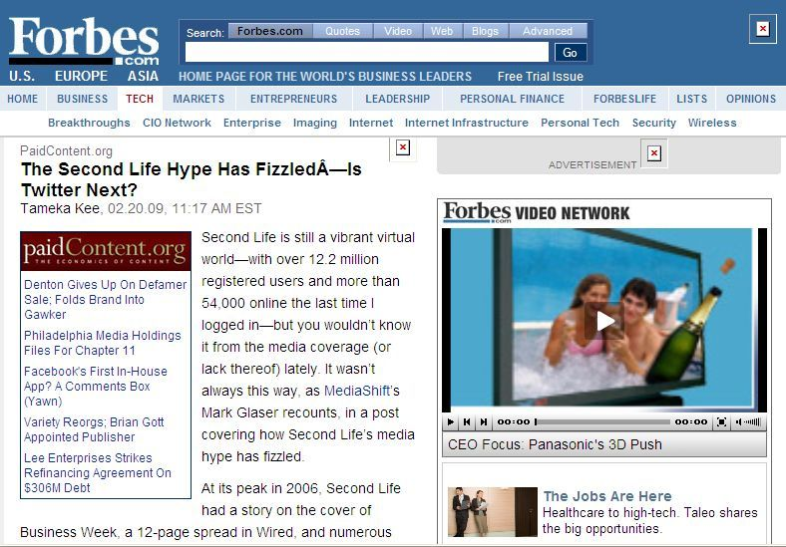
Be wary of sensationalistic journalism about new technologies that are not yet widely understood; but yes, Second Life hype has fizzled – why might this be?
Tell them

Slide 5
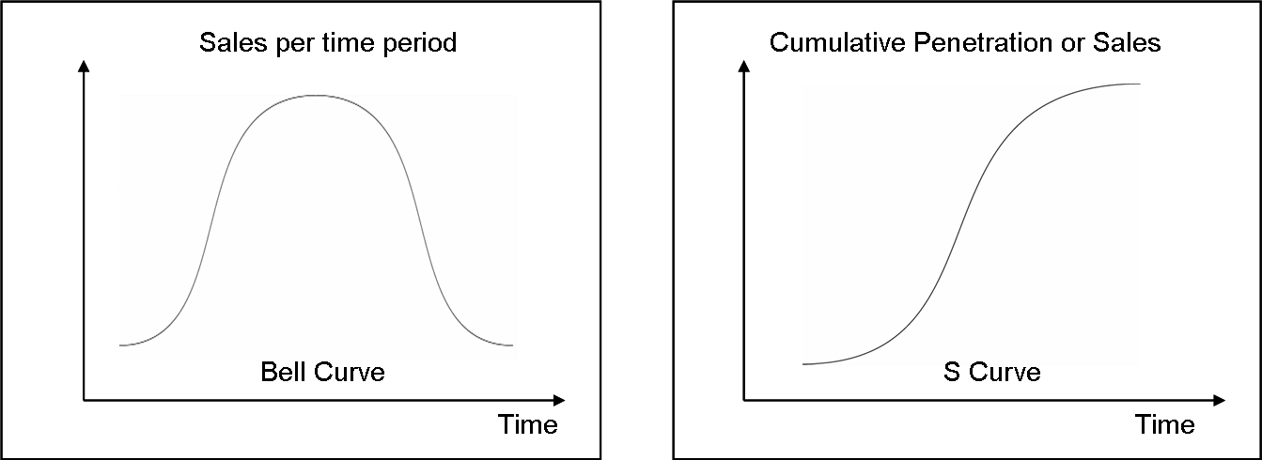
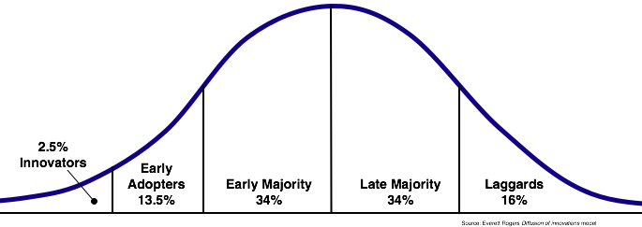
Classic Technology Adoption Curves (derived from economic theory)
The adoption rate of new technologies tends to follow predictable curves, starting with the earliest innovators and progressing through mainstream usage…

Slide 6
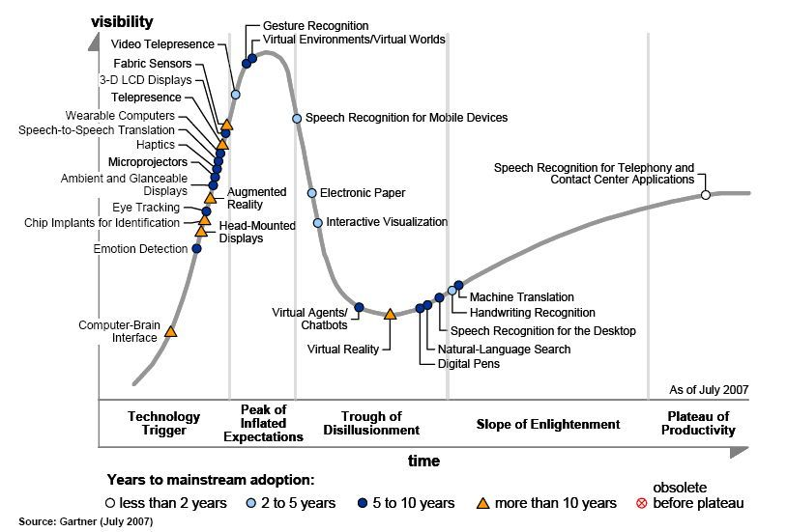
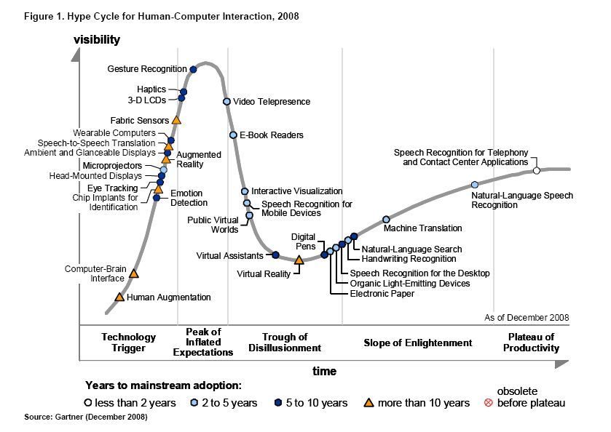
Gartner Group’s “Hype Cycle” (derived from real life)
However, new technologies are made known to mainstream users via media, who “discovered” Second Life in early 2007. By mid-2007 SL was riding high in the hype cycle but was ending a “boom and bust” cycle for companies who believed “build it and they will come”…

Slide 7
Gartner Group’s “Hype Cycle” (derived from real life)
…and by 2009 Second Life had indeed slipped from the radar of sensationalist media. However, serious individuals and companies that took time to understand it, and organizations who took advantage of its special environment, thrived as virtual worlds continued to mature…

Slide 8
interest
& utility
1998 2005 2006 2007 2008 2009 ???
Personal and Organizational Cycles of Technology Adoption
gracious!
gracious!
Organizational adoption cycles may be slower than personal ones due to drivers, costs, and consequences of technology life cycles (including hardware, software, testing, training, and communications) as well as overcoming inertia…
But why invest in virtual worlds at all?
very early innovators at our university
oh my yes!
oh my yes!
oh…
my
cycle
some colleagues
interest
wanes…
yes!
yes!
yes!
my university
oh!
oh!
oh, okay..
oh!
how?
rediscovery…
interest wanes…
how?
how?
oh…
huh?
huh?
other colleagues

Slide 9
There are more than 300 million registered participants in non-game Social Virtual Worlds…
KZero.co.uk
(KZero is a virtual worlds consultancy and specialist in connecting real worlds brands and companies with the residents and environments of virtual worlds …)

Slide 10
Casual Gaming
35
Misc
30
Ave. Age
Second
Life
Creativity
25
15M
Socializing
O Brave New World
20
HiPiHi
IMVU
Weeworld
15
20M
Club Penguin
45M
Neopets
There
10
Education
Role play
90M
Poptropica
Habbo
Hotel
5
3M
Gaia
Whyville
Note who the majority of virtual world users are today and what this may mean for institutions of higher education in the future…
TV
15M
20M
Mirror
world
Barbie Girls
Stardoll
Virtual Worlds
Sports
with over 1M participants
Fashion
Music
= growing
Toys
(data adapted from Kzero.co.uk)

Slide 11
We are going to be spending a lot more of our time in virtual reality environments…
Ray Kurzweil (1948-present)
(preeminent inventor and futurist - the “rightful heir to Thomas Edison” – awarded 15 honorary doctorates – OCR system, flatbed scanner, speech recognition software, electronic synthesizer, “The Singularity is Near”, etc…)

Slide 12
SAVE ET II
interest
& utility
1998 2005 2006 2007 2008 2009 ???
My Personal Cycle
3rd int’l class
“2nd Job” syndrome
heavy hitters
gracious!
2nd int’l class
Kira Institute
1st int’l class
First Life/Second Life invitations
conferences in SL
ED last year
learn about other universities
exploration schedule class
oh my yes!
1st work with university
my cycle
SL5B / NECC / Center / building class
CIO challenge
SAVE ET I / invites
yes!
Science Circle / “Gray Matters”
listen/talk
oh!
(UdeM) / DePaul / France
AW
how?
huh?
A quick look – details to follow…

Slide 13
interest
& utility
1998 2005 2006 2007 2008 2009 ???
My University’s Cycle
my cycle
Advisory Board
IED house /
Philosophy/ grad Communications classes
T4L/ workshop/Webinar
Classes in different disciplines / ELS / Nursing / Alumni / HR & Safety training / Security / ICC / Biosphere? / grants / WGC-Africa / Virtual U / ???
College Fairs
talk to my School
talk to other Schools/Colleges
CIO challenge
IT buys island
my university
listen/talk
oh!
CIO/IT supports “Phil’s game”
how?
huh?
A quick look – details to follow…

Slide 14
interest
& utility
1998 2005 2006 2007 2008 2009 ???
My Personal Cycle
Huh? phase – I discovered Active Worlds back in 1998, but got busy and did not pursue it… I learned of Second Life from our CIO in 2006 and in the summer of 2007 he issued a challenge to the faculty to take advantage of our bandwidth by using Second Life or Internet 2…
my cycle
CIO challenge
listen/talk
AW
huh?
my cycle

Slide 15
interest
& utility
1998 2005 2006 2007 2008 2009 ???
My Personal Cycle
How? phase – Some of us explored SL as individuals; I recognized its potential and scheduled an exploratory course for Spring 2008; my first interest was how to use SL to conduct classes between UIW and Universidad de Mexico (UdeM); I also met the owner of DePaul’s SL campus…
exploration schedule class
CIO challenge
listen/talk
UdeM
AW
how?
huh?
my cycle

Slide 16
interest
& utility
1998 2005 2006 2007 2008 2009 ???
My Personal Cycle
Oh! phase – UdeM could not join us, but suggested a partner in France; DePaul hosted our 1st class; UIW IT reps and I presented at 2008 SW Reg. EDUCAUSE conference; I discovered SL groups, gave a presentation in-world, and partnered in a peer-reviewed SL journal…
1st int’l class
ED last year
exploration schedule class
CIO challenge
Science Circle / “Gray Matters”
listen/talk
oh!
(UdeM) / DePaul / France
AW
how?
huh?
my cycle

Slide 17
interest
& utility
1998 2005 2006 2007 2008 2009 ???
My Personal Cycle
Our first class had co-instructors in San Antonio (Texas), Chicago (Illinois), and Lille (France) and students in Texas, France, and Mexico; we decided to plunge into the “deep end” and hold nearly the entire class in Second Life, learning much in the process…
1st int’l class
ED last year
exploration schedule class
CIO challenge
Science Circle / “Gray Matters”
listen/talk
oh!
(UdeM) / DePaul / France
AW
how?
huh?
my cycle

Slide 18
interest
& utility
1998 2005 2006 2007 2008 2009 ???
My Personal Cycle
1st int’l class
ED last year
Yes! phase – UIW co-sponsored city-wide virtual environments conference with ASTD; first display of UIW logo at SL’s 5th Birthday exhibitions; I realized that SL is big with educators at NECC 2008; I took a building class in SL & co-built “Center for Sustainable Living” complex…
exploration schedule class
my cycle
SL5B / NECC / Center / building class
CIO challenge
SAVE ET I / invites
yes!
Science Circle / “Gray Matters”
listen/talk
oh!
(UdeM) / DePaul / France
AW
how?
huh?

Slide 19
interest
& utility
1998 2005 2006 2007 2008 2009 ???
My Personal Cycle
2nd int’l class
1st int’l class
ED last year
Yes! phase – I obtained plans for a 2-story house being drawn by UIW Interior/Environmental Design students; I co-built the house in SL & gave IED students a tour of it in their class (SL now used multi-disciplinarily); 2nd class used SL and German Prof. taught Java/LSL in Fall 2008…
exploration schedule class
1st work with university
my cycle
SL5B / NECC / Center / building class
CIO challenge
SAVE ET I / invites
yes!
Science Circle / “Gray Matters”
listen/talk
oh!
(UdeM) / DePaul / France
AW
how?
huh?

Slide 20
SAVE ET II
interest
& utility
1998 2005 2006 2007 2008 2009 ???
My Personal Cycle
3rd int’l class
“2nd Job” syndrome
heavy hitters
gracious!
2nd int’l class
Kira Institute
1st int’l class
First Life/Second Life invitations
conferences in SL
ED last year
Oh my yes! phase – I started to learn how other universities and educators used SL and to attend SL conferences & FL/SL hybrid conferences; Second Life was enriching my First Life (FL) in many ways; I became the head of several SL groups and was invited to FL & SL events…
learn about other universities
exploration schedule class
oh my yes!
1st work with university
my cycle
SL5B / NECC / Center / building class
CIO challenge
SAVE ET I / invites
yes!
Science Circle / “Gray Matters”
listen/talk
oh!
(UdeM) / DePaul / France
AW
how?
huh?

Slide 21
SAVE ET II
interest
& utility
1998 2005 2006 2007 2008 2009 ???
My Personal Cycle
3rd int’l class
“2nd Job” syndrome
heavy hitters
gracious!
2nd int’l class
Kira Institute
1st int’l class
First Life/Second Life invitations
conferences in SL
ED last year
Gracious! phase – I became involved with the Kira Institute (www.kira.org), started to meet both FL & SL “heavy hitters” in SL, and was invited to public SL events; …but I also experienced “2nd Job” syndrome where SL activities took too much FL time & the “fun” factor diminished…
learn about other universities
exploration schedule class
oh my yes!
1st work with university
my cycle
SL5B / NECC / Center / building class
CIO challenge
SAVE ET I / invites
yes!
Science Circle / “Gray Matters”
listen/talk
oh!
(UdeM) / DePaul / France
AW
how?
huh?

Slide 22
SAVE ET II
interest
& utility
1998 2005 2006 2007 2008 2009 ???
My Personal Cycle
3rd int’l class
“2nd Job” syndrome
heavy hitters
gracious!
2nd int’l class
Kira Institute
1st int’l class
First Life/Second Life invitations
conferences in SL
ED last year
Gracious! phase – In my 3rd international class using Second Life, Université Catholique in Lille, France led and I co-taught; I met reps from the UN at a Webinar on SL and invited them to observe our class; students are building/scripting machines in international teams…
learn about other universities
exploration schedule class
oh my yes!
1st work with university
my cycle
SL5B / NECC / Center / building class
CIO challenge
SAVE ET I / invites
yes!
Science Circle / “Gray Matters”
listen/talk
oh!
(UdeM) / DePaul / France
AW
how?
huh?

Slide 23
SAVE ET II
interest
& utility
1998 2005 2006 2007 2008 2009 ???
My Personal Cycle
3rd int’l class
“2nd Job” syndrome
heavy hitters
gracious!
2nd int’l class
Kira Institute
Second Life is an important extension of my First Life! Now I am evaluating its impact and value to me & making decisions about how to leverage this important new communications tool to enhance our university’s mission, student learning, other organizations, & my own aims…
1st int’l class
First Life/Second Life invitations
conferences in SL
ED last year
learn about other universities
exploration schedule class
oh my yes!
1st work with university
my cycle
SL5B / NECC / Center / building class
CIO challenge
SAVE ET I / invites
yes!
Science Circle / “Gray Matters”
listen/talk
oh!
(UdeM) / DePaul / France
AW
how?
huh?

Slide 24
interest
& utility
1998 2005 2006 2007 2008 2009 ???
Colleague Cycles
During my own experiences in SL, I have encountered a few at our university who discovered SL years ago but, going alone, their enthusiasm waned; some have rediscovered SL and may be proponents of its use to varying degrees; other colleagues will never get it…
gracious!
gracious!
very early innovators at our university
oh my yes!
oh my yes!
oh…
some colleagues
my cycle
interest
wanes…
yes!
yes!
yes!
my university
oh!
oh!
oh, okay..
oh!
how?
rediscovery…
interest wanes…
how?
how?
oh…
huh?
huh?
other colleagues

Slide 25
interest
& utility
1998 2005 2006 2007 2008 2009 ???
My University’s Cycle
my cycle
Huh? phase – our university CIO & I discussed SL in 2006; in August 2007 he issued a challenge to faculty to use SL or Internet 2; UIW’s first class using SL was in Spring ’08; the CIO and IT folks gave critical support to “Phil’s game”; I gave a talk to my School about Second Life…
Philosophy/ grad Comms
Classes in different disciplines / ELS / Nursing / Alumni / HR & Safety training / Security / ICC / Biosphere? / grants / WGC-Africa / Virtual U / ???
College Fairs
talk to my School
CIO challenge
my university
listen/talk
CIO/IT supports “Phil’s game”
huh?

Slide 26
interest
& utility
1998 2005 2006 2007 2008 2009 ???
My University’s Cycle
my cycle
Advisory Board
IED house /
Philosophy/ grad Communications classes
T4L/ workshop/Webinar
How? phase – in Fall 2008 I showed 2-story house to IED class; I talked about SL with UIW Schools and with regional colleges; UIW Admissions had College Fair booths in SL; a Tech-4-Lunch SL workshop in the Fall was followed by an all- morning SL workshop in Jan 09
College Fairs
talk to other schools/colleges
CIO challenge
IT buys island
my university
listen/talk
how?

Slide 27
interest
& utility
1998 2005 2006 2007 2008 2009 ???
My University’s Cycle
my cycle
Advisory Board
IED house /
Philosophy/ grad Communications classes
T4L/ workshop/Webinar
How? phase – UIW IT (led by CIO) funded an island in SL; an Advisory Board is formed, members attended training Webinar and met to discuss our island and its policies; SL is explored in Philosophy & grad Comms classes (no longer is Second Life just “Phil’s game”)…
College Fairs
talk to other schools/colleges
CIO challenge
IT buys island
my university
listen/talk
how?

Slide 28
interest
& utility
1998 2005 2006 2007 2008 2009 ???
My University’s Cycle
my cycle
Advisory Board
IED house /
Philosophy/ grad Comms
T4L/ workshop/Webinar
Oh! (perhaps not quite Yes!) phase – academics started to ask how they can use SL in their classes (i.e. nursing training in simulations); English Language Services (ELS) has proposed an international “coffee house”; Alumni Office wants to build a proposed building in SL…
Classes in different disciplines / ELS / Nursing / Alumni / HR & Safety training / Security / ICC / Biosphere? / grants / WGC-Africa / Virtual U / ???
College Fairs
talk to other schools/colleges
CIO challenge
IT buys island
my university
listen/talk
oh!
how?

Slide 29
interest
& utility
1998 2005 2006 2007 2008 2009 ???
My University’s Cycle
my cycle
Advisory Board
IED house /
Philosophy/ grad Comms
T4L/ workshop/Webinar
…Human Resources and Safety are asking if SL can be used as an alternative platform for training and Security would like to hold drills; we are looking at large-scale collaborative projects with other universities, funded by grants; perhaps SL can be used for virtual classes…
Classes in different disciplines / ELS / Nursing / Alumni / HR & Safety training / Security / ICC / Biosphere? / grants / WGC-Africa / Virtual U / ???
College Fairs
talk to other schools/colleges
CIO challenge
IT buys island
my university
listen/talk
oh!
how?

Slide 30
interest
& utility
1998 2005 2006 2007 2008 2009 ???
My University’s Cycle
my cycle
Advisory Board
IED house /
Philosophy/ grad Comms
T4L/ workshop/Webinar
…as an alternative to traditional Web-based distance education; & the head of the Women’s Global Connection has asked if Second Life might be used to connect its members worldwide (I am working to pair them up with the head of Virtual Africa in Second Life)…
Classes in different disciplines / ELS / Nursing / Alumni / HR & Safety training / Security / ICC / Biosphere? / grants / WGC-Africa / Virtual U / ???
College Fairs
talk to other schools/colleges
CIO challenge
IT buys island
my university
listen/talk
oh!
how?

Slide 31
interest
& utility
1998 2005 2006 2007 2008 2009 ???
My University’s Cycle
my cycle
Advisory Board
IED house /
Philosophy/ grad Comms
How we use Second Life at our university will likely depend on the degree to which faculty & administrators weigh its value to our mission against the time and effort to learn to use it, student interest and use, and how soon virtual environments like SL go mainstream…
T4L/ workshop/Webinar
Classes in different disciplines / ELS / Nursing / Alumni / HR & Safety training / Security / ICC / Biosphere? / grants / WGC-Africa / Virtual U / ???
College Fairs
talk to my School
talk to other schools/colleges
CIO challenge
IT buys island
my university
listen/talk
oh!
CIO/IT supports “Phil’s game”
how?
huh?

Slide 32
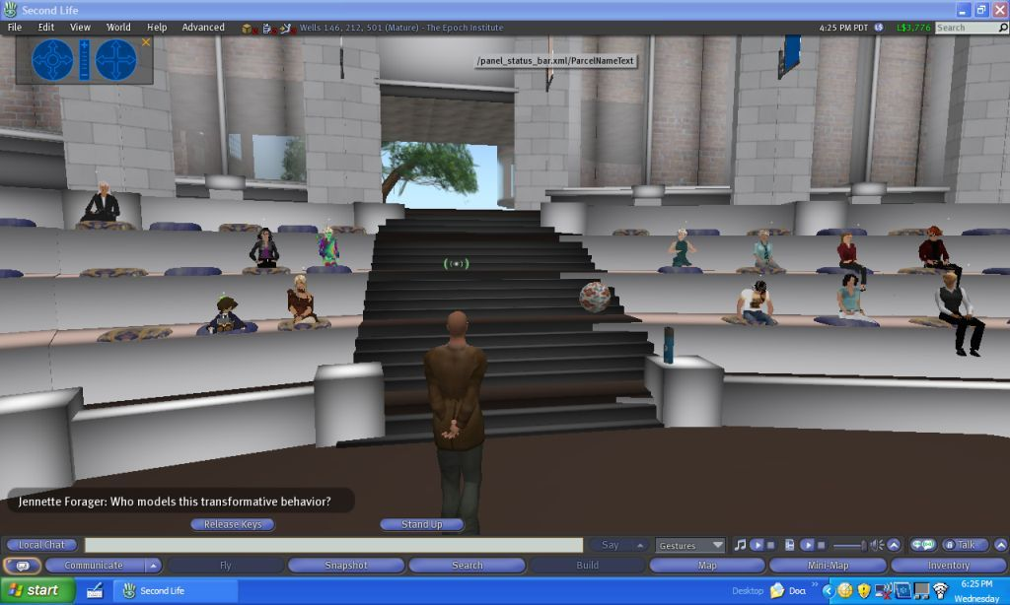
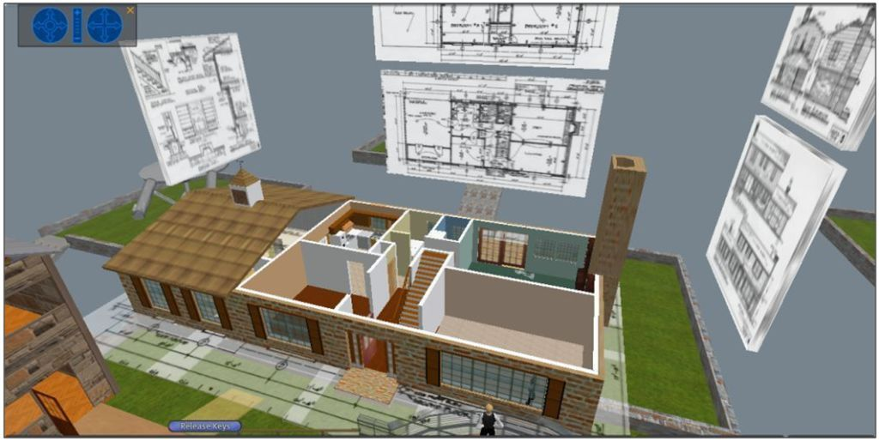
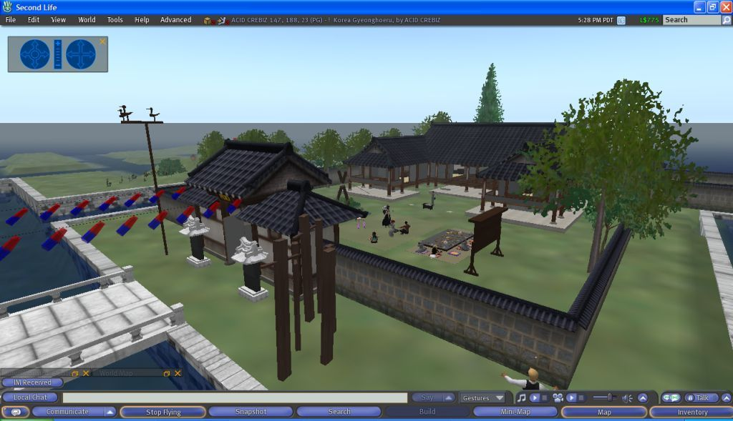
Second Life ← → First Life – teaching and learning examples
(1) Extend the traditional classroom to
accommodate distance education
(2) Enhance learning with
visual & interactive
features & multimedia
(3) Use advantages of the
new tech in radical ways
(example of avatars playing Korean
instruments and performing
Korean dances using animations)

Slide 33
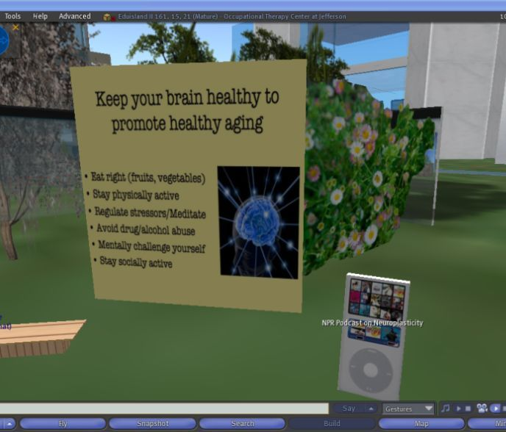
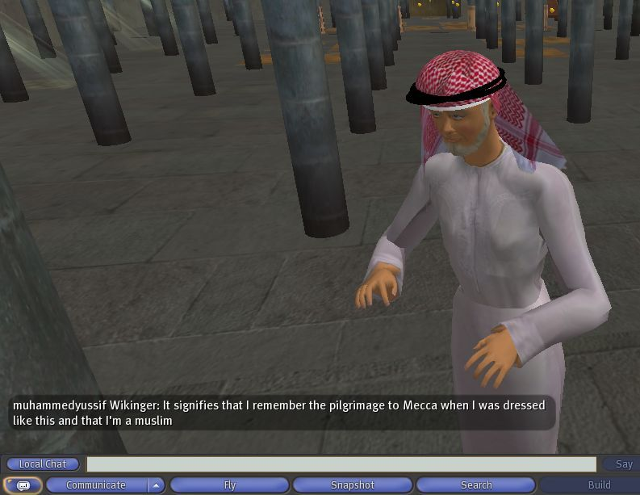
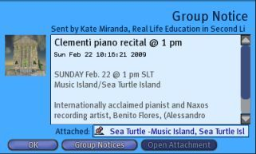
Second Life ← → First Life – teaching and learning examples
(4) Use the social and multimedia aspect of the technology to your advantage!
(examples of evaluating Masters Thesis project
and of live music recitals and concerts in SL)
(5) Use the social advantages of
the technology to meet other
people and to learn from them!
(example of conversing with a mosque
administrator I met entirely in SL)

Slide 34
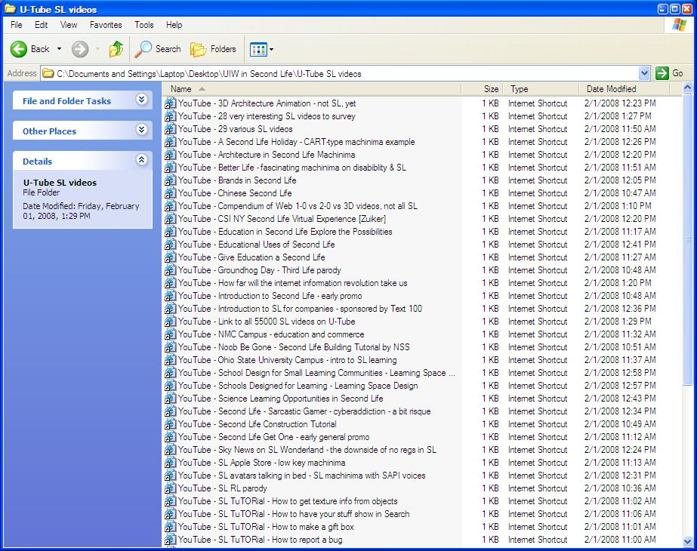
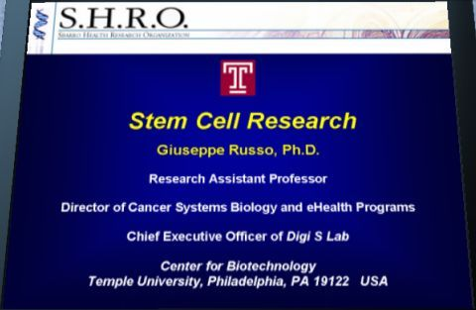
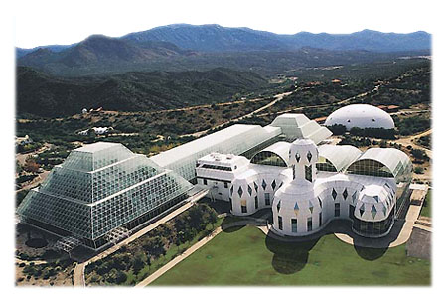
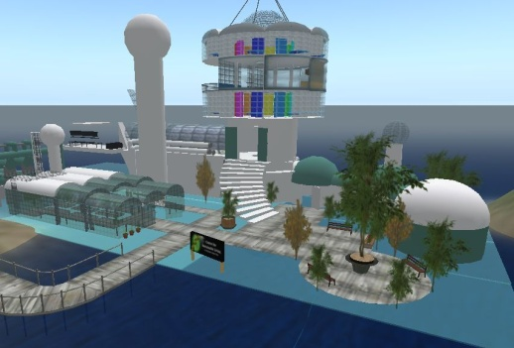
Second Life ← → First Life – beyond the classroom
(1) Traditional Web and Web 2.0 enhancements and links – blogs, wiki, YouTube, social networks, & more!
(2) National and multinational collaborative projects
(3) Professional conferencing and sharing of research worldwide

Slide 35
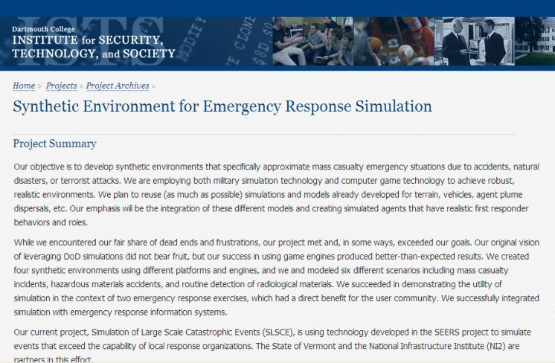
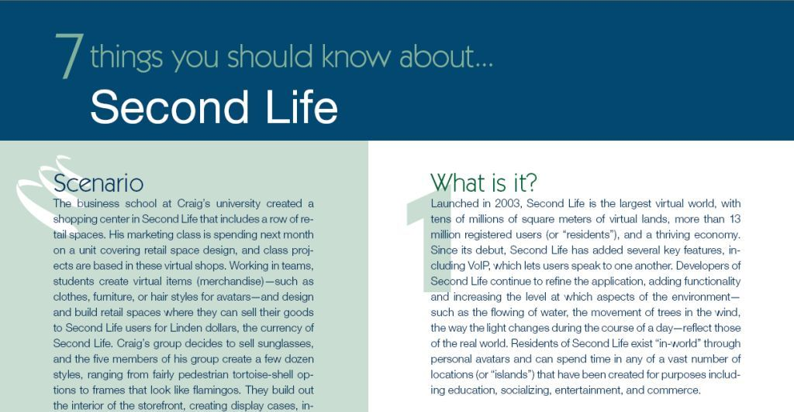
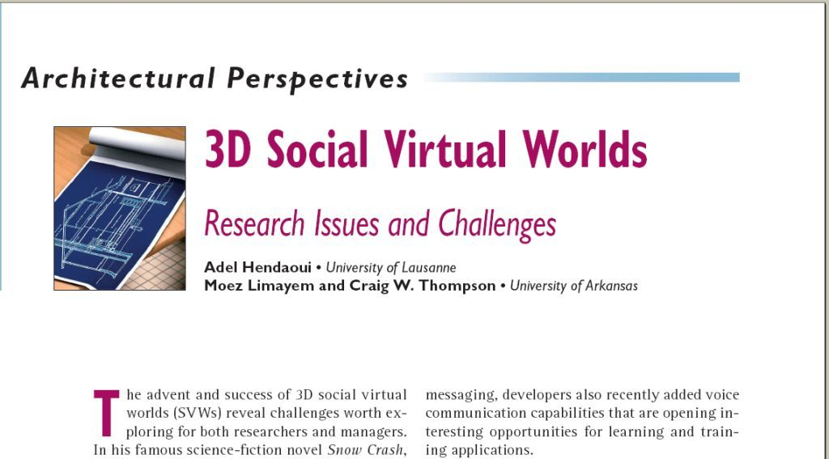
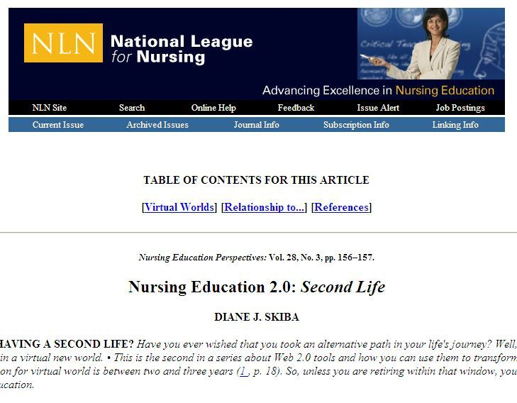
Second Life research is increasing (slowly)

Slide 36
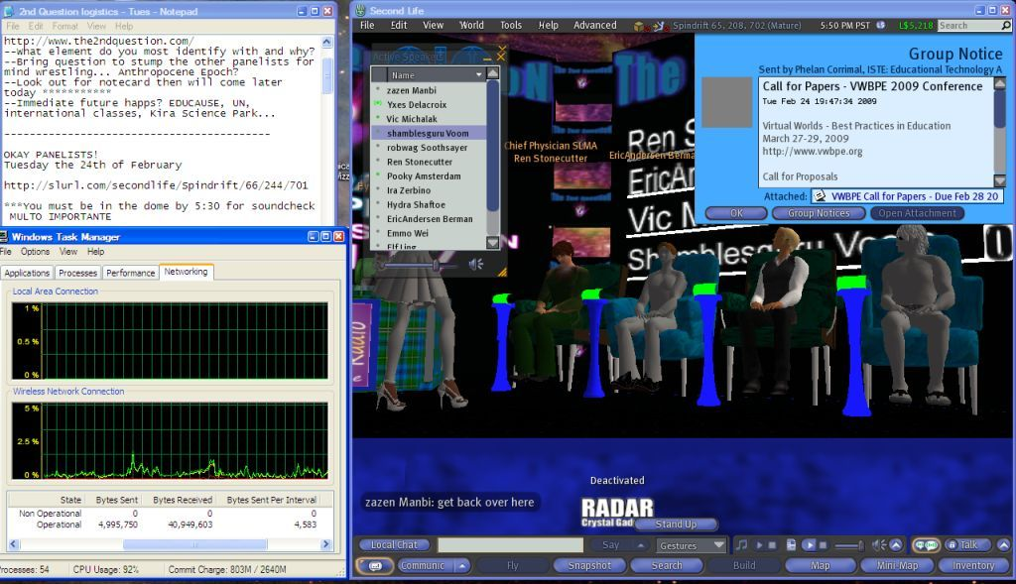
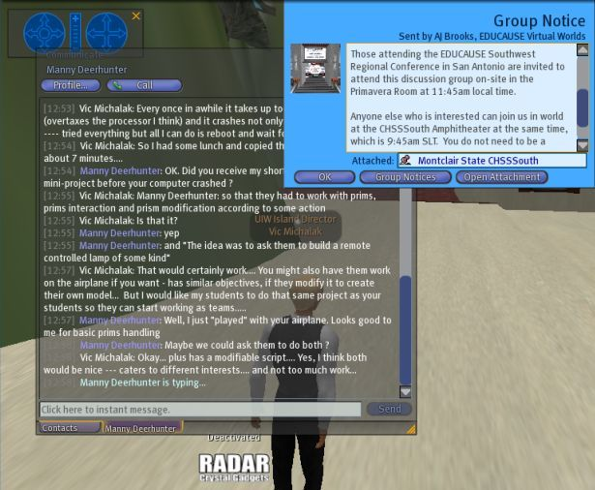
Second Life can greatly enhance your First Life!
No matter what your professional or personal interests, you are likely to find others with whom to share them in SL. There are MANY support groups for educators, administrators, and researchers in Second Life!

Slide 37
A Visit to Second Life…
(…no amount of talking can replace a demonstration)
(…but no demonstration can replace your own experience, so I invite you to get a Second Life!)

Slide 38
Does Your Campus Need a Second Life? Take Two…
Wrap-up – What I hope you have taken away:
I hope that you can envision using Second Life too!
Beware of hype, know why this is important in so many ways
Be aware of personal vs. organizational cycles
Second Life can greatly enhance your First Life!
You can teaching, learn, and do much more in Second Life…
Take advantage of this new medium in innovative ways;
don’t just repeat First Life in Second Life!
Contact me ---- seriously! youngblo@uiwtx.edu
SL: Vic Michalak
Tell them what you have told them…

Slide 39
O wonder! O brave new world that has such people in it!…
William Shakespeare (1564-1616)
(widely regarded as the greatest English writer – quote from Miranda in “The Tempest”…)

Slide 40
…sail away to whole new worlds of light and life, where our friends are…
Henry David Thoreau (1817-1862)
(American author, transcendentalist, abolitionist , philosopher – “Walden; or Life in the Woods”, etc…)

Slide 41
…to explore strange new worlds…to boldly go where no one has gone before…
Gene Roddenberry (1921-1991)
(creator of “Star Trek” – the mission of the starship Enterprise…)

