Slide 1

Balancing Old and New Services
Sandy Bennett, Manager Online Teaching and Learning Services
Lance Grigsby, Academic Consultant
© Sandy Bennett & Lance Grigsby, 2009. This work is the intellectual property of the authors. Permission is granted for this material to be shared for non-commercial, educational purposes, provided that this copyright statement appears on the reproduced materials and notice is given that the copying is by permission of the author. To disseminate otherwise or to republish requires written permission from the author.

Slide 2
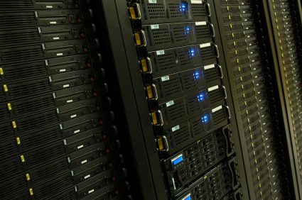
Case Study
Web server
  Out of maintenance lifecycle
  Held a variety of web services
    faculty, staff and student personal web pages.
    student and faculty organization web pages
    departmental web pages
    file storage
Notes:
The computer had to go!! It was not a viable production level computer. The services on this system needed to be evaluated. So we started from there…

Slide 3

How do you retire a service?

Slide 4

Evaluate all your services.
Notes:
What are you offering and who are you offering that to. For my group, we try to do this annually to see if we have duplication, major technology shifts or services that are with little use. Little use is always tricky, because for that one person who is using that service it is important. Here is where we hope that there is duplication where we can point them in another direction.
Sometimes this evaluation process happens less frequently and may occur every other year.

Slide 5
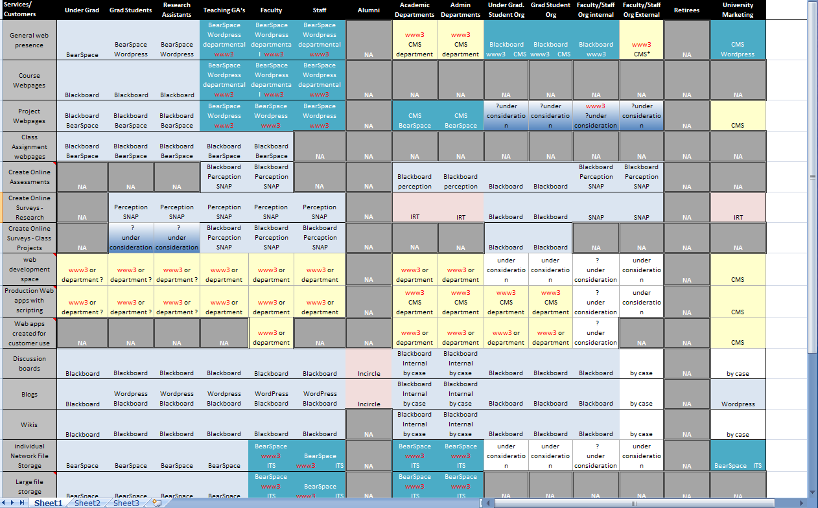
Create a Service Grid
Notes:
Here was our evaluation.
This is a two page legal size documents with our client groups on the x axis and the service they used on the y axis.
Grad Students ----
professional

Slide 6

Set your course of action.
Notes:
Plan for the termination of a service.
Any time you eliminate a service you are creating change. Because you are going to make someone do what they have been doing differently.
The planning usually does not take long. If you know where you want to go.
But other stage in the process can take some time.

Slide 7

Divide responsibilities.

Slide 8

Be patient.
Notes:
For different groups the timing was different.
We move a lot faster when adding and removing student services. Why?
For faculty and staff it can take anywhere from a few months to a couple of years.
For this example it took us 2 ½ years to change from the old to the new.
Each service and each campus will be different on how long it takes.
For example when we just update an existing service we will take 3-4 months of letting people know. Ideally we like to have 6 months for major changes to existing systems.
However when we completely change how we are doing business this is where it may take us a year to 2 years to implement a change.
Really know and understand your culture and your constituents.

Slide 9
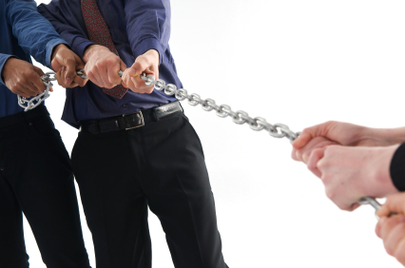
Hanging on and on and on…
Notes:
If let to their own devices even the most savvy user will hang on to something that they like or are familiar with rather than change. It is our responsibility to make the change the correct move for them to make.

Slide 10

… But they just won’t let go.
Notes:
Question to audiece: Your campu’s experience with the Google phenom??
Perception vs. reality

Slide 11

Ask for input
Notes:
Focus groups…

Slide 12
Focus Group Result
Want it to be easy use
Most did not want to know html
They wanted their websites to be aesthetically pleasing
Notes:
Easy is the way to go.
The made changes rather infrequently in most cases and they did not want to have something that was hard to figure it every time they had to update their sites.
Quite frankly html editors like – dreamweaver are difficult for the average faculty member to add on top of what they already do and ftp and file transfer was often our biggest hurdle.

Slide 13

Our solution
WordPress MU – An open source & easy to use CMS for blogs
Xythos – existing resource for traditional web sites
Blackboard – existing resource for organizations
Notes:
Students – move to network file storage within our Xythos system – web folder
Faculty/staff/grad students – web folder in Xythos for those who truly love html, Word press blog for others
URL redirects ideal for multiple systems

Slide 14

Why WordPress MU?
Flexibility: Offers ‘Web 2.0’ or traditional ‘static’ look
Ease of access to the system
No additional software required
WYSIWYG capabilities
Integration with single sign-on approach
(SSL + LDAP)
Extendable with plugins – Using multimedia
is easy
Easy to have a professional look
Notes:
Easiest application of the open-source CMS applications like Joomla, Drupal
MU not as extensible as regular wordpress
Themes also optimized for SEs

Slide 15

To Blog or not to Blog
Selling the solution: Careful use of the word ‘blog’
Teach blog as medium, not stereotypical content type
Another system for those who opt out - Xythos

Slide 16

Does your campus have web 2.0 phobia?
Notes:
Audience question: is your campus blogophobic? How would you deal with it?

Slide 17

Communicate
Notes:
Sent out message each semester
Put a subject line – rookie mistake - New on the job
Pull data on who had accounts, did they have files and had accessed their file in the last 180 (300-400 users) over 1000 accounts

Slide 18
Communication Timeline
Aug. 10, 2007:
CONTACT TARGETED
LIST OF DEVOTED USERS
March 10, 2008:
CONTACT AUG. 10
SUPERUSER GROUP (AGAIN)
May 5, 2008 :
REITERATE
AUG. 10 MESSAGE
Dec. 5, 2007:
SEND GENERAL MESSAGE
TO ALL FACULTY/STAFF
Sept. 8, 2008:
FINAL MESSAGE
Notes:
1. Aug. 10, 2007 - Send first message related to retirement of www3 server to target group. Introduce WordPress as a replacement technology; address impending change of URL structure for homepages & redirect.
2. Dec. 5, 2007 – Send second message to all faculty/ staff about server retirement, Wordpress, & the redirect. Establish timeline for dismantling: end of Summer 2008
3. March 10, 2008 – Send third message to “superuser” group generated from access reports. Reiterate retirement schedule, availability of WordPress, etc.
4. May 5, 2008 – Send fourth message to same group as March 10. Reiterate deadline, loss of access, wordpress, etc.
5. Sept. 8, 2008 – Send final message about Sept. 23 “takedown” and Oct. restriction.
We told them once a semester that we that the service was changing.

Slide 19

Have a grace period built into the process.

Slide 20
Finally
Notes:
Upgrading…wordpress.

Slide 21
Summary

Slide 22

Letting Go!

Slide 23

Moving Ahead!

Slide 24

How do your encourage your campus to accept/embrace change?

Slide 25
Thank you
Sandy Bennett
  Sandy_Bennett@baylor.edu
Lance Grigsby
  Lance_Grigsby@baylor.edu

