Slide 1







Developing a next-generation campus Web Portal
David Weil (dweil@ithaca.edu)
& Benjamin Costello (bcostello@ithaca.edu)
Copyright Ithaca College, 2009. This work is the intellectual property of the author. Permission is granted for this material to be shared for non-commercial, educational purposes, provided that this copyright statement appears on the reproduced materials and notice is given that the copying is by permission of the author. To disseminate otherwise or to republish requires written permission from the author.

Slide 2
Welcome
David Weil
  Director, Web, Systems & Departmental Services
  dweil@ithaca.edu
Benjamin Costello
  Manager, Web & eMedia Development
  bcostello@ithaca.edu
More information:
  Email us
  Visit: www.ithaca.edu/myhome

Slide 3
Presentation overview
Background
What we developed
Why we did what we did
Technologies Used
Demo
Community Response
Next Steps
Q&A

Slide 4
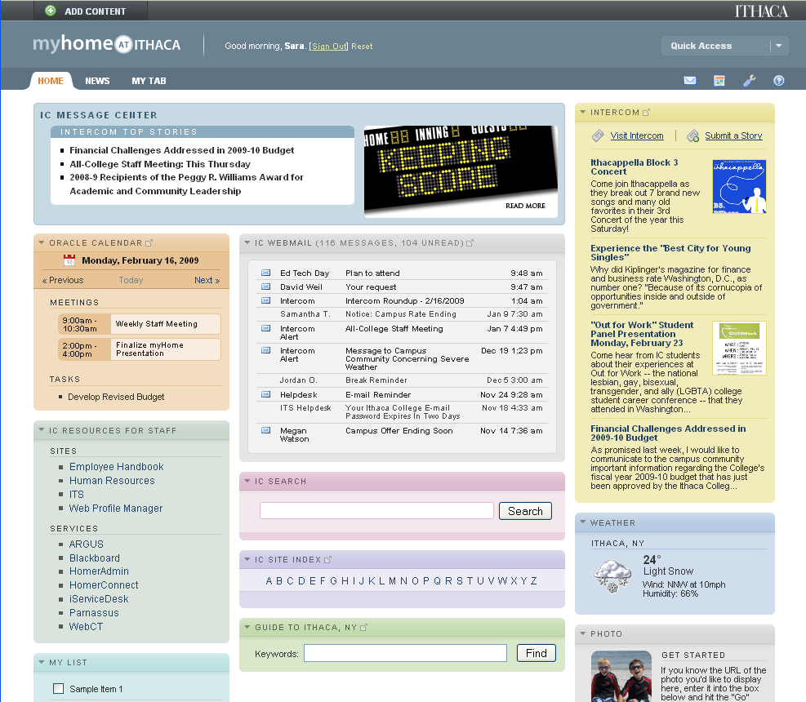

Slide 5
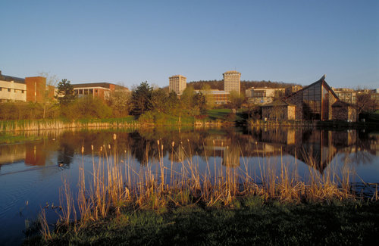
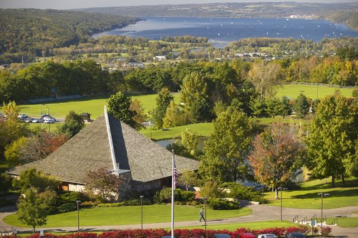
Ithaca College
Private, residential undergraduate
liberal arts college in upstate New York
Comprehensive, masters one institution
5 schools, over 100 degree programs
Faculty | 463 FT / 216 PT
Staff | 800 FT / 190 PT
Student FTE
Undergraduate | 6,000
Graduate | 400

Slide 6
Web Roles & Governance
Web Strategy Group
Information Technology Services
Marketing Communications
Executive oversight
Technical Leadership
Shares responsibility with ITS for managing the college’s Web presence
Reviews & approves policies, guidelines and resource needs
Hosting services
Web & eMedia developers

Slide 7
Web Strategy Group Membership
Vice Presidents:
  VP for Institutional Advancement
  VP for Finance and Administration
  VP for Enrollment Management
Designee for the Vice President for Student Affairs
Designee for Provost / Academic Affairs
IT Management:
  Assoc. VP for Information Technology Services
  Director of Web, Systems and Dept. Services**
  Manager of Web Development
Marketing
  Executive Director of Marketing Communications**
  Associate Director of Web Marketing
Director of Admission

Slide 8
Project Background
We had myIthaca, an award winning Web portal-like resource for prospective students…
…but, once they matriculated they were faced with a vastly inferior Web experience
False Advertising?
Buyer’s Remorse?

Slide 9
High-Level Goals
Provide a “home” for a person’s Web activities
Single entry point
Lightweight implementation
Offer myIthaca-like experience for current students
Improved communication
  Between college and IC community
  Within IC community
Increase satisfaction by making…
  Common transactions more intuitive, easier & online
  Information easier to find

Slide 10
“Lightweight”
Leverages existing Web services and content
Emphasis on user interface and presentation layer
Built using existing technology infrastructure
Political sensitivity to the concept of implementing a “Portal”

Slide 11


Options Considered
Oracle Portal
Luminis Portal / Campus Pipeline
uPortal
Doing it ourselves

Slide 12
Spring 2007
Summer 2007
Fall 2007
Web Strategy Group Defined Need
Proposal Created and Funded
Development Work Started
Spring 2008
Alpha Version – Jan
Public Beta – March
August 2008
Release 1
Researched Options

Slide 13
Why Do It Ourselves?
Leverage existing work
Wanted a “Web 2.0” experience
Work in our heterogeneous environment
Avoid a heavy enterprise implementation
Ability to integrate with non-campus services
Make use of evolving web standards

Slide 14
What We Developed
A Web 2.0 Portal Experience
  Drag and drop interactivity for arranging layout and adding new content
  Dynamic auto-refreshing content w/intelligent caching
An Ithaca College Experience
  Integrated Webmail, Calendaring, and single-sign-on brokering to most campus web services
An Aggregated Web Experience
  Access to 3rd party email accounts (Yahoo,Gmail,IMAP)
  Facebook, RSS feeds, bus schedules, etc.

Slide 15
WWW
(Public Web)
myHome
Webmail
Calendar
myIthaca
(Prospective Students)
Self Service
CMS
Directory Services
Other Web Services
ERP
myHome relationships with other services

Slide 16
Technologies Behind The Scenes
Javascript
Controls interactive interface
AJAX calls refresh content and update preferences
XML
Defines basic portal configuration
Defines portlets and their functionality
Stores all user customization settings
PHP / mySQL
Integrate with and allow Ajax to refresh data from external systems
Facilitate authentication, session management and single-sign-on brokering
Integration with our CMS

Slide 17
Resources
Web developer / designer resource
  Year one (inception to release 1.0): 1 FTE
  Year two: ½ FTE
  On-going: ¼ FTE
Concept development and project management
Additional technical support (minimal)
Runs on existing servers
  Web server - Sun hardware, Solaris, Apache, PHP
  mySQL server – Sun hardware, Solaris, mySQL

Slide 18
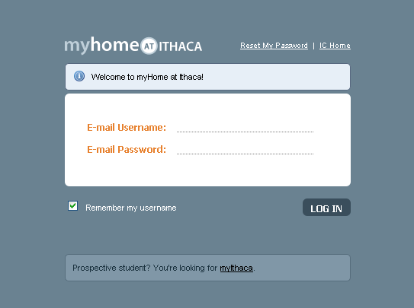

Slide 20
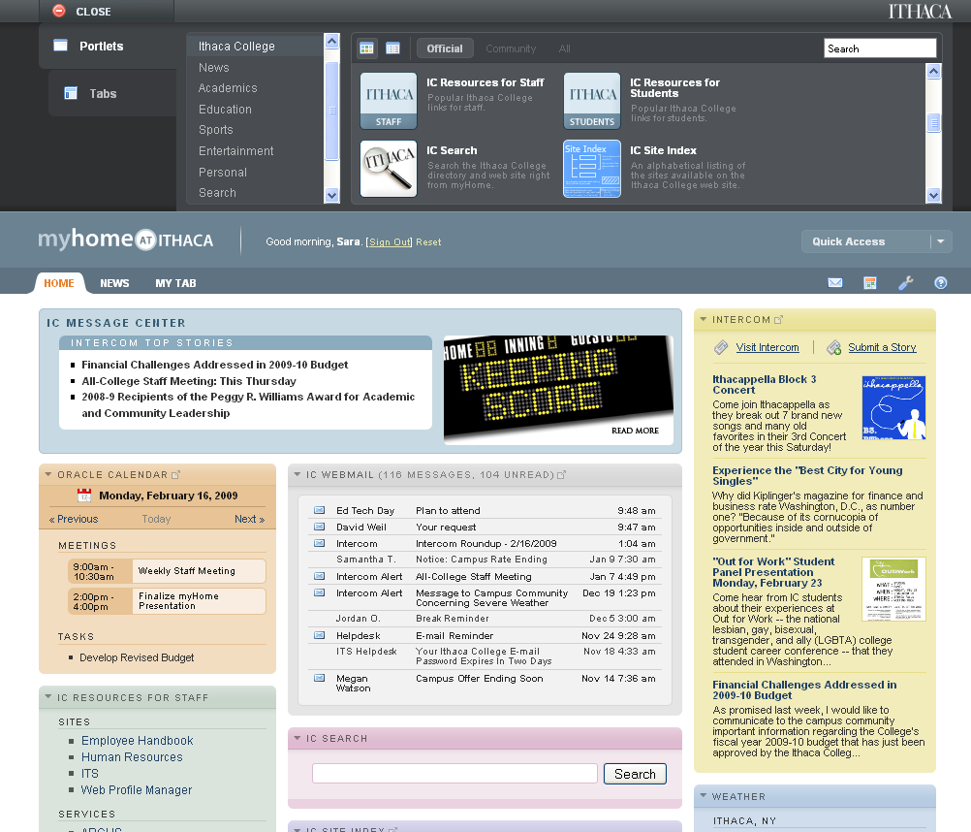

Slide 21
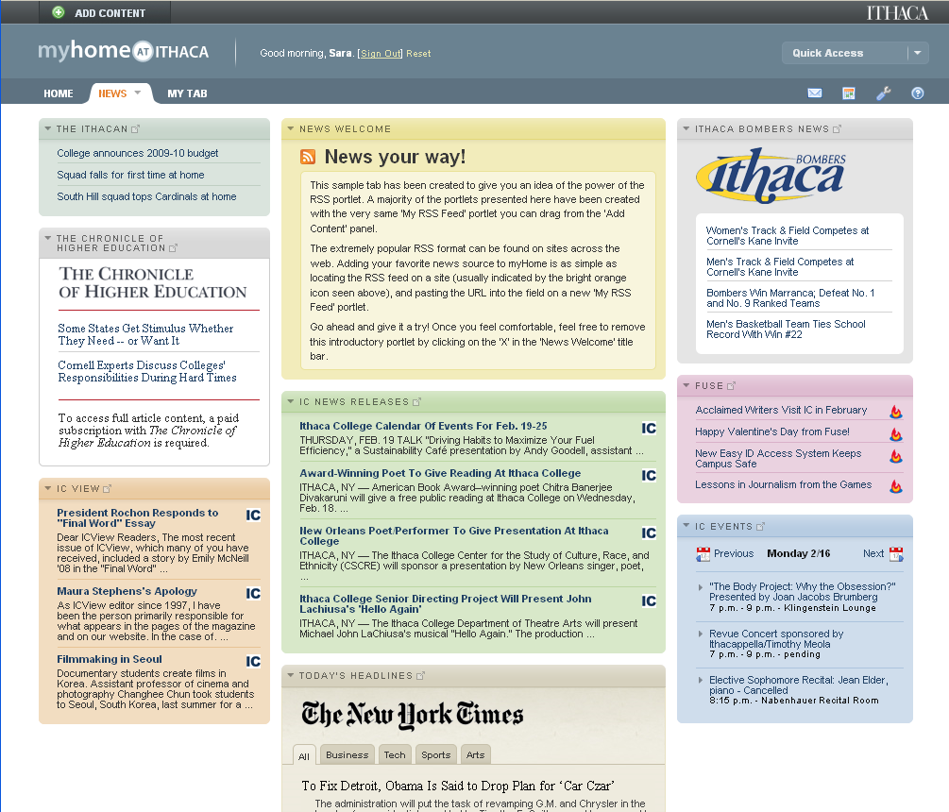

Slide 22
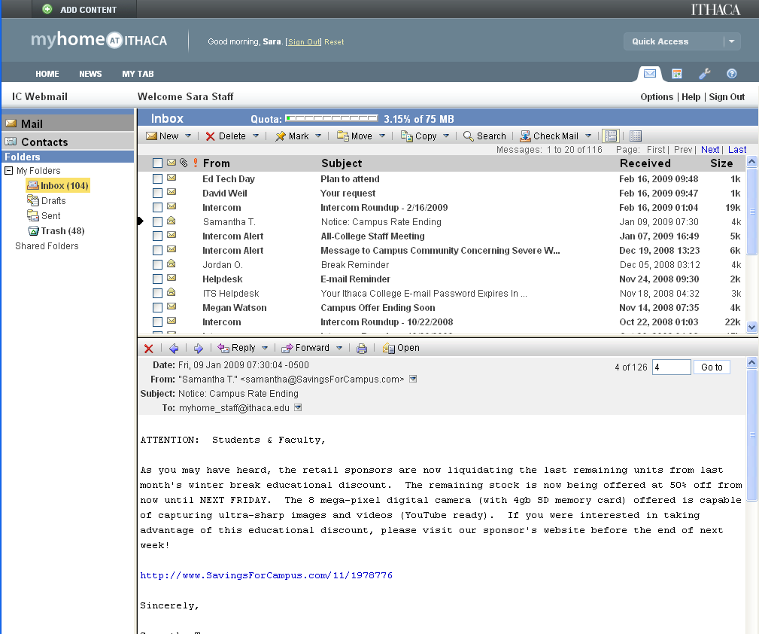

Slide 23
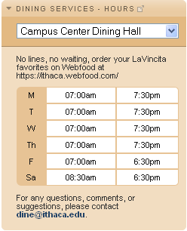
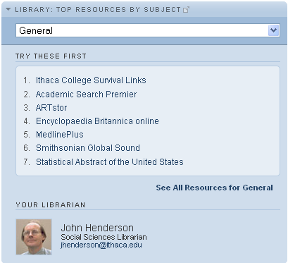

Community Content
Community Portlets
Community Tabs
FIRST YEAR STUDENTS
Resources for new students
PHYSICS MAJORS
Resources for Physics
CAMPUS HAPPENINGS
What’s going on

Slide 24
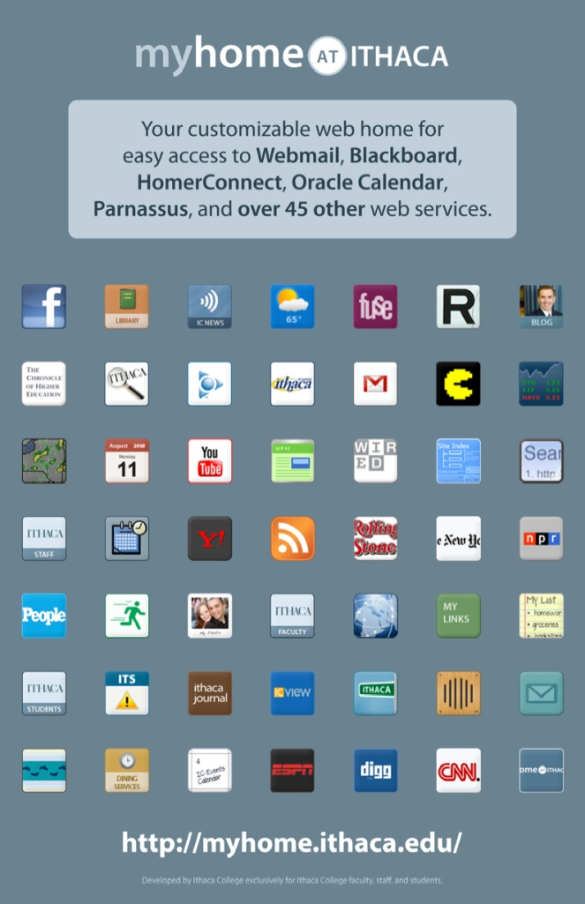
Campus-Wide Rollout
Released at start of
Fall 2008 semester
  Ads in student paper
  Intercom Announcements
  Posters around campus
Use is currently optional

Slide 25
Community Response
I absolutely love the new myHome!
This is amazing!
This is AWESOME. Serious props to whoever brought this idea into existence.
This is one of the best ideas Ithaca has ever had!

Slide 26
Total # of people who have logged into myHome

Slide 27
Unique Logins Per Day by Type
Total Logins Per Day

Slide 29







Future plans
Redirect Webmail users to myHome interface
Social Networking features
Mobile access
Entry point for all web-based services

Slide 30
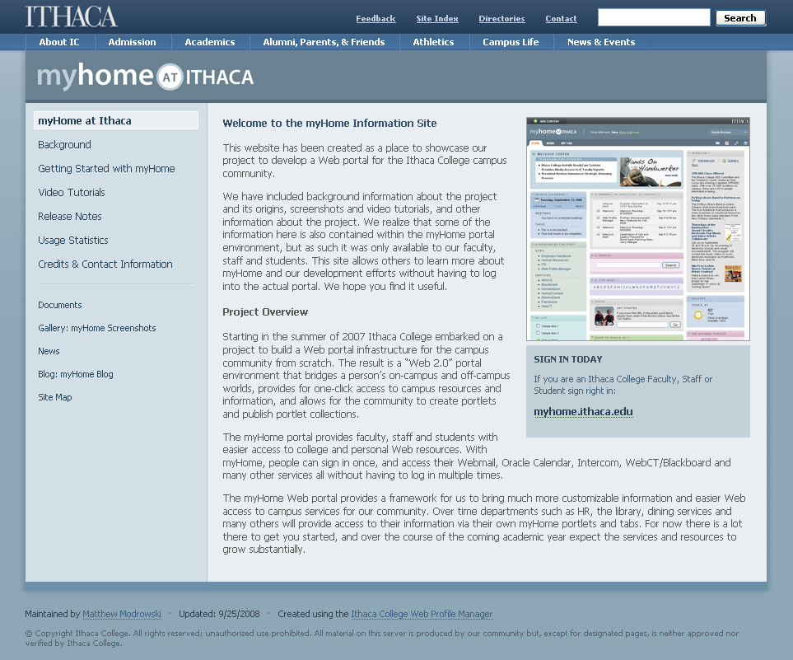
For more information
Information Site: www.ithaca.edu/myhome
  Video tutorials & screenshots
  Background information
  Copy of this presentation
eMail us:
  dweil@ithaca.edu
  bcostello@ithaca.edu

Slide 31
Q&A

