Slide 1




Navajo Technical
College
Presenters:
Jason Arvisio, Navajo Technical College
Jared Ribble, Navajo Technical College
Cris Landgraf, University of NM/ABQ-G

Slide 2
"Albuquerque Gigapop: New Mexico's On-Ramp for High-Speed Data"
1. Description of ABQ-G
2. ITTH Project
3. ITTH Future

Slide 3

ABQ-G Goals
Building inter-state connectivity
Providing Education/Research network statewide bringing opportunities to rural areas
Develop Partnerships to reduce costs and increase possibilities

Slide 4

What does ABQ-G do?
Provide low cost Commodity Internet and access to high speed research networks
Provide aggregation points for Statewide benefits
Provide technical outreach programs
Create an environment for future network growth
Enable value-added services to rural areas
Maintain robust research networks statewide

Slide 5

ABQ-G/UNM Partnerships
  Navajo Tech. College
  State of NM (DoIT)
  City of Albuquerque
  City of Rio Rancho
  CNM
  New Mexico State University
  New Mexico Tech.
  ChecsNet
  New Mexico Computational Application Center
  CereLink, Inc.
  Mesa del Sol
  PNM
  LANL
  Sandia National Labs
  City Of Rio Rancho
  Eastern New Mexico Rural Teleco
  Eastern New Mexico University
  Local Alb. Data Centers
  Comcast
  IFDM

Slide 6
Importance of Achieving Our Goals
The ITTH/ABQ-G Story
Common vision
Stakeholder relationships
Standards
Effective governance
Joint planning
Good program and project management

Slide 7

Internet to the Hogan
Navajo Technical College
Dine’ Grid

Slide 8
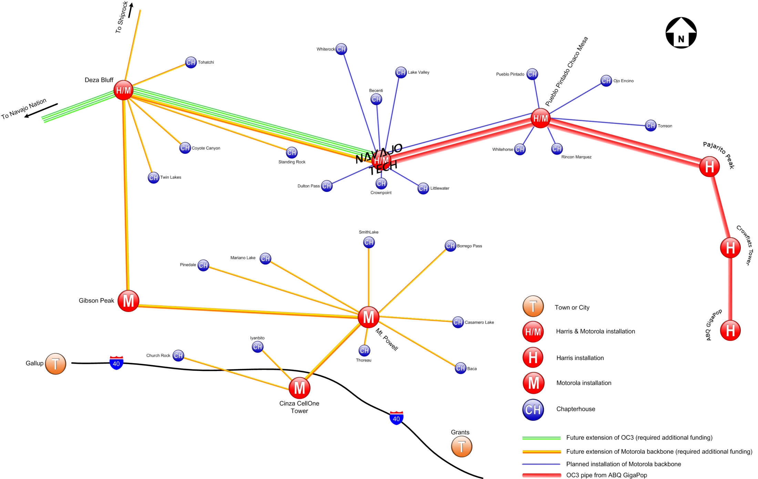


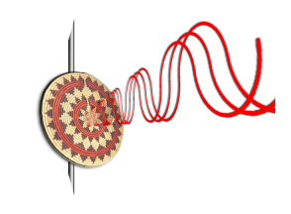

Slide 9
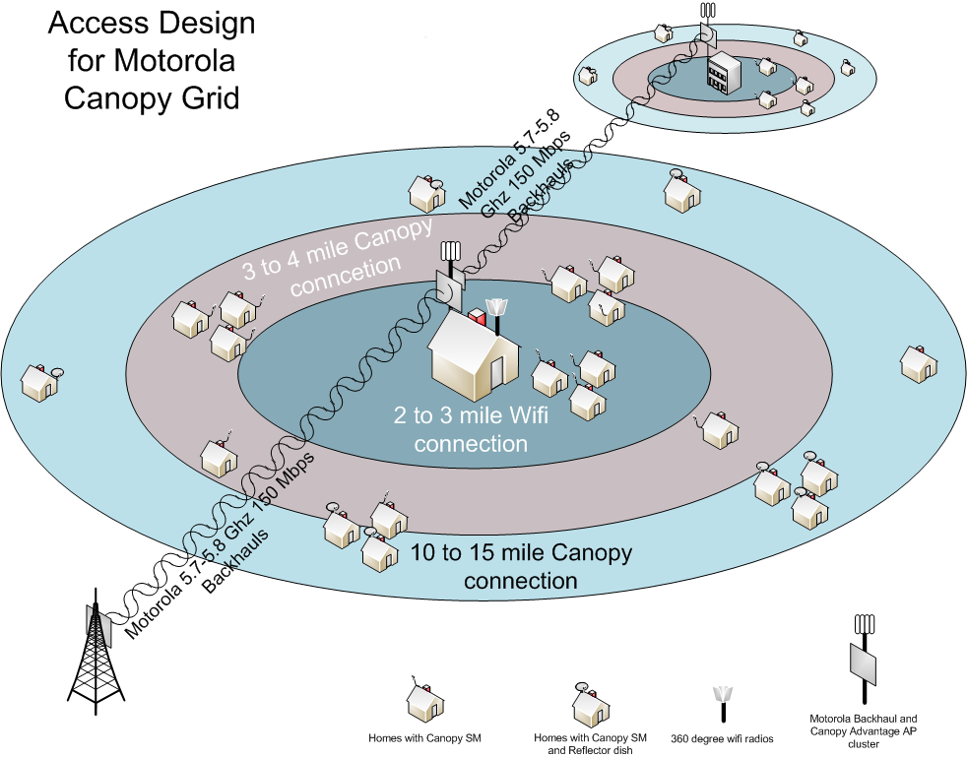

Slide 10
Scalable Distributed Supercomputing Environment
The Diné Grid
A scalable system refers to network systems: In this case the Diné Grid
is scalable in two ways. The most important of these has to do
with usage. A user at a chapterhouse or home can access the
Internet at a minimal bandwidth, or they can access
Supercomputing resources through the Gigapop in Albuquerque
to the TeraGrid, the world’s largest supercomputing grid. As
Little Fe’s are manufactured at Navajo Tech and placed in
chapterhouses, schools, public safety buildings, clinics, etc.
The distributed environment is also scalable in that it becomes
increasingly powerful as a distributed supercomputer. The supercomputer
on campus is the center of the Dinè Grid. Every new Little Fe
increases the supercomputing power available to users.

Slide 11
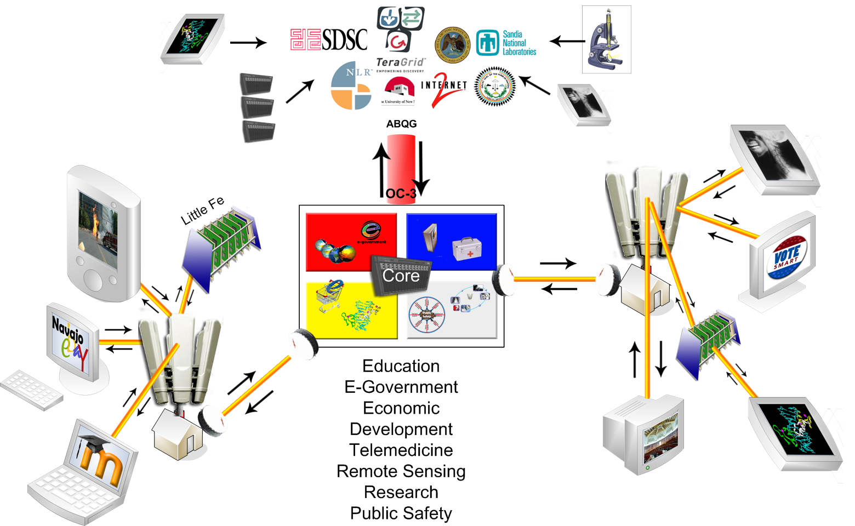

Slide 12
Internet to the Hogan and the Dinè Grid in Education
The initial idea that led to development of the project was a desire by Navajo Tech to deliver high quality distance education to chapterhouses in the Navajo Nation
This led to development of the wireless grid and work with Hans Werner Braun, the most important wireless scientist in the world.
An examination of the current state-of-the-art in E-Learning led to a realization of the need for the Dinè Grid
Science, Technology, Engineering, and Math (STEM) education has a new paradigm.
STEM provides high skill, high wage jobs. Navajo Tech has strong STEM programming. But in the contemporary world work in these fields is completed on a collaborative basis. This demands a collaborative toolkit for teaching and learning—a toolkit not currently available to any school in the Navajo Nation.

Slide 13
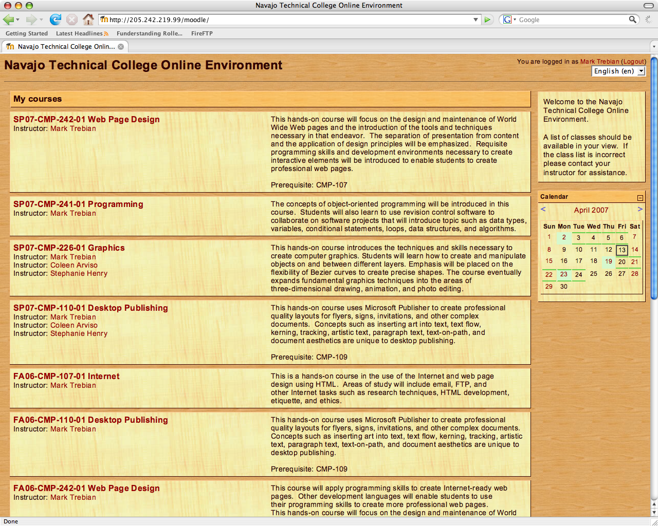
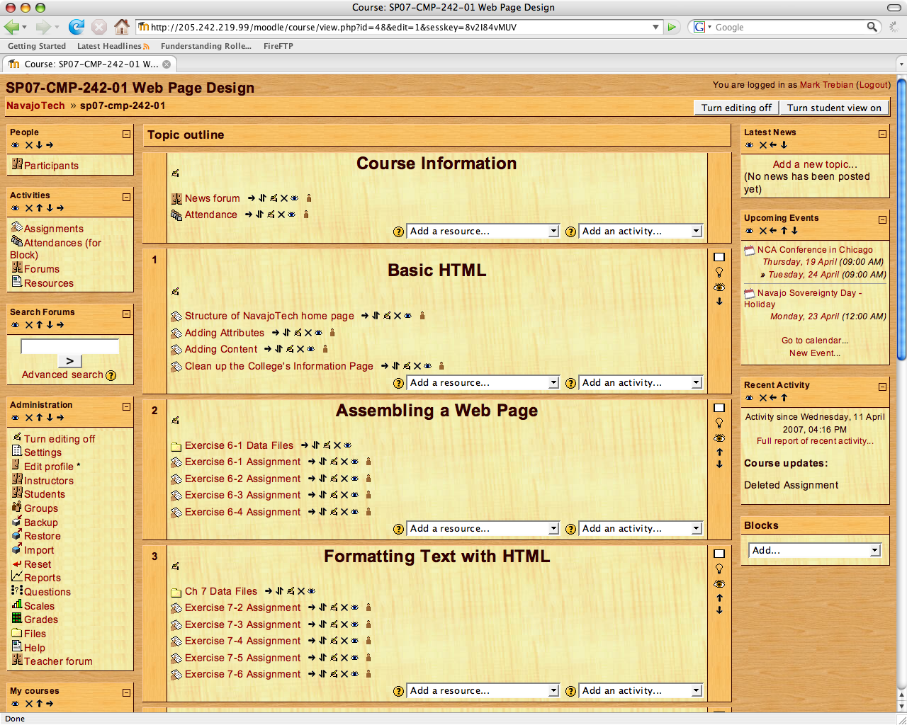
Online Education
Internet to the Hogan & the Dine’ Grid will be the vehicle through which NavajoTech and their partners will deliver online content using Moodle and advanced multimedia resources to affect fundamental changes…
…in the communities served by the project. Communities touched by the project will have access to advanced scientific curricula, cutting-edge cyber-infrastructure facilities, and resources that are currently unavailable.

Slide 14
The most important task Internet to the Hogan and the Dinè Grid is undertaking
Using all of the project’s elements to give Navajo Tech technology students practical hands-on experience with the most advanced technologies currently being developed from around the world
Inspiring Jason Arviso, Coleen Arviso, Jared Ribble, Chris Yazzie, Derickson Begay, and Mark Trebian to work on increasingly advanced degrees
Developing a pathway where selected technology students can graduate, work at the college, and then begin working on increasingly advanced degrees
Ensuring that the next generation of Navajo people have the high wage skills to move the Navajo Nation to the engine of the world’s technology train

