Slide 1
Evolving Academic Computing Offerings: A Successful Strategy
Dr. Gary Kidney | 2–18-2010
Copyright Gary Kidney 2010. This work is the intellectual property of the author. Permission is granted for this material to be shared for non-commercial, educational purposes, provided that this copyright statement appears on the reproduced materials and notice is given that the copying is by permission of the author. To disseminate otherwise or to republish requires written permission from the author.

Slide 2






Context @ Rice
Private
Small (5,243 students)
but growing
Research University
H
O
U
S
T
O
N

Slide 3
The Problems
New services land in the catalog faster than old services are discontinued.
Old services are still critical tools for some users.
Making a data-driven decision about old services is difficult.

Slide 4

OwlNet
UNIX-based infrastructure.
Previous hub of academic computing.
8-years old; frayed & disaggregated.
Still used by engineering & science for UNIX-based teaching.
Still the host for many personal, departmental, and club Web sites.

Slide 5

OwlNet Habeas Corpus
In 2006, IT announced OwlNet’s obsolescence.
With faculty, a plan was prepared to remove OwlNet from service in August 2007.
Nobody followed the plan.
So, the 2007-08 school year continued on OwlNet.

Slide 6

OwlNet, Revisited
In 2008, we approached OwlNet differently:
  Both qualitative and quantitative research.
  User centered design.
  A Request for Comment process.
  Web 2.0 technologies for engagement.
  Shared governance.

Slide 7

Data Gathering
Quantitative
  Usage statistics
    Last logon date, last file modified date
    WebTrends access reports
    Applications running
  Surveys
    General user satisfaction survey
    Faculty needs and requirements survey
    Targeted student uses survey

Slide 8

Data Gathering
Qualitative
  Focus Groups
    Students
    Faculty
    Staff
  User Interviews
    3 students
    3 faculty
    3 staff

Slide 9
User Centered Design
Created Personas (Use Case Scenarios)
  Faculty teaching with Unix tools
  Faculty using Web tools in a way incompatible with CMS
  Students completing assignments with Unix tools
  Students turning in work incompatible with CMS
  Students wanting to learn Unix for fun

Slide 10
Formative Design Report
Open discussion with stakeholders over lunch established some direction
  RedHat Linux
  Compatible with Rice’s high performance computing assets
  Use of NetID
  Use of virtualized storage
  Accessible both on and off campus

Slide 11
Request for Comment 1
Developed by IT
Reviewed by target users
  3 faculty
  3 students
  3 staff
Revised
Reviewed by target users until concurrence of target users was obtained

Slide 12
Request for Comment 2
Placed in a wiki
Opened for public comment
Presented to 2 targeted classes of students
Revised based upon comments

Slide 13
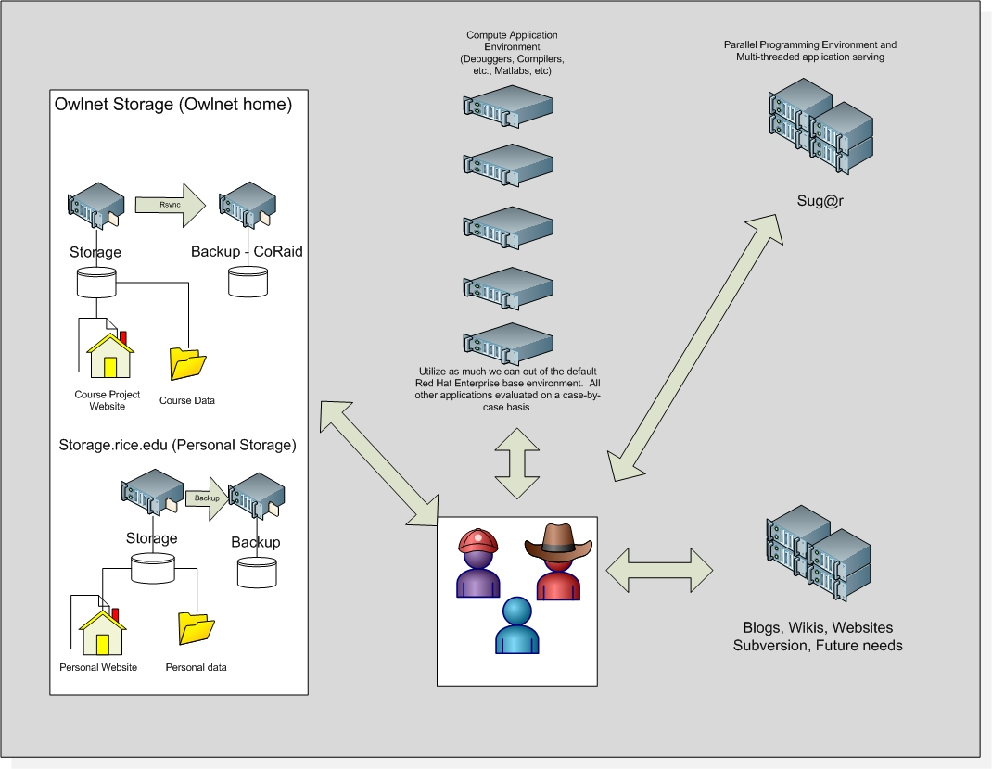
System built according to RFC roadmap
System build
  New servers and storage
  New sys admin hired
  Software stack installed
Progress reported to stakeholders 3 times:
  At midpoint
  At build conclusion
  After alpha testing

Slide 14

The difference is CLE@R
Beta test in Fall 2009
  “I'm very happy with the way things turned out. The machines have been competently configured and professionally maintained throughout the semester. I can't recall a single problem that adversely affected the students' educational experience.”
  “CLE@R gets an “A” for both product and process.”
Beta “bug list” solved December 2009.
Gamma test in Spring 2010

Slide 15
Sunsetting OwlNet
MOTD announcing sunset on 7-1-2010 posted on 12-22-2009
Users notified 1-4-2010 and offered different treatments:
  Old – when to archive & delete
  Mid-term – archive & delete, port to CMS, move to CLE@R
  New – when to move to CLE@R

Slide 16
Outcomes
Better requirement document than traditional needs analysis
Highly transparent
360°picture
Defined service-levels
IT doesn’t play the bad-guy role.
No complaints

Slide 17
Lessons Learned
Use this process again
    We are for calendar migration
Users just want to be asked
  Most common comment on account deletion letter responses – “Thanks for asking!”
Engagement in the process facilitates self-policing

Slide 18
Questions

Slide 19
THANK YOU

