Slide 1
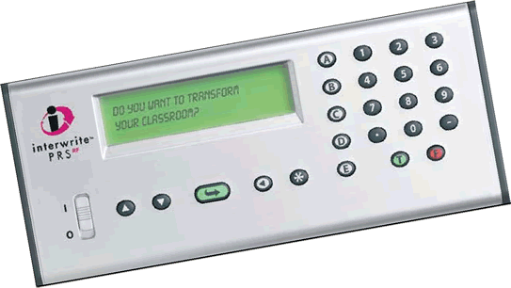

Using Student Response Systems to Promote Student Learning
Kimberly Perna, Instructional Technology Services
Greg Thorson PhD,
Ken and Lynn Hall Endowed Chair of Public Policy

Slide 2

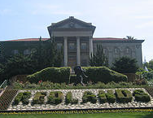

Who are we?
University of Redlands is a private liberal arts and sciences university.
The university also have a School of Business
and a School of Education.
There are seven
regional campuses
located across
Southern California.

Slide 3
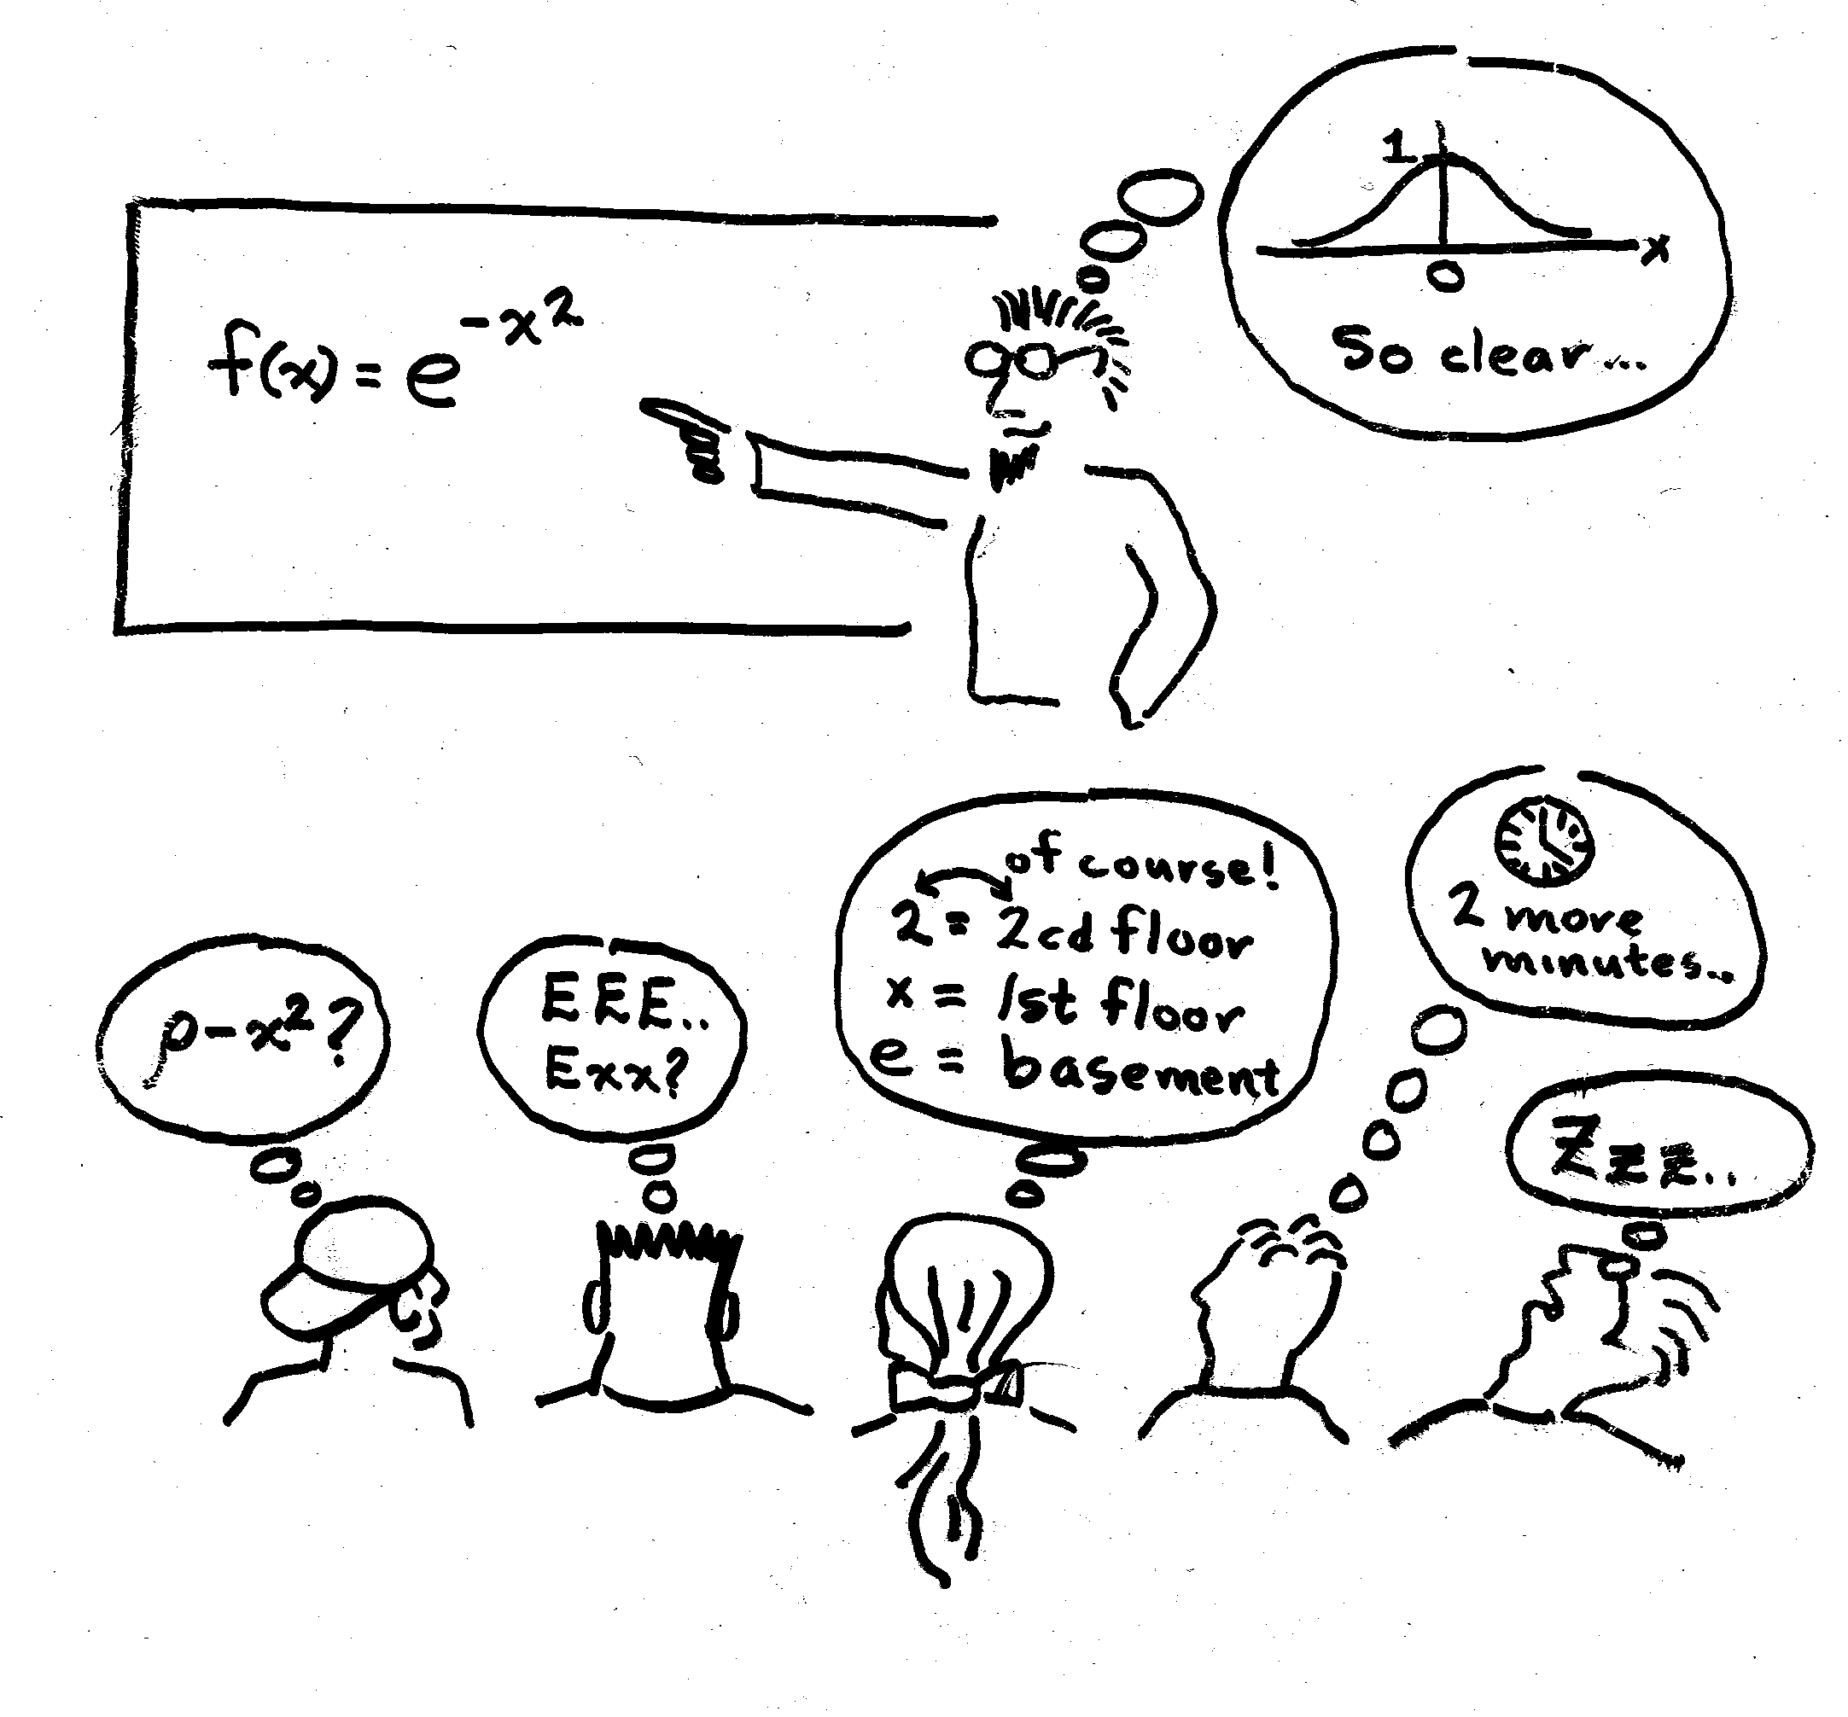
This may be occurring.
Without a way to reach all students, we may be unaware.

Slide 4
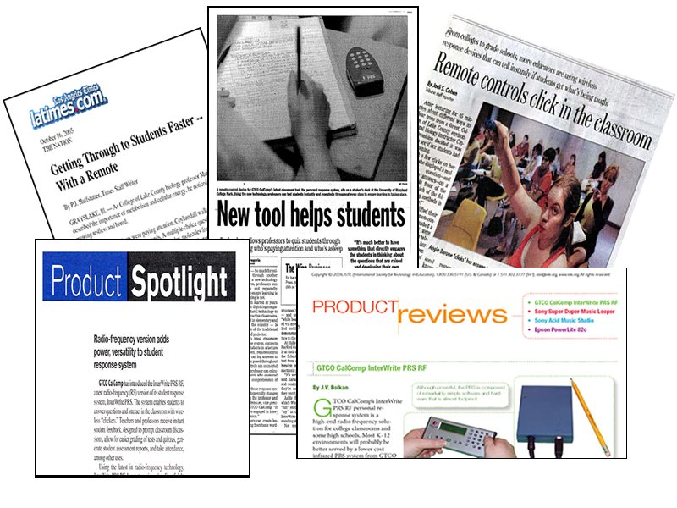
Clickers are not new.
But…they do provide new opportunities for engagement.

Slide 5
Agenda
What is a clicker and how do they work?
Five good reasons to use clickers
Clicker functionality
Clicker project student satisfaction survey
Faculty video segments
Questioning strategies
Best practices
Faculty/support considerations
Hands-on demonstration
Professor Thorson’s use of clickers

Slide 6
What is a clicker?
A clicker is a hand-held voting device.
These “remotes” send student responses by RF signal (or IR) to a computer system that displays the results instantly.

Slide 7
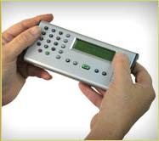
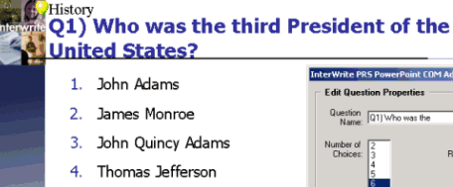
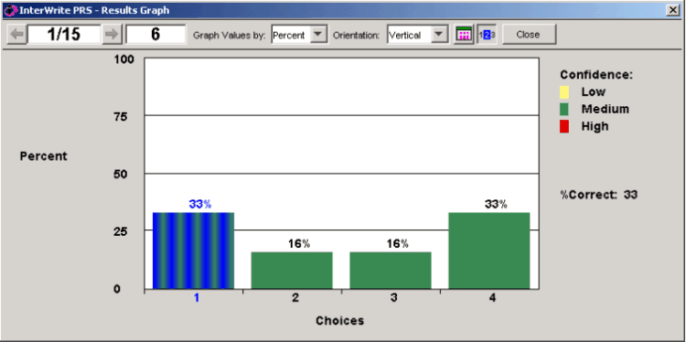
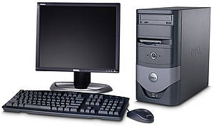
How Clickers Work
Instructor presents
a question to the students.
Students vote using hand-held devices.
2-way
communication occurs
Results are instantly made available to the students via a
bar graph displayed on the
projection screen.
Instructor station
with RF Receiver and
Interwrite PRS Software.

Slide 8
Five Good Reasons to
Use Clickers
Engage students
Promote collaboration
Provide instant feedback (Gagne)
Increase communication
Collect data
Frey and Wilson (2004)
http://www.clickerclassroom.com/WhyUseClickers.html

Slide 9
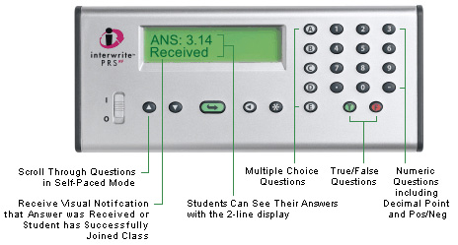
PRS Clicker Functionality

Slide 10
Faculty Representation
Spring 2008 | Spring 2009
3 faculty from Biology | 4 faculty from Biology
1 faculty from Communicative Disorders | 3 faculty from Communicative Disorders
1 faculty from Math | 1 faculty from Environmental Studies
1 faculty from Government | 2 faculty from Government
Most had read about clickers, only two had
previous experience using them.

Slide 11
Clicker project
Student Satisfaction Survey
Survey Conducted
Fall 2008

Slide 12
176 Respondents
184 respondents

Slide 13
171 Respondents
184 respondents

Slide 14
155 Respondents
184 respondents

Slide 15
168 Respondents
184 respondents

Slide 16
Describe your overall learning experience
If I had not paid any attention, than it was obvious when we used the clickers.
I enjoyed using the clickers, it was a way to question my newly learned knowledge.
I liked being able to participate and felt more involved.
Helps to see questions written in the same way as our tests.
Better than a teacher just asking a question because you weren’t afraid to answer it.
The clickers were fun, it felt like we were on a game show.
Student Comments

Slide 17
Comments to improve or enhance the use of clickers
Could be used more often.
Be graded on the quiz questions.
Have a lot more clicker questions.
I strongly encourage everyone to use them.
More instruction for the professor (outside of class).
I would participate regardless of using a clicker.
Not good for an English class.
Student Comments

Slide 18
Video Segments
Faculty Participants
Fall/Spring 08-09

Slide 19
Why our faculty wanted to use clickers

Slide 20

Dr. Tyler Nordgren
Astronomy

Slide 21
Let’s Try Them

Slide 22

Which best describes your position?
Teacher
Administrator
Staff
Business
Other

Slide 23
What type of organization do you work for?
Public School - K-12
Private School – K-12
Community College
Public College – 4 year or more
Private College – 4 year or more
Other

Slide 24
How many Educause conferences have you attended?
None – first time
One
Two
Three
Four or more

Slide 25
What was your best experience with the clickers?

Slide 26
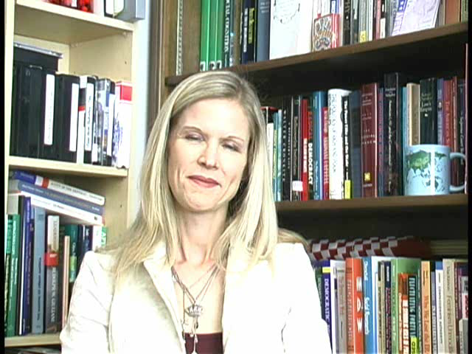
Dr. Renee Van Vechten
Government

Slide 27
Clicker Questioning Strategies
Clickers can be used in a variety of ways:
In-Class Question and Responses
Think-Pair-Share Strategy
Predictive Questioning (what happens next?)
Review Sessions

Slide 28
Our faculty – questioning strategies

Slide 29
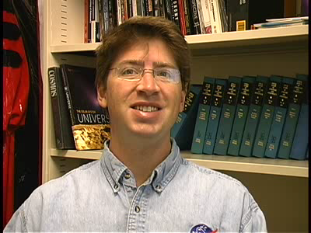
Our faculty – questioning strategies
Dr. Tyler Nordgren

Slide 30
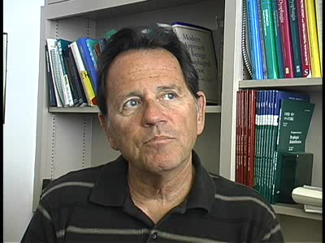
Dr. Michael Groher

Slide 31
Best Practices
Keep question and answer options short and simple.
Avoid confusing questions/answers.
Have no more than five answer options.
Allow adequate time for discussion of the results.
Include students in the discussion of results. Ask students to discuss with a partner and then re-poll.

Slide 32
Faculty Considerations
Have the ability to multi-task.
Be proficiently skilled at using technology.
Allow time at the beginning of class for students to sign-in to the PRS system.
Pose questions that encourages student discussion and interaction.
Have a back-up plan when the unexpected happens.

Slide 33
Support Considerations
Will students purchase their own clicker or will the university buy them?
If university owned, who will be responsible for checking in and checking out clickers at the beginning and end of each class?
Will the clicker system be used in one room or moved around campus?
Who will train the faculty?

