Slide 1

Copyright Texas Woman’s University 2011. This work is the intellectual property of the author. Permission is granted for this material to be shared for non-commercial, educational purposes, provided that this copyright statement appears on the reproduced materials and notice is given that the copying is by permission of the author. To disseminate otherwise or to republish requires written permission from the author."

Slide 2

Casey Foulds
Texas Woman's University
Instructional Support Services
940.898.3705 | 940.898.3211 (fax)
cfoulds@twu.edu

Slide 3
14,000+ students
4 Campuses
Strong Allied Health
4yr. Degree and Doctorate Programs
10% Men

Slide 4
WHY INTEGRATION?
LAMPS
WHY AMX?
RMS

Slide 5
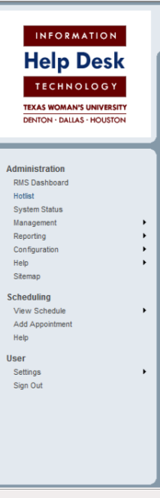
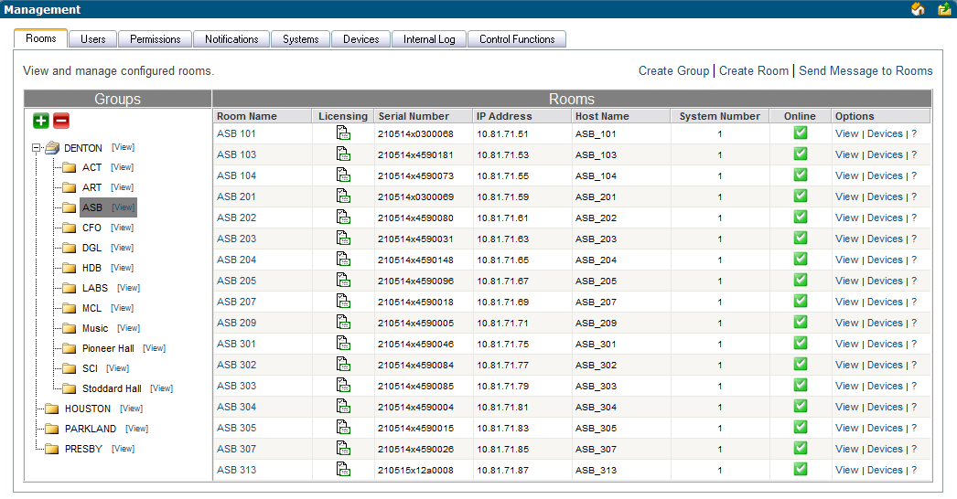

Slide 6
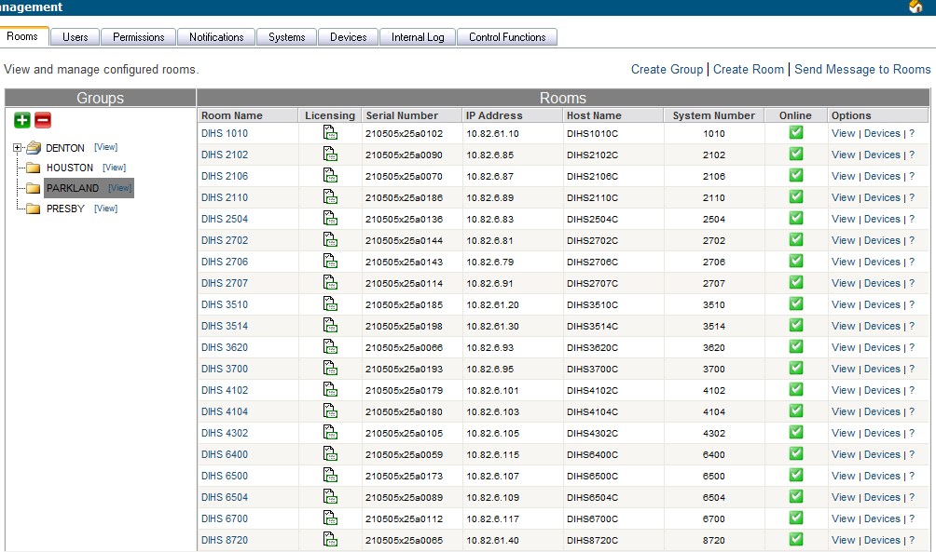

Slide 7
















The Projector is Warming up.
Please stand by.
If you need assistance at any time, please press the “Help Desk” button in the lower right corner or call 940.898.3971
Volume
Down
Volume
up
Volume Mute

Slide 8






I am unable to see the display
I am unable to hear the DVD, PC or Microphone
I am having an issue with the Document Camera
I am having a computer issue
I’m having an issue not listed above
Cancel Help Request
Volume
Down
Volume
up
Volume Mute
See – Hear – Doc Cam – PC - Other

Slide 9
2 Question System
I am unable to see the Computer
I am unable to see the DVD
I am unable to see the Doc Cam
I am unable to see the Remote Site
I’m having an issue not listed above
Cancel Help Request
Volume
Down
Volume
up
Volume Mute

Slide 10
Subject:
HDB 105 5:30 PM I am unable to see the Computer on the screen.
From:
RMS <helpdesk3@twu.edu>
Sent:
Tue 10/5/2010 5:31 PM
To:
HelpDesk3 <HelpDesk3@mail.twu.edu>
http://10.81.71.204
Click on IP to go directly to the room.
Log into RMS and reset the help request when resolved.
http://media7/RMS/admin/hotlist.aspx
“Got it!!”

Slide 11
Please verify that the projector and computer are powered on and you have selected PC in the upper left hand corner.
30
OK.
Tip: Select DVD and then PC to sync the display.
Cancel Help Request
Volume
Down
Volume
up
Volume Mute
We switched inputs for you. Can you see the image now?
YES
NO
Waiting on Technology Makes us Unpopular

Slide 12
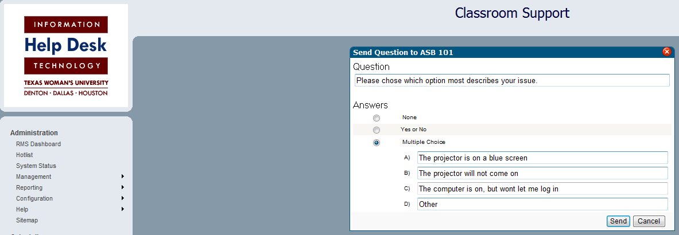

Slide 13

¼ of our calls were resolved by the time we arrived.
Then
Volume
Down
Volume
up
Volume Mute
My issue has been resolved, please cancel my Help Request.
OK
Now
¼ of our calls are cancelled before we leave our desk.

Slide 14
I am unable to see the display
I am unable to hear the DVD, PC or Microphone
I am having an issue with the Document Camera
I am having a computer issue
I’m having an issue not listed above
Cancel Help Request
Volume
Down
Volume
up
Volume Mute

Slide 15


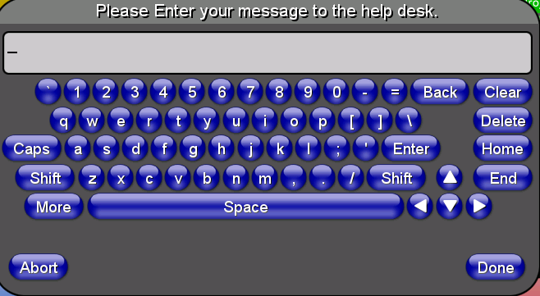

Volume
Down
Volume
up
Volume Mute

Slide 16
ASB 205 5:16 PM my plt ciappsarsx znd claxz is ztEting
We can fix it!!!

Slide 17
We love the Hotlist!!
Rebooting Remotely
Inclement Weather
Decline of VHS
Lamps

Slide 18
The Future of RMS at TWU
The Power of GREEN.
ADA.
RFID.

Slide 19
Casey Foulds
Texas Woman's University
Instructional Support Services
940.898.3705 | 940.898.3211 (fax)
cfoulds@twu.edu

