Slide 1
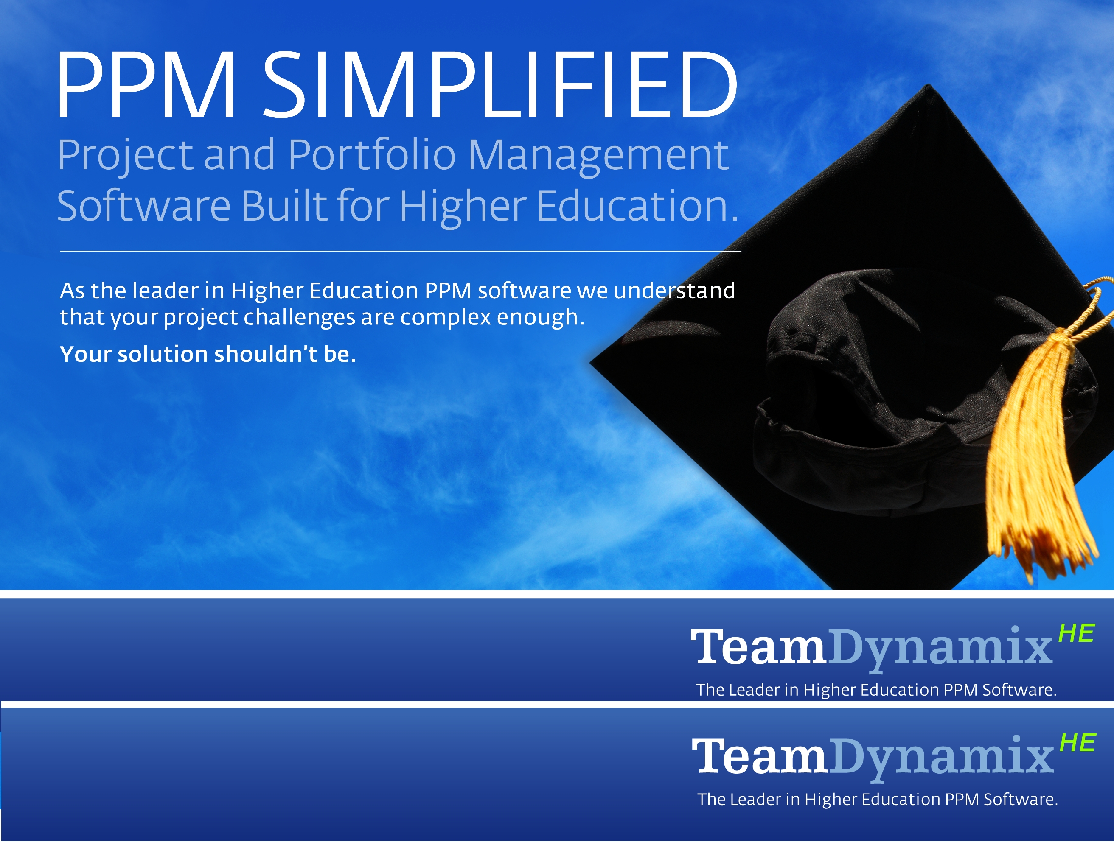

TeamDynamix Overview
TeamDynamix provide Higher Education specific Project and Portfolio Management solutions (PPM). TeamDynamix software and services adhere to a simple and proven higher education specific PPM deployment approach.
Highlights
Built specifically to support the evolution of the Higher Ed PMO
Embedded Higher Ed best practices (ECAR/Spellings)
Higher Education implementation approach (PEMM)
Intuitive solutions
Prioritizing Projects through IT Governance
Sharon Blanton, Portland State
Andrew Graf, TeamDynamixHE

Slide 2

Agenda
Building a Culture of Project and Portfolio Management at PSU
Industry Trends & Practices
Discussion & Questions
www.TeamDynamixHE.com
2
EDUCAUSE West/Southwest 2012

Slide 3
Agenda
Building a Culture of Project and Portfolio Management at PSU
Industry Trends & Practices
Discussion & Questions
www.TeamDynamixHE.com
3
EDUCAUSE West/Southwest 2012

Slide 4
Agenda
Building a Culture of Project and Portfolio Management at PSU
Industry Trends & Practices
Discussion & Questions
www.TeamDynamixHE.com
4
EDUCAUSE West/Southwest 2012

Slide 5
PM & PPM at PSU
Topics:
PSU Context
Legacy Culture
Our Solution
www.TeamDynamixHE.com
5
EDUCAUSE West/Southwest 2012

Slide 6
PM & PPM at PSU: i. Context
PSU
30,000 Students
5,000 Employees
50 Acre Urban Campus
Very Entrepreneurial Culture
100s of Partnerships
www.TeamDynamixHE.com
6
EDUCAUSE West/Southwest 2012

Slide 7
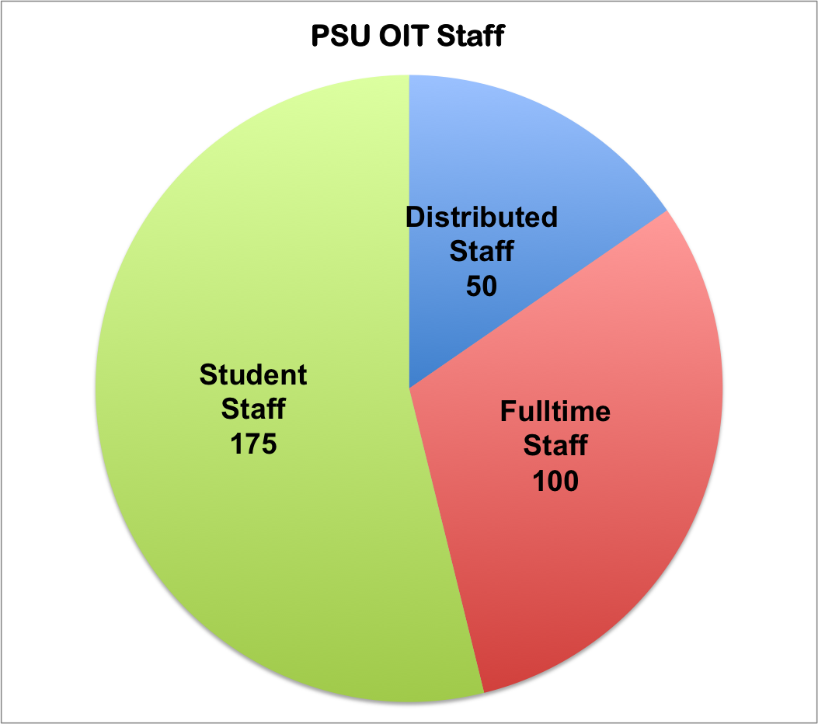
PM & PPM at PSU: i. Context
PSU OIT has a fairly typical IT structure.
www.TeamDynamixHE.com
7
EDUCAUSE West/Southwest 2012

Slide 8
PM & PPM at PSU: ii. Legacy Culture
Multiple Governance Mechanisms:
Advisory Committee for Academic Information
Administrative Priorities Committee
Technology Administrators Group
Office of the CIO
University Strategic Plan
Squeaky Wheel
Strategic 5 Year Plan
Near Term Project Planning Related to ERP
Frontline Staff, Advisors, and Implementers
Annual Planning Cycle
Very General
?
www.TeamDynamixHE.com
8
EDUCAUSE West/Southwest 2012

Slide 9
PM & PPM at PSU: ii. Legacy Culture
Confusion
Multiple governance mechanism with no rollup
Lack of coordinated communication
Lack of view into projects
Perception that everyone else was more loved by OIT
Perception that OIT was really busy but not sure why.
www.TeamDynamixHE.com
9
EDUCAUSE West/Southwest 2012

Slide 10
PM & PPM at PSU: ii. Legacy Culture
Frustration
Uncertain priorities (no comprehensive project list)
Overcommitted staff
Project delays
Lack of progress reporting
Inconsistent use of terms (what is a project vs. a task?)
www.TeamDynamixHE.com
10
EDUCAUSE West/Southwest 2012

Slide 11
PM & PPM at PSU: iii. Solution
Establish OIT Project Management Culture
Training
Use consistent methods
Add PM Staff
Templates
Multi-step Journey: Step 1
www.TeamDynamixHE.com
11
EDUCAUSE West/Southwest 2012

Slide 12
PM & PPM at PSU: iii. Solution
Multi-step Journey: Step 2
Improve Communication
Publish OIT Goals
Use consistent terminology
Provide wiki for project plans
Templates
Tell the story: OIT Achievement Report
www.TeamDynamixHE.com
12
EDUCAUSE West/Southwest 2012

Slide 13
PM & PPM at PSU: iii. Solution
Establish Overarching Governance Framework
Information Technology Advisory Council
PMO (Project Management Office)
Updated Mission, Values, and Vision
Investment Principles
Multi-step Journey: Step 3
www.TeamDynamixHE.com
13
EDUCAUSE West/Southwest 2012

Slide 14
PM & PPM at PSU: iii. Solution
Multi-step Journey: Step 4
Identify & Deploy a Tool that fits new Governance Model
Project Scorecard
Portfolio Overviews
Time Tracking
www.TeamDynamixHE.com
14
EDUCAUSE West/Southwest 2012

Slide 15
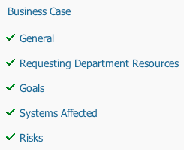
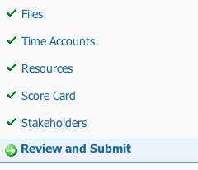
PM & PPM at PSU: Solution
Process
www.TeamDynamixHE.com
15
EDUCAUSE West/Southwest 2012

Slide 16
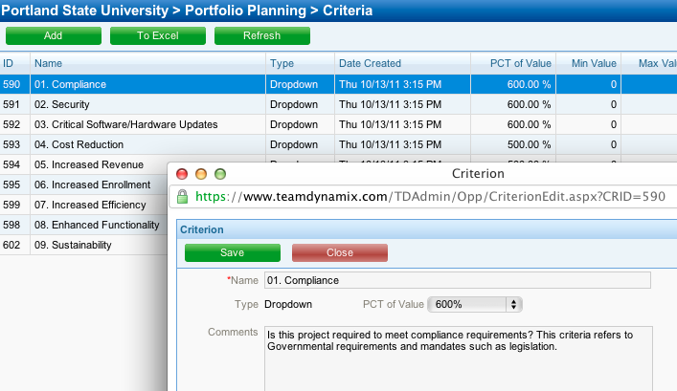
PM & PPM at PSU: Solution
The Scorecard
www.TeamDynamixHE.com
16
EDUCAUSE West/Southwest 2012

Slide 17

PM & PPM at PSU: Solution
Increased Transparency
Increased Communication
Peace, Love, & Harmony
Comprehensive Project Reports
Objective Decision Making
Results
www.TeamDynamixHE.com
17
EDUCAUSE West/Southwest 2012

Slide 18
Agenda
Building a Culture of Project and Portfolio Management at PSU
Industry Trends & Practices
Discussion & Questions
www.TeamDynamixHE.com
18
EDUCAUSE West/Southwest 2012

Slide 19
Industry Trends & Practices Agenda
TeamDynamixHE overview
Governance: Financial Drivers & Impacts
Trends & Practices
Corrective Foci
Environmental Shift (Services)
Key Take-Aways
www.TeamDynamixHE.com

Slide 20
TeamDynamixHE Overview
“To enable college and university IT organizations to achieve their business objectives through products and services that foster operational excellence and exceed expectations”
www.TeamDynamixHE.com

Slide 21



















Client Sample
www.TeamDynamixHE.com
Notes:
Have helped more institutions succeed with PPM than any other vendor
Offer the only extensive and proven Higher Education specific library of PPM implementation templates and process
Product Governance: TeamDynamixHE Advisory Council (TAC)
Higher Ed Governance/PPM Community: TDHE Community

Slide 22
TeamDynamix Overview
TeamDynamix provide Higher Education specific Project and Portfolio Management solutions (PPM). TeamDynamix software and services adhere to a simple and proven higher education specific PPM deployment approach.
Highlights
Built specifically to support the evolution of the Higher Ed PMO
Embedded Higher Ed best practices (ECAR/Spellings)
Higher Education implementation approach (PEMM)
Intuitive solutions
Governance: Financial Drivers and Impacts
Notes:
Let’s look at what is driving the need for better governance and prioritization

Slide 23
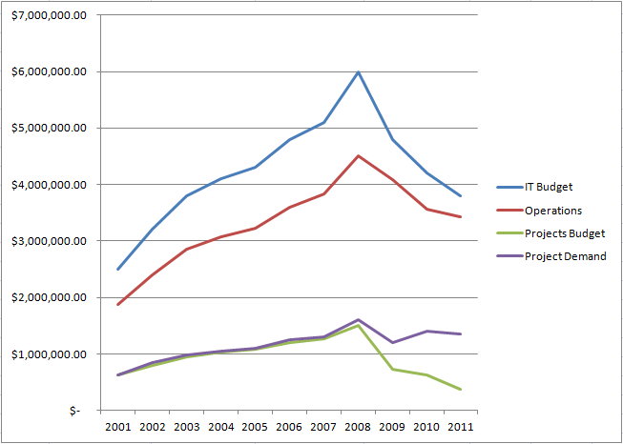


The CIO’s Environment 1999-2011
Innovation Budget (Projects)
CIO
Project Demand

Slide 24
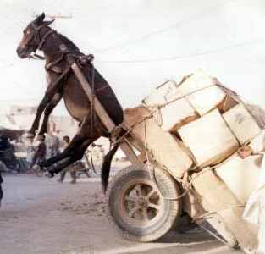


<
Budget
Budget needed to meet demands

Slide 25





President
“We gave you $10M this year. What do you mean you can’t get the work done? Just do your job and figure out how to make it work.”
Deans
CIO
Faculty
Researchers

Slide 26
Problem 1: Stakeholders Have limited Visibility
“I just don’t know what they do with $10M per year”
Stakeholders often have a limited frame of reference and don’t understand the full scope of IT work
Application Management
Learning Management System (LMS)
Student Information System (SIS)
Infrastructure Management
Servers
Content Management System (CMS)
Facilities Management System
Custom Development
Networks
Security
Support Services
Student Help desk
Faculty Help Desk
PC/Phone Mgmt.
Telephony
Admin Services
Application Hosting
Compliance
Project Services (PMO)
Email
A/V Equipment
Security
President
Limited Understanding
Limited Understanding
Notes:
The issues foundation is typically that stakeholders do now really understand what IT does. They have a limited view of the services and support provided by IT. Thus in their mind the de-value the work that IT is doing because they don’t fully understand the work load and constraints.

Slide 27





Problem 2: Stakeholders Find IT Difficult to Engage
“I don’t know how to request a new report. I guess I’ll email my friend Ken. He’ll handle it.”
Web forms
President
“I email requests to IT but never know what happens to them. It’s frustrating.”
Docs
Deans
“I need a new lap top. Who to I talk to. It’s hard to deal with IT. It will probably take forever to get it anyway.”
conversations
Faculty
“For an applications project I email a word doc request. For a hosting request I go to a web site and for an AV need I submit a ticket. What happens to all of my requests or how to check on their status. Wish it was better”
Email
Service Desk
Researchers
Notes:
Another problem we find that lead stakeholders to question IT’s value is that IT seems, to them, to be difficult to work with. Without structure stakeholders will request projects anyway they know how to get the work done. They often do not know who they should really talk to so they revert to their buddies which then overloads the buddy and potentially subverts resource capacity planning efforts. Requesters need to know a. how to request work, b. what to expect, c. how much it will cost and d. when they will see the results. Many stakeholders don’t know what services they can get from IT.

Slide 28
TeamDynamix Overview
TeamDynamix provide Higher Education specific Project and Portfolio Management solutions (PPM). TeamDynamix software and services adhere to a simple and proven higher education specific PPM deployment approach.
Highlights
Built specifically to support the evolution of the Higher Ed PMO
Embedded Higher Ed best practices (ECAR/Spellings)
Higher Education implementation approach (PEMM)
Intuitive solutions
Trends & Practices

Slide 29
Trends: Corrective Foci
Stakeholder Education: Telling IT’s Story
Make it easier to work with IT
Shift macro level decision making (Governance)
Objective prioritization, expectation setting, & scheduling
www.TeamDynamixHE.com

Slide 30
Stakeholder Education: Telling IT’s Story
Increase stakeholders’ understanding of how IT work supports their objectives and measures (services)
Increase stakeholders’ understanding of how IT supports the organization (services & portfolio)
Increase stakeholders’ understanding of the status of work they requested
Increase stakeholders’ understanding of IT’s constraints
www.TeamDynamixHE.com
Notes:
First need to help stakeholders understand IT because many time they do not. Quantity and type of work, Constraints, future commitments, current priorities.
. Factual data increases credibility
-This may be the first step or building the committees and centralizing demand management may be the first step. It will depend on the culture and pains at your institution
-services are articulated from the perspective of the customer. How they consume services (a deep subject in and of itself)

Slide 31
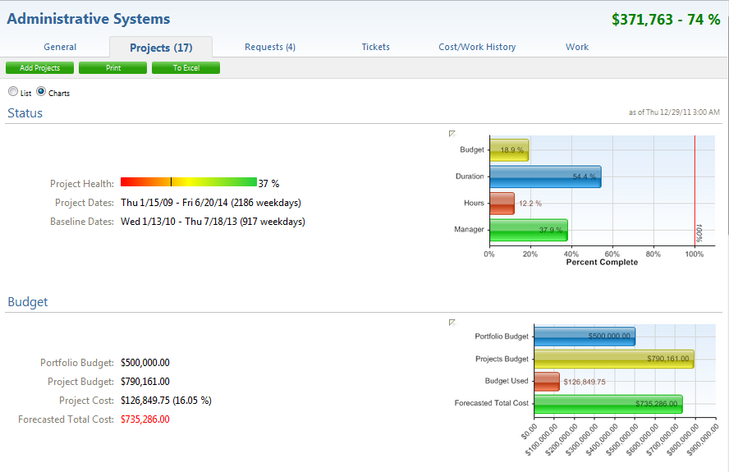
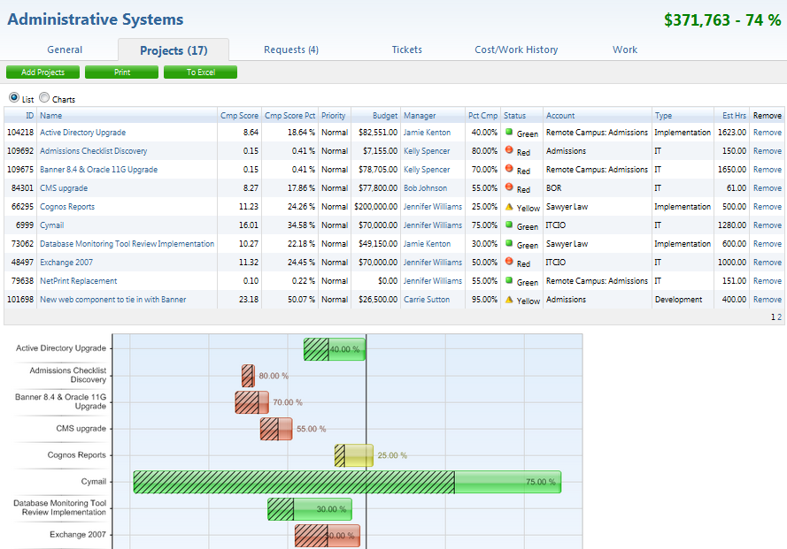
Reporting Example: The Portfolio View
www.TeamDynamixHE.com
Notes:
-Don’t need tools to report. Could use excel or PowerPoint. Doesn’t need to be task level
-Use the concept of a grouping of projects for different audiences. Portfolio, Department specific. One size does not fit all when it comes to marketing IT.

Slide 32
Make It Easier to Work with IT
Simplify the request process
Clearly explain available services and products
Provide one place to make all requests
Make it easy to “order” the offerings
Clearly set delivery & cost expectations
Effective communication of Status
www.TeamDynamixHE.com
Notes:
50-200 catalog items
ITSM tenants come into play and are worth consideration but not 100% necessary

Slide 33
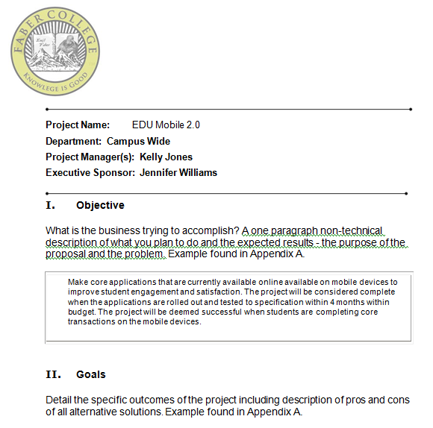
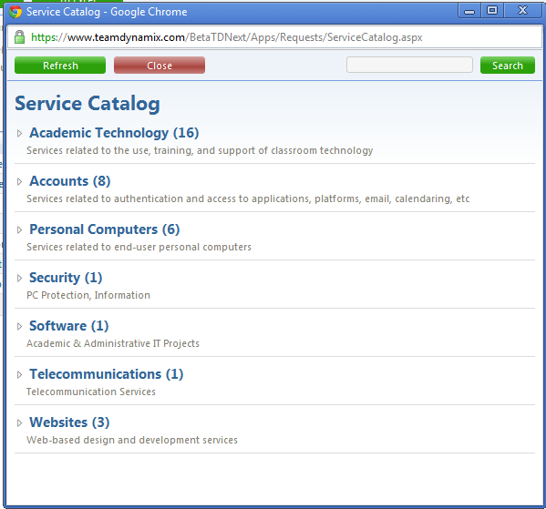
Example: Request Models
Notes:
Could be automated or could be a word document
-leverage templates there are a lot of them out there that have been proven.
Service catalog concept- simple to understand, opportunity to clearly set expectations.

Slide 34
Decision Making Shift: Governance Committees
Many structures (worthy of several presentations!)
Points Requiring Majority Agreement (and/or executive requirement)
Scope of decision making power
Structure of meetings
Frequency of meetings
Information to be prepared for meetings (by whom/when)
Portfolio/Service structures
Agreement creates buy in & self regulation (removing burden from IT)
www.TeamDynamixHE.com
Notes:
These are the very basic key success factors. If it’s not possible to assemble a true governance committee then assemble a committee strictly for the purpose of educating stakeholders. From that foundation we see schools interject suggestions guiding leadership towards accepting or even better suggesting a governance structure.
-If you’d like more information please see me after the presentation

Slide 35
Objective Prioritization, Expectation Setting and Scheduling
Clearly communicate commitments and constraints
Help stakeholders understand the impacts of priority changes
Clearly and factually present the roadblocks to completing requested work
Give Stakeholders objective and tenable choices to make
Timing
Prioritization
Reprioritization
Clearly communicate when work is slated to begin, what the stakeholder’s role is and when work is slated to be completed
Resource adjustments
Budget adjustments
Scope adjustments
www.TeamDynamixHE.com
Notes:
We have already laid a solid foundation by educating stakeholders and establishing guidelines for how work requests are processed. Negotiation and expectation is now easier to facilitate and more successful.

Slide 36
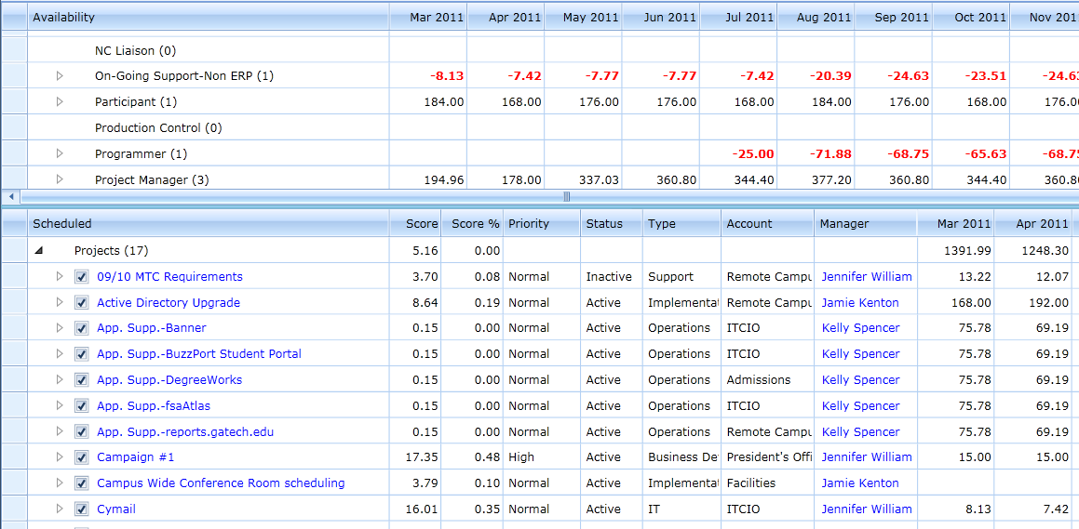
Reporting Example: Impacts of Priority Changes
www.TeamDynamixHE.com
Notes:
Helps explain choices

Slide 37
Trends: Supporting Corrective Foci
Environmental Challenges
Shifting Organizational Models
www.TeamDynamixHE.com

Slide 38
“My team’s work is tracked in many different tools or not tracked at all. I can’t figure out what everyone is doing my self let alone tell IT’s story to the outside world.”
“I can’t begin to confidently schedule prioritized work without knowing what people are working on and for how much time.”
“Work gets requested through so many different channels that determining capacity and then prioritizing is nearly impossible”
CIO
“As priorities change and new work is requested I can’t determine the impacts of the changes to even know where I might drop the ball and without facts I can’t push back on unreasonable requests. I’m stuck in a catch 22.”

Slide 39




How work is typically REQUESTED & TRACKED
Word
Word
Web forms
Support Services
Ticketing Software
Web forms
Ticketing Software
Admin Services
Excel
Excel
PPT
PPT
Email
MS Project
Email
Custom DB
Custom DB
Web forms
Word
Ticketing Software
Web forms
Word
Ticketing Software
Infrastructure Management
Application Management
Excel
PPT
Excel
PPT
MS Project
Email
MS Project
Email
Custom DB
Custom DB

Slide 40



Different Resource = Different Work Streams
Projects
Operations
Operations
Incidents
Projects
Operations
Projects
Incidents
Incidents
Notes:
To tell the WHOLE story work stream boundaries
Resource consumption and work activities are multi dimensional
Projects
“Smaller than a Project” Work
Incidents
All consume resources and drive costs
Required to fully explain constraints and demands
Including all dimensions in reporting increases credibility
Especially helpful when negotiating/justifying IT budgets must be crossed

Slide 41

Individual Administrative Burden
Word
Excel
Custom DB
PPT
MS Project
Ticketing Software
Personal To Do Lists

Slide 42
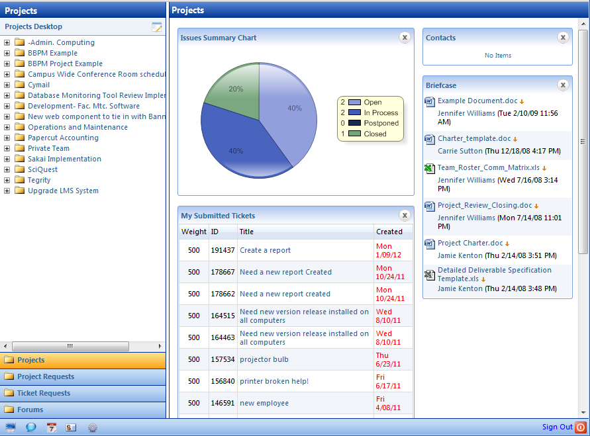






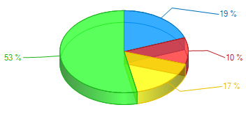
IT Work Stream Management
Work Requests
Work Request Fulfillment Work Streams
Service Catalog
Projects
Productivity
Personal Portal
Email
Routing Logic
Operations & Change Management
Mobile
Web Forms
Community
Web Svcs.
Service Desk
Tickets
Analytics
Notes:
Trending business model. Consolidating work streams. TeamDynamix has aligned the Product Road Map to support these changes

Slide 43
Key Take-Aways
Digestible Bites: Identify and prioritize key operational pains but initially focus on the top 3-5 (work backwards)
Educate Stakeholders about the total value IT provides (projects, ops, help desk)
Make it easy to engage IT (Services, Offerings, Clear Expectations)
Shift macro project prioritization decisions to the customer
Understand constraints to objectively prioritize and schedule project work
www.TeamDynamixHE.com

Slide 44
Basic Required Data
Key service definition (services described as stakeholders consume them)
Work inventory by category (projects, ops retainer, svc desk retainer)
Work inventory by customer
Who is working on what for how long employing which skill sets? (high level)
Project request inventory with required skill sets and allocations
Work and requests aligned with key services/portfolios
www.TeamDynamixHE.com
Notes:
Does not include processes. No time to go into detail.

Slide 45
Proven First Steps
#1: Secure executive support
Identify and prioritize key pains (tackle them first)
Identify the MINIMUM amount of process/tool necessary to address key pains (digestible bites)
Spend time planning for change (cultural change mgmt.)
Communicate regularly (Marketing-frequency and format)
Leverage all stars to create change
Promote successes (marketing creates leverage)
REPEAT!
www.TeamDynamixHE.com
Notes:
Easier said than done. This is what we help clients do.
Much like PSU’s approach
-

Slide 46
Agenda
Managing Stakeholder Expectations while Delivering Quality Services at Carnegie Mellon University
Industry Trends & Practices
Discussion & Questions
www.TeamDynamixHE.com
46
Educause Mid-Atlantic Conference - 1/11/2012

Slide 47
TeamDynamix Overview
TeamDynamix provide Higher Education specific Project and Portfolio Management solutions (PPM). TeamDynamix software and services adhere to a simple and proven higher education specific PPM deployment approach.
Highlights
Built specifically to support the evolution of the Higher Ed PMO
Embedded Higher Ed best practices (ECAR/Spellings)
Higher Education implementation approach (PEMM)
Intuitive solutions
Questions?
Sharon Blanton
sblanton@pdx.edu
Andrew Graf
agraf@teamdynamixhe.com

