Slide 1
Reflecting on Two Years of
iPad Use at Stanford University
School of Medicine
Connect to PSAV NETWORK
PW: EDUCAUSE-PDX
Poll via your web browser: www.rwpoll.com Session id: 854846
Brian Tobin and Joseph Benfield
Stanford University
http://med.stanford.edu/estudent
Educause West, 2012

Slide 2
How is your school supporting mobile devices?
Poll via your web browser: www.rwpoll.com Session id: 854846
No official mobile/iPad initiative
We’re considering an official mobile device initiative
We offer mobile education services, but don’t give devices
We give students mobile or iPad devices

Slide 3
Agenda
Overview and rationale
Deployment
Early results
Lessons learned and future plans
Hands-on demos
Discussions

Slide 4
MD curriculum
MD Curriculum: 4 years
  First 2 years: basic science courses
  Last 2 years: clinical clerkships, rotating monthly through different disciplines
400 MD students, 86 entering per year
Most instructors are “guest lecturers” and teach very little

Slide 5
We gave iPads to students and faculty
August 2010
  86 students received iPads, case, iAnnotate
  30 basic sciences faculty received iPads, case, iAnnotate
August 2011
  86 students received iPads, case, iAnnotate, GoodReader
  10 clinical clerkship faculty received iPads, case, iAnnotate

Slide 6
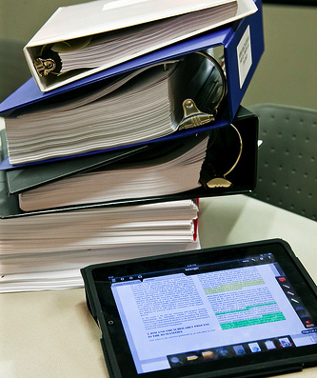
Rationale for iPad initiative
Student readiness
Going paperless and “Green”
New building and infrastructure
Mobile use in clinical settings

Slide 7
We formed implementation team
Office of Medical Education (policies, communication)
  Division of Evaluation (research)
Information Resources and Technology:
Educational Technology (implementation and training)
Desktop Support
Networking (infrastructure)
Information Security
Lane Library (copyright, fair use, content licensing)

Slide 8
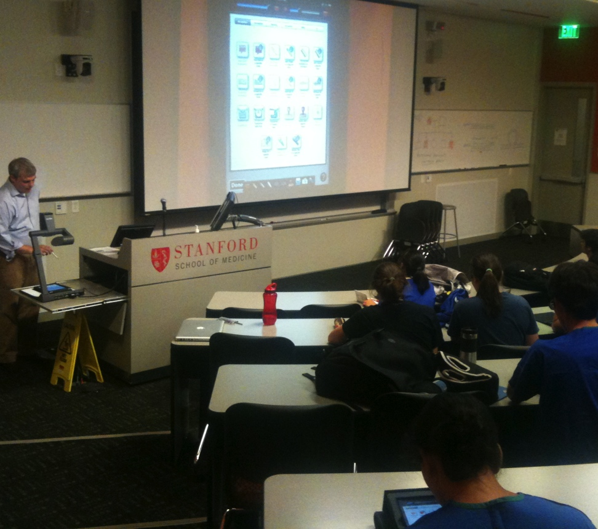
We oriented students
Training on basics
iAnnotate workshop
iPad office hours
Appropriate use discussion
Website:
http://med.stanford.edu/estudent
Notes:
We survey students every year to find out whether they feel tech-savvy, and all students now say they are at least proficient with tech, if not an early adopter

Slide 9
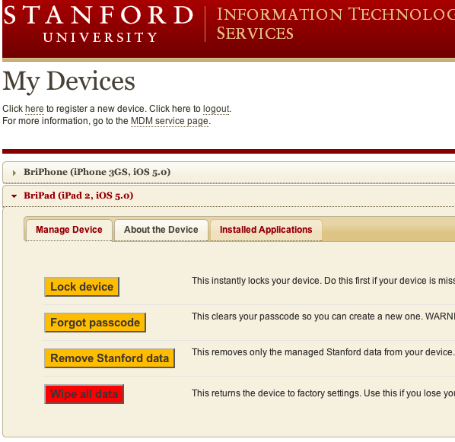
We focused on security
Access but not store clinical data
Log out of EMR
Required passwords via Device Management
Remote wipe
Built-in encryption in iOS

Slide 10
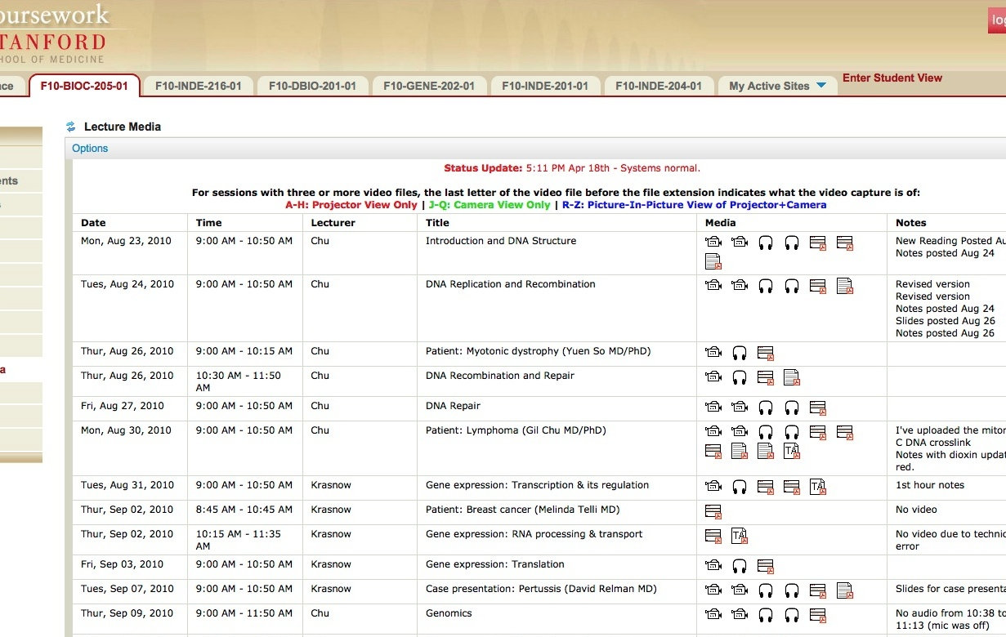
Students used LMS & Mediadropbox to download content to iPad
Notes:
Ensured Sakai learning management system, videos, mp3, course content, all iPad-friendly

Slide 11
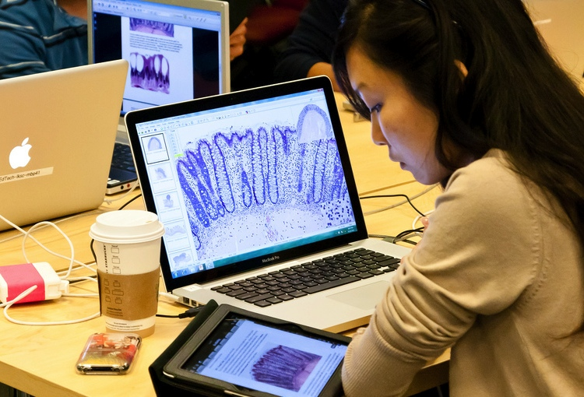
We optimized wireless capacity
New building with 802.11n
Reconfigured entire building after months of issues:
  Planned for 1 wireless device per person, needed 3
  Misconfiguration, allow for “roaming” and more IPs
  8:59am rush to download

Slide 12
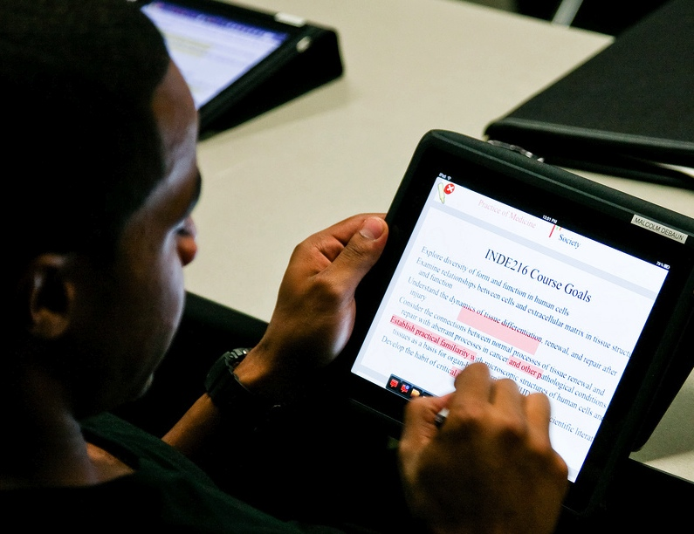
Students annotated PDFs with iAnnotate
PDFs are cross-platform
iAnnotate PDF for
readings, syllabus, slides
Notes:
Add Before/After image

Slide 13
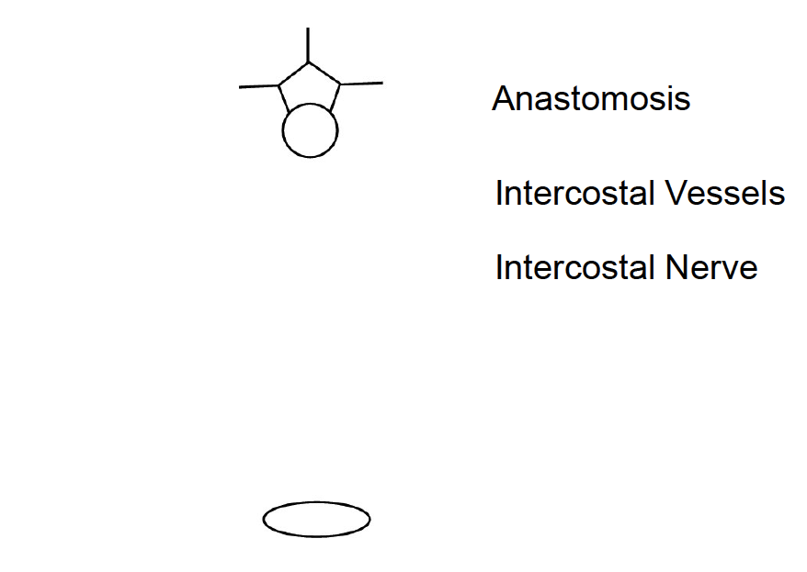
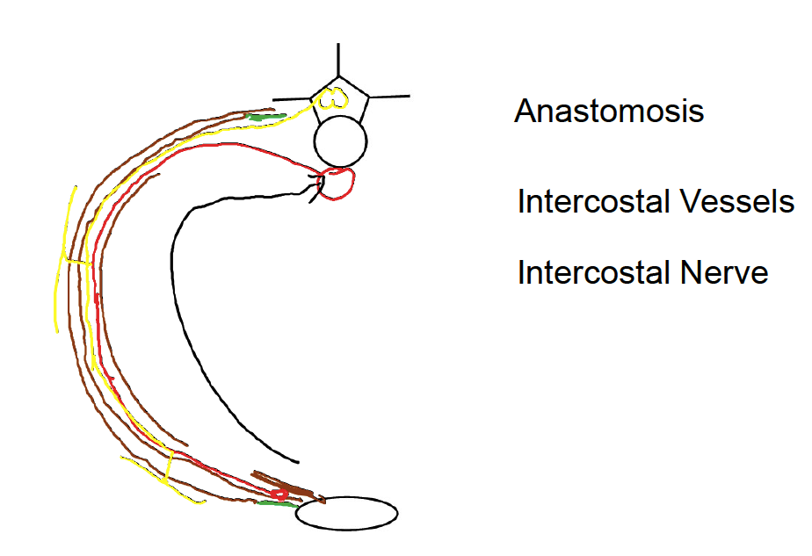
Students used iPads most in Anatomy
Anatomy coloring-book style “notes with gaps”
Stylus is adequate

Slide 14
How would faculty respond to an iPad initiative at your school?
Poll via your web browser: www.rwpoll.com Session id: 854846
Denial: If I ignore them, they’ll go away.
Anger: I can’t believe you expect iPads to change anything.
Bargaining: Let everyone else try it out.
Depression: This is a pain, but I’ll modify materials.
Acceptance: I’m excited to teach better with iPads.

Slide 15
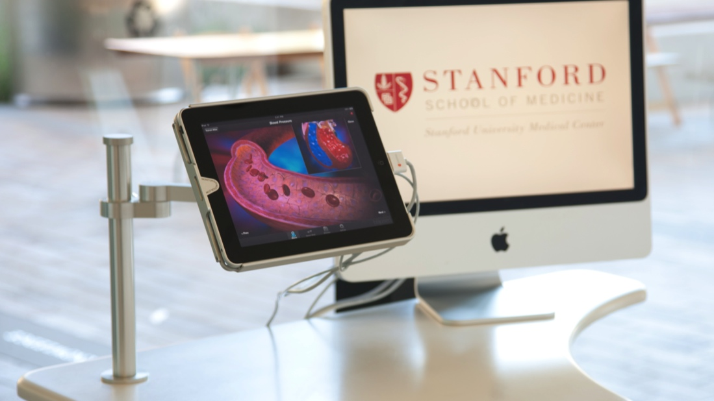
We encourage exploration and innovation
Workshops on mobile educational design principles
iTunes gift cards to faculty
Mini-grants for apps/web apps
Demo station for apps
Encourage students to share recommendations
Notes:
-We know that there’s a lot more to iPads than lecture slide annotation.
-Lots of apps are being developed for the iPad; want to help faculty and students find and build apps most relevant to them.

Slide 16
We’re preparing for clinical iPad use
Pilot in 6 of the 10 required clerkships
Students check out iPads first day of each clerkship
Communicate best practices to the faculty physicians

Slide 17
We’re collecting data
Collecting formative feedback on iPad and technology use through online surveys (qualitative and quantitative)
Tracking iPad usage patterns in required courses and pilot clerkships (in-class observation and self-report data)
Focus group and informal discussions with students
Notes:
How prepared you feel to use ipads in clerkships ADD IN

Slide 18
Results from courses
During AY 2010-2011, overall ratings were mixed.
During AY 2011-2012, survey results suggest the iPad is more important than laptop or paper for use in courses.
iPad was rated positively for studying, reading, drawing and accessing information.
Notes:
How prepared you feel to use ipads in clerkships ADD IN

Slide 19
1st-year students use more iPads

Slide 20
2nd-year students use more laptops

Slide 21
Results from clinical use
iPads are most useful for reading medical literature and looking up reference material on the go
Patient medical records are helpful on iPad, when available
iPad works well for surveying and collecting data from patients
Students need secure space to keep iPad, or a carrying case
Notes:
Add the n which is SMALL

Slide 22
Student quotes (abbreviated)
I didn’t use iPad at first, but eventually started keeping everything on it.
Introduce students to clinical resources on iPads early, then we can use them better in clinics.
We can use iPad at home to check in on patients. It’s also better than fighting for a computer in the hospital.
iPad can be difficult to carry and store versus a smartphone.

Slide 23
Lessons learned - implementation
Roll-out takes time
Faculty response is varied
Each clinic/hospital has different needs
Stylus is not precise on iPad, insufficient for some students
Mobile Device Management offers some control over devices
iPad is a new technology (applications still improving)

Slide 24
Lessons learned - content
Allow content across all devices: print/laptop/iPad
Students generally prefer paper textbooks or cheap PDFs
Interactive content:
  ePub authoring is challenging
  iBook Author is restrictive
HTML5 very good for interactive web apps

Slide 25
Changes we’ve made
For AY 2011-2012
  Clearer goals to students, expectations
  Wireless infrastructure improvements
  Print option for students (opt-in)
For AY 2012-2013
  Proposals: offer keyboard case and stylus options
  AirPlay wireless projector streaming from instructor iPad
  Offer Septris gaming platform for building clinical cases
  Testing ePub / interactive content authoring

Slide 26
Hands-On Agenda
Time to let you experiment with a handful of iPad tools we use.
We’ll cover:
  iAnnotate: document annotation app
  StanMed: clinical reference app
  MDM: mobile device management
  Peripherals: stylus, case, keyboard/keyfolio
  Septris: a web-based game for mobile devices (and others)

Slide 27
Hands-On: iAnnotate
Intro/reminder to Stanford use
Intro to interface
Video
Questions/Discussion

Slide 28
Hands-On: StanMed app
Designed by dept. of Anesthesia @ Stanford
Used as bedside and general reference
Best feature: cache content for places there is no internet access. This is major issue for Anesthesia

Slide 29
Hands-On: Mobile Device Management
What is MDM? A way to help users set up devices quickly, ensure security measures are in place, distribute in-house apps, wipe device remotely if lost or stolen
Stanford MDM – sync email and cal, can view device info remotely
Hoping there will soon be a way to push purchase apps to users

Slide 30
Hands-On: Peripherals
Stylus – examples at your tables
Cases – a lot of options
Keyfolio – growing in popularity for users who do a lot of iPad typing. Considering these for next class of MD students
Other?

Slide 31
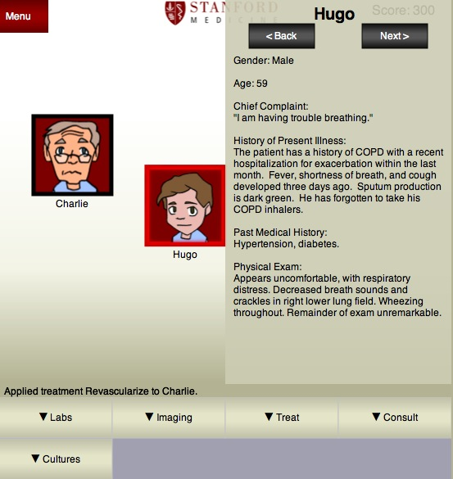
Hands-On: Septris
Mobile web game
http://cme.stanford.edu/septris/

