Slide 1
Discuss with others:
What new approaches is your
campus using to integrate
information literacy into the curriculum?
Notes:
Yvonne
As they walk in, tell them to discuss this.

Slide 2
Innovative Models for Integrating Information Literacy across Campus
Educause
West/Southwest Regional
Conference
Portland, OR
February 22,
2012
Rebecca Blakiston
Yvonne Mery
University of Arizona Libraries
Notes:
2:30-2:35 (Yvonne)
Introduce us
Overview of presentation – 3 ways to integrate IL across campus
Explain what we mean by Information Literacy

Slide 3
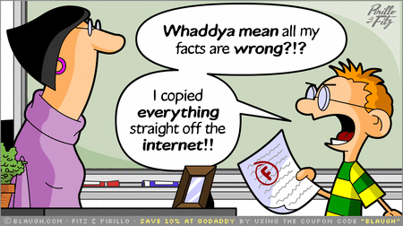
Information Literacy

Slide 4
Let’s Discuss
What new approaches is your
campus using to integrate
information literacy into the curriculum?
Notes:
2:40-2:45 (Yvonne)
Discuss with audience input
UA Problems – budget, staff, large number of students

Slide 5
Model 1
ULIB 197R – The Online Research Lab
ULIB 696A – Information Research Strategies for Graduate Students and Researchers
Notes:
2:45-2:46 (Yvonne)
1st model – online courses offered for credit
Goal of reaching all students their first year.

Slide 6
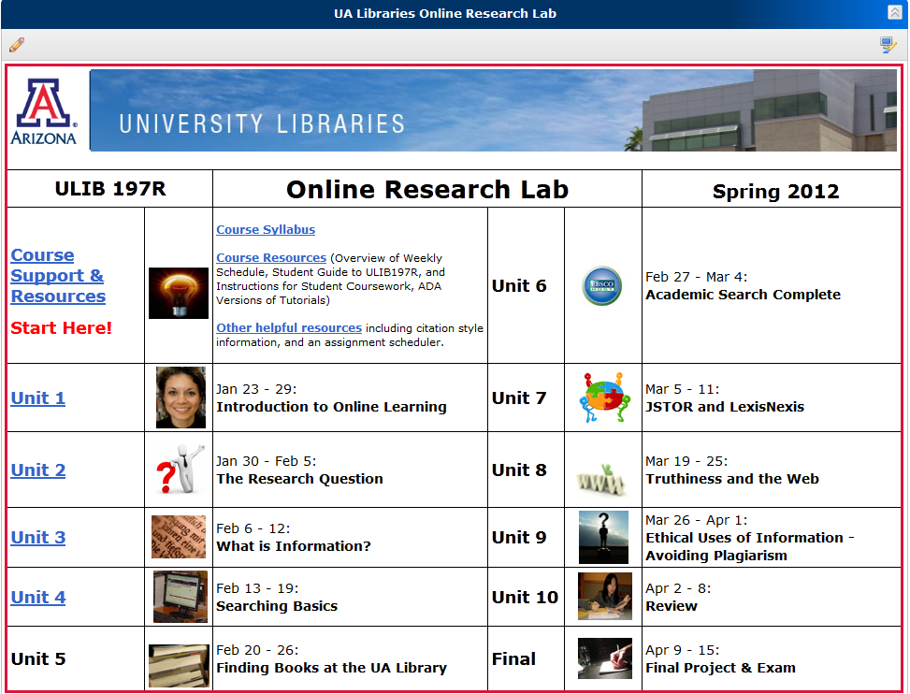
Online Credit Course
Notes:
2:46-2:51 (Yvonne)
Online, one-credit, library grants credit
English 102 alignment – collaboration with department
Goals, audience, curriculum
Delivery TAs
Challenges
Successes – Research Study
The ORL live (demo tutorial)

Slide 7
Is It Effective?
Notes:
2:45-2:46 (Yvonne)

Slide 8
Embed information literacy within foundational research courses to reach all students within a major.
Model 2
Notes:
2:56-3 (Rebecca)
Relationship with History department
History 301 foundational research course; required 3 f2f sessions in the past
Worked collaboratively with history faculty and instruction librarians

Slide 9
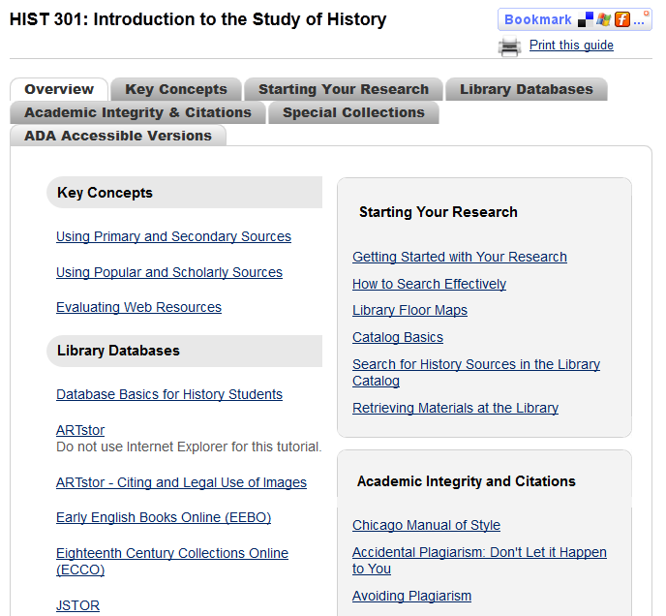
Customized Course Guide

Slide 10
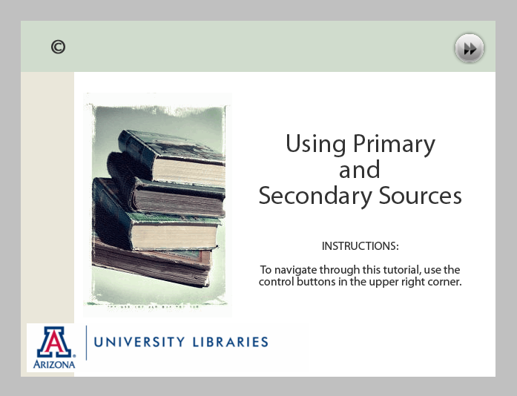
Interactive Lessons
Notes:
3-3:05
Example
Primary & Secondary sources tutorial http://www.library.arizona.edu/tutorials/primary_and_secondary_sources/
Student reads content (which was developed as collaboration with History). A lot of tutorials stop here, but we apply their knowledge in practice scenarios. How important it is to hear from faculty to understand content.
Mention that these are “scalable” to be used in other classes, not dependent on a specific class/assignment. Key concepts.
Side-by-side – Early American Newspapers: http://www.library.arizona.edu/applications/quickHelp/tutorial/americas-historical-newspapers
Also used beyond history major

Slide 11
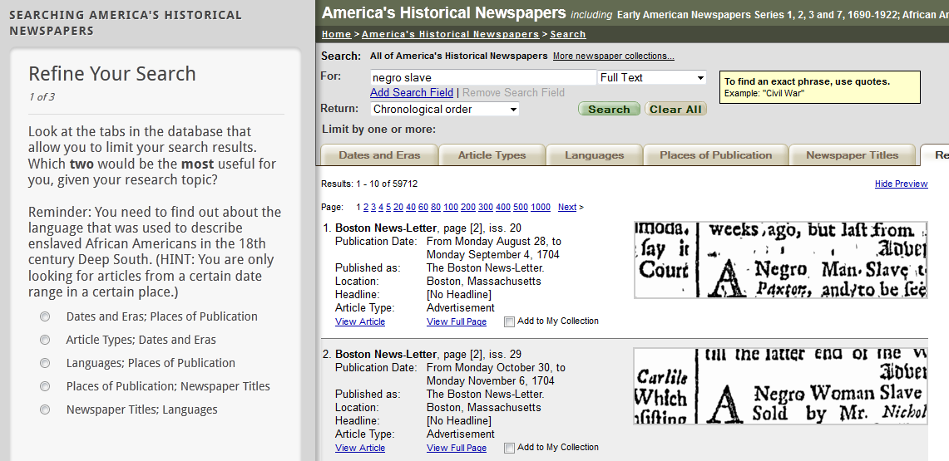
Guides on the Side
Notes:
3-3:05
Example
Primary & Secondary sources tutorial http://www.library.arizona.edu/tutorials/primary_and_secondary_sources/
Side-by-side – Early American Newspapers: http://www.library.arizona.edu/applications/quickHelp/tutorial/americas-historical-newspapers
Also used beyond history major

Slide 12
Model 3
Integrate customized library resources into course management sites globally.
Notes:
3:05-3:10
Have developed course guides individually in the past and subject guides for a particular discipline.
Majority of courses have CMS, D2L
Goal to have seamless access to library resources.
Mapped databases and tutorials to discplines and student level
Now automated in all d2l course sites. Can be customized upon request by faculty.
Show example. ASTR203 example.

Slide 13
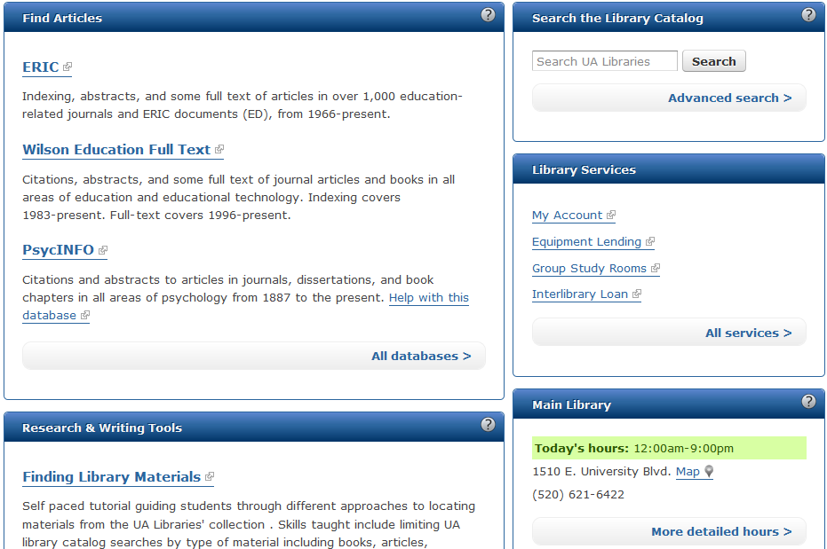
Library CMS Widget

Slide 14

Questions

Slide 15
References
Mery, Y., Newby J., and Peng, K. (2011). “Why one-shot information literacy sessions are not the future of instruction: A case for online credit courses.” College and Research Libraries (to be published May 2012). Pre-print: http://crl.acrl.org/content/early/2011/08/26/crl-271.short
(33% responsibility).
Mery, Y., Newby, J., and Peng K. (2011). “Assessing the reliability and validity of locally developed information literacy test items.” Reference Services Review 39(1). (50% responsibility).

