Slide 1
MyPlan: Challenges and opportunities for supporting online academic planning
Deborah Wiegand, Assistant Dean, Undergraduate Academic Affairs
Curtis Howell, Undergraduate Student, Informatics and Business
Jill Yetman, Manager, UW-IT Academic Services

Slide 2
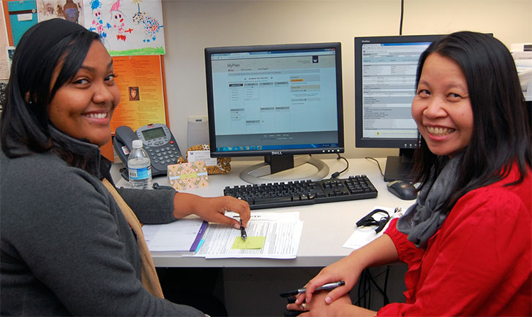
What is MyPlan?
Planning and communications platform
Notes:
Students and advisors
UW-IT on Kuali Student

Slide 3
Demo
Student Experience
Information Challenges
Role of Advisor
Shared Ownership
Q&A

Slide 4
Demo

Slide 5
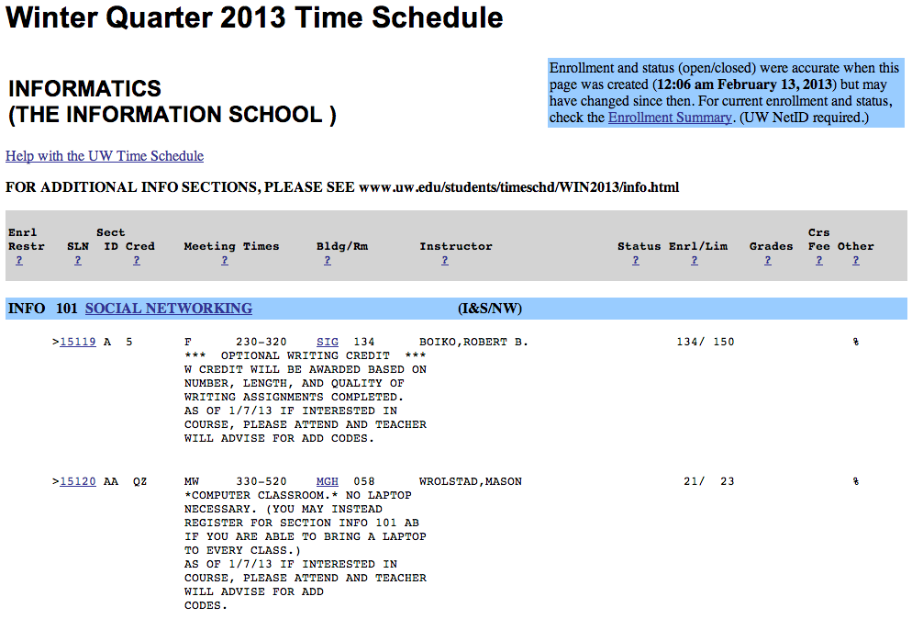
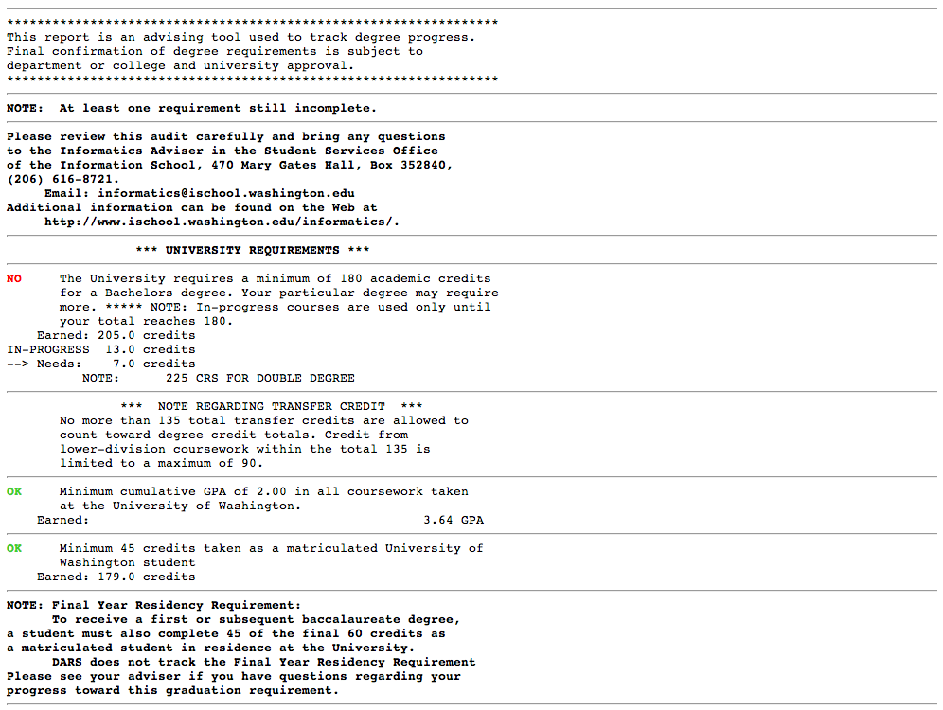
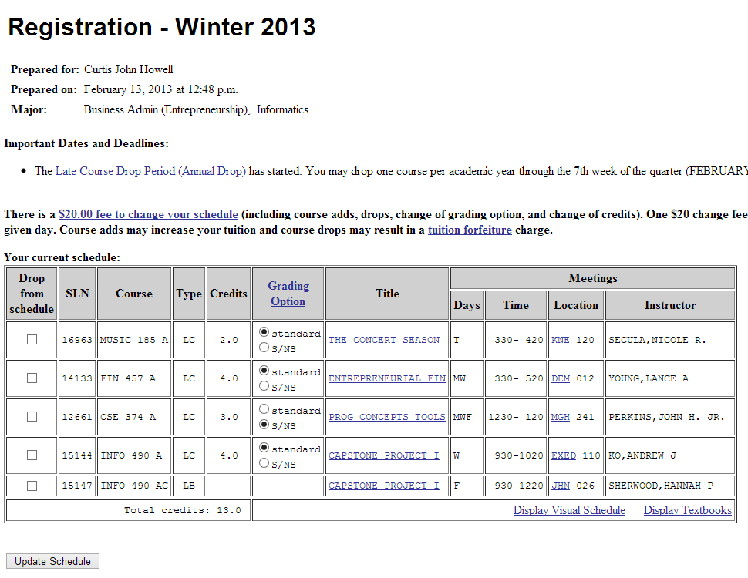
Student Experience
Notes:
Funded by students
Expectations of modern web experiences
Flexibility- students can add courses from multiple locations and can bookmark a class if they aren’t ready to choose a quarter to take it

Slide 6
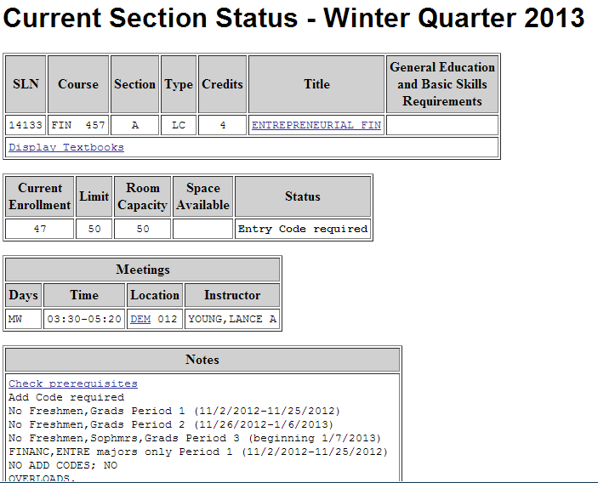
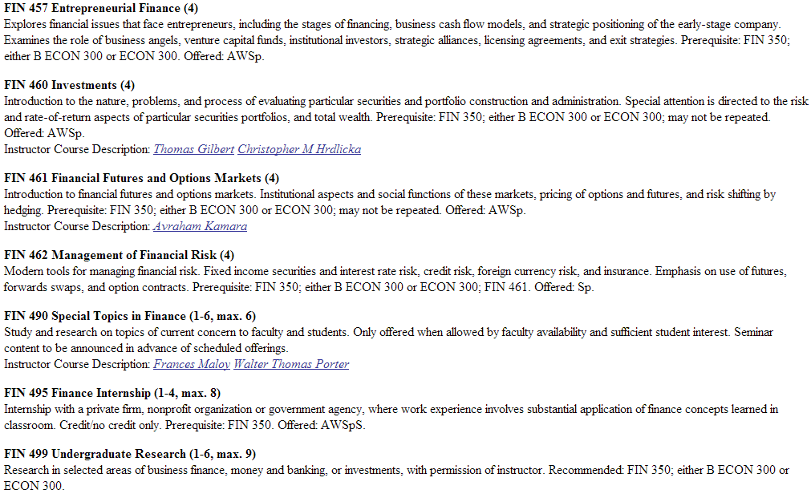
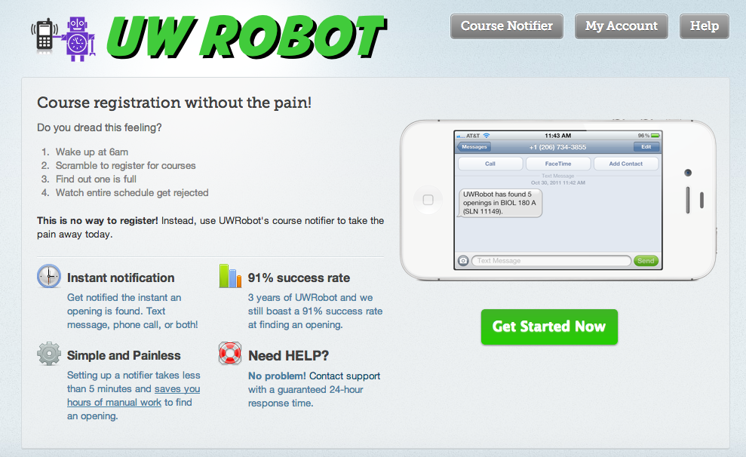
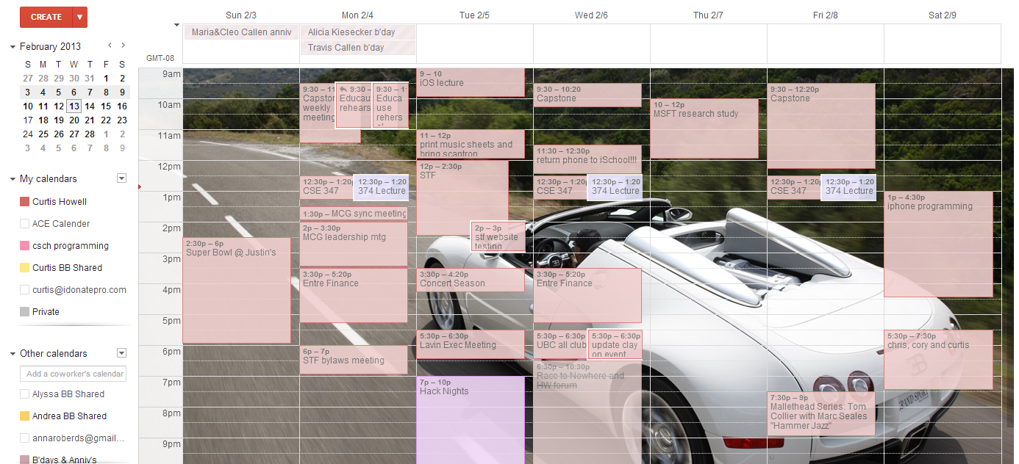
Fragmented Workflow
I need more than 15 web pages to register each quarter
Notes:
UW robot- 3rd party tool because IT doesn’t provide course availability notification service, but 3rd party tool too taxing on server resources

Slide 7
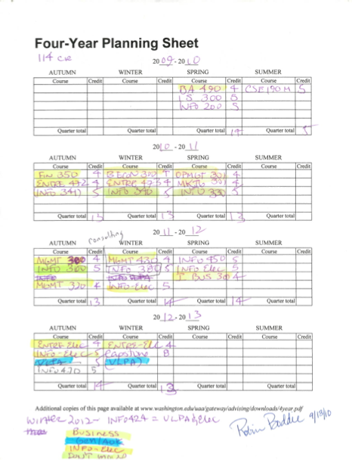
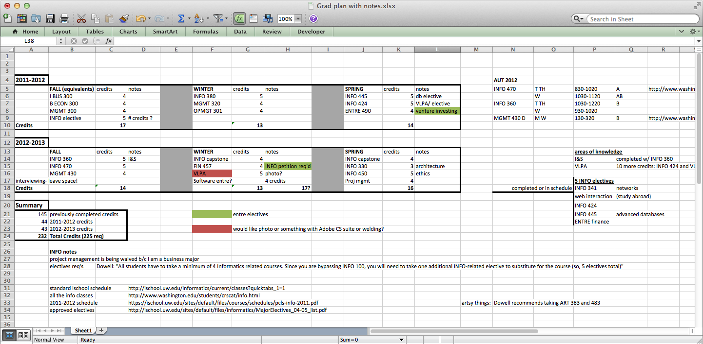
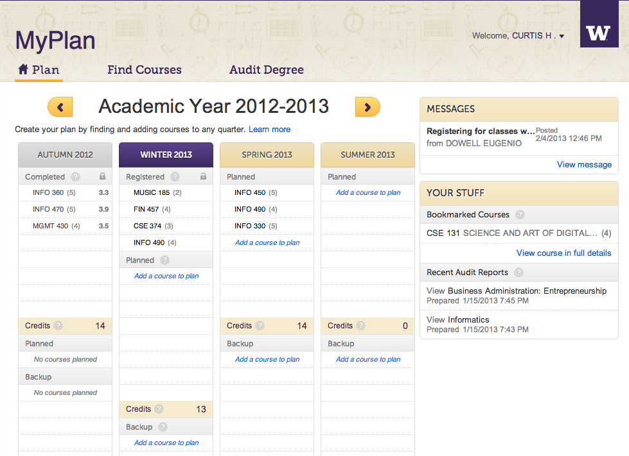
Efficiency
 | Editable | Connected
Paper grid
Excel
MyPlan
Excel
MyPlan
Paper grid
Notes:
Connected to advisors and course database

Slide 8
Information Challenges
Technical complexity and obstacles are a given
Political, organizational barriers are key to collecting and displaying centralized information
Solutions require patience, creativity, and negotiation

Slide 9
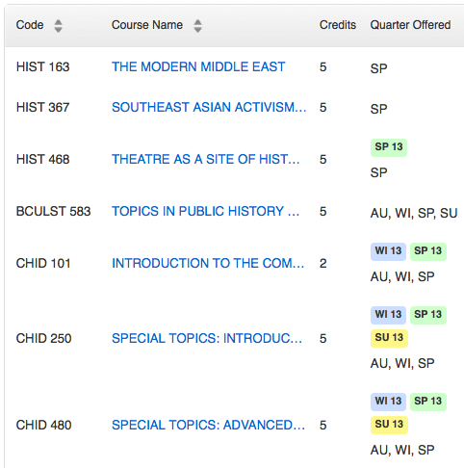
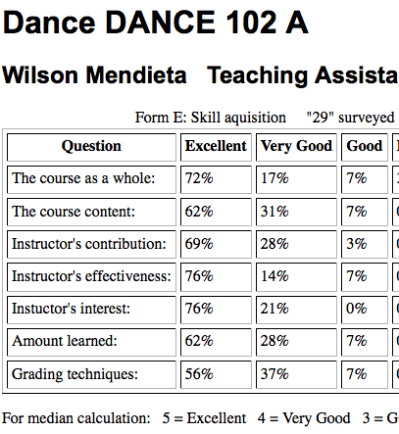
Students <> Current Processes
Quarter projected
Course evaluations
Notes:
Two examples on screen.

Slide 10
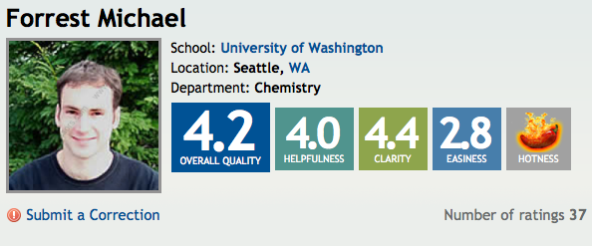
Students <> Institution
The information students want to see in MyPlan doesn’t 100% align with what the university can sponsor
Notes:
student comments on instructors and courses
grade distribution for instructors and courses
student demographics in a class
courses not offered
courses a program would accept for degree requirements

Slide 11
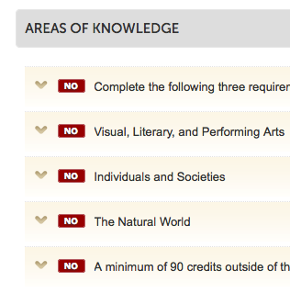

Departments <> Departments
Arts & Sciences
Nursing
Notes:
Centralized tool pushes on former practices. Tension amongst departments.
course last offered
degree audits are encoded very differently across programs
time schedule and course catalog data fields are not always used consistently
perceived need for customization; concern/fear of standardization

Slide 12

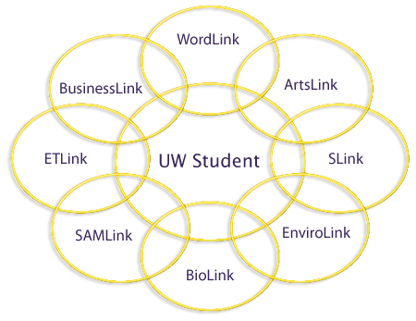






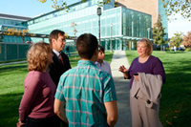

Customization <> Consistency
The Graduate School
The University of Washington has been awarding graduate degrees since 1885. Currently, at all three campuses, there are over 11,500 graduate students enrolled in 346 graduate degree programs – and many more areas of study.
SCHOOL OF SOCIAL WORK
UW School of Nursing
UW School of Law
Leaders for the Global Common Good

Slide 13
Customization <> Consistency
SCHOOL OF SOCIAL WORK
The Graduate School
The University of Washington has been awarding graduate degrees since 1885. Currently, at all three campuses, there are over 11,500 graduate students enrolled in 346 graduate degree programs – and many more areas of study.
SECOND LAW OF
HIGHER EDUCATION:
The entropy of THE U
must increase!
UW School of Nursing
UW School of Law
Leaders for the Global Common Good

Slide 14


Students >< Adviser
WHO’S IN CONTROL?
Messaging
Permissions
Plan approval
Modifying plans
PROGRAM STRUCTURE
Cohort vs. random walk
Templates

Slide 15
< Shared Ownership >
ENGAGING STAKEHOLDERS
WHO? WHEN?
GOVERNANCE STRUCTURE
SHARED DECISIONS
ACCEPTANCE & ADOPTION
FOSTER CHANGE

Slide 16
QUESTIONS?
THANKS
FOR
LISTENING

