Slide 1


Research Information Management Systems
Scholarly Assessment in Transition
Educause West/Southwest Online Conference
Jeremy McLaughlin
Director of Sales, North America
Symplectic Ltd.
Jeremy.mclaughlin@symplectic.co.uk

Slide 2


Symplectic was founded in 2003 in London, UK to serve the needs of researchers and research administrators.
In December 2010, Symplectic became a portfolio company of Digital Science, a business unit of Macmillan Publishers Ltd.
Symplectic Elements is a Research Information Management system that allows universities to easily pool data from different sources and verify data.
Symplectic Elements is in use in Australia, New Zealand, Japan, UK, and the US.
www.symplecticelements.com

Slide 3


Research Administration/Evaluation
IT
Faculty
Library
Administration

Slide 4
Research Administration/Evaluation
--Bibliographic Data and Impact – Evolving
--Standards and Access – Innovation
--Future Considerations

Slide 5






Bibliographic Data
Management of research information data is tough!
De-centralized needs and
practices
Author name
disambiguation
Data infrastructure and
normalization

Slide 6

Bibliographic Data
Management of research information data is tough!
What counts as research output? When?
-Publications
-Data
-Negative results
-Pre-publication
-Data Management Planning

Slide 7



Impact
Measuring individual and institutional influence
1970s
2013
*Thomson Reuters

Slide 8


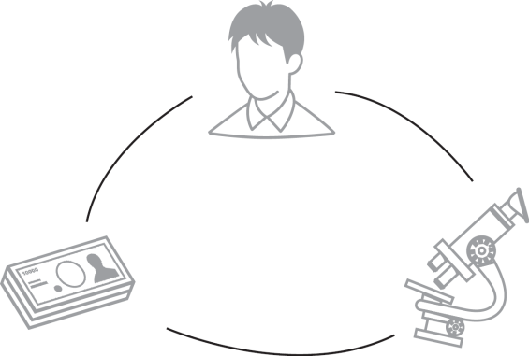
Standards
Interoperability and data exchange
Standardization – what is necessary to
define people, objects, relationships
Relate research outputs to funding

Slide 9






Access
Visibility and re-use of research information

Slide 10
What next?
--Institutional and National/Global Standards!!
--Centralized/Aggregated institutional research gathering
--Contextualize and tie to other initiatives
--Minimize interaction: single point of access integrated with daily workflow
--Support open access for publications and data management plan
--Reuse data and collaborate

Slide 11
Research Information Management Systems
Scholarly Assessment in Transition
Educause West/Southwest Online Conference
Thank you!...
Questions?
Jeremy McLaughlin
Director of Sales, North America
Symplectic Ltd.
Jeremy.mclaughlin@symplectic.co.uk
www.symplecticelements.com

