Slide 1


ELI Online
Participant Orientation Session
January 24, 2013
From Denver, Colorado
Notes:
V

Slide 2

Today’s Orientation
Online Annual Meeting
Program
Virtual Conference Center
Getting Ready
  Technology
  Credentials
Team Resources
Questions?
Sneak Preview
Notes:
V

Slide 3
Online Meeting Overview & Agenda
Notes:
V

Slide 4

ELI: Third Online Meeting
Responding to members
Modeling the way
Expanding the community
Bringing outstanding content to your campus
Notes:
V

Slide 5
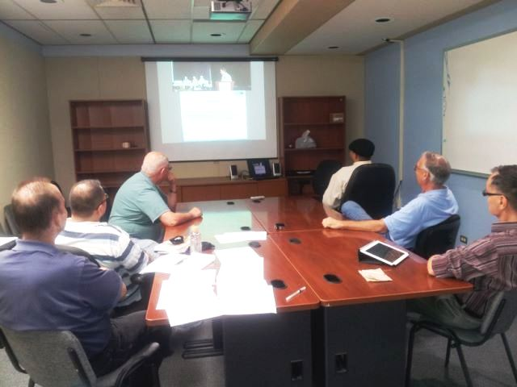
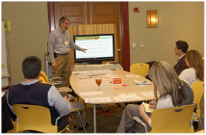
Registrants
2012: 106
  Teams of 1 to 50+; exposure close to 380 individuals.
2013: 75, on track to surpass 2012
  56 institutions
  27 states plus Canada and the United Kingdom
Notes:
V

Slide 6

Our Largest Online Program --
Over 40 Sessions and Seminars
Webcasts
  General Sessions (4)
  Featured and Concurrent Sessions (26)
Exclusive Online Content
  Preconference seminars (2)
    Requires an additional fee.
  Online Sessions (9)
Notes:
V

Slide 7

New Features
Digital Poster Gallery
ELI Central Online
Questions for the Profession
Digital Badges
  12 available badges
  http://www.educause.edu/eli/events/eli-annual-meeting/innovation-and-networking
Notes:
V

Slide 8
Virtual Conference Center

Slide 9
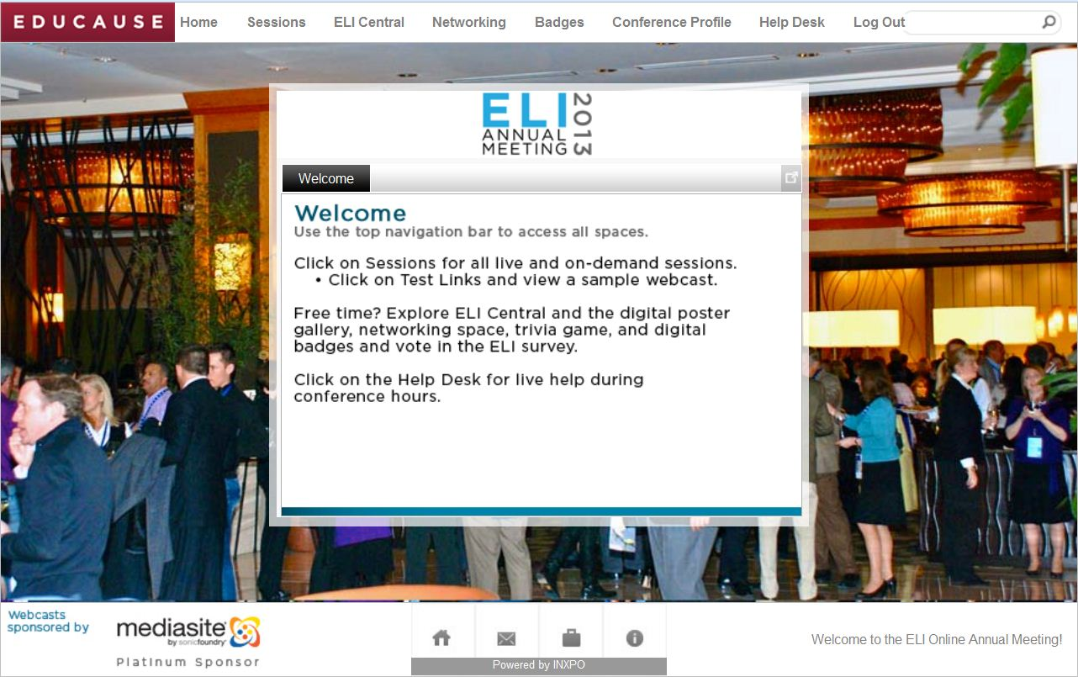

Slide 10
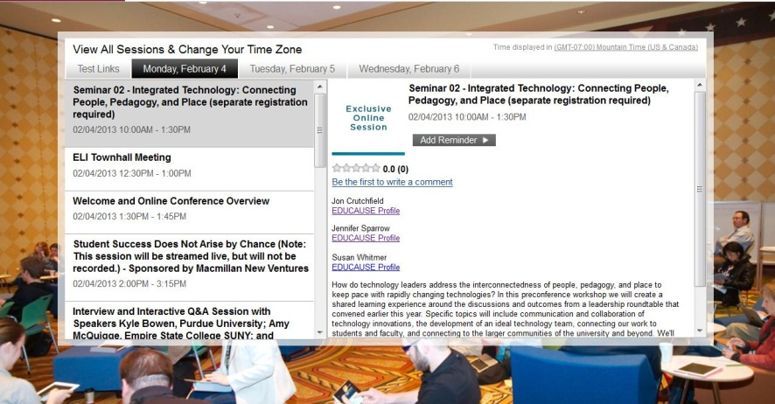
Sessions
All live and recorded presentations
On-Demand
  NOTE! Within 15 minutes to 3 hours; uploaded during 30+ minute breaks.
  Private for 90 days
    Virtual Conference Center
    Recordings Page
  Public after 90 days

Slide 11
Session Tips
Set your default time zone on both the website and in the Virtual Center
Click on each day’s tab
Add sessions to your calendar
  Note: Use the EDUCAUSE site to access the itinerary builder and iCalendar download. http://www.educause.edu/eli/events/eli-annual-meeting/program/online-agenda
  Title, speaker name and profile link (contact info and bio), abstract
Evaluate sessions

Slide 12
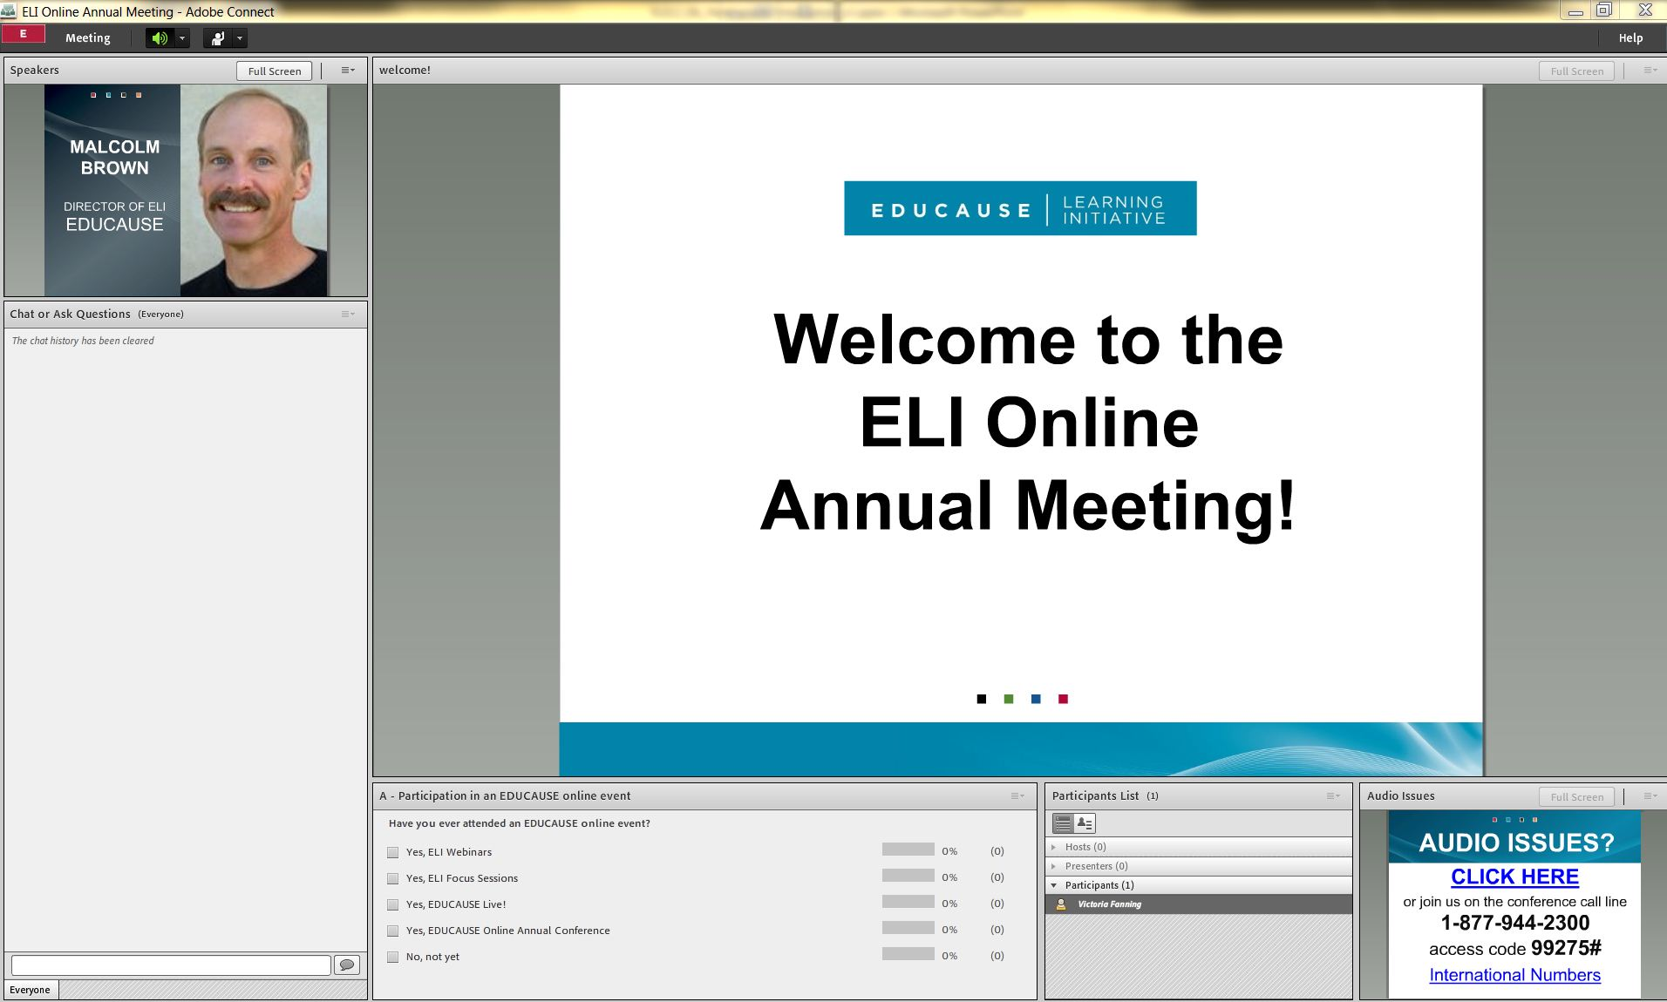
Exclusive Online Sessions
Speaker
Chat and ask questions
Answer Polls
Roster and 1:1 Chat

Slide 13
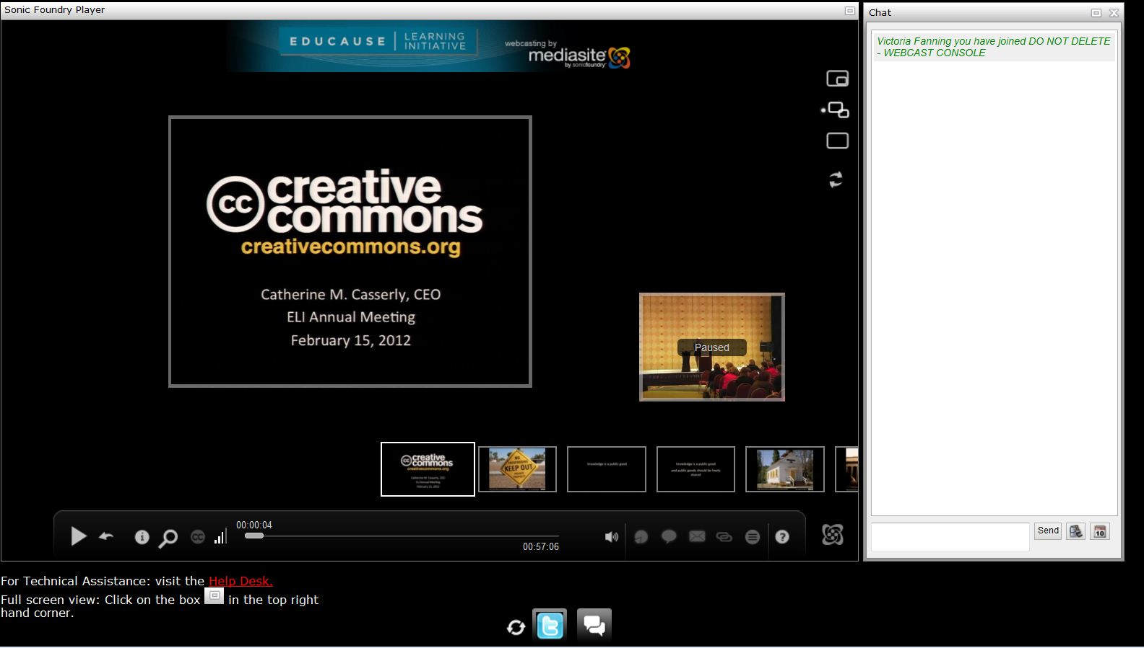
Webcasts: Sonic Foundry

Slide 14
Webcasts: Optional Pods
Chat: Chat and submit speaker questions
  Session moderators are in EVERY room
Twitter (optional)
Help Desk
  TIP!: Open, close, maximize and move pods on your own.
  Mediasite Player: 6 viewing options plus full view

Slide 15
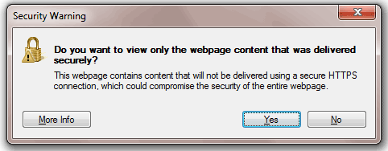
Webcasts: Technical Note
Internet Explorer, Firefox, Safari
  Virtual Convention Center = https
  Webcasts = http
  Click View Now: You may get a warning message
    Do you want to view only the webpage content that was delivered securely? No = I also want to view http page
    Only secure content is displayed. Yes = show all content

Slide 16
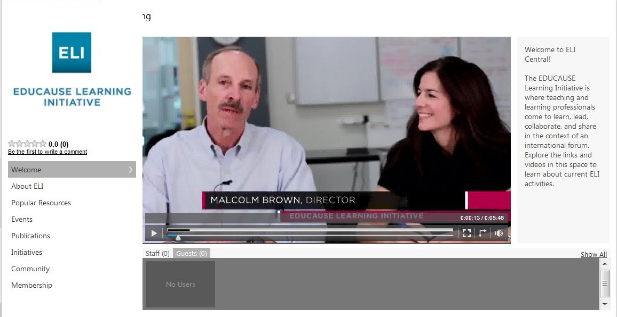
ELI Central Online

Slide 17
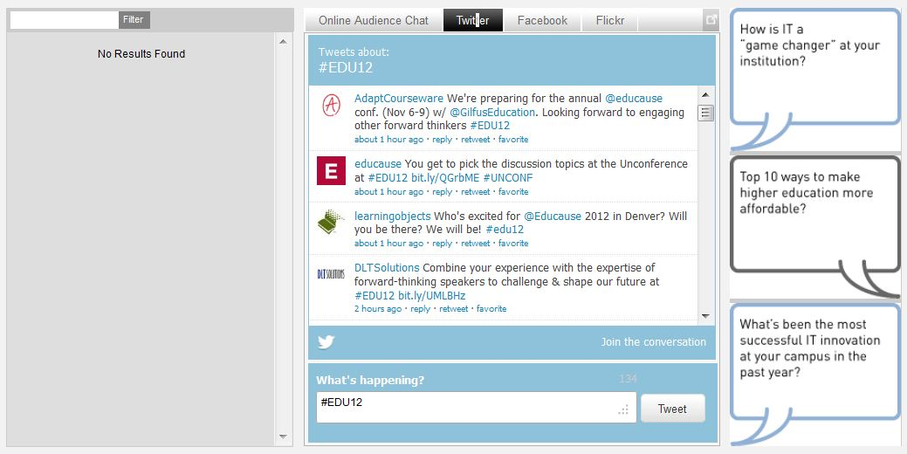
Networking
Online Participant Chat
  Answer “Questions for the Profession”
Twitter #eli2013
Facebook
Flickr: Tag photos eli2013
YouTube

Slide 18
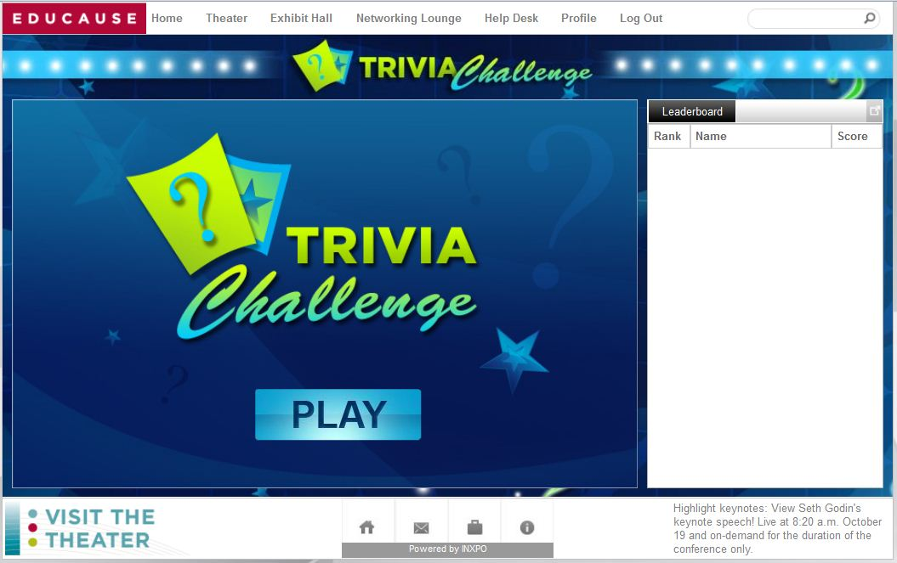
Game Room
Trivial Pursuit
  Campuses in attendance, Denver, IT, EDUCAUSE, Movies
  No google searches allowed!
  Time counts ☺

Slide 19
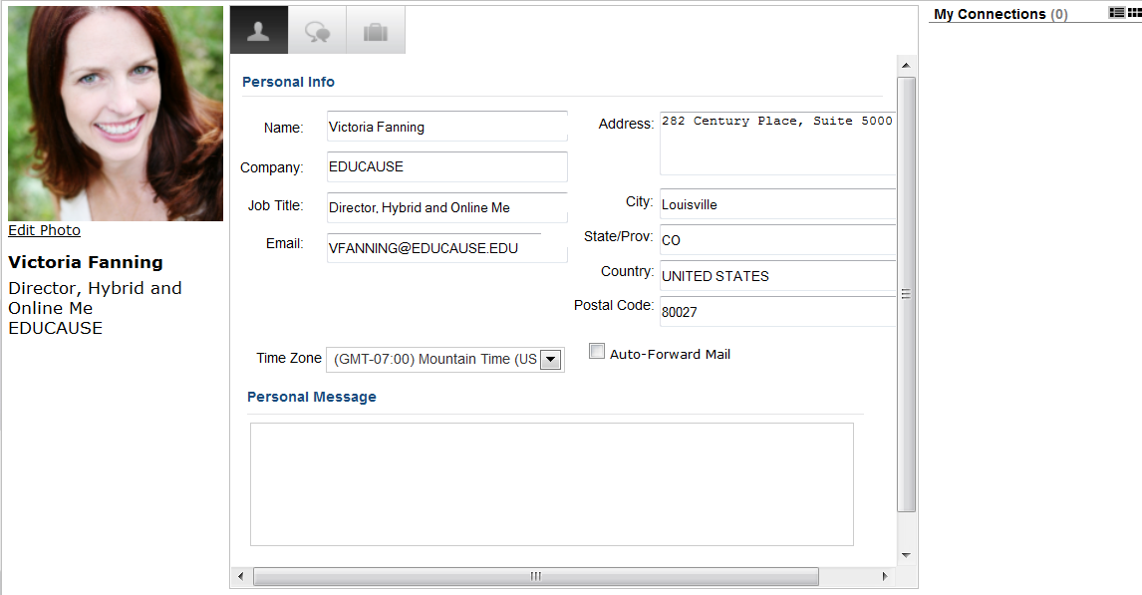
Profile Page: Conference Profile Only
Individuals: Upload your picture
Teams: Upload a team or campus picture and change your name
Communicate: Chat, e-mail, Vcard
Changes do not affect your EDUCAUSE profile.

Slide 20
Assistance & Help
Registration or profile help: info@educause.edu
Program or general questions: onlineconf@educause.edu
Virtual Conference Center or Webcast Help: Help Desk during conference dates and times
Adobe Connect: Write to _Technical Help

Slide 21
Technology & Credentials

Slide 22
Technology Preparation http://www.educause.edu/eli/events/eli-annual-meeting/program/technical-requirements
A high-speed WIRED connection
System checks:
  Virtual Conference Center (port 1935 or 80 must be open)
  Mediasite Player
  Adobe Connect
Phone for online sessions (back-up)
NOTE: Mobile devices are NOT supported

Slide 23
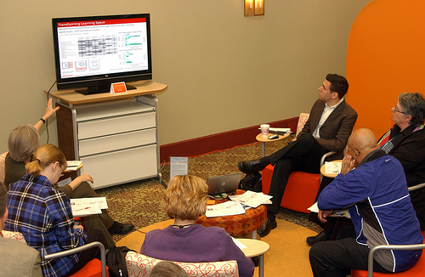
Technology and Teams
Screen
Projector
3 systems checks: On the computer you plan to use
Conference phone: Back-up for Adobe Connect

Slide 24
Credentials
Virtual Conference Center:
  Username/Password sent via e-mail on January 23 and 31.
  They will not change.
  EARLY OPENING (today & Jan. 31–Feb. 1): Test your credentials and your audio/video connections on the computer and in the room you plan to use.
Preconference Seminars
    E-mail from vfanning “Log In Information for Your Preconference Seminar” on January 31.

Slide 25
Team Resources

Slide 26
Resources Page
EDUCAUSE On Campus
Campus Flyer
Vote on which sessions to watch

Slide 27
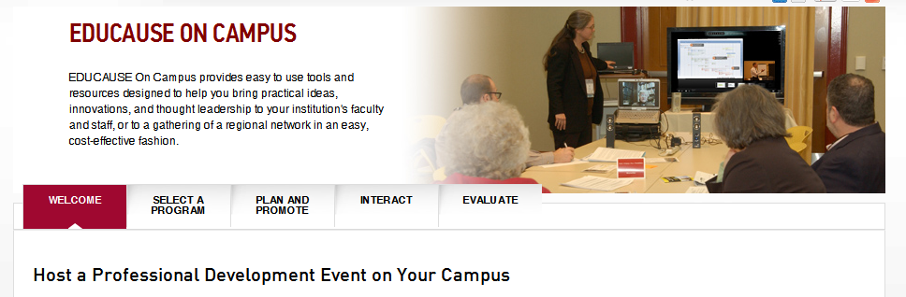
What is EDUCAUSE On Campus?
Easy to use tools and resources to offer affordable EDUCAUSE professional development events on your campus –
http://www.educause.edu/conferences-events/educause-campus

Slide 28
Options
Select a program
Interact
Online events
Content kits
Discussion/Facilitation guide
Tips
Strategies
Building community
Plan and Promote
Checklist
Pre-event survey template and tips
E-Mail template
EDUCAUSE logo
Poster
Evaluate
Questions
Online survey tools

Slide 29
Webcasting Sponsor
Platinum Partner
www.sonicfoundry.com

Slide 30
Questions?

Slide 31
Visit the Virtual Conference Center and test your system today.
Early Opening: January 24, 31 and February 1 (closed Feb. 2-3)
Live and On-Demand
  February 4–April 26: Full environment open & access to the private recordings page
  April 26–2016: Recordings, mp3 and mp4s in the EDUCAUSE Public Library

