Slide 1
Clickers AND CATS
Using Learner Response Systems for Formative Assessments in the Classroom
Copyright Charlotte L. Briggs ©2010.This presentation is the intellectual property of the author. Permission is granted for this material to be shared for non-commercial, educational purposes, provided that this copyright statement appears on the reproduced materials and notice is given that the copying is by permission of the author. To disseminate otherwise or to republish requires written permission from the author.
Contact: Charlotte L. Briggs, University of Illinois at Chicago, clbriggs@uic.edu.
Notes:
Presentation Length: 30-40 min for presentation alone; 60-90 minutes with interactivity.
Audience: This presentation is intended for groups of faculty who are familiar with using clickers in the classroom, and who know how to make clicker slides, but who would like more ideas for using clickers in educationally sound ways.
Additional Materials:
Copies of Angelo & Cross (1993) Classroom Assessment Techniques
Clickers & CATs Table handout
CATs Worksheet
Clickers

Slide 2
What’s it about?
Nope!
Not kitties!
Photo: Charlotte L. Briggs, 2007.

Slide 3
CATs with Clickers
University of Colorado—Boulder 2010
Image: Jossey-Bass 1993
Notes:
CATs stands for Classroom Assessment Techniques, a well-tested set of activities for assessing how things are going in a class. CATs are ways for instructors to quickly get feedback from students to help make immediate adjustments to improve teaching and learning. CATs are a powerful supplement to end-of-course evaluations, which are useful only for making improvements the next time a course is taught.
This presentation is about using clickers to conduct CATs.
If you’re familiar with clickers, it will introduce you to a new way to use them.
If you’re already familiar with CATs, it will encourage you to try them with clickers and give you a handout to help you find the CATs that can most easily be conducted with clickers.

Slide 4
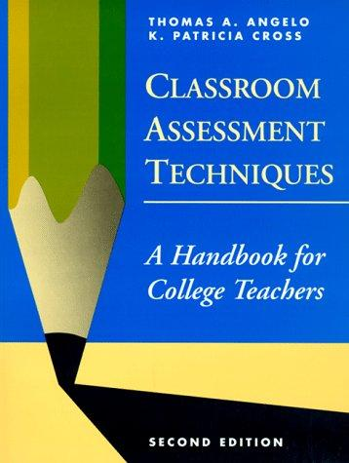
How much do you know about CATs?
Could have written the book myself
Have used CATs in my own teaching
Heard of them, but haven’t used them
Never heard of them
Actually, I know a lot about CATs: Garfield, Morris, Cheshire, Krazy…
Jossey-Bass 1993
Notes:
CLICKER SLIDE: Please convert this to a clicker slide using your own clicker software.
Use this clicker exercise to:
Role model a “prior knowledge probe” CAT with clickers (You don’t need to point this out to your participants now. Just let them experience it, and then you can refer back to it later.)
Determine your participants’ level of familiarity with CATs
Identify any participants who have experience with CATs
Elicit a few examples of CATs used by participants (make sure they understand that they don’t need to be examples that used clickers)

Slide 5
How much do you know about clickers?
Nothing
Seen them on “Who Wants to be a Millionaire”
Experience only as student/audience
Experience as instructor/presenter
Hey, I invented clickers
Photo: University of Colorado at Boulder, 2010
Notes:
CLICKER SLIDE: Please convert this to a clicker slide using your own clicker software.
Use this clicker exercise to:
Role model a “prior knowledge probe” CAT with clickers (You don’t need to point this out to your participants now. Just let them experience it, and then you can refer back to it later.)
Determine your participants’ level of familiarity with clickers
Identify any participants who lack experience with clickers so you can pair them up later with experienced clicker users
Elicit a few examples of how participants are using clickers. As you progress with your presentation, you might be able to point out examples that are or are not CATs or that are a good example of a particular type of CAT.

Slide 6
This presentation was designed for those who…
Want more ideas for educationally sound uses of clickers
Would like to use clickers for formative assessment
Would like to use clickers to gather evidence of teaching quality for tenure or promotion
Have some experience using clickers
Know how to construct a clicker slide
Notes:
Want more ideas for educationally sound uses of clickers—Presenter(s) assume(s) that participants have come to the workshop because they care about their teaching and want to use clickers to improve their courses and help their students learn better.
Would like to use clickers for formative assessment—Formative assessment will be explained later.
Would like to use clickers to gather evidence of teaching quality for tenure or promotion—If participants haven’t thought of using clickers for this purpose, it’s a great opportunity to be aware of.
Have some experience using clickers--Refer to the clicker results. Reassure anyone without experience that they’ll be fine too!
Know how to construct a clicker slide--Have participants raise their hands if they know how to construct a clicker slide. Later they’ll work in breakout groups of 4 to 5 people, so ask them to count-off up to the number of groups you anticipate, repeating the count until all experienced clicker users are assigned to groups. Next have the inexperienced clicker users repeat the process so each will be grouped with experienced clicker users. Instruct participants to remember their group for later.

Slide 7
Purpose
Introduce CATs as a set of techniques for using clickers that are:
extensively-tested
educationally effective
enhanced by technology (clickers)
Notes:
When we’re looking for ways to use new instructional technologies, we don’t always have to reinvent the wheel. CATs have been around for a long time, but we think it’s worth teaching them as a technique for clickers because the clickers can actually enhance the process by making them faster and easier. We don’t want to be using technology if it doesn’t really “add value” to the learning process.

Slide 8
Objectives
Introduce concept and practice of “classroom assessment techniques” (CATs) as a means of formative assessment
Introduce Angelo and Cross’s Classroom Assessment Techniques book as a teaching and learning resource
Demonstrate that clickers can be used to conduct many of Angelo and Cross’s CATs.

Slide 9
Rationale
Let instructional needs and good pedagogy drive technology use.
Instructional Goals
Good Pedagogy
Technology Use
Notes:
We always want to avoid using “technology for technology’s sake.” If we aren’t using a technology for a sound educational purpose, then we’re wasting precious instructional time that could be put to better use to foster learning. Also, the novelty of new instructional technologies soon wears off and then students tend to get bored or annoyed.

Slide 10
So, really, what are CATs?
Quick, easy ways to get feedback from students about:
Prior knowledge
Preconceptions/misconceptions
Opinions
Understanding
Confusion
Satisfaction
Notes:
Many of them take just a few minutes to conduct, especially with clickers

Slide 11
You might already know some CATs. . .
Minute Paper
Muddiest Point
One Sentence Summary
Reading Rating Sheets
Notes:
A number of CATs have become popular with college and university instructors, including:
Background Knowledge Probe—Just like we did at the beginning of this presentation with the questions about familiarity with CATs and clickers
Minute Paper – after a lecture/lesson students write for 1 minute in response to the questions: “What was the most important thing you learned during this class?” and “What important question remains unanswered?”¹
Muddiest Point—at the end of a class or section of a lecture, students write down what they are most confused about.
One Sentence Summary—students summarize what they know about a topic in a single sentence that answers the questions: “Who does what to whom, when, where, how and why?”²
Reading Rating Sheets—students evaluate individual readings within a course.
Angelo and Cross (1993), p. 148
Angelo and Cross (1993), p. 183

Slide 12
A CAT starts with a goal or a teaching question
Goal: Ensure students understand photosynthesis before moving on to unit on soil nutrients.
Question: Do I need to spend more time on photosynthesis before I move on to soil nutrients?
Notes:
Usually the question is narrow and specific, and focused on a decision the instructor wishes to make during a single class or unit in the course.

Slide 13
The goal or teaching question is then converted to an assessable question that can be answered with a CAT
Did students grasp the main points of today’s lesson?
Notes:
Just as in any research or assessment process, the next step is figuring out how to “operationalize” the goal or question.
How can we make it really concrete and measurable?
We call this an “assessable question” – a question that can be assessed.

Slide 14
Why use CATs?
Notes:
There are a number of reasons to use CATs.

Slide 15
Monitor what student think or understand. . .
Notes:
The purpose of CATs is to gauge what students think or understand. . .
Do they already know something about the material about to be covered?
Did they understand a reading assignment?
Do they have an opinion about a topic?

Slide 16
. . .and what they can do
Notes:
Can they use a given framework to analyze a case?
Can they follow a set of principles to predict an outcome?
Can they apply a set of rules or steps to solve a problem?

Slide 17
Formative Assessment
Low stakes
Constructive feedback
Improvement focused
During the learning process
Notes:
CATs, by definition, are used for “formative” assessment.
In the field of assessment and testing, the word formative is used to refer to assessments that are used to provide low-stakes feedback to help a student or instructor do better during the learning process.
The term summative assessment is used to refer to assessments that are used to make usually high stakes decisions that are final, such as what grade to give a student or whether an adjunct should be asked back to teach again.
Often when we talk about formative assessment we mean giving feedback to students to help them do better before they must perform on a test for a grade.
In this case, CATs are formative assessments that gather information from students as feedback to the instructor about how he or she is doing and what could be done to make the learning process better. In the process, students often receive helpful feedback also.
The purpose CATs is to allow the instructor to shape—or reshape—the educational process by making adjustments while the course is going on…while it’s in motion.

Slide 18
Challenge: We can seldom assess knowledge and needs before the course starts
Notes:
In an ideal world we would do a needs assessment of our learners before each course and design the course for that particular group of students, but it’s pretty rare that instructors get information about their students before the start of a course. In some cases, we may know what courses they’ve taken, and we might even know what grades they’ve received, but we often know little about what they truly understood and retained from prior learning experiences.

Slide 19
Challenge: Getting a handle on what’s going on in large classes
Notes:
…And when a class is large, it’s especially difficult to get to know students and to monitor what’s happening for them as the course progresses.

Slide 20
CATs help faculty monitor student learning.

Slide 21
A little history. . .
Notes:
Next, let’s look at how Angelo and Cross’s book, Classroom Assessment Techniques, came about.

Slide 22
Angelo & Cross (1993)
Collected and tested CATs
Research & workshops nationwide
>5000 faculty
Sponsors: National Center for Research to Improve Postsecondary Teaching and Learning (NCRIPTAL), Harvard Graduate School of Education, Harvard Seminar on Assessment and grants by Ford and Pew
Notes:
The National Center for Research to Improve Postsecondary Teaching and Learning (NCRIPTAL) was a federally funded project to identify effective teaching, learning and assessment practices at the college level, to conduct research to validate them, and to disseminate them more widely.
As part of that project, as well as several related grant funded initiatives, Angelo and Cross set out to identify effective ways that faculty members used informal research methods in the classroom, not necessarily so they could publish the results, but so they could improve their courses.
After identifying a large number of CATs that faculty members around the US were already using, they conducted workshops with faculty to test the techniques and to disseminate them.

Slide 23
Angelo & Cross (1993)
50 CATs
Organized by purpose
Classroom Goals Inventory
Notes:
The result was a book published by NCRIPTAL in 1988 that compiled many of the most popular CATs that could be used in the widest variety of disciplines and classroom situations.
A few years later, in 1993, Angelo and Cross, through Jossey-Bass, published this edition of the book, which very quickly gained respect and popularity in the teaching and learning community.
The book includes 50 CATs that are organized by their assessment purpose, such as to test prior knowledge or to poll student opinions.
The book also includes an inventory by which faculty can explore the goals they have for their students in a particular course, and compare them to the goals of instructors at other 2-yr and 4-yr institutions. The inventory is, itself, a very valuable faculty development tool, but beyond the scope of this presentation.

Slide 24
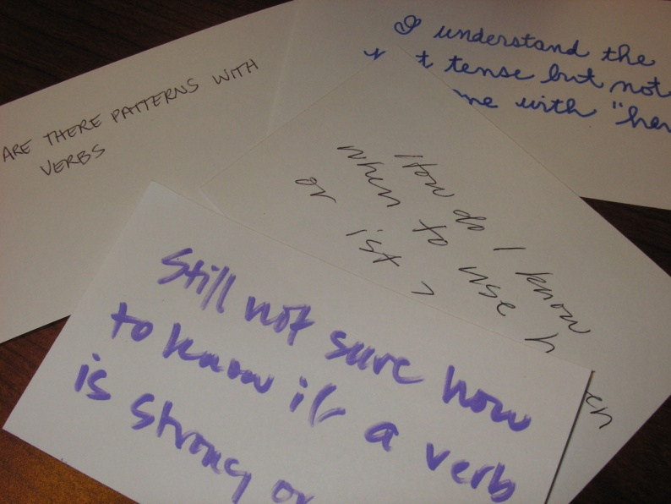
CATs w/ Clickers
Quicker
Easier
Data for P & T
Notes:
The whole point of CATs is that they are quick enough and easy enough to conduct even in a large or busy course.
Indeed, many of the commonly recommended uses of clickers would qualify as “classroom assessment techniques.”
An additional benefit of conducting CATs with clickers is that it can help an instructor to collect quantitative data to document their teaching improvement efforts for tenure and promotion purposes.

Slide 25
CATs with Clickers Table
13
“as is”
10
modified
23 CATs with clickers
Get table HERE
Notes:
Likewise, of the 50 CATs in Angelo and Cross’s (1993) Classroom Assessment Techniques book, 23 can be conducted with clickers. (Briggs, 2009). Thirteen of those 23 CATs can be conducted with clickers by using the original instructions in Angelo and Cross. Ten more can be conducted with clickers if they are modified to fit a multiple choice format.
Using clickers makes the gathering of formative assessment data quicker, and makes the evaluation of the data easier.
Rapid, informal data collection and analysis greatly aids continuous improvement of courses. (Briggs, 2003)
========================
REFERENCES
Briggs, C. L. (2009). Classroom Assessment Techniques with Clickers Table.
Briggs, C. L., & Stark, J. S. (2003). Data gathering practices of continuous planning academic departments. Annual forum of the Association for Institutional Research, Tampa, FL.
The table needs to be used with the book to be meaningful.
Explanation of the table:
Left-hand column: name of CAT, organized into categories based on the purpose of the assessment. The names of the CATs and the categories are verbatim from Angelo & Cross.
Middle column: page number in Angelo & Cross where you’ll find the CAT.
Right-hand column: Suggested adaptations to some of the CATs so they can be performed with clickers.
If the right-hand column is blank, it means the CAT can be performed with clickers without any modification.

Slide 26
Table of CATs for Clickers
Notes:
Let’s take a look at a table that shows the CATs that can be conducted with clickers.
The table needs to be used with the book to be meaningful.
Explanation of the table:
Left-hand column: name of CAT, organized into categories based on the purpose of the assessment. The names of the CATs and the categories are verbatim from Angelo & Cross.
Middle column: page number in Angelo & Cross where you’ll find the CAT.
Right-hand column: Suggested adaptations to some of the CATs so they can be performed with clickers.
If the right-hand column is blank, it means the CAT can be performed with clickers without any modification.

Slide 27
Impact of Modifications
Conversion from open-ended to MCQ can downgrade complexity
Class discussion can restore depth
Photo used by permission of Vanderbilt University
Derek Bruff, author of Teaching with Classroom Response Systems, teaching a math class with clickers.
Notes:
On the surface, the modified CATs tend to be less intellectually complex than their original versions because they usually involve adapting an open-ended question to a multiple choice question(MCQ) format.
However, if the alternative in a large class is no data gathering at all, the MCQ may still yield valuable information.
In addition, if the clicker question is used to prompt class discussion, all or most of the original depth and richness can be restored.
Indeed, clickers are often cited as an effective tool to spur discussion in large classes where students may otherwise be more reluctant to speak up. Many clicker techniques, therefore, include class discussion or debriefing as a follow-up to the multiple choice clicker question.
Even if many students are not reluctant to speak up, the results of a clicker question can be a “reality check” on what students really think or know.

Slide 28
Modified CAT with clickers
Background Knowledge Probe
Notes:
The next slide is an example of a Background Knowledge Probe that has been modified so it can be conducted with clickers.

Slide 29
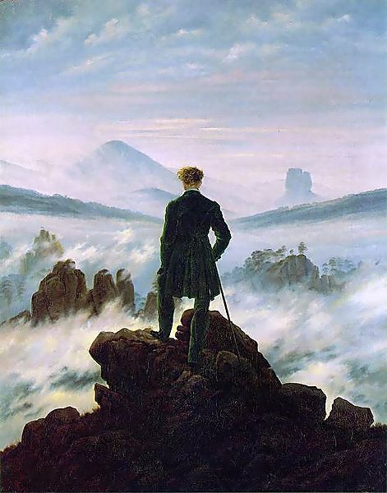
Which of the following is NOT a characteristic of Romanticism?
Attention to “the natural”
Valued “folk” literature, such as fairy tales
Had a strong geographical center in Düsseldorf
Referred to “the blue flower” as a central symbol for longing
Valued medieval literature and art.
Notes:
In the original version of the Background Knowledge Probe, the instructor might have asked: Write 5 things that you remember about German Romanticism from your prior course on German Literature.
In the modified version, students are asked to “vote” on the characteristic that does not belong to German Romanticism. After seeing the results of the voting, students might discuss the characteristics with a partner or in a small group, and then vote again. Alternatively, several students could be asked to voluntarily defend their differing answers to the class, after which the class could vote again, hopefully with stronger consensus around the correct answer.
[This slide can be converted to a clicker slide if you want to try it in your workshop. Participants with no background in romanticism will, of course, have to guess.]

Slide 30
Modified CAT with clickers
One Sentence Summary
Notes:
The next slide is an example of a One Sentence Summary exercise that has been modified so it can be conducted with clickers.

Slide 31
One Sentence Summary
Working as quickly as you can, answer the questions:
“Who Does What to Whom, When, Where, How, and Why?”
in relation to the following topic: Grand Juries.
Then do your best to synthesize the answers to each of the seven WDWWWWHW questions into a single informative, grammatical, and long summary sentence.
Notes:
In the original version of the One Sentence Summary, the instructor might have asked: Working as quickly as you can, answer the questions “Who Does What to Whom, When, Where, How, and Why?” in relation to the following topic: Grand Juries. Then do your best to synthesize the answers to each of the seven WDWWWWHW questions into a single informative, grammatical, and long summary sentence. (Adapted from Angelo & Cross, p. 185)
The instructor would collect the sentences and analyze them between class sessions to determine whether to spend more time on the topic, and which specific misconceptions must be corrected.
[If you have time, this exercise can be incorporated into your workshop, for participants to try on their own, or in pairs or groups.]

Slide 32
Find the 2 errors in WDWWWWHW
Who and Why
When and Where
How and Why
Who and How
Does What to Whom and How
Who: A grand jury is a panel of judges
Does What to Whom: that decides if someone should be charged with a crime
When: when the offense might be a felony carrying prison time
Where: in federal courts and most state courts
How: by listening to arguments by attorneys for both sides
Why: so common sense, community perspectives are part of the criminal justice system
Notes:
In this modified version of the One Sentence Summary, the instructor constructs the sentence, and asks students to select the part of the sentence that is incorrect. Pair work and discussion can follow.
[This slide can be converted to a clicker slide if you want to try it in your workshop]
This clicker slide is rather complicated, but after completing one or two exercises in this format, students catch on quickly.
The sentence is laid out on the right with the question words highlighted in yellow.
The clicker question asks students to “Find the errors” in the sentence by selecting the response option on the left that indicates the 2 parts of the sentence that are incorrect.
[The correct answer is D—Who and How. Who: A grand jury is made up of ordinary citizens not of judges. How: A grand jury listens to evidence presented by the prosecutor, not to arguments by attorneys for both sides.]

Slide 33
Classroom Assessment Project Cycle
Plan
Implement
Respond
Notes:
A CAT should be one step in a classroom assessment process that includes planning, implementing and responding.

Slide 34
Classroom Assessment Project Cycle
Plan:
* Choose class
* Focus on goal/question
* Choose CAT
Notes:
In the planning phase of a Classroom Assessment Project Cycle, the instructor identifies a goal or question for a specific class, and then selects a CAT to collect data to answer the question. The table of contents in Angelo & Cross (1993) is organized into sections devoted to different types of teaching question, which makes it easier for an instructor to go directly to one section of the book and peruse the options to find the one that is best suited to the instructor’s question and the teaching context. Each set of instructions includes examples of how the CAT can be used in several different disciplines and additional suggested variations.

Slide 35
Classroom Assessment Project Cycle
Implement:
* Teach
* Collect data
* Analyze data
Notes:
In the implementation phase of a Classroom Assessment Project, the instructor teaches the target lesson and carries out the CAT before, during or after the lesson, depending on the question to be answered. Then the instructor “analyzes the data” and determines how to interpret it in light of their original question. When CATs are conducted with clickers, analysis is usually completed by the clicker program itself which provides the frequencies and percentages for each response. Most often, however, the instructor must still interpret the results for him/herself, and decide what to do with them. One instructor may be satisfied with 70% of students getting an answer correct, while another may only be satisfied when 95% of students answer correctly. Likewise, one instructor may choose to devote more class time to clearing up students’ “muddiest point,” while another may choose to offer additional resources for students to review outside of class.

Slide 36
Classroom Assessment Project Cycle
Respond:
*Formulate response
* Communicate results, try out response
* Evaluate impact on T&L
Notes:
In the responding phase of a Classroom Assessment Project Cycle, the instructor decides how to follow up on what is learned from the CAT. Faculty who use CATs often report that debriefing the class on the results of the CAT, the instructor’s interpretation of the data, and any resulting decisions to follow-up helps build rapport and a sense of reciprocity with students that more generally improves class morale.
In many cases, it makes sense to collect data again after any changes are made to the course to determine if those changes were effective.

Slide 37
Design a follow-up project
Plan
Implement
Respond
Notes:
CATs become part of a continuous improvement cycle when one project cycle is followed-up by repeating the CAT after a change, or by developing new questions to assess.

Slide 38
Resources
Charlotte Briggs (2009), Classroom Assessment Techniques with Clickers Table.
Thomas Angelo and K. Patricia Cross (1993), Classroom Assessment Techniques
Derek Bruff (2009), Teaching with Classroom Response Systems: Creating Active Learning Environments
Derek Bruff’s blog: Teaching with Classroom Response Systems.
Doug Duncan (2004). Clickers in the Classroom: How to Enhance Science Teaching Using Classroom Response Systems
University of Colorado at Boulder, Science Education Initiative.

Slide 39
Questions or Comments?
Charlotte Briggs
Director of the UIC Office of Dental Education
clbriggs@uic.edu
College of
Dentistry

