Slide 1

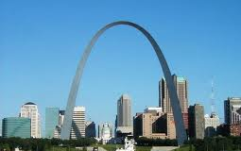
Security Professionals Online Conference Orientation Session April 10, 2013
From St Louis, Missouri
Notes:
Required – Title Slide

Slide 2

Today’s Orientation
Online Conference
Program
Adobe Connect
Getting Ready
Technology
Team Resources
Questions?
Notes:
Required - Main Body Slide

Slide 3
Online Conference Overview & Agenda
Notes:
Optional – Agenda Slide – Option 2
Instead of using the agenda template on the previous slide, you also have the option to use this section break template to place sub titles or section breaks within your presentation.

Slide 4

Security: Third Online Conference
Responding to members
Modeling the way
Expanding the community
Bringing outstanding content to your campus

Slide 5
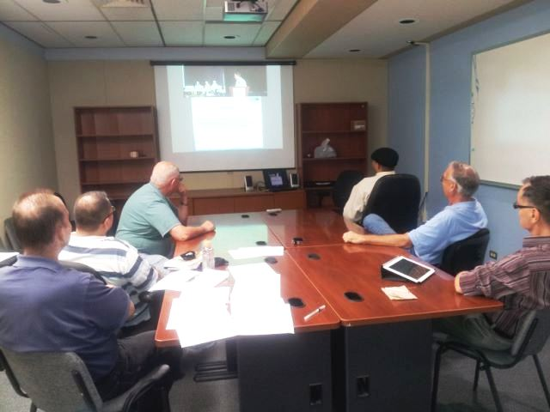
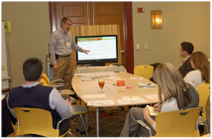
Registrants
2012: 75
Teams of 1 to 20+; exposure close to 250 individuals.
2013: 60+
40 institutions
22 states plus Canada

Slide 6

14 Sessions
Webcasts
General Sessions (2)
Concurrent Sessions (7)
Exclusive Online Content
Online Sessions (5)

Slide 7

Networking
Conference hashtag: #SEC13
Registration List

Slide 8

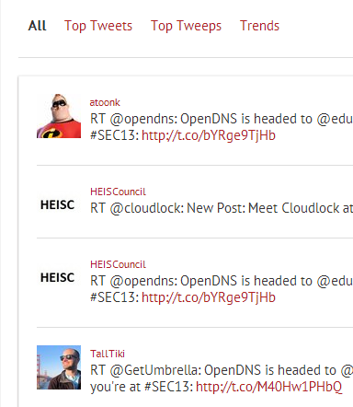
Get the #SEC13 Scoop
Your all-in-one stop for #SEC13 tweets, photos, videos, slides and conversations.
eventifier.co/event/SEC13

Slide 9
Adobe Connect & Mediasite

Slide 10
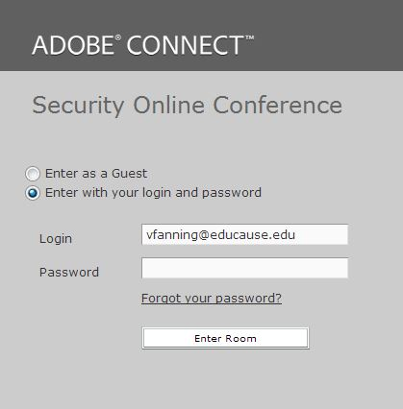
Adobe Connect
http://educause.acms.com/seconline
April 12: Username/Password

Slide 11
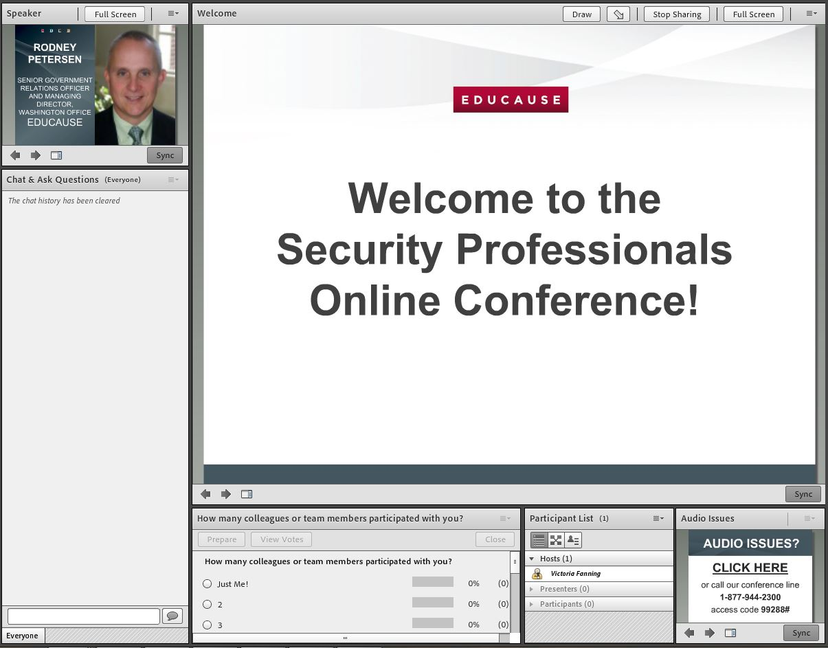
Exclusive Online Sessions
Speaker
Chat and ask questions
Answer Polls
Roster and 1:1 chat

Slide 12
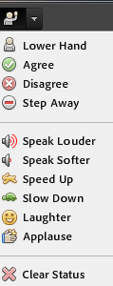
Express yourself in Adobe Connect!
Phone
Chat
Polls
Emoticons
Raise/Lower Hand
Applaud
Laughter

Slide 13
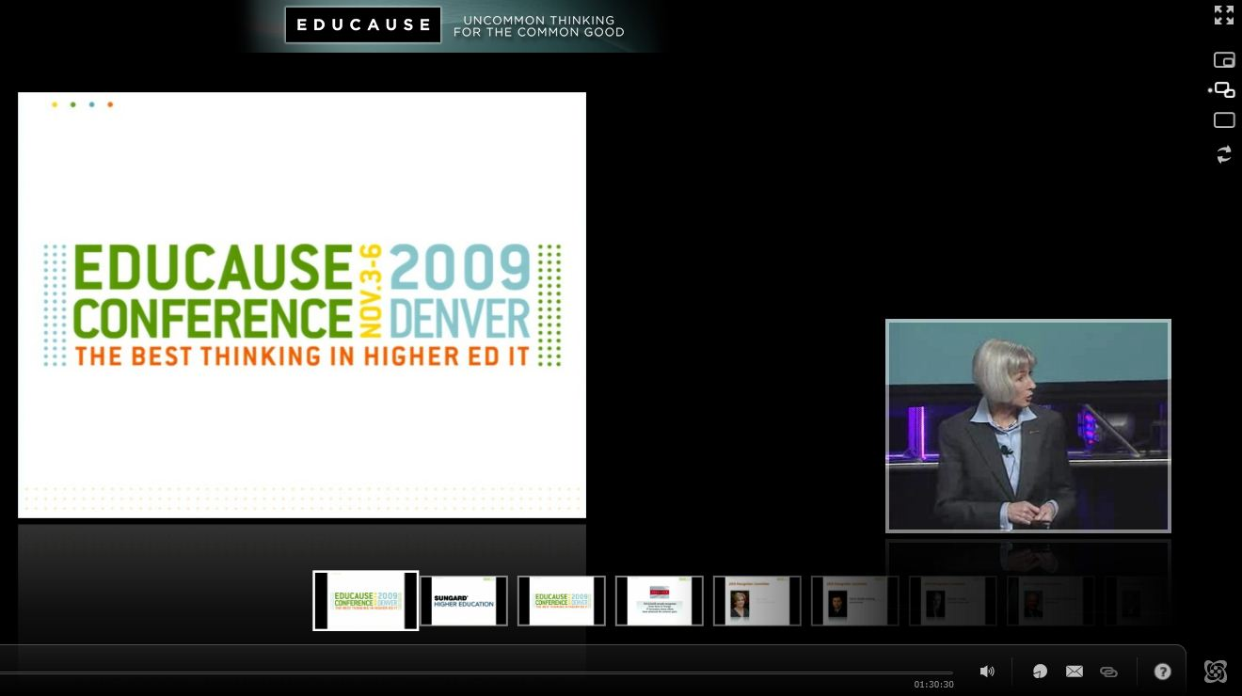

Webcasts: Sonic Foundry
Session moderators will monitor questions from the online audience
Full Screen;
Picture within a Picture;
Side by Side
Submit a question

Slide 14
Recordings
On-Demand NOTE!
Available 15 minutes to 3 hours after session end time; uploaded during 30+ minute breaks.
April 16–July 17 (Restricted)
Live and on-demand sessions available to online and face-to-face attendees only
July 17 (Public)
On-demand sessions, MP3 and MP4 files publicly available from the EDUCAUSE library for three years.

Slide 15
Technology

Slide 16
Technology Preparation http://www.educause.edu/events/security-professionals-conference/program-and-agenda/online-login-and-technical-requirements
A high-speed WIRED connection
Perform system checks:
Mediasite Player / SAMPLE SESSION
Adobe Connect
Backup audio: telephone for exclusive online sessions
NOTE: Mobile devices have limited functionality. Install the Mediasite Mobile app and the Adobe Connect app.

Slide 17
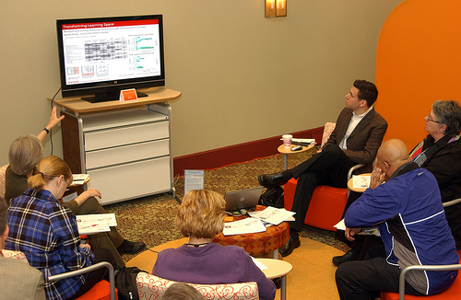
Technology and Teams
Screen
Projector
2 systems checks: On the computer you plan to use
Conference phone: Back-up for Adobe Connect

Slide 18
Team Resources

Slide 19
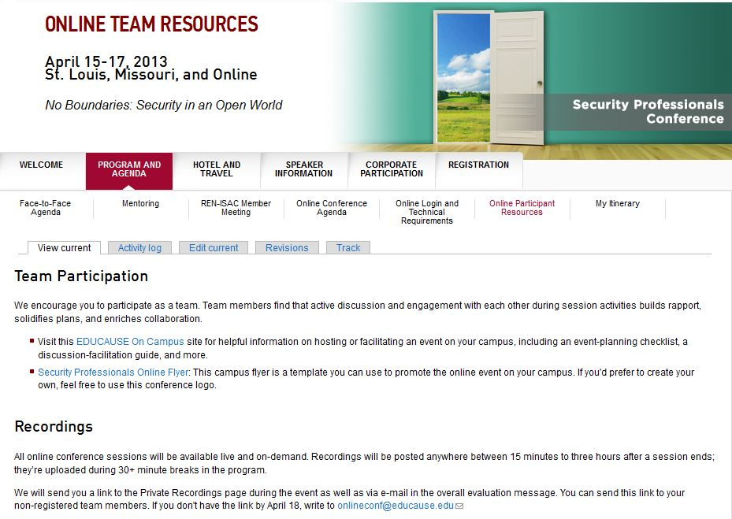
http://www.educause.edu/events/security-professionals-conference/program-and-agenda/online-team-resources

Slide 20

Customizable campus flyer or use our Conference logo

Slide 21
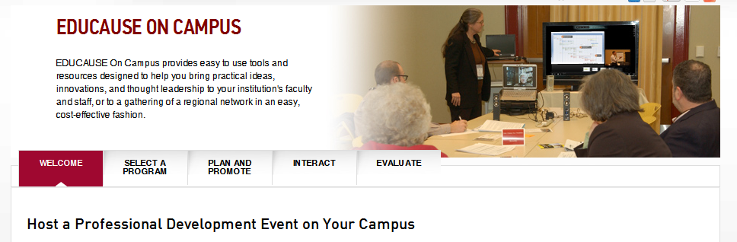
What is EDUCAUSE On Campus?
Easy to use tools and resources to offer affordable EDUCAUSE professional development events on your campus.
http://www.educause.edu/conferences-events/educause-campus

Slide 22
Options
Select a program
Interact
Online events
Content kits
Discussion/Facilitation guide
Tips
Strategies
Building community
Plan and Promote
Checklist
Pre-event survey template and tips
E-Mail template
EDUCAUSE logo
Poster
Evaluate
Questions
Online survey tools

Slide 23
Webcasting Sponsor
Platinum Partner
www.sonicfoundry.com

Slide 24
Questions?

Slide 25

See you next week @ SEC13! Your EDUCAUSE online conference team: Loren Benavente Victoria Fanning Shannon Smith onlineconf@educause.edu

