Slide 1
EDUCAUSE 2011 Online
Annual Conference:
Orientation Session
October 12, 2011

Slide 2

Today’s orientation
Online Annual Conference overview
Program
Virtual Convention Center overview
Getting Ready
  Technology
  Preparing your room
Tips for facilitation
Questions?
Access the Virtual Convention Center

Slide 3

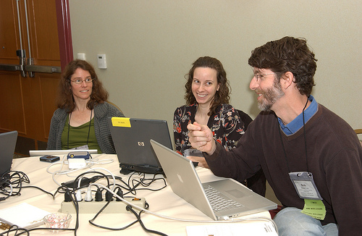
Third ONLINE ANNUAL MEETING
Responding to members
Modeling the way
Expanding the community

Slide 4
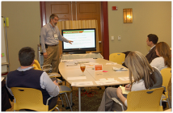
PARTICIPANTS
2009: 270 registrants
2010: 324 registrants
  45 states and 8 countries; estimated exposure ~2,000
2011: 250 registered (anticipate 350)
  42 states
  8 countries including Australia, Canada, Denmark, Hong Kong, Ireland, Norway, Sweden, United Kingdom
  162 institutions

Slide 5
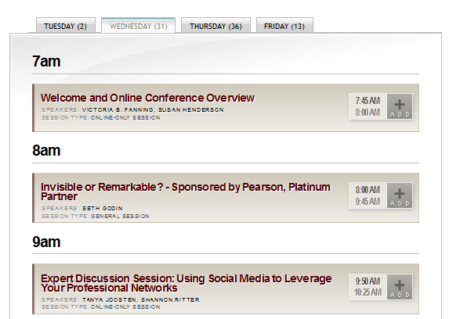
Online program http://www.educause.edu/E2011/Program/Online
Streamed Sessions from Philadelphia
  General sessions (3)
    NOTE: Seth Godin’s session is only available for the duration of the conference.
  Select featured and themed sessions (65)
Online-Only Content
  NEW! Preconference seminars (2)
    There’s an additional fee to attend.
  Expert discussion sessions
  Lightning rounds
  Speaker interviews with Q&A
NEW! Virtual Exhibit Hall
  10 virtual booths

Slide 6
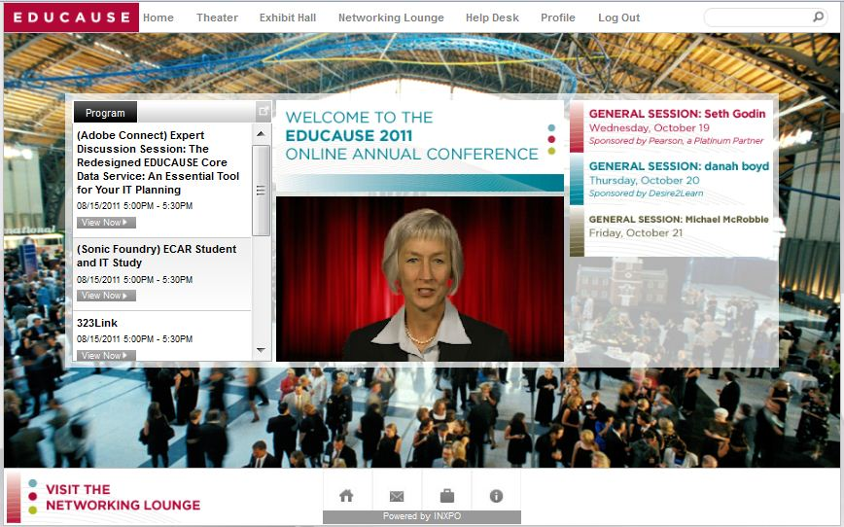
Welcome Lobby
Top bar: Access all locations
Left side: Current program
Main screen: Welcome video
Right side: General session streams

Slide 7
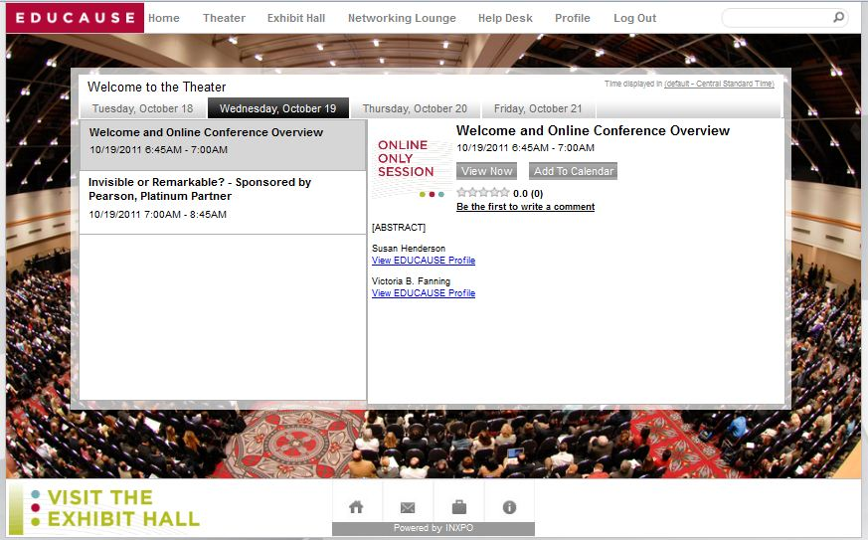
Theater: access all presentations
Live and on demand streams
  On demand streams:
    available within 15-60 minutes after the session ends
    private for 90 days after the conference ends
Online-Only
  Adobe Connect
Virtual Exhibit Hall
  2.5 hours of live chat time

Slide 8
Theater: Additional notes
Change your default time zone
Click on each day’s tab to see a listing
Add sessions to your calendar
  Note: Use the EDUCAUSE site to access the EDUCAUSE itinerary builder and iCalendar download.
Title, speaker name and profile link, abstract
Evaluate this session

Slide 9
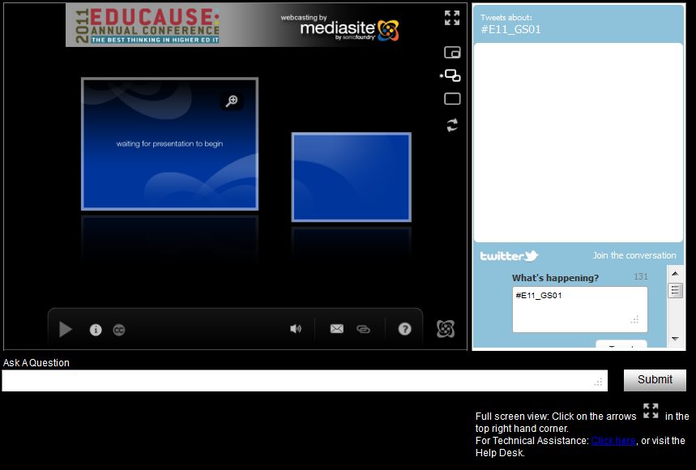
Streams: sonic foundry & 323link
Global
  Ask/submit question: Session moderators are in EVERY room
  Twitter box with the unique session hashtag automatically populated: Optional
  Technical Help link
Sonic Foundry (55 sessions)
  Full screen view and 6 viewing options
323Link (13 sessions)
  One view with a closed captioning option

Slide 10
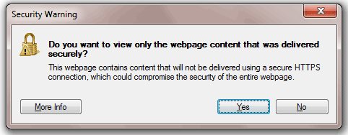
streams: technical note
Internet Explorer, Firefox, Safari
  Virtual Convention Center = https site
  Streams = http site
  Click View Now: You may get a warning message
    Do you want to view only the webpage content that was delivered securely? No = I also want to view http page
    Only secure content is displayed. Yes = show all content

Slide 11
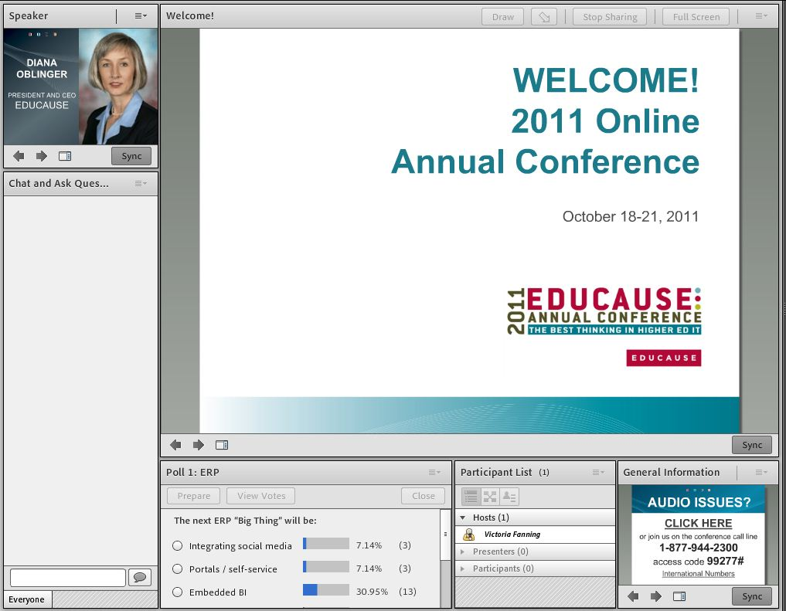
Online-only sessions
Speaker
Chat and ask Questions
Interactive Polls
List of Participants

Slide 12
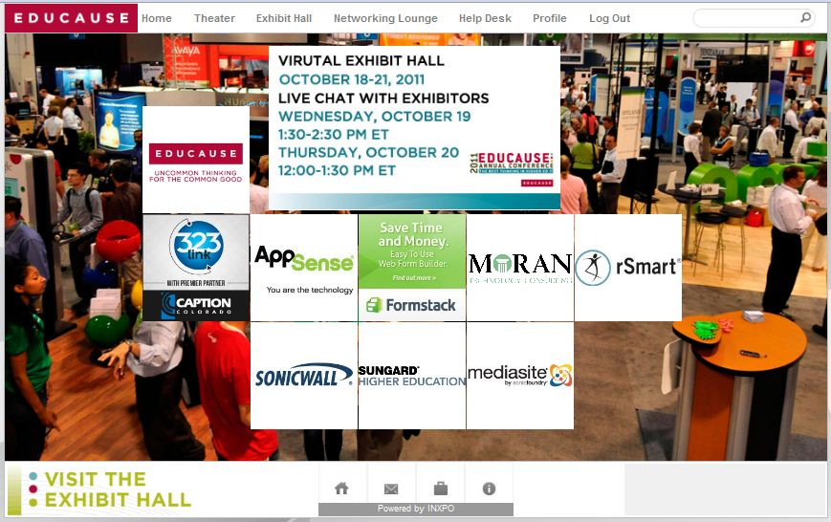
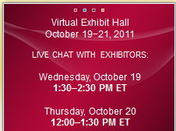
Virtual exhibit hall: Oct. 19-21
Open: Videos, Resources, Links
  October 19-21
  90 days after the conference ends
Live Chat
  Wednesday: 1:30-2:30 p.m. ET
  Thursday: 12:00-1:00 p.m. ET

Slide 13
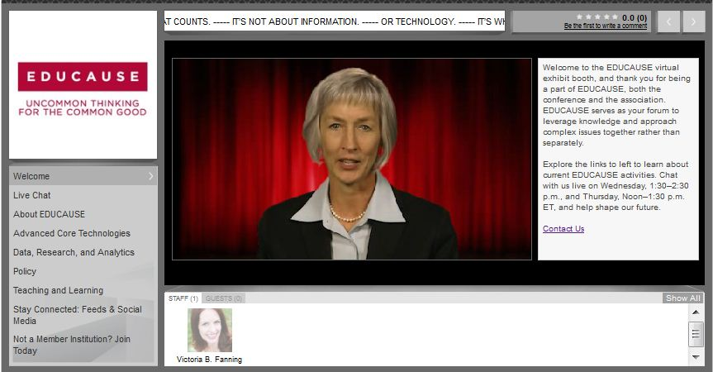
Virtual Booths
Abstract
Video or logo
Content tabs
  Welcome
  Live Chat: Wed & Thurs
    Send a general message
    Click on a representative’s image to communicate privately (they may also click on your icon)
  Resources
    Links
    Documents
    Social Media

Slide 14
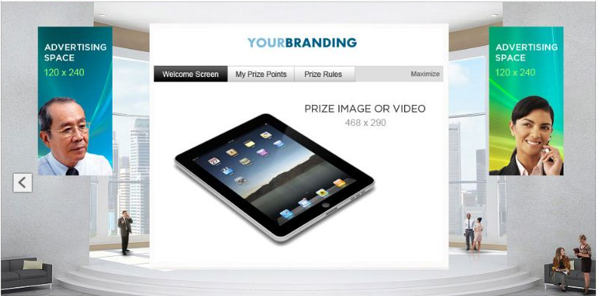
Prize center: Oct. 19-21
Click on a prize
Enter the booth
Click on “Win xx Prize” link
Fill in your name
Click submit
WINNERS announced:
October 21 at 11 a.m. ET

Slide 15
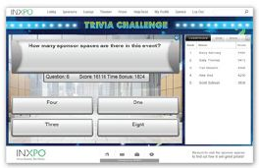
Game room: Oct. 19-21
Trivial Pursuit
  30 questions:
    Philadelphia, general campus trivia, EDUCAUSE
    No google searches allowed!
  Time counts ☺

Slide 16
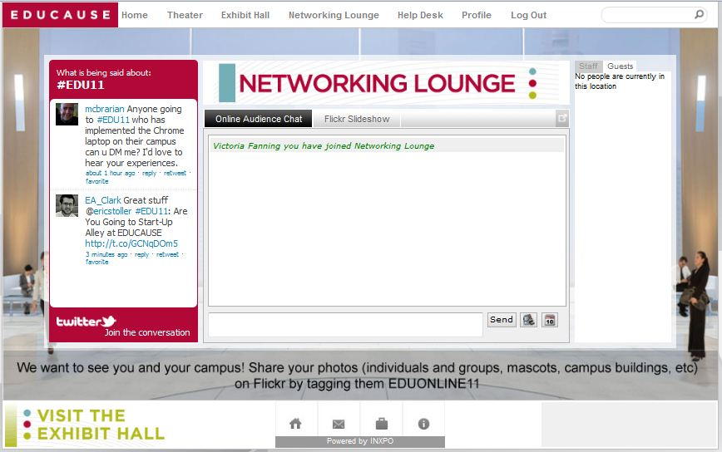
Networking lounge
Twitter Feed: #EDU11
  general conference hashtag for f2f and online audiences
Online Audience Chat
  online participants only
Flickr Slideshow: EDUONLINE11
  online participants only
Stay connected outside of the networking lounge too! EDUCAUSE social media tags and links for f2f and online audiences: http://www.educause.edu/E2011/Community

Slide 17
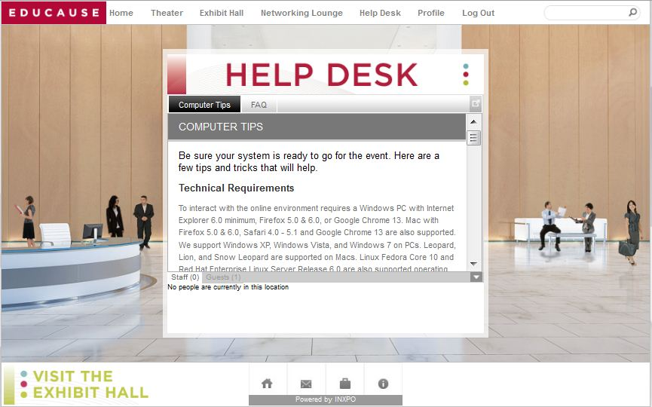
Help desk
LIVE staff:
  October 19-21
  Conference times
Before/After:
  Contact Us

Slide 18
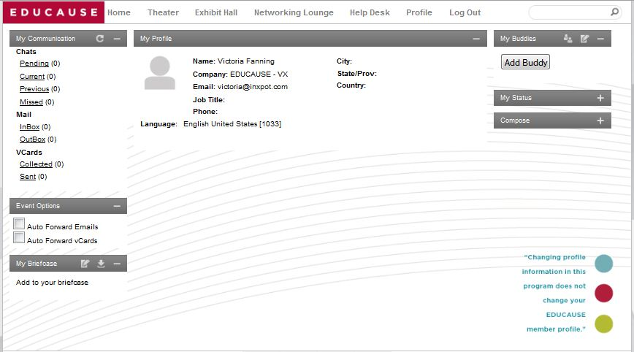
Profile page: conference profile
Individuals
  Upload your picture
  Add your e-mail address
Teams
  Upload a team or campus picture
  Change your name
Chat, send e-mail, send a Vcard
Click on your EDUCAUSE profile to change your EDUCAUSE information

Slide 19
Getting ready: technology http://www.educause.edu/E2011/Online/Requirements
A high-speed WIRED connection
System checks and installation:
  INXPO: Port 1935 or 80 must be open
  Silverlight
  Adobe Connect
Adobe Connect sessions, back-up
  A reliable telephone line and a conference phone if you are participating as a team - in case of audio issues
NOTE: Mobile devices are NOT supported

Slide 20
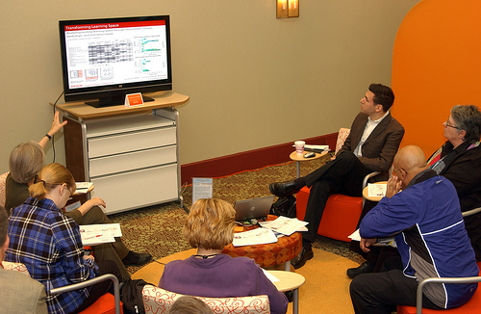
Technology & teams
Screen
Projector
3 systems checks: On the computer you plan to use
Conference phone: Back-up for Adobe Connect only

Slide 21
Registration: Additional Logins
If you purchased additional logins, please ask your colleague(s) to register by October 13!
Confirmation numbers were sent in the immediate registration confirmation message.
If it a confirmation number wasn’t used, Member Services sent you (the main contact) a note this morning.

Slide 22

EDUCAUSE EVENT PLANNING KIT
http://www.educause.edu/wiki/Event_Planning_Kit

Slide 23

HOSTING RESOURCES
A wiki-based team kit
Readiness Checklist
  Send invitations
  Explore the program
  Room set & tech
  Food & beverage
Survey
Evaluations
Promotional Email
Logos and Poster Template

Slide 24
FACILITATOR RESOURCES
A wiki-based team kit
Discussion guide
How to facilitate
(Tips and Podcast)
Reflection worksheets
Tips for interaction
Post-event ideas

Slide 25
Attendee resources Page: EOB today
Login information and link
Virtual Convention Center PDF guide
Additional team resources
  Campus Flyer
  List of session streams that you can use to create a campus survey - ask colleagues to vote on which stream they want to watch live.
Help and links

Slide 26
QUESTIONS?

Slide 27
Let’s check out the virtual convention center!
Open Dates
  October 12: 2:30-3:30 p.m. ET
    NOTE: The exhibit hall, prize center and game room will open on October 19.
  October 18: Preconference Seminars
    See the e-mail “Log In Information for Your Preconference Seminar” sent on October 14 to access your room.
  October 19-21: Full environment open
  October 21–January 18: On demand sessions

Slide 28
Log in
Log in to the Virtual Convention Center.
  Enter in your EDUCAUSE Profile Credentials.
  The INXPO system check will run automatically.
  You’ll then enter the virtual environment.
We’ll stay in this Adobe Connect room in case you need help from 2:30 to 3:00 p.m. ET.

