Slide 1

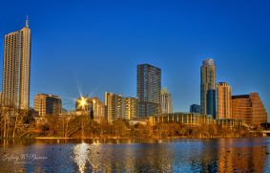
ELI 2012 Online
Annual Meeting
Orientation Session
February 7, 2012
From Austin, Texas

Slide 2

Today’s orientation
Online Annual Meeting overview
Program
Virtual Conference Center overview
Getting Ready
  Technology
  Preparing your room
Tips for facilitation
Questions?
Access the Virtual Conference Center

Slide 3
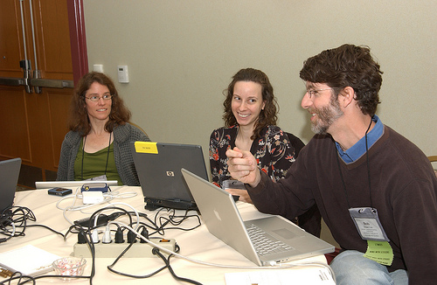
Educause Learning Initiative 2nd ONLINE ANNUAL MEETING
Responding to members
Modeling the way
Expanding the community
Bringing outstanding content to your campus

Slide 4
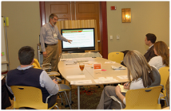
PARTICIPANTS
2011: 111 registrants
  34 states and 3 countries; estimated exposure ~380
2012: 71 registered (anticipate 115)
  29 states and Canada
  57 institutions

Slide 5
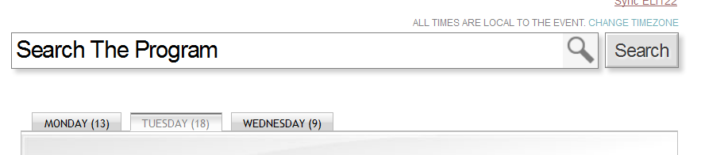
Online program http://www.educause.edu/ELI12/Program/Online
Webcasts
  General sessions (4)
  Select featured and concurrent sessions (20)
Online-Only Content
  NEW! Preconference seminars (2)
    Requires an additional fee.
  Expert discussion sessions
  Lightning round
  Speaker interviews with Q&A

Slide 6
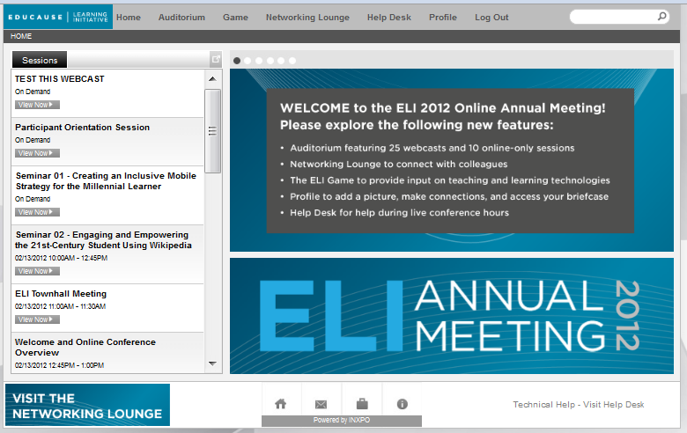
Lobby
Notes:
Top bar: Access all locations
Left side: Current program
Main screen: Conference information

Slide 7
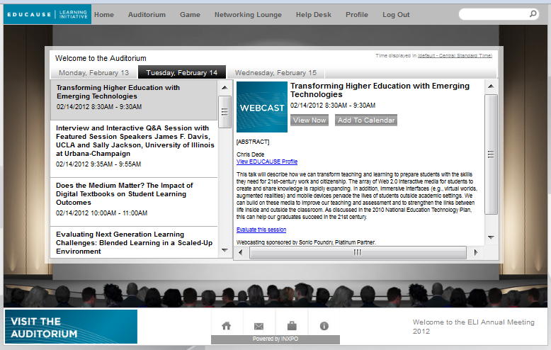
Auditorium
Access live and recorded presentations
Live:
Webcasts (recorded)
Online-Only
  Adobe Connect
Recorded sessions:
  available within 15-60 minutes after session ends
  private for attendees for 90 days after the conference ends
  publicly available after 90 days

Slide 8
Auditorium: Additional notes
Set your default time zone
Click on each day’s tab to see the program
Add sessions to your calendar
  Note: Use the ELI site to access the ELI itinerary builder and iCalendar download. http://www.educause.edu/ELI12/Online/Itinerary
Title, speaker name and profile link, abstract
Evaluate this session

Slide 9
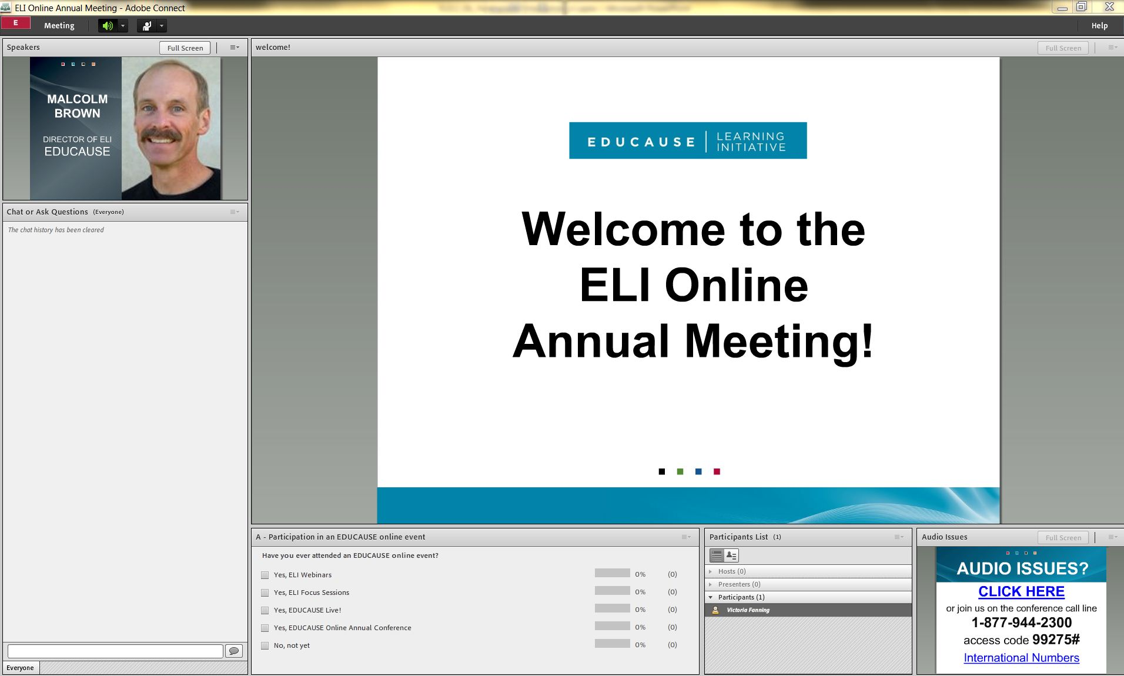
Online-only sessions
Speaker
Chat and ask questions
Answer Polls
List of presenters and participants

Slide 10
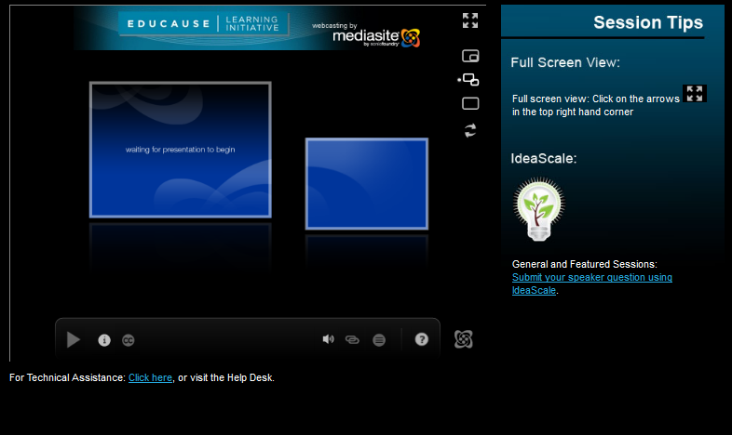
Webcasts: sonic foundry
Ask/submit question:
  IdeaScale: General and Featured Sessions
  Question Box: Concurrent Sessions
  Session moderators look for your questions in each session
Technical Help link
Mediasite Player
  NOTE: There is a FULL SCREEN view with 6 viewing options.

Slide 11
Notes:
Show them how to make it full screen and what the options are.

Slide 12

Engage in 3 Easy Steps
Go to http://learn.ideascale.com
Select “sign in” on the right hand corner, using one of the login options (Google, Facebook, Twitter)
Select one of the categories/speaker names on the left, submit a question or idea, and vote on others’ questions/ideas
Notes:
V
(a web-based tool that uses crowdsourcing to rank user-submitted questions, suggestions and ideas)

Slide 13

ELI Interactive Game click on “Game”
4 Easy Steps
Select and register 5 technologies
Check out the technology questions
Make the case for your technologies
Vote on the technologies
Winners get a $50 Amazon Gift Card!
Notes:
V

Slide 14
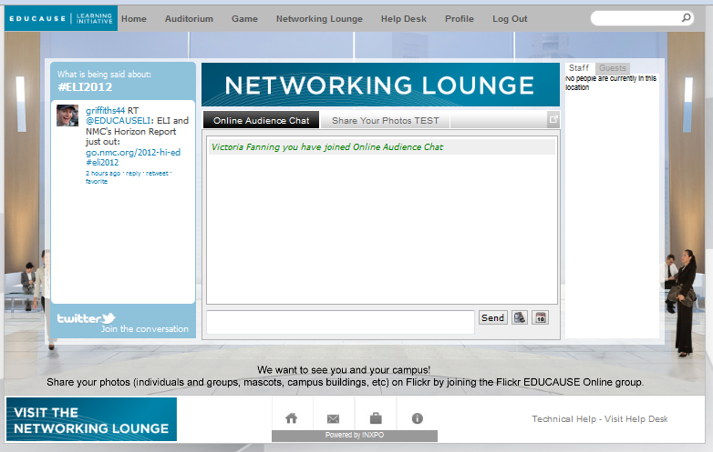
Networking lounge
Twitter Feed: #ELI2012
  general conference hashtag for f2f and online audiences
Online Audience Chat
  online participants only
Flickr: http://www.flickr.com/groups/eli2012/
Stay connected outside of the networking lounge too! http://www.educause.edu/ELI2012/network

Slide 15
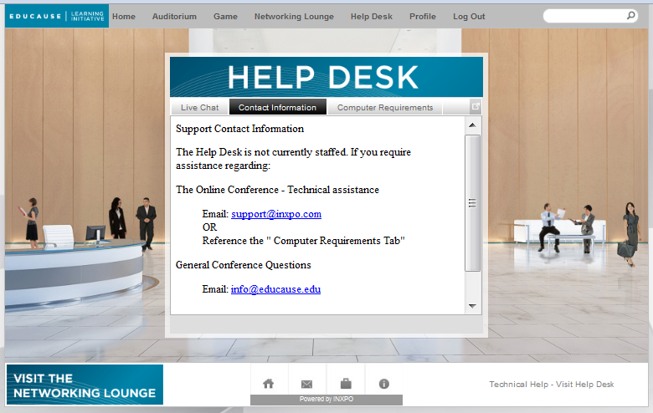
Help desk
LIVE staff:
  Conference dates and times
Registration or profile help
Virtual Conference Center help

Slide 16
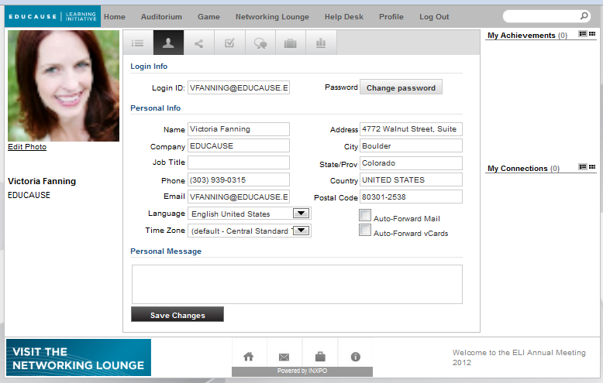
Profile page: conference profile
Individuals
  Upload your picture
  Add your e-mail address
Teams
  Upload a team or campus picture
  Change your name
Communicate:
  Chat, e-mail, Vcard
Click on your EDUCAUSE profile to change your EDUCAUSE information

Slide 17





Badges:
Collect at least FOUR and win a prize!
Session Seeker: Attend 5 or more sessions
Chat-ter Box: Adobe Connect chat contributor
eSocializer!: Online audience chat contributor
I Tweet!: Twitter use
Gamer: Four ELI interactive game winners

Slide 18
Technology Preparation http://www.educause.edu/ELI/EDUCAUSELearningInitiative2012/TechnicalRequirements/240954
A high-speed WIRED connection
Perform system checks:
  INXPO: Port 1935 or 80 must be open
  Mediasite Player: Install Silverlight
  Adobe Connect
Phone line for online only sessions
  Individual: a reliable telephone with mute
  Team: line with conference phone
  NOTE: Mobile devices are NOT supported
Notes:
Slides 20 and 21 are redundant.

Slide 19
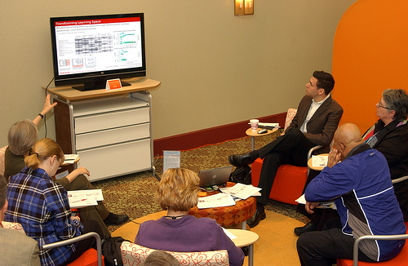
Technology & teams
Screen
Projector
3 systems checks: On the computer you plan to use
Conference phone: Back-up for Adobe Connect only

Slide 20
GENERIC CREDENTIALS
If you want someone else to login using your registration, but you don’t want to share your EDUCAUSE profile credentials.
  Click on this URL: http://www.educause.edu/inxpo/share/ELI122
  Share the automatically generated credentials
    NOTE: These credentials cannot be changed. If you lose them, simply click on the URL noted above.
You can log in using EITHER your EDUCAUSE profile OR generic credentials, but not both.

Slide 21
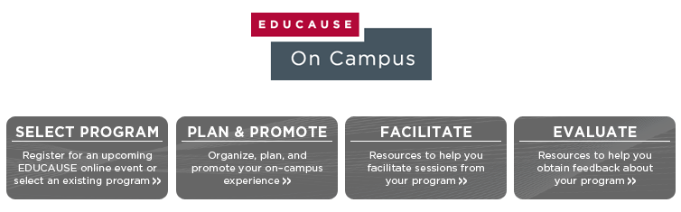

What is EDUCAUSE On Campus?
http://www.educause.edu/eoncampus
Notes:
We know that professional development is important on your campus. We also know that you have limited time and resources. So, to help you, we took the resources from the Event Planning Kit and combined them with the content kits available on Educause On Campus to create a brand new resource to help you bring quality Educause events directly to your campus. So, let’s take a quick look at what you can find online.

Slide 22



Select a program
Plan and Promote
View
  the upcoming online events
  quality online content kits
Select
Register for events
Plan
  Checklist
  Pre-event survey template and tips
Promote
  E-Mail template
  EDUCAUSE logo
  Poster

Slide 23
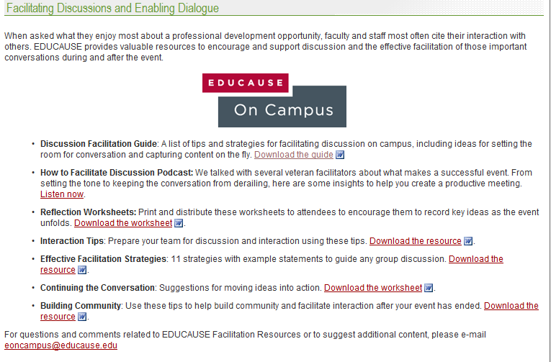


Slide 24
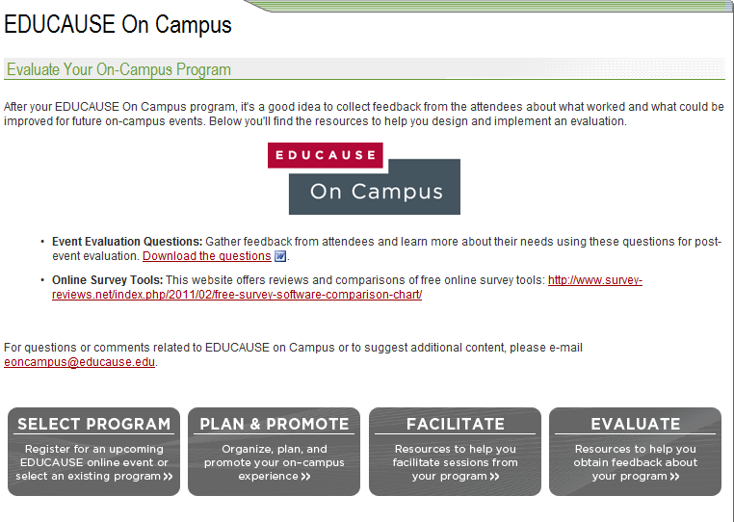

Slide 25
Participant resources Page:
Friday, February 10
Login information and links
Generic credential’s link
Team resources
Orientation session recording
Additional help links

Slide 26
QUESTIONS?

Slide 27
Visit the Virtual Conference Center and test your system today.
February 7: 1:30–3:30 p.m. CST
    NOTE: The game will not open until February 13
Attend the Conference:
February 13: Preconference Seminars
    See the e-mail “Log In Information for Your Preconference Seminar” to be sent on Feb. 10 and 13 to access your room.
February 13–15: Full environment open

Slide 28
ELI Recordings
February 15–May 15 (Restricted)
  On-demand sessions available to ELI 2012 online attendees only
After May 15 (Public)
  On-demand sessions, MP3 and MP4 files publicly available from the EDUCAUSE resource center.

Slide 29
Log in
Log in to the Virtual Conference Center.
  Enter in your EDUCAUSE or generic Profile Credentials
  The INXPO system check will run automatically.
  You’ll then enter the virtual environment.
We’ll stay in this Adobe Connect room for an additional 30 minutes in case you need help.

