Slide 1


West/Southwest
Online Regional Conference
Orientation Session
February 16, 2012
From Portland, Oregon

Slide 2

Today’s orientation
Online Regional Conference overview
Program
Virtual Environment
Getting Ready
  Technology
  Preparing your room
Tips for facilitation
Questions?

Slide 3
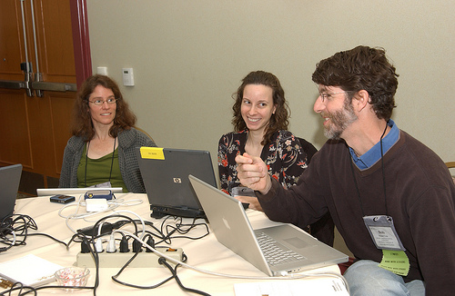
West/southwest 2nd ONLINE and co-located regional conference
Responding to members
Modeling the way
Expanding the community
Bringing outstanding content to your campus

Slide 4
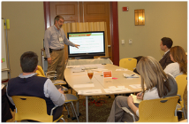
PARTICIPANTS
2011: 45 registrants
  18 states and Canada; estimated exposure ~125
2012: anticipate the same numbers
  13 states
  14 institutions

Slide 5
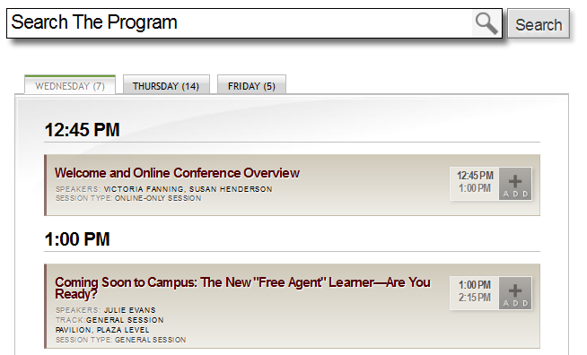
Online program http://www.educause.edu/WSWRC12/Program/Online
Webcasts
  General sessions (2)
  Select concurrent sessions (10)
Online-Only Content
  Expert discussion sessions
  Lightning round
  Speaker interviews with Q&A

Slide 6
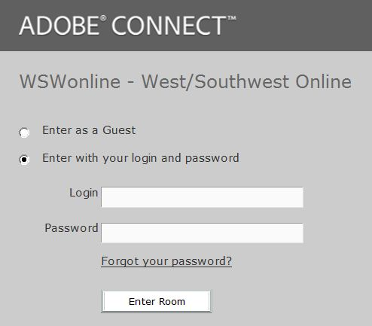
ADOBE CONNECT “THE HUB”
West/Southwest Online Meeting Room:
  You made it! (http://educause.adobeconnect.com/wswonline)
To enter the room:
  Username/Password
  February 21
Eval & Archive Link:
  February 24

Slide 7
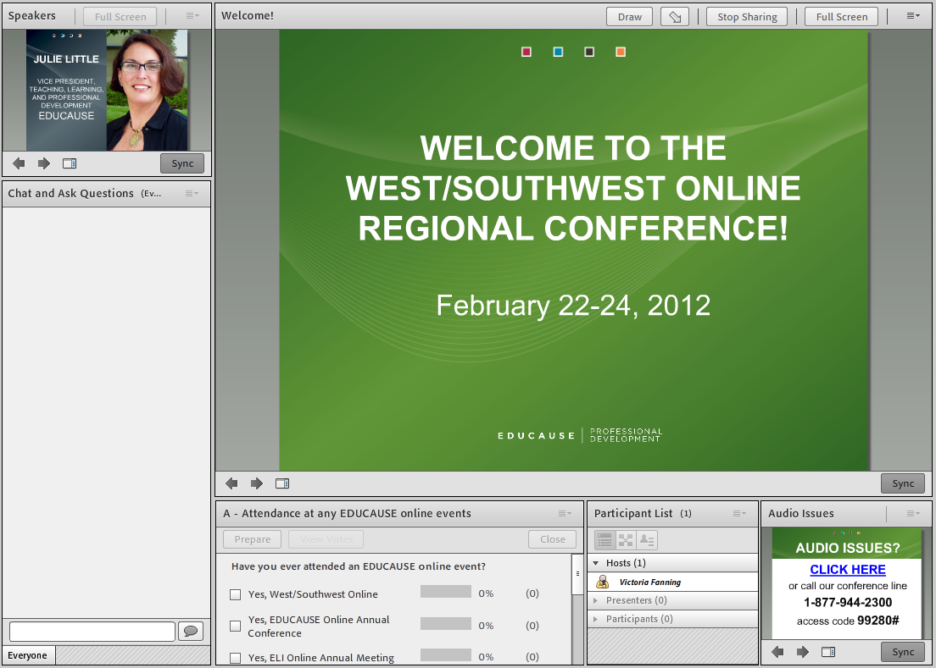
Online-only sessions
Speaker
Chat and ask questions
Answer Polls
List of presenters and participants

Slide 8
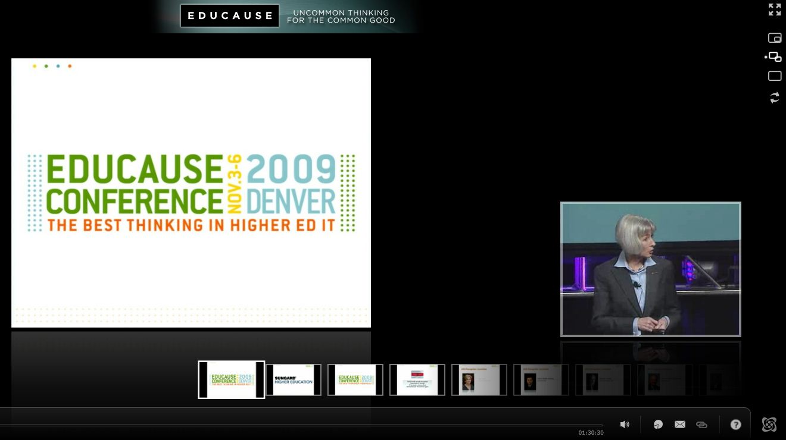
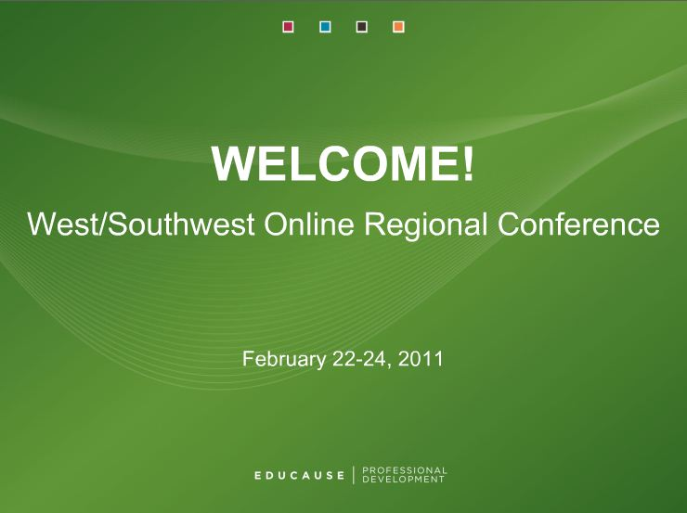
WEbcasts: Sonic Foundry using a mediasite player / silverlight
  Production quality cameras with direct audio and slide feeds
  Session moderators will monitor questions from the online audience
Full Screen;
Picture within a Picture;
Side by Side

Slide 9
Networking
Conference hashtag: #WSWRC12
Blogs, Flickr: WSWRC12

Slide 10
Technology Preparation http://www.educause.edu/wswrc12/online/tech
A high-speed WIRED connection
Perform system checks:
  Mediasite Player: Install Silverlight
  Adobe Connect
Phone line for online-only sessions
  Individual: a reliable telephone
  Team: conference phone
  NOTE: Mobile devices have limited functionality
Notes:
Slides 20 and 21 are redundant.

Slide 11
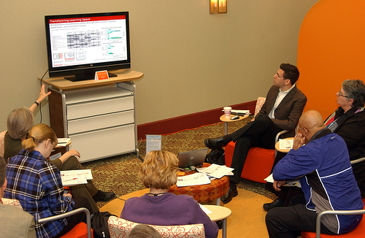
Technology & teams
Screen
Projector
2 systems checks: On the computer you plan to use
Conference phone: Back-up for Adobe Connect only

Slide 12
Recordings
February 22–May 22 (Restricted)
  Live and on-demand sessions available to online attendees only
After May 22 (Public)
  On-demand sessions, MP3 and MP4 files publicly available from the EDUCAUSE resource center.

Slide 13
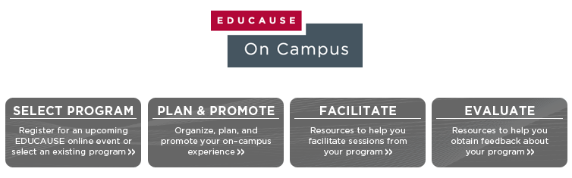

What is EDUCAUSE On Campus?
http://www.educause.edu/eoncampus
Notes:
We know that professional development is important on your campus. We also know that you have limited time and resources. So, to help you, we took the resources from the Event Planning Kit and combined them with the content kits available on Educause On Campus to create a brand new resource to help you bring quality Educause events directly to your campus. So, let’s take a quick look at what you can find online.

Slide 14



Select a program
Plan and Promote
View
  the upcoming online events
  quality online content kits
Select
Register for events
Plan
  Checklist
  Pre-event survey template and tips
Promote
  E-Mail template
  EDUCAUSE logo
  Poster

Slide 15
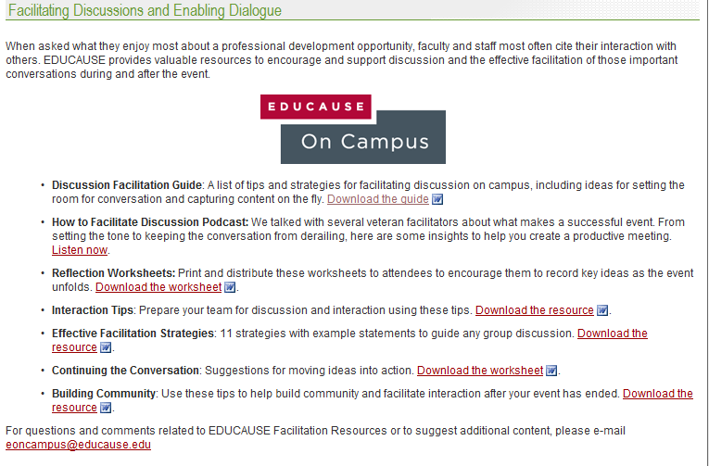


Slide 16

Webcasting Provided By
Platinum Partner

Slide 17
QUESTIONS?

