Slide 1
The Challenges and Successes of Technology Vendor Engagement for iPASS Reform
iPASS: Transformative advising and planning reform for increased student success

Slide 2
The iPASS Ecosystem
Bryant, G.. (2015). Driving Toward a Degree: The Evolution of Planning and Advising in Higher Education. Boston, MA: Tyton Partners.
Notes:
Mei-Yen
I wanted to take a few minutes to talk about some of the nuts and bolts of what it means to engage in iPASS reform as college.
One component of this work is the technology and there is a lot of technology out there for iPASS. From Tyton Partners research:
9 product categories
120 providers
7 different competitive segments
No complete solutions available
The average colleges engaged in iPASS uses 3-4 different vendors
This presents institutional challenges: systems integration and frequent updates, management over multiple platforms, inconsistent collaboration among internal and external stakeholders
There is a move in the industry to more holistic solutions→mergers/acquitions→will this result in more or less collaboration/interoperability?
How can colleges have a voice in shaping the industry?
ATD building relationships with tech vendors to try to work collaboratively and influence the industry
This is one way of understanding different categories of the iPASS ecosystem
Technology helps think about the workflow aspect of student success, asking “What tools can enable integration, feedback loops, and improved productivity?” BUT technology adoption alone does not = iPASS…

Slide 3
Common Challenges
Engagement & Communication
Effective communication of project vision to all stakeholders
Initiative fatigue and time/resource constraints
End-user adoption of technology/behavioral change
Effective training models for faculty and students
Data & Technology
Integrating multiple student success technologies
Identifying most valuable data (lead and lag) to track for various stakeholders
Building and maintaining effective relationship with multiple vendors
Advising Policies & Practices
Effective advising models tailored for various students, for example for dev ed students or STEM students
Starfish flag management
Scaling the work
Strategy & Planning
Alignment with other student success work
Efficient and effective change management
How to maximize resource efficiency to help build sustainability
Notes:
Data and tech related challenges
Integrating multiple student success technologies
Identifying most valuable data (lead and lag) to track for various stakeholders
Building and maintaining effective relationship with multiple vendors
Effective training models for faculty and students
End-user adoption of technology/behavioral change

Slide 4
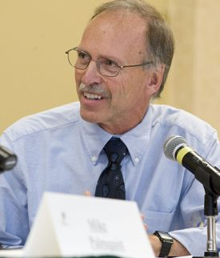
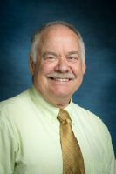
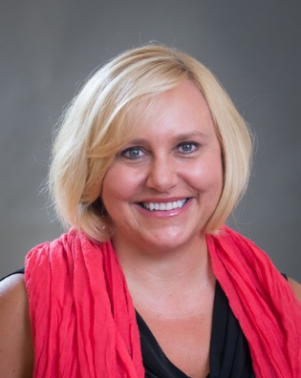
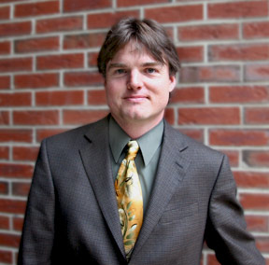
Today’s Speakers
Paul Thayer
Associate Vice President for Student Success
Colorado State University
Pat Burns
Vice President for Information Technology / Dean of Libraries
Colorado State University
Dawna M. Perez
Dean, Student Success
Northern Essex Community College
Jeff Bickford
Chief Information Officer
Northern Essex Community College

Slide 5
Colorado State University
Notes:
Slide for Colorado State

Slide 6
Strategy: Improve Student Success
Learning
Persistence
Retention
Completion
Tactic: Improve
Learning by
Improving Advising
Lower the Cost of Degree

Slide 7
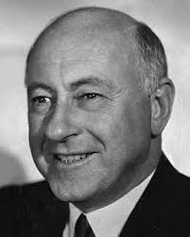
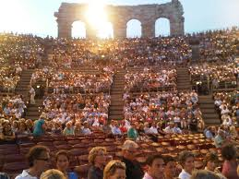
Our IPAS Team
Assoc. VP for
Student Affairs
VP for IT
ASC’s
OnlinePlus
Registrar
Mobile
Committee
Provost’s
Office
Academic
Computing
Cecile B. DeMille
Administrative
Computing
Fin. Aid
Students
Center for
Advising &
Student
Achievement
Institute for
Teaching &
Learning

Slide 8
Our IPAS Systems
u.direct®
+
u.achieve®
Be
____________
Beacon
Cray XT6m
SSC – Campus
Grades First

Slide 9
Not a Problem
University support, from President Tony Frank on down
Coordinating among diverse CSU staff during implementation
Commitment and performance of CSU staff during implementation – exemplary effort and diligence

Slide 10
Issues Encountered
Vendor non-delivery
Solution: CSU lowered expectations and vendor redirect to a productive area
Vender underperformance
Solution: CSU hired a staff member with significant expertise in the product, and we did some (much) of the vendor’s work
“Data diarrhea” – massive staff effort of ETL (Extract, Transform, Load); launched a data re-architecture activity for IPASS-2

Slide 11
Northern Essex Community College
Notes:
Slide for Northern Essex

Slide 12
NECC’S VISION FOR iPASS
NECC will provide a student experience that is integrated, personal, and consistent across campuses and during their entire time at the College. All students will access the tools and information they need to successfully apply, enroll and flourish in an academic program that aligns with their personal and professional goals. Through integrated technology tools and interdepartmental collaboration, students will be able to navigate NECC’s resources: advising and degree planning, academic and non-academic support services, career exploration and development, online and in person. Faculty and staff will have the predictive and real-time information to identify and help struggling students as early as possible.

Slide 13
Our Technology (New/Current/Integration)
Pre-existing technology:
SIS – Banner
LMS – Blackboard
Degree Audit/Planner – DegreeWorks
Early Alert - Starfish
Tracking Academic Support - TutorTrac
Career Resources Management – Symplicity NACElink
Onboarding with iPASS:
SmartCatalog – course catalog software
Data Warehouse and Analytics
Tools and Supports NECC will Engage:
A Consultant to work with our Data Team
A Technology Master Plan
Communication with Vendors
Change Management Training and emerging new models of providing student services in collaboration with Academic Affairs

Slide 14
Vendors
Selection
Compatibility
Integration Experience
Capabilities
Communication
One Point Person
Bi-weekly meetings of Stakeholders (Technical & Functional)
Leading Change
Working Group of Stakeholders
Established Sense of Urgency
Develop Vision & Strategy
Communicate Change Vision
Develop Short-Term Wins

Slide 15
Discussion: Engaging Tech Vendors
Place questions in the chat box for the panelists or for each other
Share your own stories about tech vendor engagement in the chat box
Notes:
Facilitated discussion (facilitator and audience questions)
What factors did you consider when selecting your technology vendors?
What was your institution’s approach to managing the vendor relationship? One point person per technology? Centralized point person for all technology?
How did the technology vendors collaborate with both the technical and functional departments on campus?
Tell one story of a challenge you experienced in working with a technology vendor over the course of implementing a new technology. What changes, if any, did you make as a result of this challenging experience?
What two strategies have helped you build successful relationships with technology vendors?

Slide 16
Advice Sharing
Share other advice you have in the chat box
Notes:
Will move to this slide at the end when
- Put small note on the slide for the audience to share other advice they have in the chat box

Slide 17
Spring iPASS Webinar Schedule
rpkGROUP
Driving Toward a Degree: Market Perspectives on the Adoption of iPASS as a Mechanism for Advising Reform.
Send us the topics your interested in learning more about or sharing with your peers!
Notes:
March 2016: The Student Interface.
April 2016: Driving Toward a Degree: Market Perspectives on the Adoption of iPASS as a Mechanism for Advising Reform.

Slide 18
Register to attend DREAM at www.AchievingtheDream.org/DREAM2016
Top Reasons to Attend DREAM
Learn about the communication and engagement efforts taking place at other iPASS institutions
Share your experiences and successes with other iPASS grantees
Check-in with your iPASS Coach and grant staff
Attend the rest of DREAM for an excellent professional development and networking opportunity!

