Slide 1
Accelerating Successful iPASS Implementation
Gardner Heaton

Slide 2
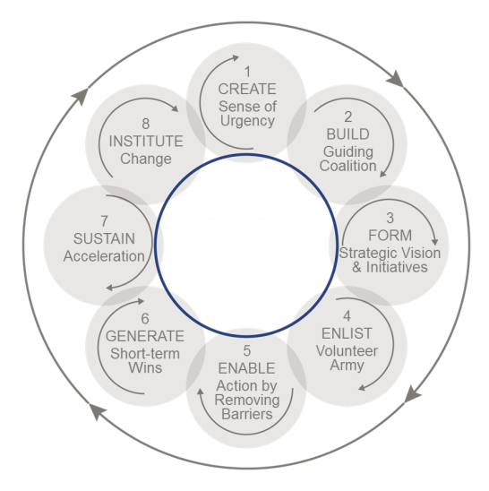
8 Steps to Accelerate Change
© 2016 Kotter International

Slide 3
Create a Sense of Urgency
STEP 1
Leaders must describe an opportunity that will appeal to individuals’ heads and hearts and use this opportunity to engage an urgent army of volunteers.
© 2016 Kotter International

Slide 4
“
…the core of the matter is always about changing the behavior of people, and behavior change happens in highly successful situations mostly by speaking to people’s feelings.
– John Kotter and Dan Cohen, The Heart of Change
”
© 2016 Kotter International

Slide 5
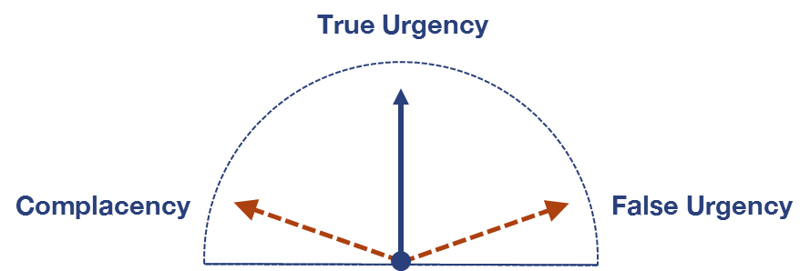
What Do We Mean by Urgency?
© 2016 Kotter International

Slide 6
What Does True Urgency Look Like?
When this happens…
You have …
No recognition of the need to change; desire to maintain the status quo; “we’ve done just fine in the past, we don’t need a change”
Complacency
Shifting focus; frenetic/frantic activity (meeting after meeting, initiatives and projects piling up but nothing ending); worry and burnout
False Urgency
Focus and energy directed toward the important issues and on creating an environment where people can move forward
True Urgency
© 2016 Kotter International

Slide 7
Critical Mass
Think Broadly
Who needs to be urgent?
How many need to be urgent?
What keeps them from being
urgent?
50% + 1
Barriers
© 2016 Kotter International

Slide 8
Elements of an Opportunity Statement
WHAT and
WHY NOW?
WHY US?
WHAT DO WE
NEED TO
CHANGE?
WHAT IS IN
IT FOR US?
What is the
window of opportunity?
What is creating the
opportunity?
Why are we uniquely
positioned to take advantage of this?
What is the payoff?
What would need to change in order to take advantage of this opportunity?
What shifts must be realized?
Do differently?
What are the benefits to me?
What is in it for all other stakeholders?
© 2016 Kotter International

Slide 9
Characteristics of a good Opportunity Statement
Brief and simple = ½ page of straightforward language
Rational = appeals to the head in light of real data
Emotional = appeals to the heart
Positive = opportunities drive optimism
Authentic = the senior team (the authors) really believe it
Clear = unambiguous
Aligned = connected to the institution’s existing strategy
© 2016 Kotter International

Slide 10
Professional Membership Association
Together, we agree that the time is now to change the way we think and behave in order to shape our future.
To become a more valued, relevant organization, we will focus our priorities to:
Elevate public awareness
Advocate for the profession
Create and expand the sharing of knowledge and expertise to ensure a prosperous future for our members
Never before have we needed this level of bold, visionary leadership to inspire our professionals to work together and build a better world—through our practice.
© 2016 Kotter International

Slide 11
United Nations Agency
The full realization of women’s rights is the imperative of our time.
Our agency is the global champion for women and girls, the leading voice to
advance gender equality.
We are a driven, passionate team striving to implement change in women’s lives.
We have the trust of the countries and the global women’s movement that created us.
We are uniquely placed to galvanize the UN System, and draw on the expertise and collective
energy of our wide network of partners from all walks of life.
We can mobilize a global movement at a moment of renewed commitment to drive resources for
women’s empowerment.
A new roadmap for global progress is under way. There is growing recognition that sustainable development, peace and security, and human rights will remain elusive without women and men working together. Pervasive discrimination, inequality, and violence against women and girls limits all of humanity from acting as agents of change.
This is the moment to galvanize accountability for commitments made and forge a truly transformative agenda.
UN Women must and can seize this opportunity!
© 2016 Kotter International

Slide 12
United Way (Select Cities)
Economic, social and technological forces have ignited the power and passion of individuals to affect change through actions big and small.
United Way’s experience in bringing people and organizations together to solve community problems uniquely positions us to harness this extraordinary energy of individuals to do the seemingly impossible.
We will connect people to purpose and powerful experiences that unleash life’s possibilities by:
Understanding the hearts and minds of individuals, meeting them where they are and inspiring them to action:
Making it easy for people to bring others along
Investing in and fully leveraging technology to create lasting personal and emotional connections
Connecting people who are helping to those who are helped
Continuously learning and bringing outside voices in.
In order to succeed we will take risks, be courageous and BOLD.
Together we will change lives forever.
© 2016 Kotter International

Slide 13
Key Principles for Leading Change
Management and Leadership
Have to vs. Want to
Head and Heart
Select Few vs. Diverse Many
© 2016 Kotter International

Slide 14
8 Steps to Accelerate Change
© 2016 Kotter International

Slide 15
Thank you!

