Slide 1
How Intentional Change Leadership Can Help Your iPASS Implementation Succeed
iPASS: Transformative advising and planning reform for increased student success

Slide 2
Why iPASS?
The power of integrated planning and advising services lies in their ability to spur transformative change, rather than merely promote efficiency.
For Montgomery County Community College
iPASS is the accelerator, the momentum builder, with the effort touching and empowering all internal stakeholders.

Slide 3
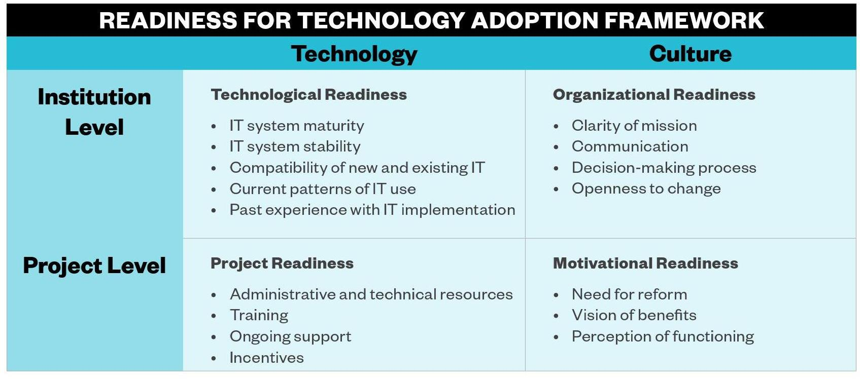
Montgomery County Community College’s Readiness for the Work
Karp, M. M., & Fletcher, J. (2014). Evaluating your college’s readiness for technology adoption. New York, NY: Columbia University, Teachers College, Community College Research Center.

Slide 4
Transformative Change
Organizational growth and development that combines structural, process, and attitudinal change.
Structural Change
Attitudinal Change
Process Change

Slide 5
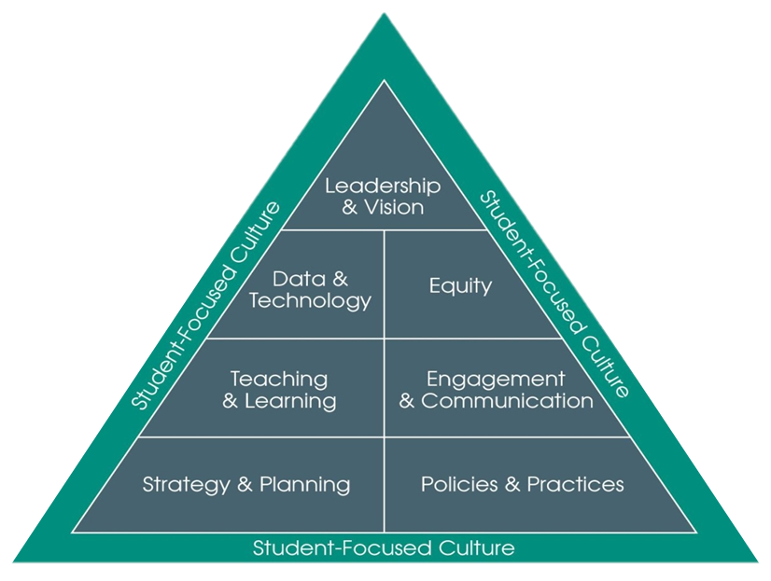
Building Capacity Through iPASS

Slide 6
Montgomery County Community College’s New Student Pathway

Slide 7
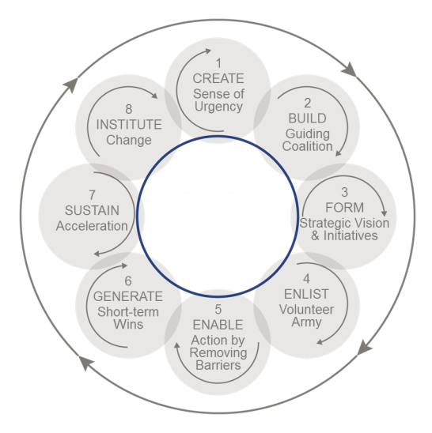
8 Steps to Accelerate Change
© 2015 Kotter International

Slide 8
Four leadership types
Visionary: Both institutional leaders and project leaders were adaptive.
Presidential: Institutional leaders were adaptive, but project-leaders were technically-focused.
Divided: Institutional leaders were technically-focused, but project leaders were adaptive.
Technological: Both institutional leaders and project leaders were technically-focused.

Slide 9
Questions to Consider
What fundamentals (resources, culture, tools, talent, and policies/practice) need to be in place or developed to successfully take on and implement an effort like iPASS?
What strategies are most useful to garner the necessary internal stakeholder buy-in to accelerate and sustain implementation?
How will success measured in the long term and what additional strategies and supports (including resources) might be needed to really leverage the power of the technology?

Slide 10
Common Challenges
Engagement & Communication
Effective communication of project vision to all stakeholders
Initiative fatigue and time/resource constraints
End-user adoption of technology/behavioral change
Effective training models for faculty and students
Data & Technology
Integrating multiple student success technologies
Identifying most valuable data (lead and lag) to track for various stakeholders
Building and maintaining effective relationship with multiple vendors
Advising Policies & Practices
Effective advising models tailored for various students, for example for dev ed students or STEM students
Starfish flag management
Scaling the work
Strategy & Planning
Alignment with other student success work
Efficient and effective change management
How to maximize resource efficiency to help build sustainability

