Slide 1
Aligning iPASS and Guided Pathways
Notes:
Mei-Yen
Frame as reform for 2 and 4 years

Slide 2
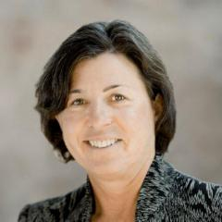
Welcome and Introductions
Dr. Karen A. Stout
President & CEO
Achieving the Dream
Melinda Mechur Karp, Ph.D.
Assistant Director
Community College Research Center
Notes:
Mei-Yen (2 min)
Welcome
Set context for why this webinar topic
Introduce Karen and Melinda
Overview structure for webinar and Q&A

Slide 3
Outline for Presentation
Context for Guided Pathways
Context for iPASS
Alignment of Key Components of iPASS and Guided Pathways
iPASS and Guided Pathways as Transformative Change
Institutional Capacities to Support iPASS and Guided Pathways
Questions to Consider
Audience Questions
Notes:
Mei-Yen

Slide 4
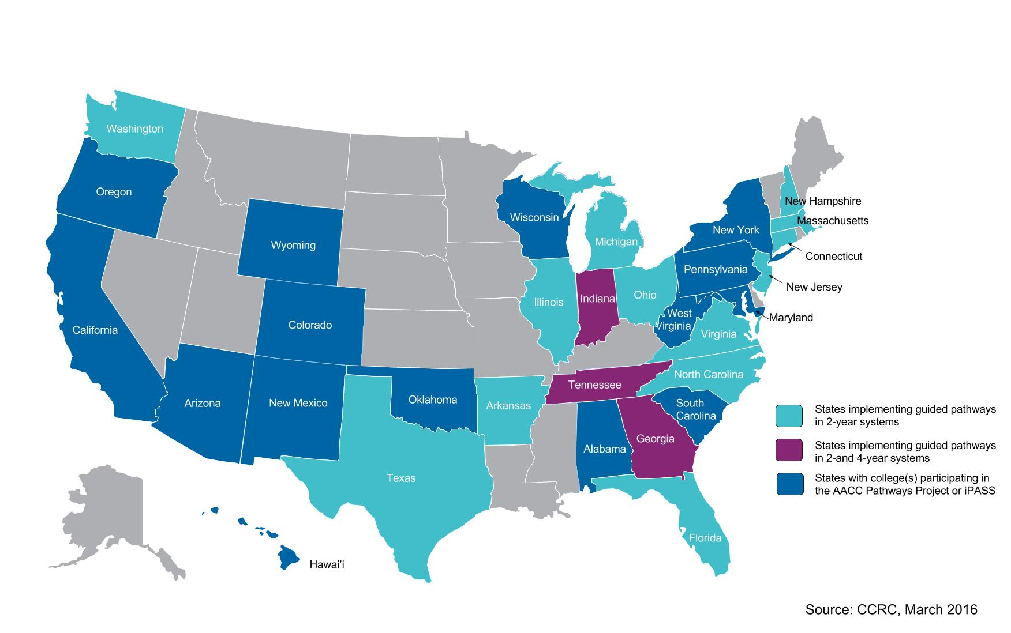
States Where Systems or Networks of Institutions are Pursuing Guided Pathways or iPASS
Notes:
Karen
Coordinated efforts to scale pathways

Slide 5
Context for Guided Pathways
Clarifying curricular paths
Helping students get on a path
Keeping students on a path
Ensuring learning: Program learning outcomes
Notes:
Karen

Slide 6
The Movement Towards Guided Pathways
Developmental Education Initiative begins to looks at building pathways through dev ed and into credit-bearing courses
2009
Completion by Design created to develop comprehensive pathways to completion
2011
University Innovation Alliance begins to innovate scalable student success solutions
2014
Policy makers and educators begin to question low completion rates
2000
AACC and partners begin ambitious pathways project
2015
Achieving the Dream (ATD) begins to changes the conversations from access to access and success
2004
ATD experience shows more holistic reform needed
2009-10
iPASS Round 1 grant work begins
2012
CCRC publishes comprehensive call to action to build guided pathways to completion for all students
2015
AASCU’s Reimagining the First Year project begins
2016
Notes:
Karen

Slide 7
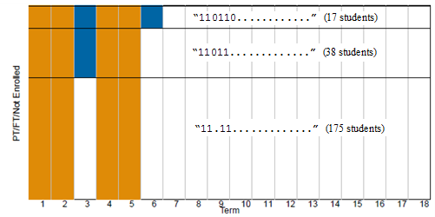
Ideal Student Pathways
Source: Crosta, 2013.
Notes:
Melinda
What we think students do

Slide 8
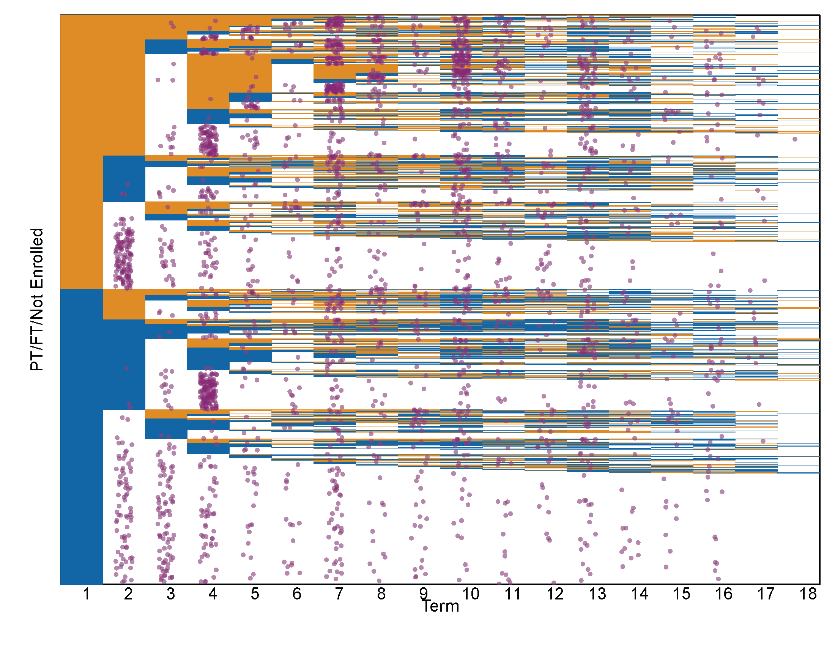
Actual Student Pathways
Source: Crosta, 2013.
Notes:
Melinda
What students actually do
A lot of ways to get to finish line (or not)
Many not navigating successfully

Slide 9
New Students Want to Know
What are my career options?
What are the education paths to those careers?
What courses do I need to take?
How long will it take to complete a credential and how much will it cost?
How much financial aid will I receive?
Will my credits transfer?
Notes:
Karen
Perspective from the field: Intake and getting students on path

Slide 10
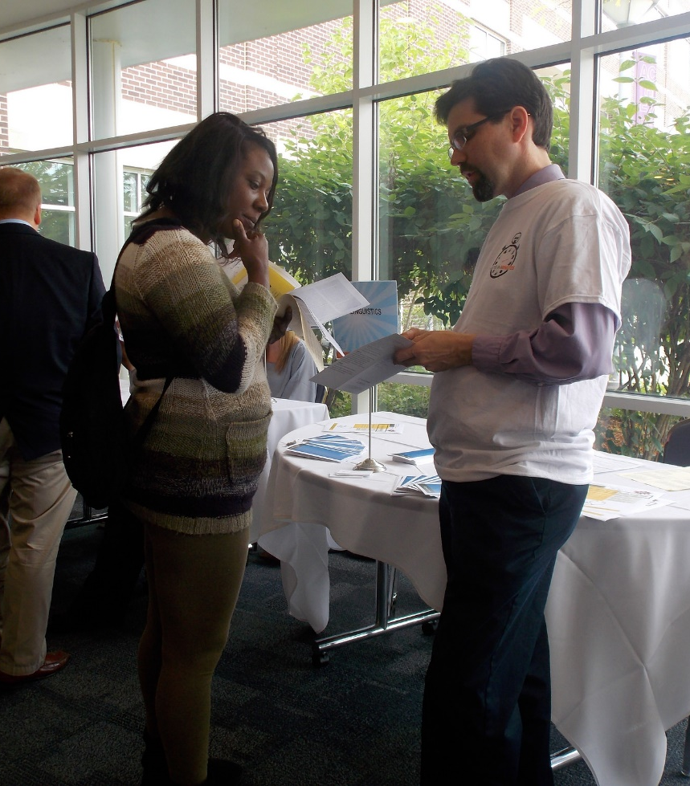
Returning Students Ask
How far along am I toward completing my program? Am I on-schedule?
How much more will I have to pay?
What will I need to take next term and what will my scheduled be?
What if I want to change programs?
How can I get work experience in my field of interest?
Notes:
Karen
Perspective form the field: Progression and completion

Slide 11
Guided Pathways
Clear roadmaps to student goals
Churning
Early transfer
Intake redesigned as an on-ramp
Completion
Excess credits
Students’ progress closely tracked
Time to degree
Learning outcomes/assessments aligned across programs
Skill building
Notes:
Melinda
Translation from Karen’s perspective from the field (previous slides)
Here are some ways colleges have moved forward with first step of clarifying pathway….transition to screenshots…

Slide 12
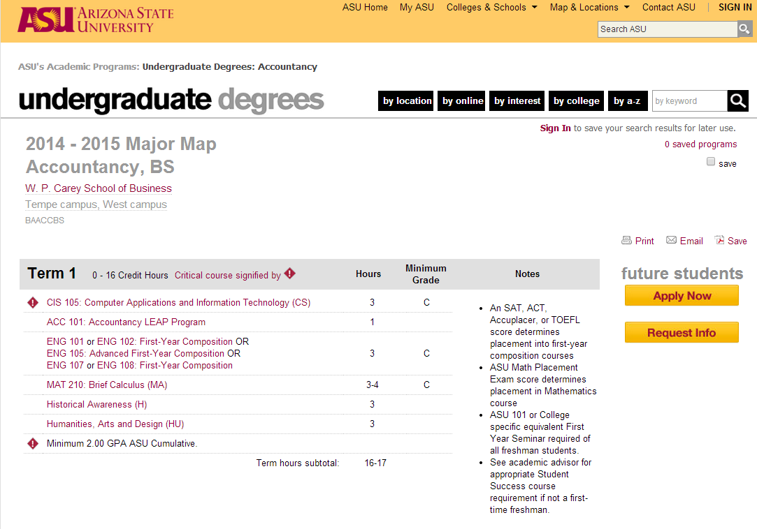
Notes:
Melinda

Slide 13
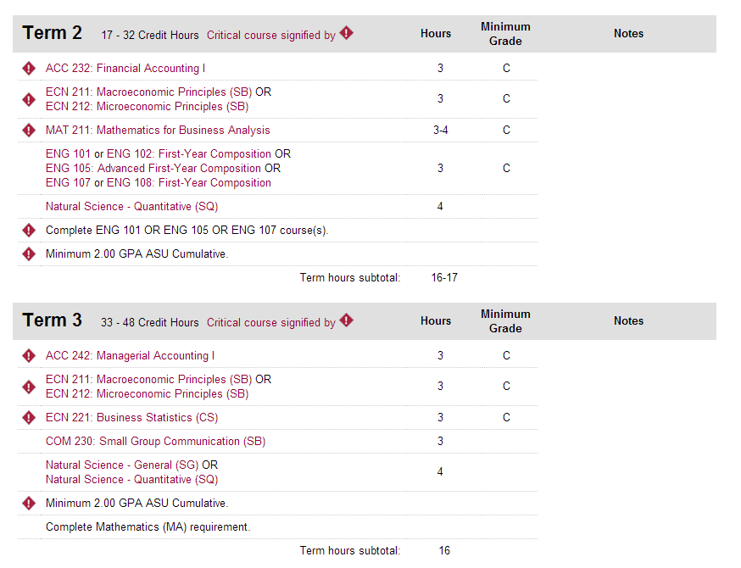
Notes:
Melinda

Slide 14
Notes:
Melinda

Slide 15
Notes:
Melinda
St.Petersburg College
Associate in Science
Environmental Science Technology

Slide 16
Notes:
Melinda
St.Petersburg College
Associate in Science
Environmental Science Technology

Slide 17
Notes:
Melinda
St.Petersburg College
Associate in Science
Environmental Science Technology

Slide 18
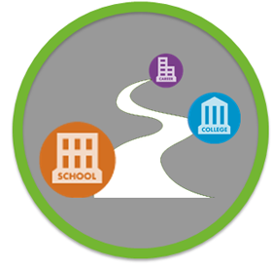
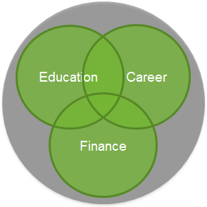
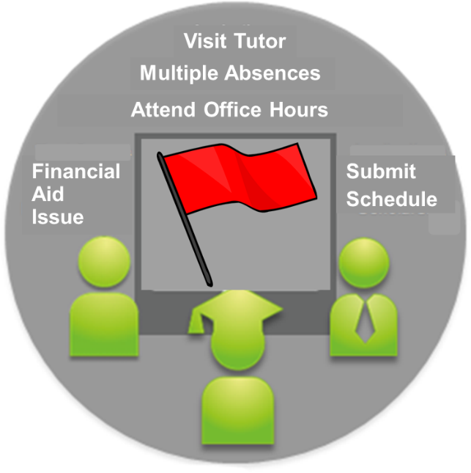
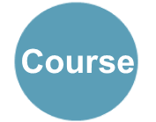
Integrated Planning and Advising for Student Success (iPASS)
+
+
Course
Degree Planning
Coaching & Advising
Early Alerts & Risk Targeting
Notes:
Melinda
Very brief overview of iPASS (since the audience are all iPASS grantees, not much needed)

Slide 19
Definition of iPASS
iPASS uses technology to promote, support, and sustain long-term intrusive and holistic advising relationships. Using technology enables personnel throughout the college to engage in advising and student support relationships that
approach student support as a teaching function;
touch students on a regular basis; and
connect them to the information and services they need when they need them, in order to keep students on track to graduation.
Notes:
Melinda

Slide 20
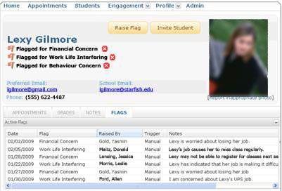
Notes:
Melinda

Slide 21
Aligned Redesign Approach
Guided Pathways | iPASS
Redesign the entire student experience | Support students through their entire experience from connection to the college through to transfer to a four-year institution or career.
Unify multiple student success initiatives | Integrate the myriad student support services and technologies that support students through degree and career planning, risk targeting and intervention, counseling and coaching, and transfer and articulation.
Begin with the students’ end goals in mind | Use technologies and services support students as they connect with the institution to learn about their education and career goals and support students to stay on the path to their goals.
Notes:
Karen
Both are redesign approaches focusing on the entire student experience
After clarifying program maps, it takes a lot of internal management to make systems intuitive and build out the connective power of the pathway. Requires unifying technologies and initiatives.
Focused on student education and career goals

Slide 22
Aligned Principles
Clarifying curricular paths: Degree maps; transfer articulation
Helping students get on a path: Coaching and Advising; Diagnostics
What is my path?
What are my career options?
What if I want to change programs?
What if I run into trouble?
What will I need to take?
What if I need an early intervention?
How do faculty and staff communicate to ensure my success?
Am I on track to graduate?
What will I need to take next term?
How can I get help?
Keeping students on a path:
Early Alert & Tracking; Degree Audit; Coaching
Ensuring learning: Program learning outcomes:
Tutoring; Analytics
What knowledge have I gained and how does it prepare me for further education or the workforce?
Notes:
Karen
Guided Pathways = white puzzle pieces
iPASS= yellow

Slide 23
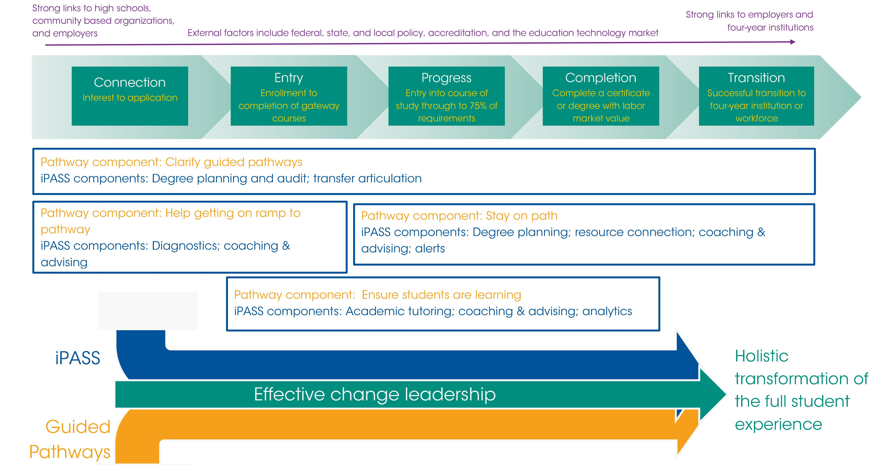
Alignment of iPASS and Pathways
Notes:
Karen
Summary—another way to summarize what we showed you
Key is that this is about change leadership…transition to transformative change framework

Slide 24
CCRC’s Transformative Change Framework
Structural change
Process change
Transformative change
Attitudinal change
Notes:
Melinda
EXAMPLE→
Structural change: Clarify degree pathway map (Guided Pathways) and implement degree planning tool to support advisors to work with students in a more coaching/proactive advising approach (iPASS).
Process change: Embedded, proactive advising and progress tracking is the system for student supports (Guided Pathways and iPASS)
Attitudinal change: Student support through Guided Pathways and iPASS is an institutional priority with broad ownership

Slide 25
Institutional Capacities for Transformative Change
Notes:
Karen
This is hard work—we’ve worked with many colleges and even those on the leading edge are not actually doing Guided Pathways and iPASS in the way the principles describe them.
Capacities needed to position an institution to do Guided Pathways and iPASS (transformative change)
Strength in seven capacities is key to iPASS and Guided Pathways success, particularly….(pick 2-3 to highlight)
Engagement & Communication: iPASS and Guided Pathways require broad engagement and buy-in from stakeholders across the institution. As grantees of iPASS, you all know from your Kotter Change Leadership training that communicating to build urgency is critical for success.
Leadership & Vision: iPASS and Guided Pathways are transformative institutional change efforts and strong leadership (leadership that is cross-hierarchical and cross-functional) as well as having a vision that is aligned across all levels of the organization is crucial.
Teaching & Learning: Developing clear roadmaps requires difficult and intentional conversations within departments and clear expectations so that when students are creating their degree maps (a part of iPASS) the maps can be a powerful tool for students.
Data & Technology: Can you do Guided Pathways without iPASS or vice versa? Both require strong data & technology to be successful.
Equity: This is one of the most crucial capacities for iPASS and Guided Pathways and it is mostly likely to be overlooked. As we redesign the student experience, are we assuming a one-size fits all approach to a students’ progression through the pathway? How are we incorporating equity-minded practices in the development of Guided Pathways and iPASS? This is particularly illuminated with the increasing focus on predictive analytics in iPASS.
Strategy & Planning: Pursuing iPASS and Guided Pathways is a long-term process, cannot be completed in one academic year. Strong institutional capacity in strategy & planning will ensure the transformative change takes roots and has the desired impact.
Policies & Practices: As CCRC’s definition suggests, transformative change requires institutionalization of new policies and practices within the culture of the organization. iPASS and Guided Pathways are more than boutique interventions but need new policies and practices for real adoption to take place.

Slide 26
Questions to Consider
For those actively pursuing iPASS and Guided Pathways
For those actively pursuing iPASS and heading towards Guided Pathways
What structures or processes have you put in place to ensure they are being pursued as a cohesive transformative change strategy rather than as isolated initiatives?
What specific changes are you producing through iPASS and Guided Pathways that address all levels of transformative change (structural, process, and behavioral)?
Consider mapping the ways in which your iPASS systems will support the Guided Pathways reform.
What momentum from iPASS (urgency and buy-in) can you leverage to Guided Pathways reform?
What vision do you have for the student experience and how can iPASS and Guided Pathways get you there?
Click here to download CCRC’s Guided Pathways Adoption Self-Assessment
Notes:
Karen
To what extent are your Guided Pathways and iPASS efforts adhering to the principles and approach we discussed today?
Note link to Pathways readiness self-assessment
Emphasize that these are both long-term processes – not over one year or even one grant cycle
Plug June webinar on Integrating and Mapping Student Success Initiatives (details on next slide)

Slide 27
Questions and Comments?
Upcoming Webinars
Wednesday, June 8th at 3:30pm EDT | iPASS grantees on integrating student success initiatives
July TBD | Designing the Student Interface
Notes:
Mei-Yen facilitate/read questions from the audience for Melinda and Karen to respond to

