Slide 1
Northeast Wisconsin Technical College Green Bay, Wisconsin
Christine Lemerande, Early Alert System Manager
Kelly Casperson, Academic Advising Manager

Slide 2
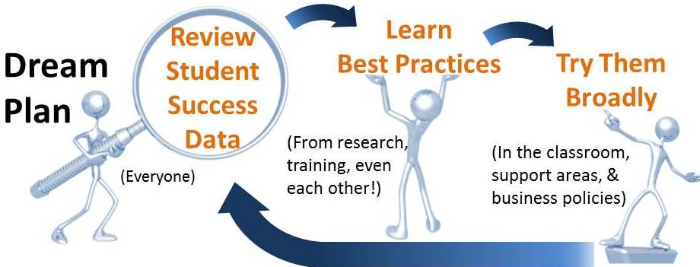
Culture of Student Success
Notes:
Structure and process:
Dream Core team
Data Jedi
FORCE docs
Dream leading indicators

Slide 3
2016 Community College Survey of Student Engagement (CCSSE)
Notes:
Create an environment that minimizes bad habits of students
Proactively put things in place to create the right behavior instead of waiting for the wrong one to occur
Leverage strong instructor to student relationships to influence engagement and motivation
Optimize the student success network – resources and academic support services
Engage students who need help the most in support services available
Persistence data is lower than we’d like
Helped us engage campus community in redesign

Slide 4
Using Evidence to Support Redesign
iPASS
Round 1 2013-2014
Intervene earlier with non-cognitive and predictive
Early alert and transparency for faculty and staff
Starfish Early Alert and Connect
Intake survey, predictive analytics, and integrated faculty & academic advising
Round 2 2015-2018

Slide 5
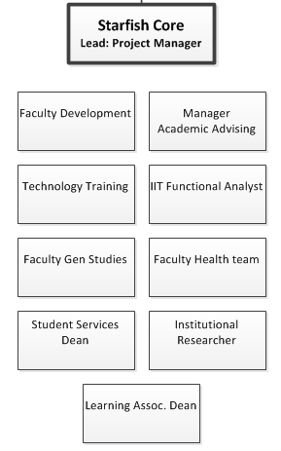
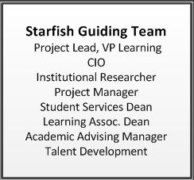
Starfish Organization

Slide 6
Evaluation and Refinement: Flags, Kudos, Referrals
Semester | Kudos | Flags | Referrals | Students
Fall 2013 | 1,725 | 1,375 | 0 | 1,353
Spring 2014 | 12,250 | 7,363 | 0 | 6,193
Fall 2014 | 12,228 | 8,053 | 402 | 6,567
Spring 2015 | 14,570 | 7,533 | 915 | 6,830
Fall 2015 | 14,682 | 7,374 | 997 | 6,792
Spring 2016 | 13,614 | 7,835 | 1,048 | 6,384
Notes:
Data from using Starfish: what to do with it?
Fall 2014: Focus on using system for referrals
Large-scale initiative at scale: how to keep momentum?
Spring 2015: surveyed students and faculty
Focus on monitoring flags raised and closes
Focus on getting students to services they need

Slide 7
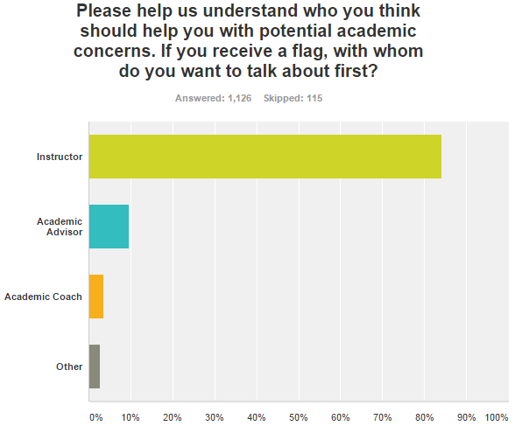
Evaluation and Refinement: Flag workflow
Notes:
Use this response to help build flag and referral mapping
Reinforces what we were hearing from faculty, students, and advisors

Slide 8
Culture Reinforced by Evolving Business Practices
Building a core team to manage software and systemic change
Moving Advising from reactive to proactive
Giving IIT a collaborative voice in the project
Making referrals much easier and more targeted
Intentionally documenting communication from faculty
Requiring adjunct faculty training

Slide 9
Evaluation and Refinement: Student Intake Survey
Creating the team
Research
3) Building the survey
Notes:
Building the survey:
Creation of the team, research of non-cognitive surveys, decision to map questions to existing services
NWTC developed a 14 question survey to administer to new program students during their registration session with Academic Advisors
Questions seek to provide data that we do not currently collect from students/non-cognitive factors (i.e. How many hours do you plan to work per week while enrolled in classes? Do you have reliable transportation? How certain are you of your career/program choice? )
Based on students’ responses, they receive Starfish referrals to services that may be of assistance to them
Using the survey:
Connecting questions to teams
Expectations
How to close referrals
Getting referrals to teams
Student Services teams are reaching out to these students and “clearing/resolving” the referrals prior to the start of the Fall 2016 semester
Questions will enhance predictive analytics after 3 years of answers
Integrating into new student reg process
System not ready at first: used survey monkey, needed reporting,
Data now all in Starfish
Development of hierarchy of referrals, decision based off volume a way to manage the number of referrals received
Clear referrals by 4 weeks into survey
“regular” referrals in starfish based on observed behavior

Slide 10
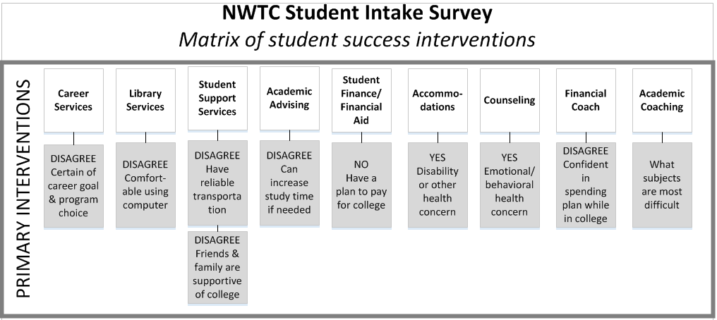
Evaluation and Refinement: Matrix
Notes:
Hierarchy:
Data now all in Starfish
Development of hierarchy of referrals, decision based off volume a way to manage the number of referrals received
Clear referrals by 4 weeks into survey
“regular” referrals in starfish based on observed behavior

Slide 11
Evaluation and Refinement: Results
Notes:
Hierarchy:
Data now all in Starfish
Development of hierarchy of referrals, decision based off volume a way to manage the number of referrals received
Clear referrals by 4 weeks into survey
“regular” referrals in starfish based on observed behavior

Slide 12
Evaluation and Refinement: Qualitative Analysis
Feedback Loop with Student Services
Flash Focus Groups – Student Interviews
Notes:
How we’re learning what needs to be changed
Feedback loop with services, meet every 3 weeks
Data Jedi student interviews at Welcome Week
What needs to be changed
Students don’t remember taking survey
Students not checking email in summer
Some students want contact in summer, some in fall
Additional questions to ask
Services needed more training on process
Faculty connection to students increased persistence
Student feedback—Career services referrals, Counseling and Accommodations
CCCSE: students are aware of support services

Slide 13
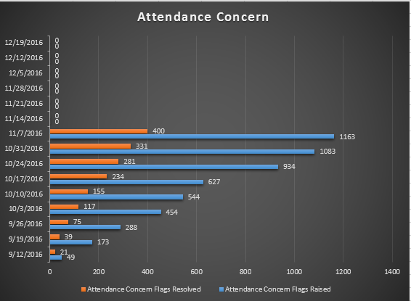
Evaluation and Refinement: Leading Indicators
All Learning departments meet weekly to focus on the same data

