Slide 1
From Throwing Stones to Creating Ripples: Ramapo’s Approach to Student Success
Christopher Romano, Vice President of Enrollment Management and Student Affairs
Joseph Connell, Assistant Vice President of Student Success
Ramapo College of New Jersey October 2016

Slide 2
Ramapo College of New Jersey
Founded in 1969
Approximately 6000 students
~5800 undergraduate students
~ 200 graduate students
51% of students live on campus
Designated by the State as “New Jersey’s Public Liberal Arts College”
Fall 2014 First-Year Class:
978 students
Average SAT of 1162
31% of class meet institutionally approved diversity metrics

Slide 3
Throwing Stones: The Old Model
Educational Opportunity Fund Program (EOF), Office of Specialized Services and Athletics sent faculty members multiple surveys at different times of the semester asking for student updates
Faculty reported not as much “loop closing” if feedback was submitted
Chance that if a student was both EOF and Athletics affiliated, faculty would end up receiving two different surveys at two varying times for the same student
Surveys took significant amount of time either because of manual student/course entry or continuous copy/paste
These populations accounted for less than 30% of the incoming class annually
What about the other 70%?
New Strategic plan calls for increased first-year retention rates and increased four and six year graduation rates.
How do we build on the old model to achieve this goal?

Slide 4
Increase student success by getting students with early signs of academic problems the help they need earlier in the semester.
Improve the old early alert system to make it easier for faculty to communicate with the constituencies that provide help mid-semester and create a one-stop-shop that will take less time each semester.

Slide 5
Change work needs to be small enough to be manageable, but big enough to be meaningful.
5 Years
Long-term goals
3 Year
Qualitative Data
Trend Data to Inform/Support Initiative
1 year
Small Wins
Manageable and incremental targets that if met will encourage support to make it to 3 year plan.
Targets that if met, support making it to five year targets.
Targets that if met, move College forward towards institutional goals.
Include extended planning horizon and longer term outcomes.

Slide 6
Connect Implementation Goals Year 1
Goal 1: Reduce the number of units sending academic progress reports to faculty
Measure: Number of forms sent to faculty
Target: Reduce number of forms from 3 to 1
Finding: Met
Goal 2: Increase percentage of academic progress reports submitted by faculty
Measure: Number of surveys received by units
Target: Establish baseline of surveys received in 2013-2014; compare baseline to numbers received by units in 2012-2013
Finding: 77% of faculty submitted academic progress reports during the 2013-2014 Academic Year and over 56% of courses had surveys completed. (No unit had previously achieved a 50% survey completion rate)

Slide 7
Connect Implementation Goals
Goal 3: Provide earlier outreach to academically at risk students as identified by academic progress reports, grades and other early alerts
Measure: Number of contacts with at-risk first-year students on a monthly basis
Target: Establish baseline of contacts made in 2013-2014; compare baseline to numbers made by units in 2012-2013 (approximately 20%)
Finding: Percent of Academic Warning first-year students who met with their advisor twice on or before 4/2/14 course registration date was 30.9%. (In 2012-2013, CAAFYE met with less than 20% of first-year students on academic warning two times in the spring semester)

Slide 8
Adjust Goals Based on Feedback
Faculty
Requested the ability to comment on more students via progress surveys
Requested there be less choices on the survey to minimize sideways scrolling
Students
Appreciated finding some of their resources in one place, but hoped for more
Offices
Began questioning what is Connect?
How do we get involved?

Slide 9
Connect Goals and Outcomes: 2014-2015
1
Expand student’s Success Network
2
Increase percentage of academic progress reports submitted by faculty
3
Provide earlier outreach to academically at risk students as identified by academic progress reports, grades and other early alerts
4
Expand and streamline progress surveys to serve more students with more targeted feedback.

Slide 10
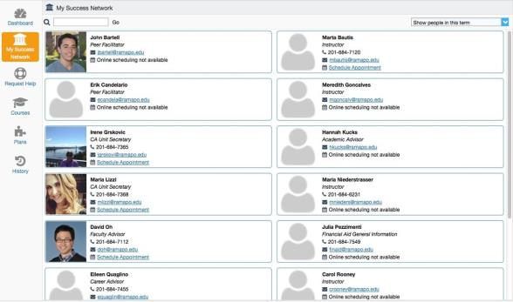
Connect Goals
Goal 1: Expand the student’s success network.
Year 1 Offices:
Center for Student Success
EOF
OSS
Athletics
Adult Degree Completion Program
Cumulative: 5 offices
Year 2 Additional Offices:
Cahill Career Development Center
Financial Aid
Residence Life
Roukema Center for International Education
Cumulative: 9 offices
Year 3 Additional Offices:
Student Affairs
Dean of Students
Teacher Education
Connect Screenshot of a Student’s Success Network
Cumulative: 12 offices

Slide 11
Additional Students. More Targeted Feedback.
2013-2015 Student Populations | 2015-2016 Student Populations
First-Year Students | First-Year Students
Sophomore Students | Sophomore Students
Athletics | Juniors
EOF | Transfers
OSS | Athletics
Academic Warning | EOF
 | OSS
 | Academic Warning
2013-2015 Progress Survey Items | 2015-2016 Progress Survey Items
Academically at Risk | Academically at Risk
Attendance Concern | Attendance/Participation Concern
BIT Concern | Center for Reading & Writing Referral
Center for Reading & Writing Referral | Good Work
Great Work | Missing Assignments
Low Participation
Missing Assignments
Low Quiz/Test Scores
Showing Improvement Kudos

Slide 12
Connect Quantitative Feedback
Question: As a result of the messages from connect@ramapo.edu that indicated opportunities for improvement in your courses, please specify if you followed up with any of the following campus resources; check all that apply.

Slide 13
3 Year Findings

Slide 14
Closing the Loop: First Year Students

Slide 15
Student Meetings Regarding Academic Probation

Slide 16
Connect Qualitative Feedback
1
EOF Advisor
3
Student Success Advisor
Working with Connect has made the advisement process more interactive between the students and myself. It really is a great central system that has even more capabilities than we are currently doing. I think the biggest relationship it has improved has been between student and faculty member. Students get flagged and once I have been able to get in touch with them, a lot of them have already spoken to their faculty member. It has given the students a better sense of ownership in terms of their progress.
Connect identifies students who are struggling or are having academic difficulty, which is a benefit to the student and me. We are able to determine the support mechanisms needed.
2
OSS Advisor
4
Faculty Member
I believe I am better informed about how my students are doing in the classroom. Connect has often prompted me to reach out to a student that I might have otherwise overlooked. When students receive a Connect report from a professor they respond more proactively than an email just from me.
As an adjunct last semester, Connect managed to scare some of my students into doing their missing assignments. It was effective too because the athletics department intervened in response to my referral and told a student he could not come to practice until I said his work was turned in.

Slide 17
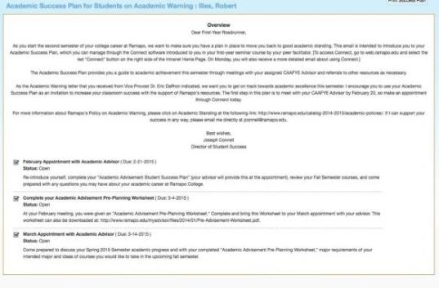
Looking Forward
Expand use of Success Plans: 1) Create plans for all first-year students; 2) Create plans for career development activities; 3) use to support all students with less than a 2.0
Analyze impact of certain flags on first year student retention and incorporate into Predictive Modeling
Add Degree Planning

Slide 18
Questions?
Joseph Connell
Assistant Vice President of Student Success
jconnell@ramapo.edu
Chris Romano
Vice President of Enrollment Management and Student Affairs
cromano@ramapo.edu

