Slide 1
iPASS Community Webinar Student-facing Solutions to Address iPASS:
Current Views from
Montgomery County Community College
and
West Virginia University
September 28, 2016

Slide 2
Blackboard Dashboard for Students

Slide 3
IPAS

Slide 4
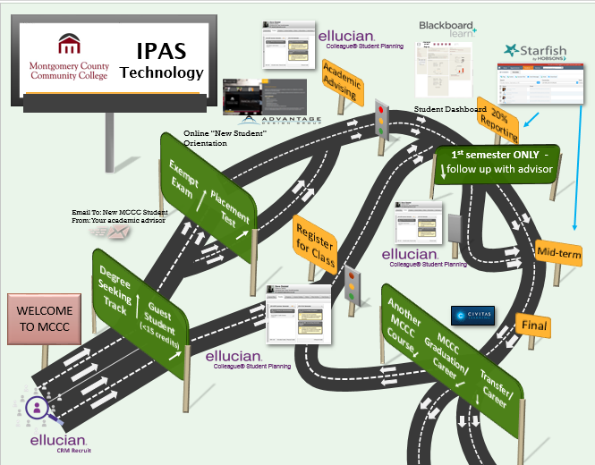
IPAS Technologies

Slide 5
Blackboard Dashboard
Why here?
Meet students where they are!
Why this design?
Had to scrap the first one

Slide 6
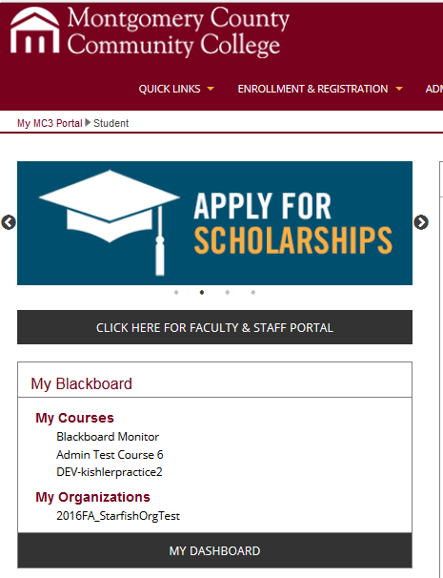
Where is it found?
Can be found directly as a link on student portal or as soon as a student accesses Blackboard

Slide 7
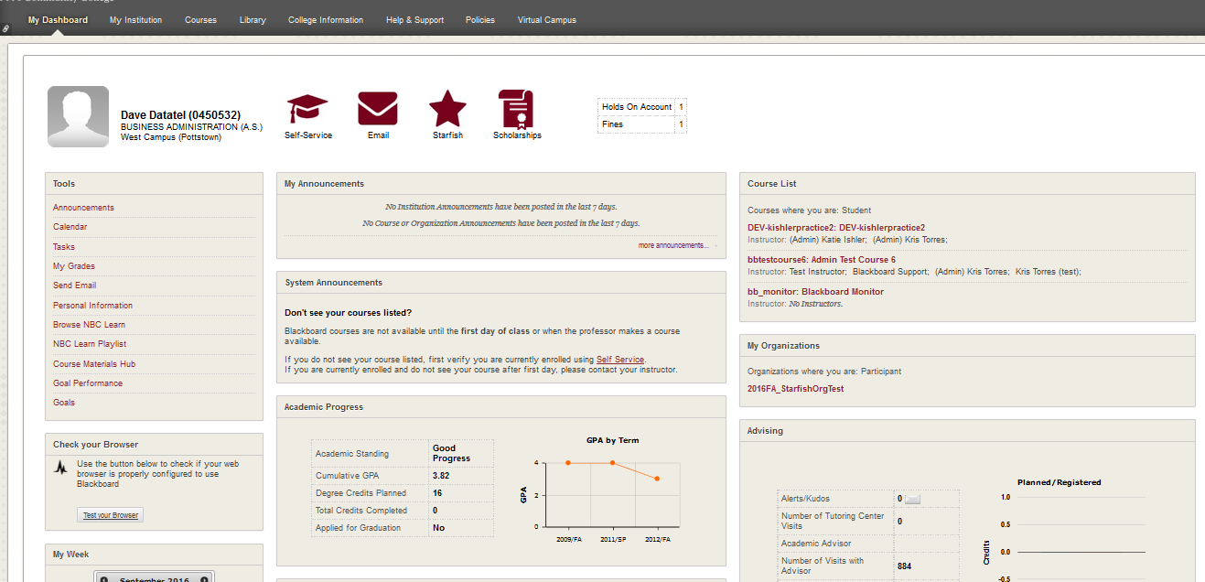
What students see

Slide 8
Where the data comes from

Slide 9
Demographic information
Demographic information -Name -ID number -Program of study -Campus location Actionable links -Self-Service -Student email -Starfish -Scholarships

Slide 10
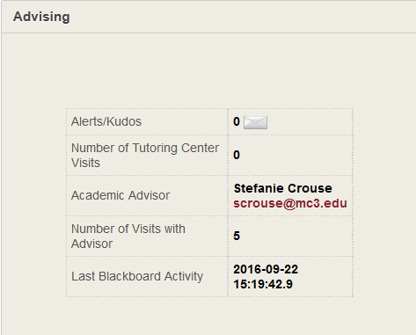
Advising Information
Any Starfish early alerts (link to Starfish)
# of Tutoring Center visits
Advising information (including email link)
# of visits with advisor
BB activity

Slide 11
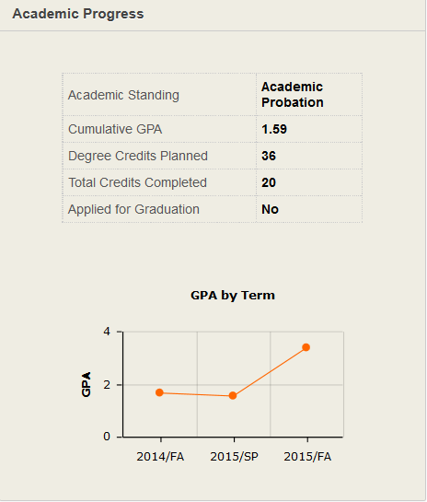
Academic Progress
Academic Standing
Cumulative GPA
Degree Credits Planned
Total Credits Completed
Applied for Graduation
GPA by term (visual)

Slide 14
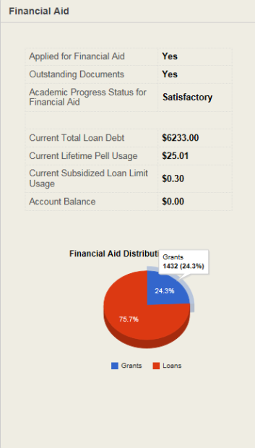
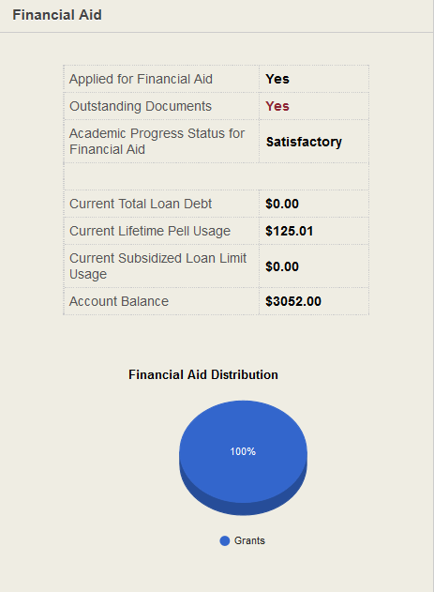
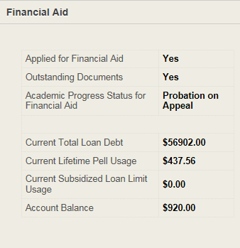
Financial Information

Slide 15
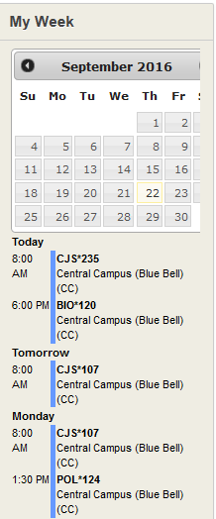
My Week

Slide 16
Final Thoughts
Meeting students where they are
Future goal → put on the student portal
Raise awareness and make more actionable steps

Slide 17
Questions?
Stefanie Crouse
scrouse@mc3.edu

Slide 18
Guiding Students Towards Success

Slide 19
Customized Journeys Shepherd Students Through Their Biggest Challenges
Where Do Students Say They Need the Most Help?
Orientation and Onboarding
Major and Career Exploration
Academic Performance
Financial Aid
Campus Engagement
Career Preparation
Administrative Hold Resolution
High
How a “Journey” Works
Med
Open Case in SSC-Campus
Low
Notify When Off Path
Connect with Resources
Define a Customized Path
Proactively Prompt Actions
Validate When Back On Path
Analyze Trends

Slide 20
Customized Journeys Shepherd Students Through Their Biggest Challenges
Where Do Students Say They Need the Most Help?
Orientation and Onboarding
Major and Career Exploration
Academic Performance
Financial Aid
Campus Engagement
Career Preparation
Administrative Hold Resolution
High
How a “Journey” Works
Med
Open Case in SSC-Campus
Low
Notify When Off Path
Connect with Resources
Define a Customized Path
Proactively Prompt Actions
Validate When Back On Path
Analyze Trends

Slide 21
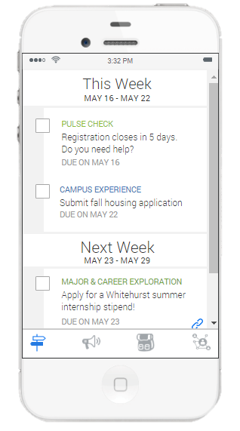
Guide: Including “students” in “student success”
Path
Personalized, chronological feed of tasks, events, and other curated content to give students 'turn-by-turn” directions
Self-Reported Data
“Pulse check” surveys and intake questions to uncover previously unattainable student data
Organizational Tools
Course schedule, calendar integration, and mobile appointment scheduling to promote positive habits
Support Network
Catalog of campus resources, including a student’s “coordinated care network” to facilitate fluid interaction and transparency of support
Interventions & Conversations
Trigger-based warnings and notifications to keep students on track with academic and administrative milestones
Academic Planning
Student-driven exploration and learning, including major selection and career planning

Slide 22
Guide: Including “students” in “student success”
WVU Focused
Existing & New Datasets
Landing page and app theme customized to mirror member institution’s branding
Powered by existing source system data and student, self-reported data
Multi-Modal Delivery
Intervention Workflow
Mobile-first app supported by desktop site and email, SMS, and push notifications
Configured to each member’s campus and modulated by student risk and preferences

Slide 23
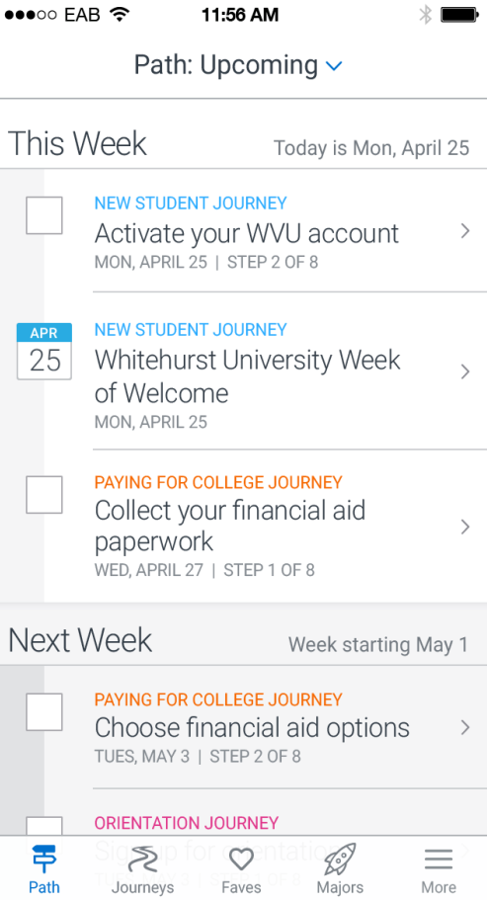
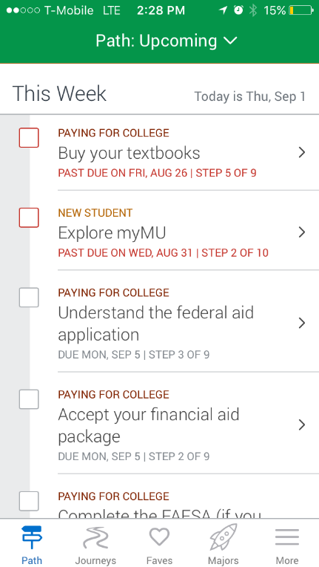
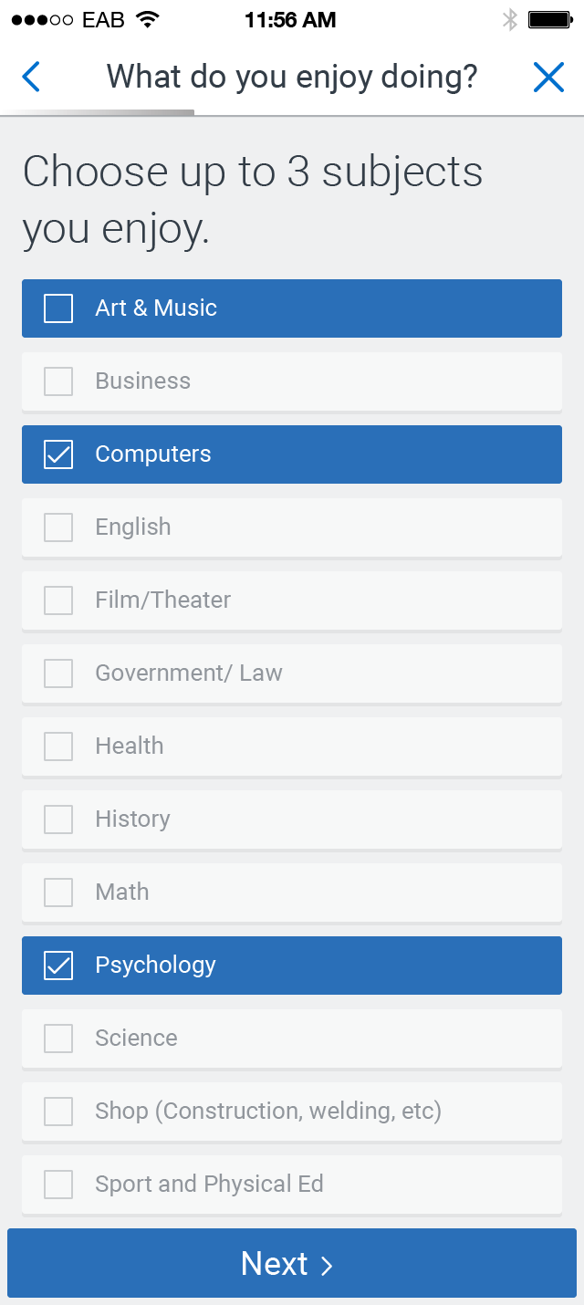
Smart Journeys for Students
What makes Guide’s Path Smart?
Auto-complete – SIS confirmation a task is actually done
Notifications – reminds via text, email, or push for the student
Resource connections – resources attached and linked to each journey
Segmented – content is custom for you as a user
Path items in chronological order
Auto-complete based on SIS data
Journey Topics
Paying for College
Get Involved
Work and Career
Health & Wellness
New Student
Academic Success
Degree Planning
Life Skills

Slide 24
Major Exploration
Three subjects do you enjoy
Three activities you enjoy (teaching, writing, organizing, etc.)
Three fields that interest you
Produces: Best Degree Matches, Hiring Demand, and Average Salary

Slide 25
Project Launch
Quick Implementation
3.5 months from Kickoff to live student users
No major bugs or crashes
Two releases since implementation with expanding features
<6
months from welcome call to launch
Smooth Pilot Launch
High adoption rate 55%+
Strong survey results
515
unique student users
85
Highest survey response
Launch
Top Completed Events
Welcome to West Virginia University-217
Learn the college basics-208
Complete major explorer-194
Apply for campus housing-158
Select room and roommate-158
Complete placement testing-157
Review orientation details-154
Register for orientation-151
Know your options before choosing classes-151
Learn about orientation-147
17
average # of steps marked complete by active users of 74 total steps thru fall
40%
completed major explorer

Slide 26
Pilot Survey Results Show Positive Early Reviews
Highlights from Summer Pilot Survey
N = 312 student users from 6 member schools
Selected Student User Quotes
68%
Users gave a likelihood of 7+ (1-10 scale) when asked if they would refer Guide to a friend
Overall, what could be added or changed to make app more helpful to you?
23%
Respondents who say they use Guide at least several times per week (9% daily)
“App is perfect.”
“Everything is right there on Guide I probably wouldn't add anything else”
“Nothing it's perfect”
“Nothing. Guide was so easy to use and very helpful!”
“Nothing!!! The app is wonderful!”
“Nothing, it was pretty amazing!”
“I believe it is great the way it is, everything was very easy to navigate through and keep track of.”
65%
Users who stopped using Guide report they will use it once the Fall semester begins
85%
Respondents found the content in Guide very easy, or somewhat easy to understand
90+%
Respondents claim finding the Guide app in the App Store, and logging in with SSO is very or somewhat easy
0%
Respondents who stopped using Guide did so because there is another app like it

Slide 27
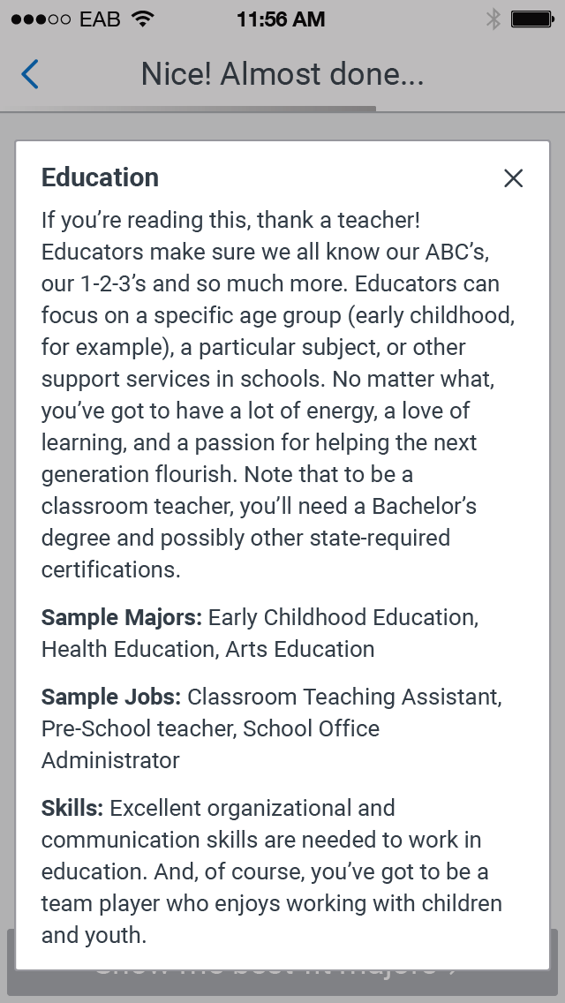
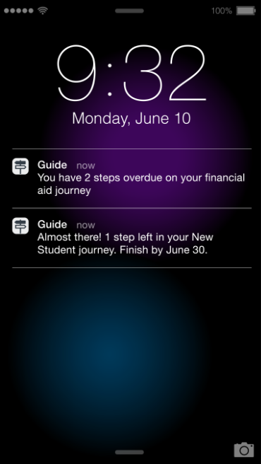
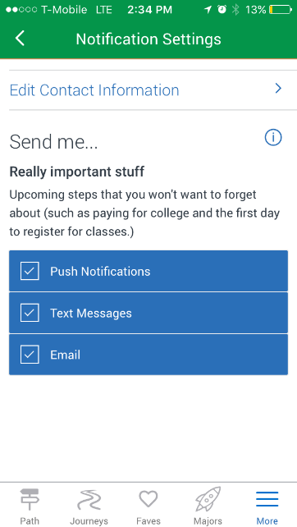
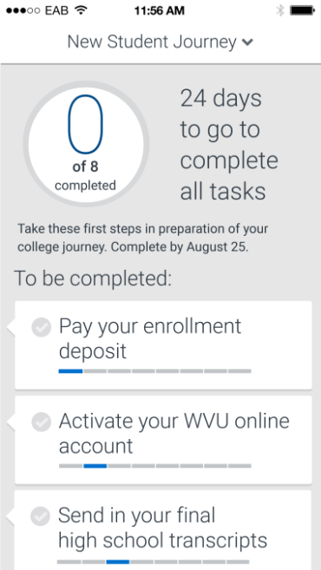
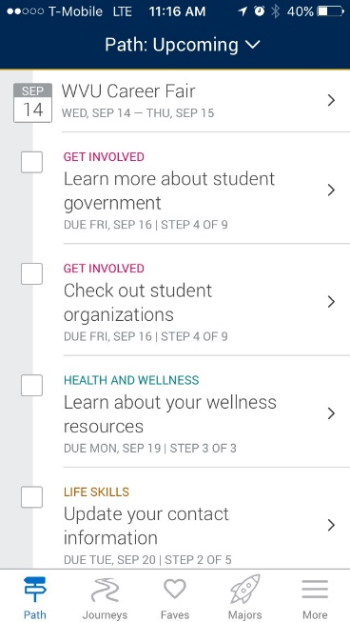
Nudges towards Success

Slide 28
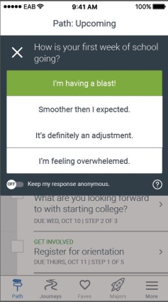
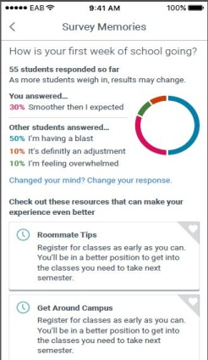
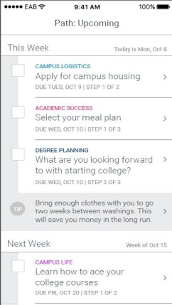
Quick Polls: Building Interaction
Quick Polls
Pulse check with students on how their college experience is progressing
Examine how valuable a university resource is and how it may be improved
Tips
Provide helpful, quick tips that students can choose to act on if they want to (not required)
Ensures content in Guide stays relevant and timely
Can include both general and college-specific tips

Slide 29
Final Thoughts
Action is the key – identification of students at risk not enough
We need to reimagine our support – allowing students to become self directed learners
Must coordinate – over message students
Need to think about what other data to include – and what data needs to feed what activities
Think small – no silver bullet

Slide 30
Contact Me
John P. Campbell
Associate Provost and Chief Information Officer
john.campbell@mail.wvu.edu

