Slide 1
Advisor Voices
University of Texas at San Antonio, Northeast Wisconsin Technical College, University of North Carolina at Charlotte

Slide 2
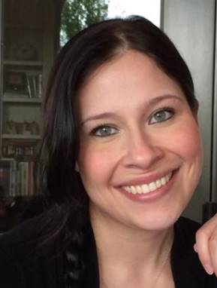
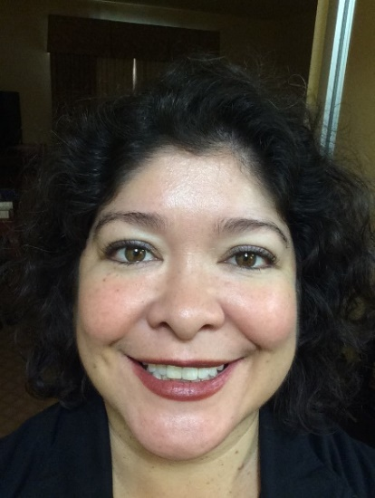
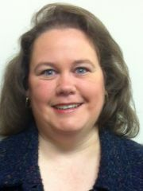
Today’s Presenters
Miranda Swain, University of Texas at San Antonio
Jackie Loden, University of Texas at San Antonio
Barbara Smith, University of Texas at San Antonio
Notes:
Miranda Swain is an Academic Advisor II at The University of Texas at San Antonio. She has been an academic advisor at the university for the last five years. She earned both her Bachelor’s degree in Humanities and her Master’s degree in Education: Reading & Literacy from UTSA. Her professional interests include advising theory, training & development, Positive Psychology, educational psychology, and student success.
Jackie Loden is the Director of the Arts & Humanities Advising Center at the University of Texas at San Antonio. She has been with UTSA Academic Advising for over 12 years. Her professional interests include positive psychology and student resilience, advisor training and development, and advising theories.
Barbara Smith is the Executive Director of Academic Advising at the University of Texas at San Antonio (UTSA). She earned both her Bachelor’s and Master’s degrees in Biology from UTSA. She has worked over 18 years in academic advising. She is committed to student success and the academic advising profession and has held various leadership roles in advising associations and currently serves on the NACADA Finance committee and Annual Conference committee. Her professional interests include advisor training and development, appreciative advising, and advisor professional development to enhance student success.

Slide 3
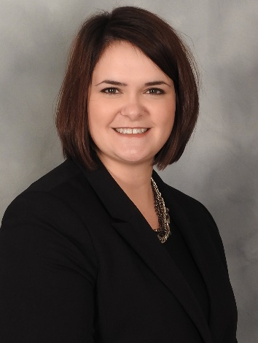
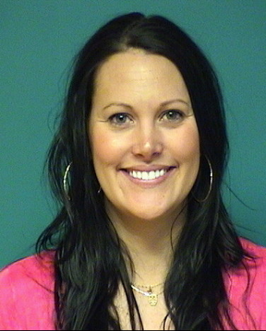
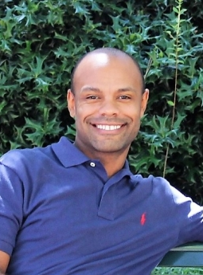
Today’s Presenters
Kelly Casperson, Northeast Wisconsin Technical College
Jenni Hyland, Northeast Wisconsin Technical College
LeeFredrick Bowen, University of North Carolina at Charlotte
Notes:
Kelly Casperson, Northeast Wisconsin Technical College’s Early Alert System Manager, recently transitioned from the role of Academic Advising Manager in May 2017. She holds a Master’s degree in Higher Education Administration from the University of Wisconsin-Milwaukee and a Bachelor’s degree in Communication Processes from the University of Wisconsin-Green Bay. Prior to her leadership roles, Kelly spent 3 years on the Academic Advising team at NWTC and 3 years in high school recruitment for the college. Her new role includes early alert system configuration, intervention assessment, and on-going user and student adoption. She is a member of NWTC's iPASS teams making decisions on the overall management of our system and initiatives.
Jenni Hyland has a Master’s Degree in Student Affairs and College Counseling from the University of Wisconsin-Oshkosh and a Bachelor’s degree in Psychology and Human Development from the University of Wisconsin-Green Bay. She started her career working with domestic abuse survivors and through that saw the positive changes education can make in people’s lives. She joined the academic advising team at NWTC in 2007 and works primarily with the college’s Nursing and Health Science program students. She provides leadership for NWTC’s New Student Registration programming and the Academic Advising team’s social media marketing.
Fred joined UNC Charlotte and the University Advising Center staff in April 2013. He was appointed Starfish Implementation Director in July 2014-May 2016 then became Director for Advising Systems in 2016 to Present. He still has the user experience as an advisor with a small caseload of students in his current roll. Prior to working at UNC Charlotte, Fred worked as an Academic Advisor for the Thomas Harriott College of Arts and Sciences at East Carolina University for over 2 years and worked as an Admissions Counselor at the Undergraduate Office of Admissions at ECU for over 4 years. Fred earned his B.A. in English is 2003 and then earned his M.A in English in 2010 from ECU.

Slide 4
Advisor Voice Panel
Miranda Swain, Academic Advisor II
Jackie Loden, Director of Academic Advising
Barbara Smith, Executive Director of Academic Advising

Slide 5
Our Experience
Mixed Emotions (Learning and Doing)
Cultural Shift
Establish More Professional Identity
Unity within the advising community
Proactive
Data driven decisions
Change

Slide 6
Surprise about Technology
Not a Failure if Move or Change Technology
Huge Investment of Time
Requires Continuous Updates/Maintenance
Not the Magic Bullet

Slide 7
Rewards
More Personal and Deeper Relationship
More Aligning of Policy and Processes
Strengthened Communication
Data Driven Decisions

Slide 8
Words of Wisdom
Prepare Staff to Utilize the Tool
Allow the Academic Advisor Time to “PLAY” with the System
Get Buy-in from All University Partners
Celebrate

Slide 9
Thank you
Miranda Swain
Miranda.Swain@utsa.edu
Jackie Loden
Jackie.Loden@utsa.edu
Barbara Smith
Barbara.Smith@utsa.edu
Notes:
If time permits.

Slide 10
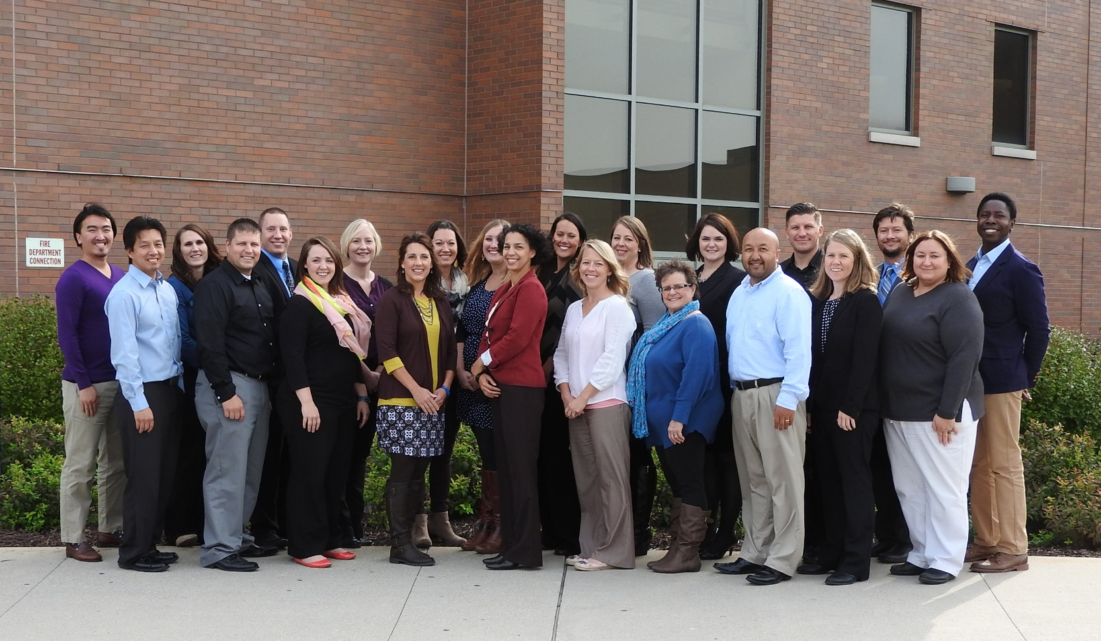
iPASS at NWTC: An Advising Perspective
Jenni Hyland, Academic Advisor
Kelly Casperson, Early Alert System Manager
Notes:
Julia

Slide 11
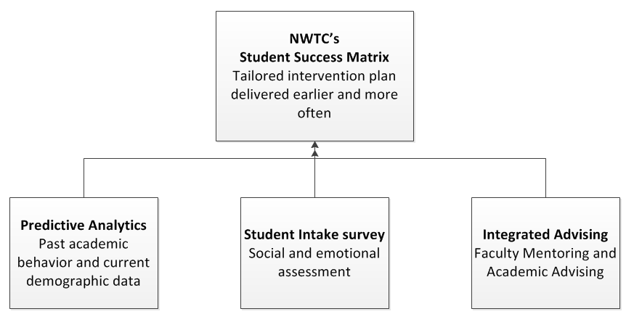
Integrated Planning and Advising for Student Success
Notes:
Hand out ipass cover sheet

Slide 12
Student Intake Survey
Can I get extra help with Math and English?
I’m not sure how I am going to pay my tuition or my rent.
Who can help me if I get overwhelmed with my responsibilities?
Notes:
Building the survey:
Creation of the team, research of non-cognitive surveys, decision to map questions to existing services
NWTC developed a 14 question survey to administer to new program students during their registration session with Academic Advisors
Questions seek to provide data that we do not currently collect from students/non-cognitive factors (i.e. How many hours do you plan to work per week while enrolled in classes? Do you have reliable transportation? How certain are you of your career/program choice? )
Based on students’ responses, they receive Starfish referrals to services that may be of assistance to them

Slide 13
Integrated Advising with Faculty Mentoring
Students
Academic Advisors
Faculty
Faculty and Academic Advisors collaborate to have meaningful connections with all new program students
Sessions focus on academic planning, course registration, career development, and engagement
Notes:
Applying structure, process, and data
Integrated advising
Advising reform
Made data available to faculty—how and why, advising reform
Solving persistence puzzle together

Slide 14
What’s Next?
Inside Track
25-month grant to reform our Advising service model
Intensive 3-day “coaching” training for Advisors, with monthly 90-minute training opportunities
Training also provided to other student services staff that advise students
Quality assurance program

Slide 15
LEEFREDRICK BOWEN, Academic Advisor and Director for Academic Advising Systems

Slide 16
Advisor Technological Ecosystem

Slide 17
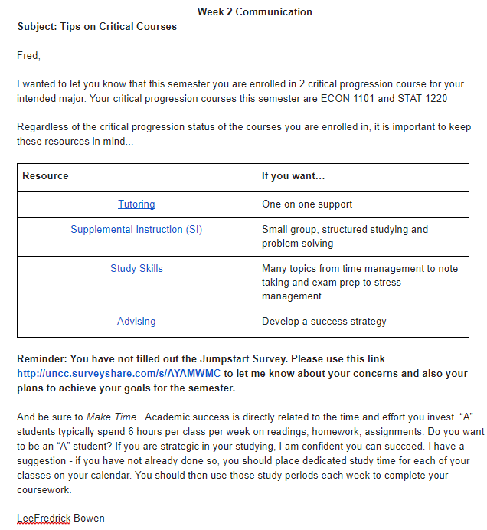
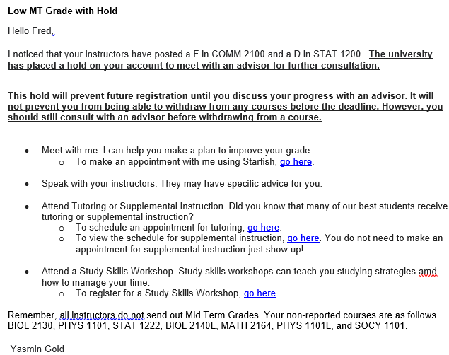

Slide 18
Advisor Targeted Engagement
Week 0:
Welcome email to treatment group students.
Assigns “advising homework” intended to guide student to set specific goals for the semester.
Week 2:
Tell students which of their courses are critical for progression in their major.
Tell students about success services available for those courses.
Acknowledge student’s response to ”advising homework” or remind about assignment.

Slide 19
Advisor Targeted Engagement
Week 4:
Follow up on early alert flags. Messages customized based on the number of flags and flags in critical progression courses.
Prime students for UCAE communication on success services available for courses in which early alert flags were raised.
Acknowledge student’s response to ”advising homework” or remind about assignment
Week 6:
Acknowledge student’s use of success services.
Prompt student to report on actions taken.
Remind students about success services for critical progression courses.
Week 8:
Follow up on mid term unsatisfactory grades. Messages customized based on the number of MT grades and MT grades in critical courses.
Notice of mandatory risk advising hold for high risk students.

Slide 20
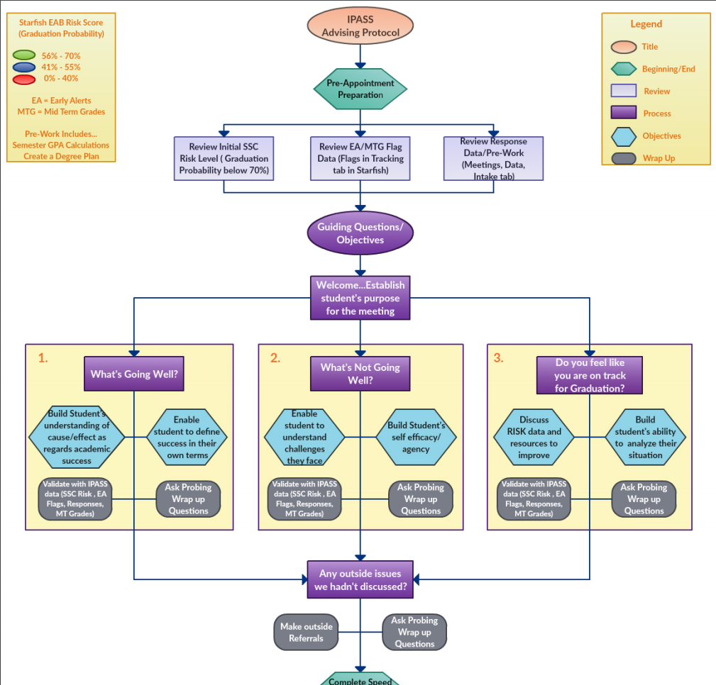

Slide 21
Advisor Panel Discussion

Slide 22
Announcements
Education Community Maintenance
Upcoming Webinars:
Webinars will resume in September

