Slide 1
Advisor Competencies

Slide 2
Sustained
Ongoing support rather than an “inoculation” approach.
Strategic
Differentiated services to maximize capacity.
Integrated
Services are an integral part of all students’ experiences, and are not viewed as stand-alone interventions.
Proactive
Services are designed to provide students information and services before they request them.
Personalized
Students receive the support they need when they need it, from an individual who knows them well.
Karp, M.M., & Stacey, G.W. (2013). What we know about nonacademic student supports. Research Overview. New York, NY: Community College Research Center, Teachers College, Columbia University.

Slide 3
Impact on the Student Experience
iPASS enables advisors to engage in advisor:student relationships that:
Approach advising as a teaching function.
Impacts students on a regular basis.
Connect them to the information and services they need when they need them, in order to keep students on track to graduation.

Slide 4
Why Use Competencies for iPASS Advising?
Identify people with the necessary emotional intelligence and interpersonal skills to be a good advisor
Increase student satisfaction
Reduce advisor turnover or burnout and increase job satisfaction
Create clear promotion pathways
Competency-based hiring practices—when well-designed—can lead to a more diverse team
Identify transferable skills among your advisors
Notes:
Good advising through iPASS relies on high emotional intelligence and interpersonal skills that are difficult to teach
You end up hiring the right people for the role—benefits students, advisors, and the institution
Competency-based hiring practices—when well-designed—can lead to a more diverse team
Competencies can identify transferable skills for new hires and existing employees for when you have a new role to fill
A clearly defined competency-based selection process can aid in recruiting, demonstrate fairness, encourage diversity and simplify the process of filling new openings. But creating or refining your selection process requires time and effort.
Diversity
By focusing on behavior, competency-based selection can ensure that people of all ages and backgrounds receive consideration, regardless of the length of their formal experience or other factors.

Slide 5
As you listen, keep your iPASS advising redesign vision in mind and consider how individual advisors contribute to achieving this vision.

Slide 6
Advisor Competencies
A competency-based approach to create a talented work-force

Slide 7
Dr. Shellie Keller, Associate Vice President, Academic Success College of Southern Nevada
Dr. Keller is a passionate and driven student success advocate and leader. Her responsibilities at the College of Southern Nevada include faculty advising, learning support services, and student success research and initiatives. Dr. Keller’s research interests include advisor competencies, advising and mentoring, student engagement, emotional and social Intelligences, and self-regulated learning. Her work as an advisor for 7-years motivated her dissertation research on advisor competencies.

Slide 8
Advisor Competencies: A Competency-Based Approach to Create a Talented Workforce
Competencies & Best Fit Model
Advisor Competency Model
Hiring Practices
Job Announcements
Assessment Tools for Interviewing
Advisor Competency Matrix: A Tool for Professional Development

Slide 9
Competency is a capability or ability that leads to or causes effective performance (McClelland, 1973, 1985; Boyatzis, 1982, 2008).

Slide 10
The Scales & Clusters of Emotional, Social and Cognitive Intelligence Competencies (Boyatzis, 2011)
Cognitive Intelligence | Emotional Intelligence | Social Intelligence
Systems Thinking | Self-Awareness | Social Awareness
Pattern Recognition | Self-Management | Relationship Management
Best Fit
Job Demand
Students
Organization
Environment
Individual
Competencies
Institution
Advisor

Slide 11
Cognitive Intelligence Competencies
Pattern Recognition - perceiving themes or patterns in seemingly random items, events, or phenomena
Systems Thinking - perceiving multiple causal relationships in understanding phenomena or events

Slide 12
Currently, emotional and social intelligence competencies account for a significant and relevant amount of the variance in predicting and understanding performance (Boyatzis, 2008).

Slide 13
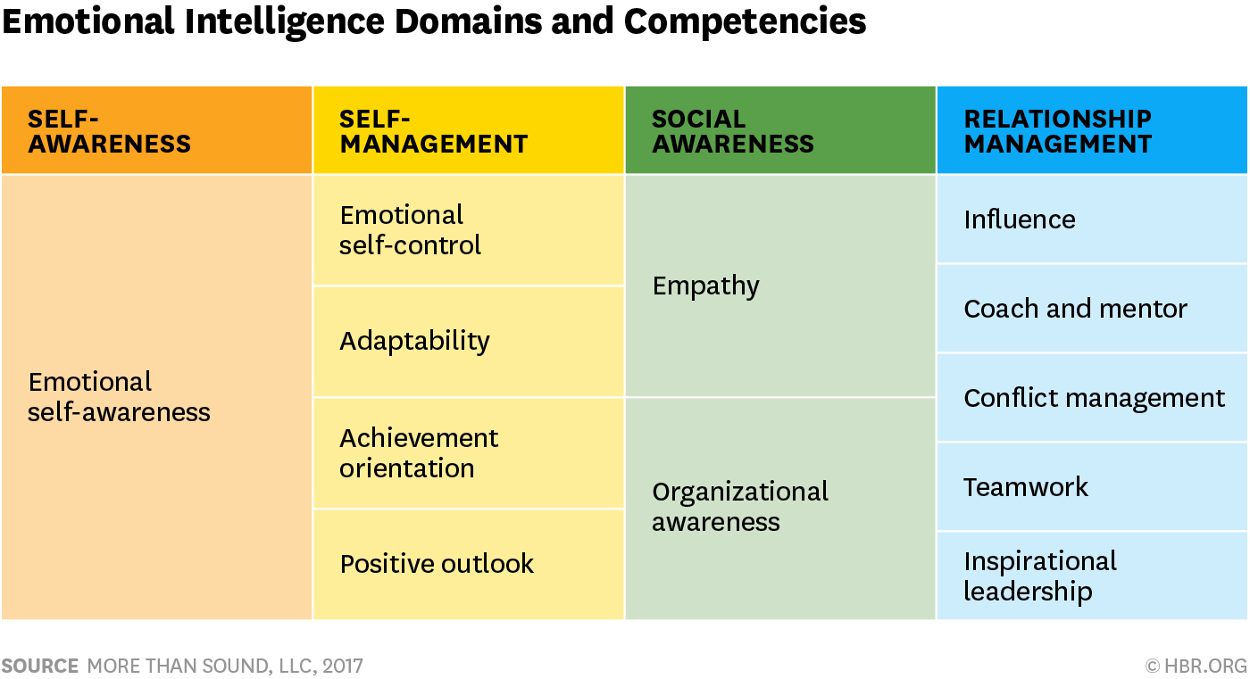
Primal Leadership: Realizing the Power of Emotional Intelligence (Daniel Goleman, Richard Boyatzis,& Annie McKee, 2002)

Slide 14
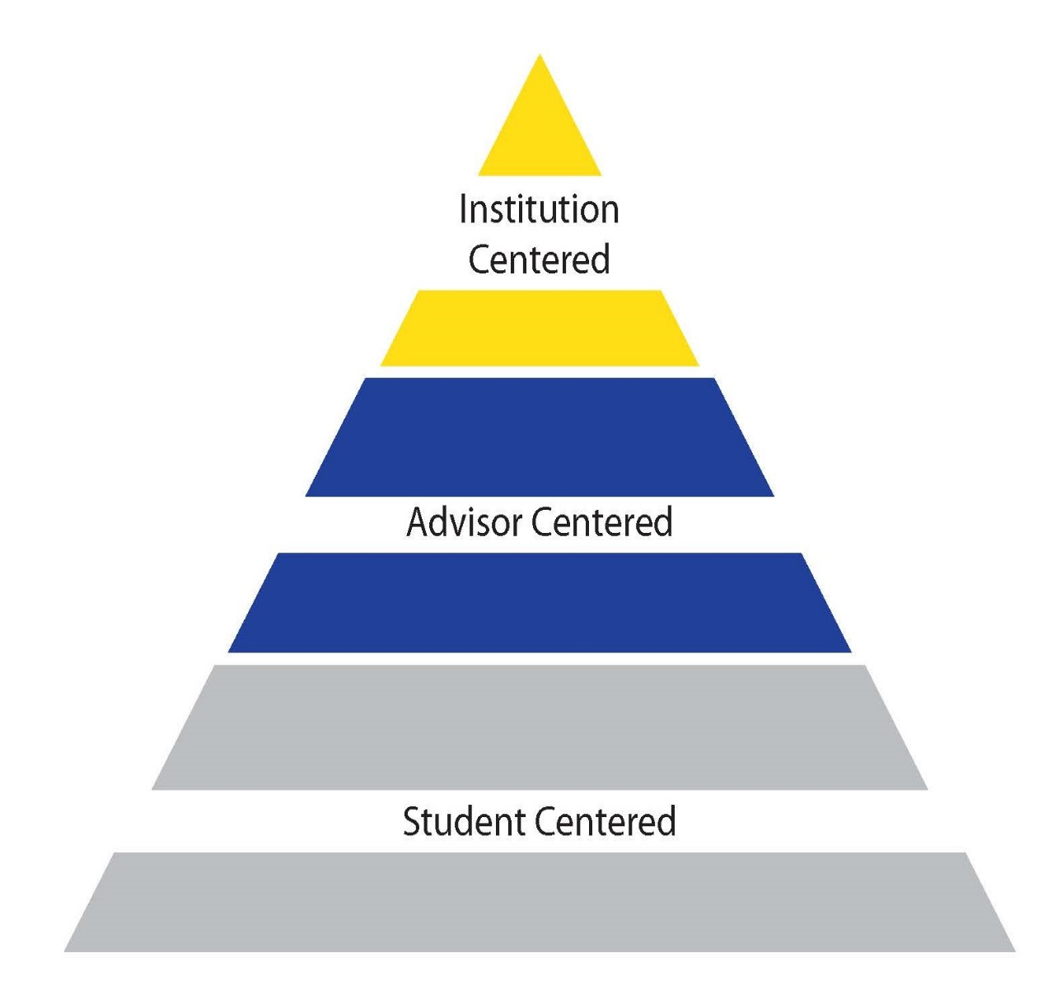
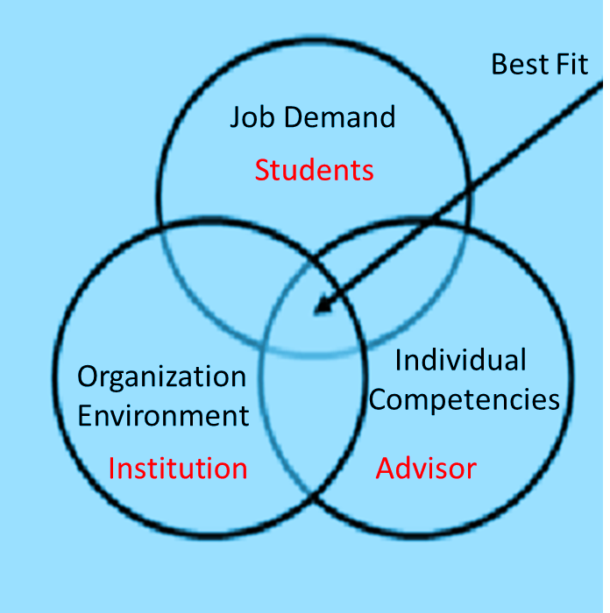
ADVISOR COMPETENCY MODEL

Slide 15
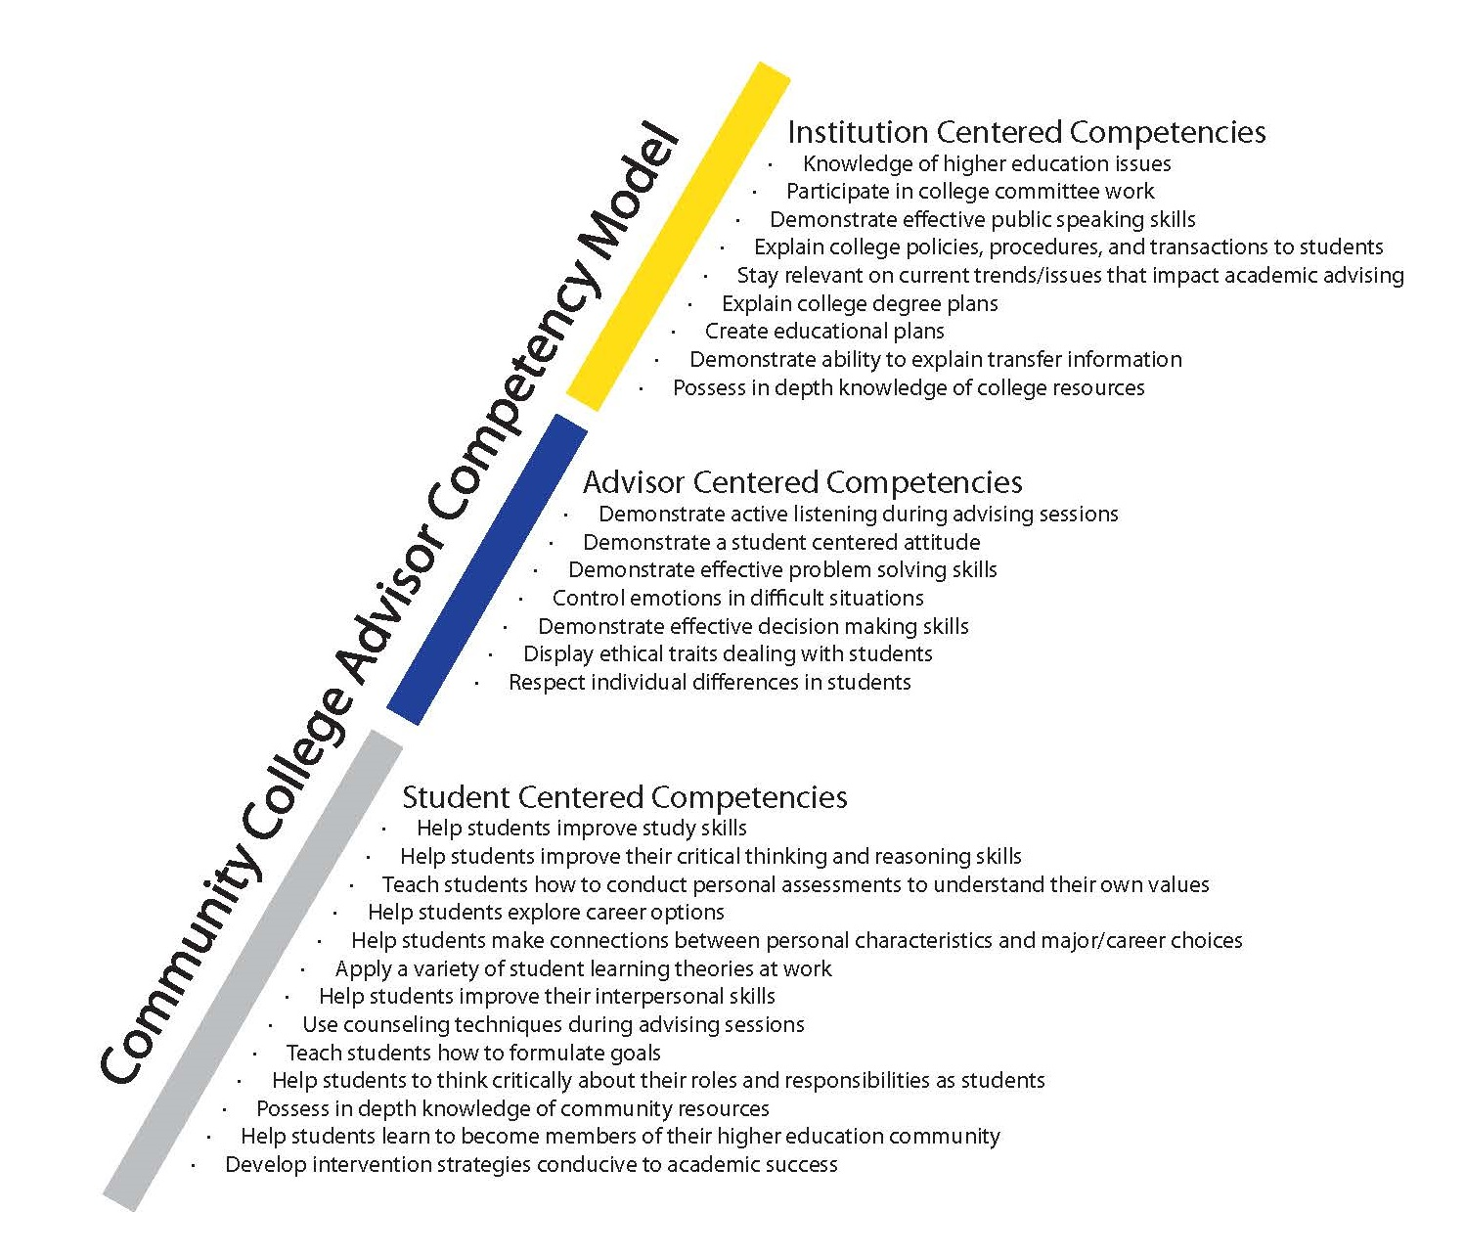

Slide 16
Hiring Practices
Job Announcement
Assessment tools for interviewing
Minimum qualifications
Education
Experience
Preferred qualifications
Hiring pool
Critical Incident Interviewing
Behavioral Event Interviewing
The purpose of BEI is to assess the competencies and best fit
The best predictor of how people will behave in the future is how they behaved in the past.

Slide 17
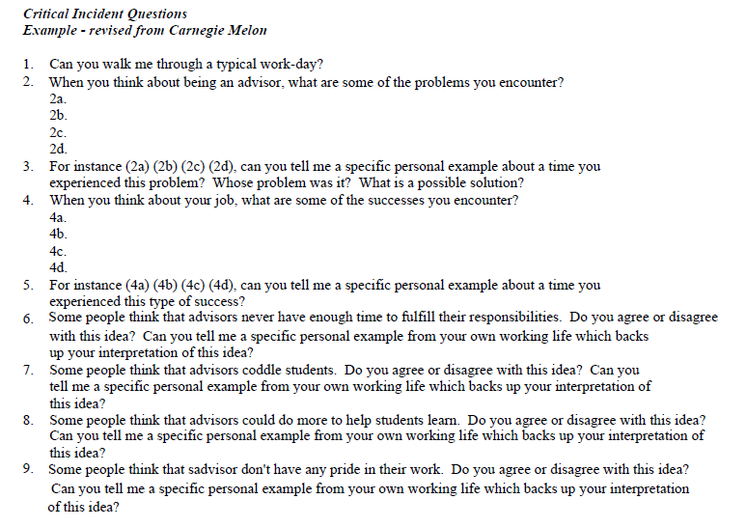

Slide 18
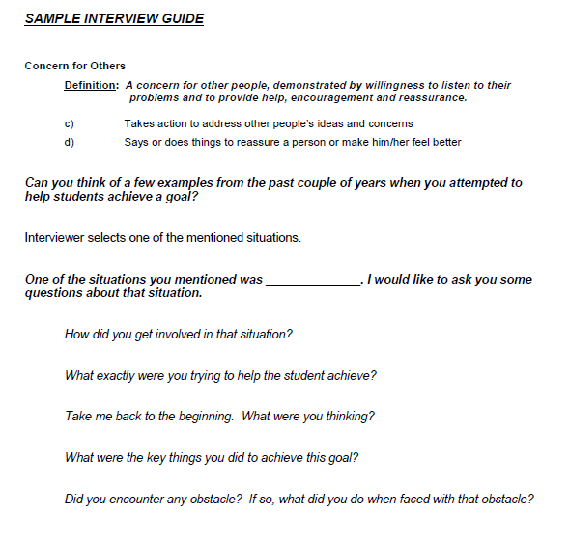

Slide 19
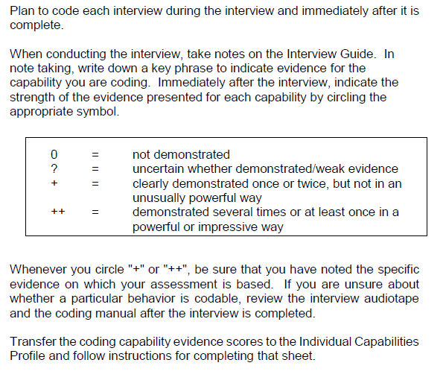
HOW TO
RATE THE BEHAVIORAL EVENT INTERVIEW

Slide 20
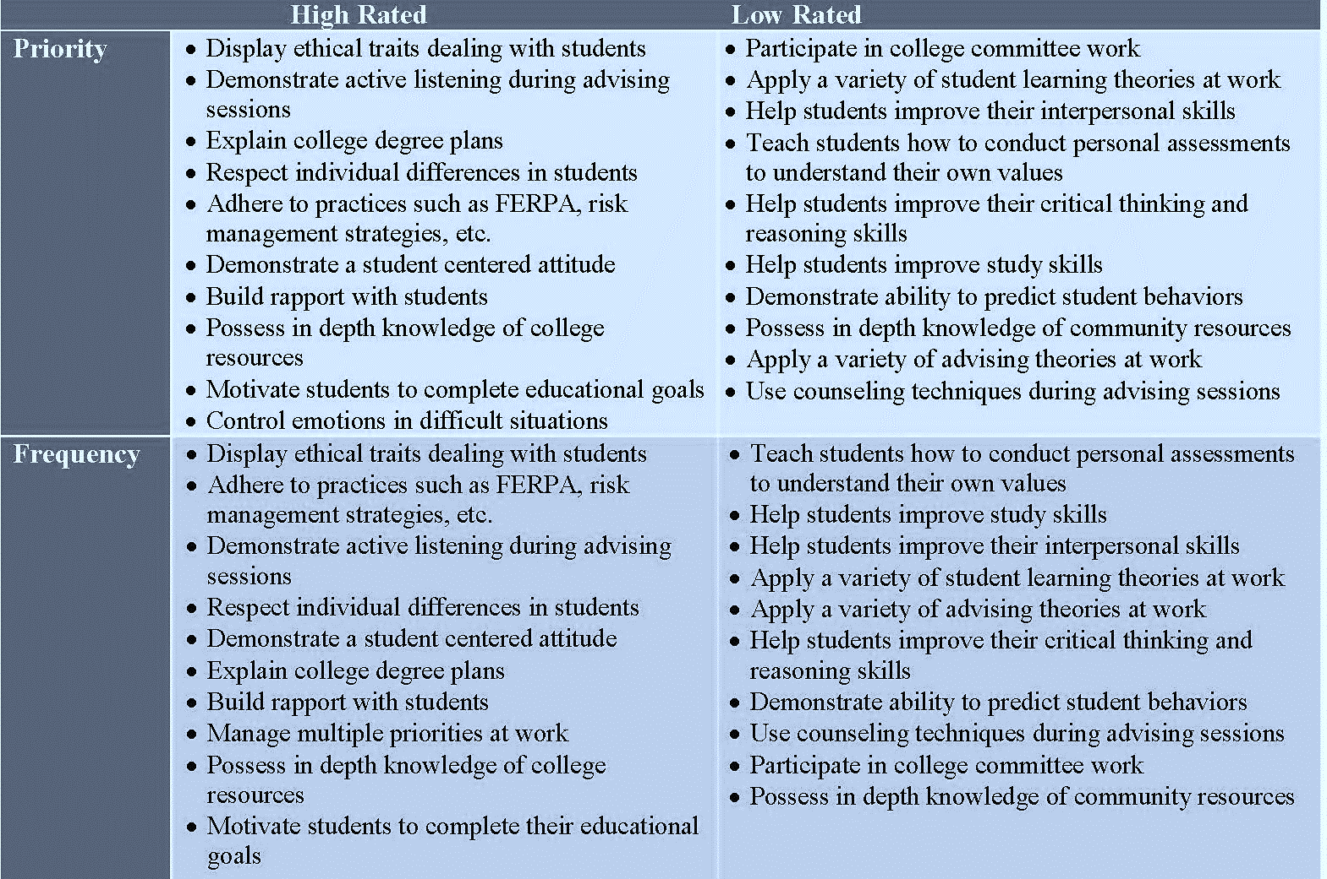
ADVISOR COMPETENCY MATRIX:
A TOOL FOR PROFESSIONAL DEVELOPMENT

Slide 21
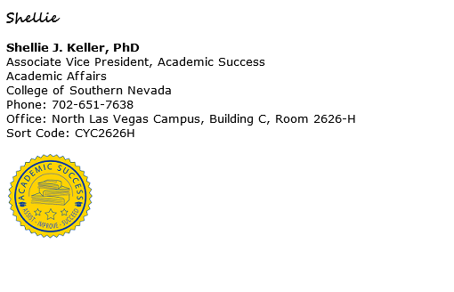

Slide 22
Q & A

Slide 23
Essentials of Developing your own Competency Model
Make sure advisors are involved in the development
Communicate regularly and honestly about the process and the impact on individuals’ daily work and career prospects
Ensure competencies are relevant for your future advising vision
Keep the number of competencies manageable and realistic
Explain the impact of the new model on hiring, career progression, and professional development thoroughly
Don’t forget the student voice!

Slide 24
Questions to Consider
What defines the ideal advisor in your new model?
Consider ways to bring the student voice into these discussions
How do you prioritize leadership, functional, and foundational competencies?
What competencies or skills do advisors need upon hire?
What competencies or skills are most important to train new advisors on?
What progression of professional development opportunities will help all advisors move closer to that ideal advisor model?
What competencies do advisors require to move to the next level?

