Slide 1
The Evolution of Academic Advising in Higher Education
October 11, 2017

Slide 2
Tyton Partners Leads a Research and Action Collaborative for Student Success through Academic Advising Redesign
Through our Driving Toward a Degree initiative, we have launched three studies focused on the roadmap to advising redesign:
2015: The Evolution of Planning and Advising in Higher Education
Supplier landscape: >120 companies
2016: Establishing a Baseline on Integrated Approaches to Planning and Advising
National survey: 1,000 institutions, 1,400 respondents
2017: The Evolution of Academic Advising in Higher Education
Supplier landscape: >180 companies
National survey: 1,400 institutions, 2,200 respondents
.
Reports are available online at:
drivetodegree.org
In collaboration with:

Slide 3
Survey Respondents Demographic Summary
Survey respondents by institutional size and type
Under 1,000
(13%)
Under 1,000
(12%)
4-Year Public
(16%)
4-Year Public
(23%)
4-Year Private
(37%)
1,000-4,999
(53%)
4-Year Private
(39%)
1,000-4,999
(65%)
5,000-9,999
(16%)
2-Year
(47%)
2-Year
(38%)
5,000-9,999
(11%)
10,000-19,999
(11%)
10,000-19,999 (7%)
20,000+ (7%)
20,000+ (5%)
Institutional Size
Institutional Type
Institutional Size
Institutional Type
2015
n = 1,096*
2017
n = 1,313*
*Note: In several instances we received multiple responses form the same institution so we used a key respondent methodology, whereby we only used the most senior respondent at an institution by role/title.

Slide 4
2017 Survey Respondents Demographic Summary
Survey respondents by functional area, title, and years in position
Director of
Advising
(20%)
<1
(8%)
Academic
Advising
(28%)
Primary-role
Advisor (9%)
1-3
(31%)
Student Support
Services
(12%)
Provost (3%)
Vice President/
Vice Provost
(15%)
Student Affairs (7%)
4-5
(15%)
Academic
Program/
Department
(24%)
Dean
(17%)
6-9
(14%)
Enrollment
Mgmt. (7%)
Director
(13%)
10-15
(16%)
Faculty w/
Advising Duties
(12%)
Other
(22%)
16-20 (7%)
Other (10%)
>20 (10%)
Functional Area
Role
Years in Position

Slide 5
Since 2015, All Types of Institutions Report Increases in Advising Success
% Agree
Overall, my institution successfully achieves an ideal advising situation.
50%
40%
30%
20%
35%
35%
30%
10%
23%
15%
17%
0%
2-Year
4-Year Public
4-Year Private
2015
2017
What is responsible for recent perceived improvements?

Slide 6
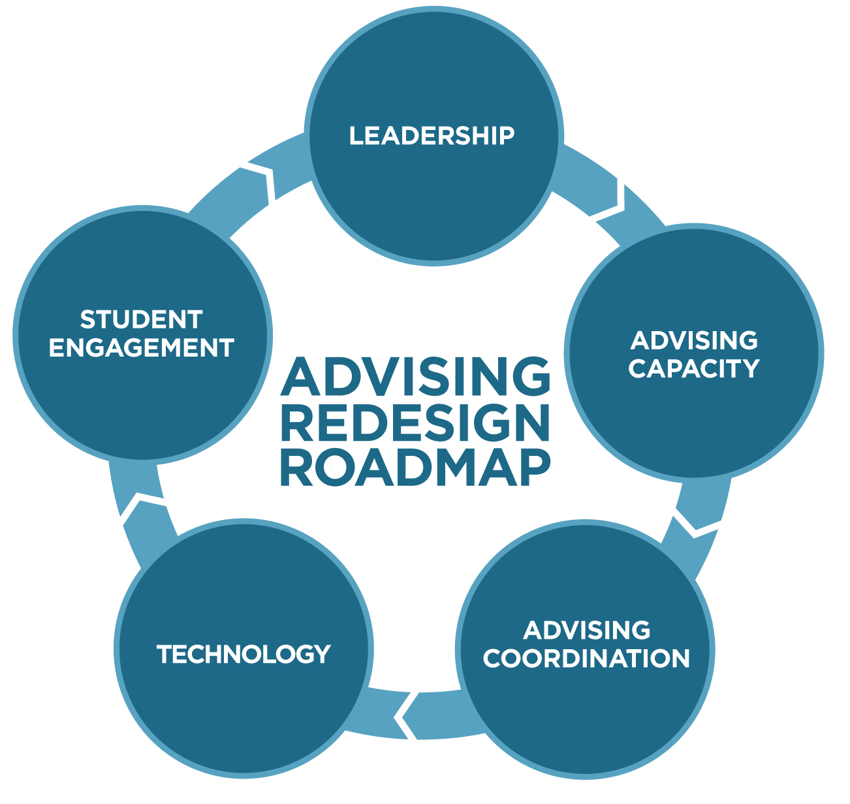
Thought Leadership
The Redesign Roadmap Highlights Five Key Elements to Improve Academic Advising
Notes:
In the next few minutes, we’re going to take a whirlwind tour of our 2017 research findings. I am excited to discuss more of these ideas and findings throughout the day. Whatever you see today, we’ll send and you can read more in a our reports. If you want a cut of the data specific to your type of institution, we can do that too.
Our observations are categorized in 5 elements that comprise the redesign roadmap. These elements help us understand the state of the field and where/how progress is occuring…
Let’s look at leadership

Slide 7
Thought Leadership
60% of Institutions Report Clear Ownership over Academic Advising

Slide 8
The Split Organizational Model is Most Popular…
In your opinion, which of the following best describes the type of academic advising that occurs at your institution?
Split: Faculty advisors and primary-role advisors in an advising center share advising responsibilities
46%
Other
12%
14%
Self-contained: All advising occurs in a center that is staffed primarily by primary-role advisors
13%
15%
Supplementary: Faculty advisors have primary responsibility for advising, with support from advising center with primary-role advisors
Faculty Only: All students are assigned to a department advisor, usually a professor from the student’s academic discipline

Slide 9
…Yet, It Is Not Associated with High Clarity of Ownership
Clear ownership of academic advising exists at my institution.
100%
7%
15%
18%
20%
Disagree
9%
80%
26%
26%
31%
Neutral
60%
40%
84%
60%
56%
49%
Agree
20%
0%
Self-contained
Faculty only
Supplementary
Split
Notes:
What impact does clarity of ownership and org model have on outcomes? The answer is complex – perception of success vs outcomes as lagging indicator

Slide 10
For Self-contained, Supplementary, and Faculty Only Models, Perception of Success Deviates from Observed Student Outcomes
Faculty only
Perceived successful by 33%
Avg. graduation rate: 51%
What model produces positive outcomes that correspond to the perception of success?
Better
Supplementary
Perceived successful by 33%
Avg. graduation rate: 45%
Student Outcomes
Split
Perceived successful by 30%
Avg. graduation rate: 38%
Self-contained
Perceived successful by 51%
Avg. graduation rate: 32%
Worse
Negative
Positive
Perception of Advising Success
Perception of success is a leading indicator, and may forecast upcoming improvements in graduation and retention rates (lagging indicators)
Notes:
Better student outcomes means above average grad and retention rates.
Overall avg. grad rate = 40%
Overall avg. retention rate = 67%
Positive perception means > overall % perceiving success
Overall % perceiving success = 34%

Slide 11
Thought Leadership
37% of Institutions Report that They Have Too Few Academic Advisors

Slide 12
Larger Institutions Have Larger Advising Caseloads and Report More Spending on Advising Resources
% Reporting Recent Trend in Advising Resources
Over the past three years how has the level of personnel dedicated to academic advising in your institution changed?
% with Advising Caseloads > 250 Students
100%
3%
7%
6%
6%
4%
40%
17%
9%
16%
13%
13%
80%
26%
30%
38%
35%
33%
60%
39%
Caseloads
20%
40%
61%
46%
48%
10%
20%
42%
38%
0%
0%
< 1,000
1,000 - 4,999
5,000 - 9,999
10,000 - 19,999
20,000 +
Grown
Remained constant
Declined
Unsure/It's complicated

Slide 13
Advising Structures Involving Primary-role Advisors Are More Likely to Report Unmanageable Advising Caseloads
Is your caseload size manageable to effectively meet the needs of your students?
100%
5%
Seldom/Never
16%
16%
10%
15%
Sometimes
80%
19%
20%
31%
60%
40%
81%
Always/Often
64%
71%
53%
20%
0%
Self-contained model
Split model
Supplementary model
Faculty-only model
% with Advising Caseload > 250 Students
67%
12%
5%
1%

Slide 14
Thought Leadership
33% of Institutions Report that a Lack of Coordination across Departments Impedes Advising Improvement

Slide 15
Overall, Coordination Has Improved Since 2015
Cross-departmental collaboration exists to support academic advising.
% Agree
50%
40%
30%
44%
20%
35%
10%
0%
2015
2017

Slide 16
Collaboration Is More Common at Institutions Using Self-contained Advising Centers
Cross-departmental collaboration exists to support academic advising.
100%
10%
15%
Disagree
18%
18%
80%
32%
60%
44%
41%
43%
Neutral
40%
59%
20%
39%
41%
42%
Agree
0%
Self-contained
Faculty only
Supplementary
Split

Slide 17
Thought Leadership
A Majority of Respondents Report that Technology Enhances Academic Advising

Slide 18
Institutions Increasingly Believe Technology Improves Academic Advising
Technology effectively enhances our academic advising function.
% Agree
60%
50%
40%
30%
53%
20%
32%
10%
0%
2015
2017

Slide 19
A Majority of Institutions Report that Spending on Technology Has Increased in Recent Years
How has spending on advising technology changed over the past 3 years?
100%
7%
4%
4%
Don't know
4%
Declined
8%
Remained
constant
22%
80%
25%
36%
60%
40%
73%
Grown
67%
50%
20%
0%
< 5,000
5,000-20,000
≥ 20,000
Enrollment

Slide 20
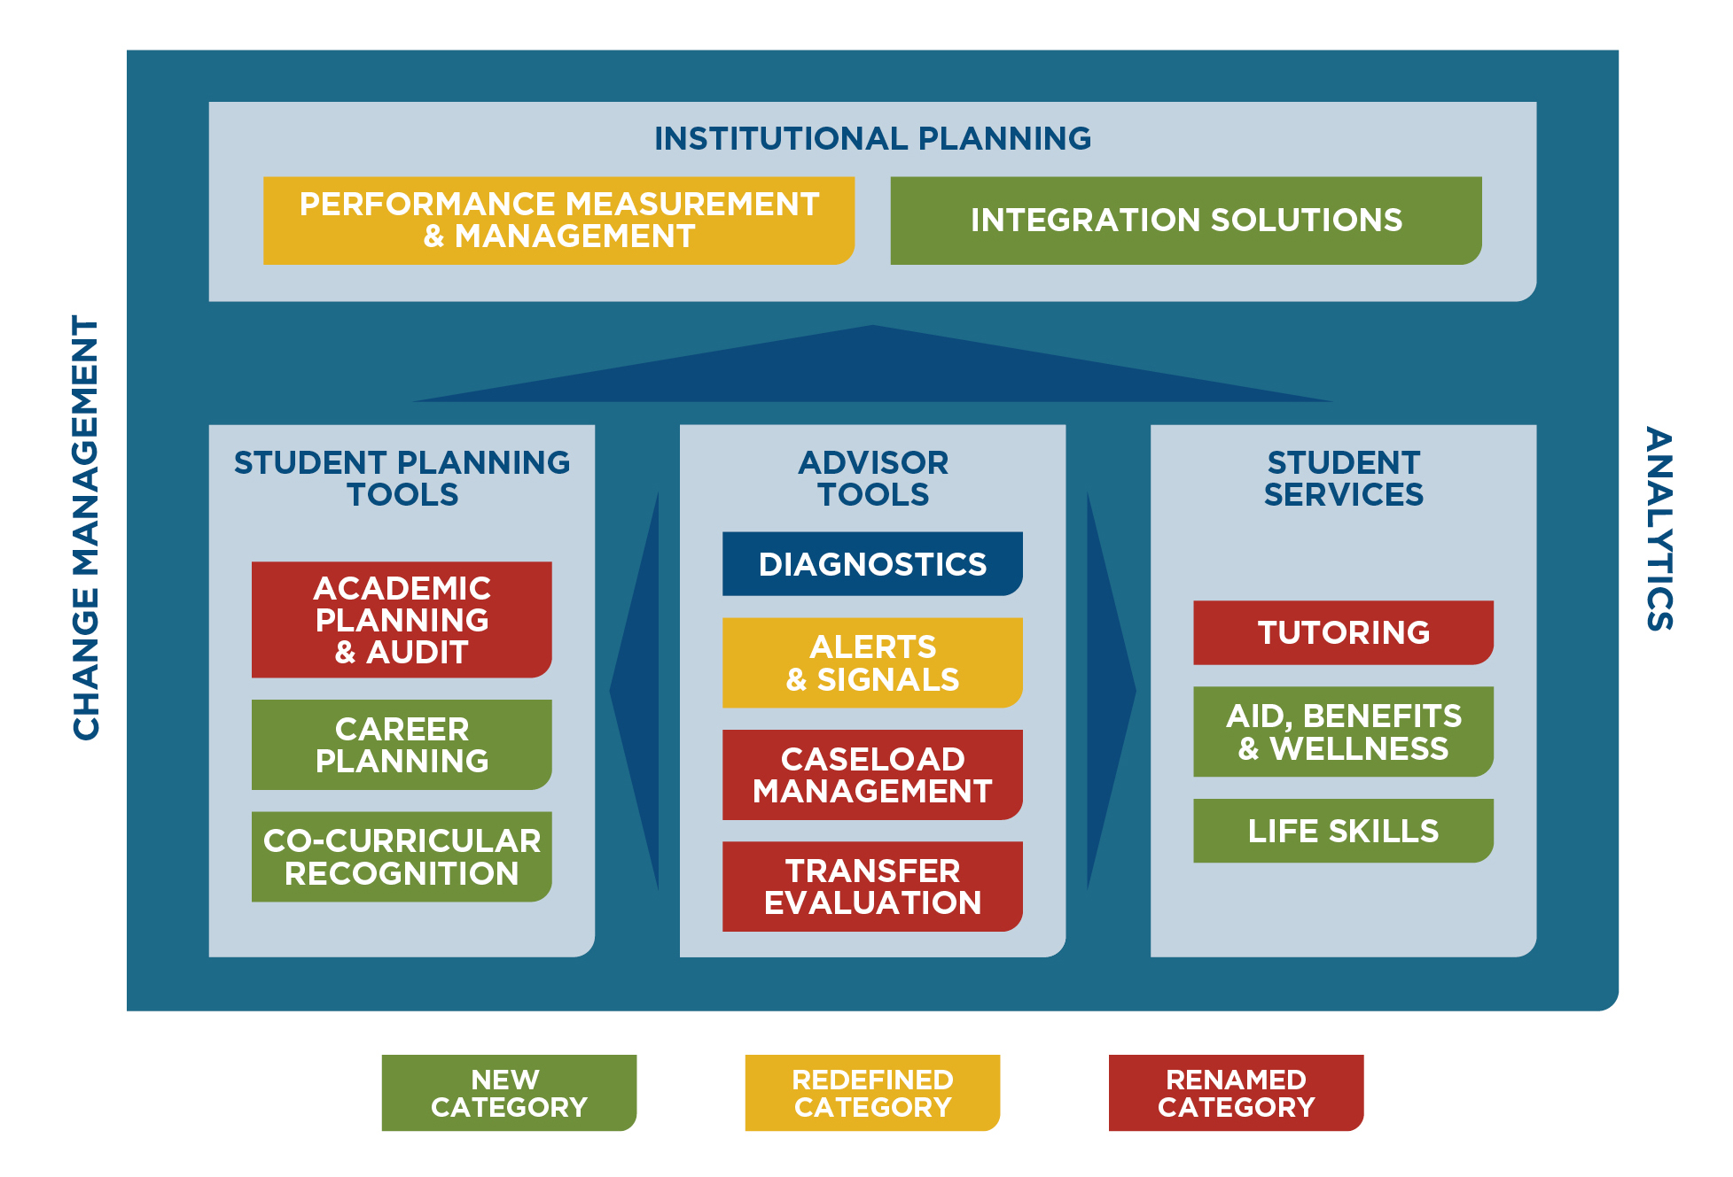
Student Success Technologies Are Segmented into 12 Distinct Product Categories across 4 Workflow Areas

Slide 21
Notable Providers across the 12 Product Categories

Slide 22
Current Institutional Use of Technology Varies by Category; Academic Planning Remains the Most Used
Which of the following academic advising functions does your institution use technology to support?
100%
2%
5%
5%
5%
7%
13%
11%
11%
11%
15%
Don't know
19%
26%
80%
23%
31%
26%
33%
32%
37%
60%
44%
Not used
47%
40%
40%
42%
42%
50%
43%
40%
58%
20%
35%
Limited use
29%
24%
22%
21%
19%
13%
13%
Widespread
use
0%
7%
Academic
Planning
& Audit
Alerts
& Signals
Integration
Solutions
Caseload
Management
Transfer
Evaluation
Resource
Connection*
Career
Planning
Diagnostics
Performance
Measurement
& Management
Technology that fulfills multiple functions promises to add value by streamlining operations
Note: Resource Connection encompasses the Academic, Aid, Benefits & Wellness, Life Skills, and Co-Curricular Recognition categories.

Slide 23
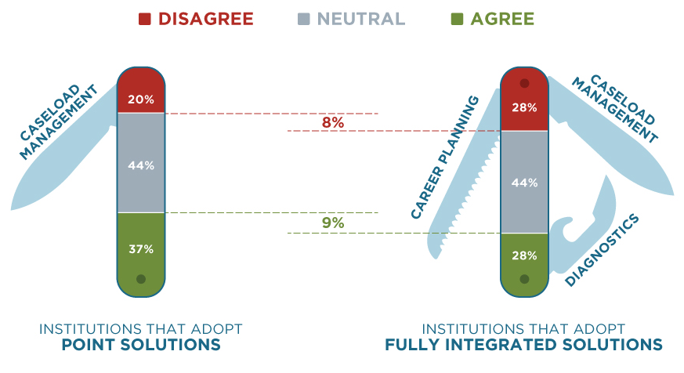
Institutions Using Point Solutions – rather than Integrated Ones – Report Modestly Greater Success
Overall, my institution successfully achieves an ideal advising situation.
Fully integrated solutions are not yet meeting expectations, but given the “neutral” sentiment, room for improvement exists for all tech offerings

Slide 24
Thought Leadership
40% of Institutions Report that a Lack of Student Engagement Impedes Advising Improvement

Slide 25
Nearly Half of Institutions Surveyed Use the Prescriptive Advising Model
In your opinion, which of the following best describes the type of academic advising that occurs at your institution?
Advising as Teaching: Connect students with who they are, what they are learning, and who they want to become
Intrusive / Proactive: Incorporate intervention strategies for students who otherwise might not seek advising
18%
18%
Developmental: Focus on the whole student, facilitating students’ non-cognitive skills
Other
8%
12%
45%
Prescriptive: Offer course and degree information and prescribe solutions for academic problems

Slide 26
Prescriptive and Intrusive Models Are Associated with Relatively Poor Student Outcomes…
Advising as Teaching
Perceived successful by 43%
Avg. graduation rate: 49%
Better
Developmental
Perceived successful by 40%
Avg. graduation rate: 44%
Student Outcomes
Prescriptive
Perceived successful by 20%
Avg. graduation rate: 38%
Intrusive (Proactive)
Perceived successful by 46%
Avg. graduation rate: 33%
Worse
What are the implications of the widespread use of the prescriptive model, given its poor efficacy?
Negative
Positive
Perception of Advising Success
Notes:
Positive student outcomes means above average grad and retention rates.
Overall avg. grad rate = 40%
Overall avg. retention rate = 67%
Positive perception means > overall % perceiving success
Overall % perceiving success = 34%

Slide 27
…However, Developmental and Advising as Teaching Models Are Works-in-Progress, as Student Disengagement is More Likely
What are the barriers to improving academic advising at your institution?
Students are not taking advantage of resources
% Agree
40%
30%
20%
40%
41%
34%
36%
10%
0%
Prescriptive
Developmental
Intrusive (Proactive)
Advising as Teaching

Slide 28
48% of Institutions Have Adopted the Guided Pathways Approach (Partially or Completely)
Has your institution adopted or begun to adopt guided pathways?
The guided pathways model entails a systemic redesign of the student experience from initial connection to college through to completion.
In this study, we describe guided pathways as courses in the context of highly structured, educationally coherent program maps that align with students’ goals for careers and further education.
No guided pathways adoption
40%
Don't know
12%
21%
27%
Guided pathways adoption
across some departments
and/or colleges
Guided pathways adoption
across all departments
and/or colleges

Slide 29
Guided Pathways Adoption Is Associated with Advising Success
Overall, my institution successfully achieves an ideal advising situation.
100%
17%
18%
28%
Disagree
80%
60%
41%
47%
45%
Neutral
40%
20%
42%
36%
28%
Agree
0%
Guided Pathways
Adoption across All
Departments/Colleges
Guided Pathways
Adoption for Some
Departments/Colleges
No Guided Pathways
Adoption

Slide 30
Thought Leadership
Progress Is Being Made, But Much Work Remains to Move Outcomes across the Field
60% of Institutions Report Clear Ownership over Academic Advising
40% of Institutions Report that a Lack of Student Engagement Impedes Advising Improvement
37% of Institutions Report that They Have Too Few Academic Advisors
A Majority of Respondents Report that Technology Enhances Academic Advising
33% of Institutions Report that a Lack of Coordination across Departments Impedes Advising Improvement

Slide 31
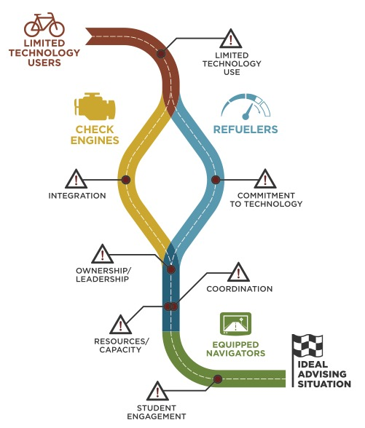
Tyton Partners Identified Four Institutional Segments that Differ in Attitudes toward Advising and Level of Success
35% of respondents
24% of respondents
20% of respondents
21% of respondents

Slide 32
Segments Vary in Perceptions and Attitudes around Advising
Perception of success
My institution does not achieve an ideal advising situation.
My institution successfully achieves an ideal advising situation.
Clarity of ownership
Ownership of academic advising is unclear.
Clear ownership of academic advising exists at my institution.
Cross-departmental coordination
There is little coordination in support of academic advising.
Cross-departmental collaboration exists to support academic advising.
Value of technology
Technology does not enhance academic advising.
Technology enhances academic advising.
Preferred spending area
Investing in people has the greatest potential to improve academic advising.
Investing in technology has the greatest potential to improve academic advising.
Limited Technology Users
Check Engines
Refuelers
Equipped Navigators

Slide 33
Successful Segments Adopt Technology for Advising (Even When They Prefer to Invest in People)
Which of the following academic advising functions does your institution use technology to support?
% Reporting Widespread Use
100%
80%
60%
40%
85%
82%
70%
50%
48%
20%
42%
26%
32%
22%
0%
Academic Planning & Audit
Alerts & Signals
Caseload Management
Check Engines
Refuelers
Equipped Navigators

Slide 34
Successful Segments Invest in Advising Personnel…
Over the past three years, how has the level of personnel dedicated to academic advising in your institution changed?
% Reporting Growth
60%
40%
52%
55%
20%
40%
38%
0%
Limited Technology Users
Check Engines
Refuelers
Equipped Navigators

Slide 35
…and Assign Responsibility over Advising to a Single Individual
Is there one individual with overall responsibility for academic advising at your institution?
% Answering Yes
60%
40%
53%
47%
20%
40%
31%
0%
Limited Technology Users
Check Engines
Refuelers
Equipped Navigators
Advising improvements may be achieved through reorganization of existing resources - not necessarily making new investments

Slide 36
Successful Segments Are Committed to Advising Redesign
Redesign of academic advising is included in my institution’s strategic plan.
% Agree
80%
60%
40%
64%
48%
20%
34%
32%
0%
Limited Technology Users
Check Engines
Refuelers
Equipped Navigators

Slide 37
We Help Institutions Move Farther along the Road to an Ideal Academic Advising and Improved Student Success
Is responsibility for advising held by a single or multiple bodies?
Does the advising organizational structure support manageable caseloads?
Is advising transactional or transformational?
Does the advising organizational structure support cross-departmental coordination?
Is technology adopted and implemented as point or integrated solutions?
By benchmarking against peers in a similar segment, we help institutions identify and overcome barriers to achieving best in class advising

Slide 38
Leverage Academic Advising Redesign to Improve Student Success and the Bottom Line
What can your institution do to drive outcomes?
The potential results
Hire additional 40 advisors
Predictive analytics to target and intervene with at-risk students
Instituted mandatory advising for all students
Creation of key performance metrics communicated regularly to leaders across campus
Improved student persistence yielded
370 additional students
in the first semester alone
accounting for
$1.3 Million
in annual revenue

Slide 39
Brand Exposure
Want to Learn More?
Start a conversation about how advising redesign might look on your campus:
Gates Bryant (gbryant@tytonpartners.com)
Nicholas Java (njava@tytonpartners.com)
Download our 2017 Driving Toward a Degree reports, including the data presented here, at drivetodegree.org
While you’re there, use our self-assessment to determine where your institution is on the road to advising success.
Sign up for our monthly “snapshot” at tytonpartners.com
Follow us on @tytonpartners
Upcoming events:
Tyton Partners will be presenting in Philadelphia, PA, for the 2017 EDUCAUSE Annual Conference, October 31st to November 3rd

