Slide 2
Notes:
You don’t need me to tell you

Slide 3
Notes:
about what we’ve been through in 2020

Slide 4
Notes:
I’m hear to talk about 2021

Slide 5
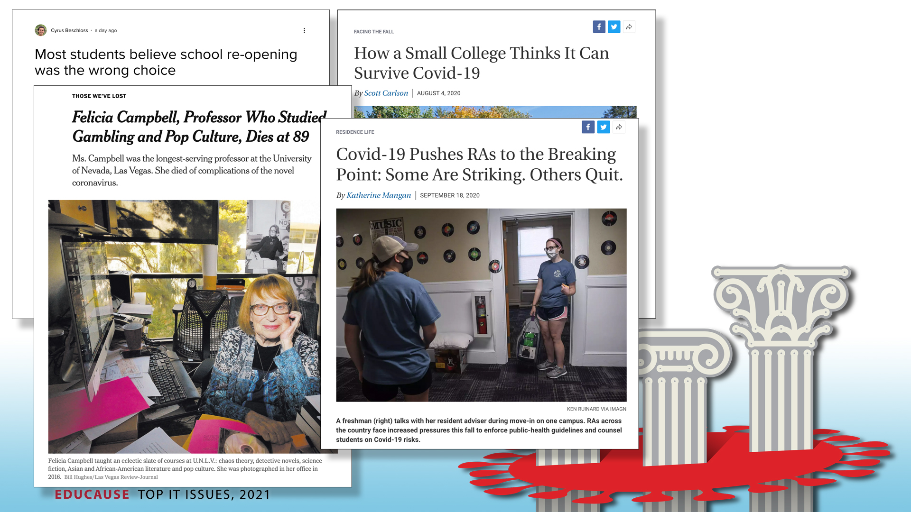
Notes:
And what that might look like for all of us

Slide 7
The Pandemic will end
Notes:
Well, the first thing to remember is that the pandemic actually WILL end. Teaching a class or living in a dormitory will cease to be a life-or-death decision, face masks will induce nostalgia (or PTSD), and March will be a month of madness once again.

Slide 8
What
happens
next?
Notes:
What will be left and what will we face on the other side of COVID?
What role will technology play in higher education’s recovery?
Will the pandemic prove to be higher education’s extinction event?
Will our ecosystem emerge stronger and fitter for the future?
Might both be true?
These are the questions the 2020-21 EDUCAUSE IT Issues panel has explored in anticipation of 2021.

Slide 9
Alternative Futures
Notes:
Throughout the pandemic, we have all learned a different way to plan. We’ve learned the futility of making long term plans to mitigate a disease whose symptoms, diagnosis, treatments, and prognosis are all poorly understood and complex. We’ve also learned about how useful scenarios can be when we’ve got to plan in the face of enormous uncertainty. Scenarios help us anticipate alternative potential futures that we can plan for, so we are prepared not only for what we might hope or dread, but also for what actually happens.

Slide 10
A new approach for 2021
Notes:
This year, EDUCAUSE took a different approach to the IT Issues project. You will find no Top 10 IT Issues for 2021. Our planning horizons are so short now! So we thought a single list of Top Issues was too constraining. Instead, we took our cues from you, and used a scenario approach to consider three different potential ways institutions might emerge from the pandemic. This year we offer three Top Issues lists instead of one, and examine the Top 5 issues within each of three scenarios.

Slide 11
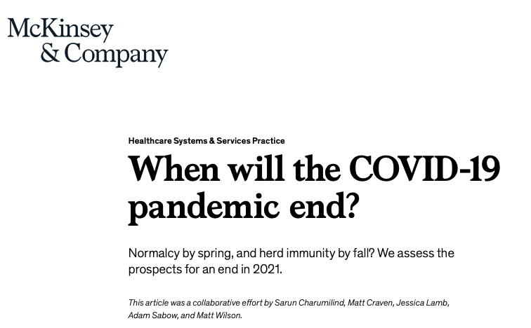
Assumptions for the 2021 Top Issues
The Pandemic will begin to resolve some time in 2021
Notes:
As we thought about potential scenarios that be useful in thinking about pandemic recovery, we made three assumptions:
Assumption 1: The pandemic will begin to resolve some time in 2021. That means that one or more effective vaccines will become available and distributed. And in fact we’re seeing signs that make that look pretty likely.
https://www.mckinsey.com/~/media/McKinsey/Industries/Healthcare%20Systems%20and%20Services/Our%20Insights/When%20will%20the%20COVID%2019%20pandemic%20end/When-will-the-COVID-19-pandemic-end-final.pdf

Slide 12
Assumptions for the 2021 Top Issues
The Pandemic will begin to resolve some time in 2021
Our scenarios should be high-level views of possible recovery visions
Notes:
Assumption 2: Our scenarios should be high-level views of possible recovery visions. The three scenarios we chose are very general and based on how an institution’s vision, culture, and business model may influence its approach to recovery.

Slide 13
The Scenarios
Restore:
Figuring out how to get back to where we were before the pandemic
Evolve
Adapting to the new normal
Transform Redefining our institution and taking
an active role in creating the innovative future of higher education
Notes:
The scenarios we chose were:
Restore: We will be focused on figuring out what to do to get back to where we were before the pandemic
Evolve: We will be focused on adapting to the new normal
Transform: We will be focused on redefining our institution and taking an active role in creating the innovative future of higher education

Slide 14
Assumptions for the 2021 Top Issues
A single scenario would probably fit very few institutions
Notes:
Assumption 3: A single scenario would probably fit very few institutions. Leaders might, for example, adopt one scenario to guide financial health and another to guide education and academic work. So we needed to give our survey respondents a lot of flexibility in picking the issues.

Slide 15
The Vote: 19 issues (same as always)
Affordability and digital equity
Agility and change
Cost management
Data and analytics
Digital transformation
Enrollment and recruitment
Equitable access to education
Financial health
Holistic student experience
Information security
Institutional culture
Institutional innovation
Online learning
Risk management
Student success
Technology alignment
Technology strategy
Technology-enabled curriculum
Work from anywhere
Notes:
So here’s what we did. First our IT Issues panel prioritized nineteen potential Top IT Issues for 2021. That’s the same as every year, when they pick about 15-20 issues for members to vote on.
What was different about this year was that the panelists created three versions of each issue, one for each scenario.
So then our survey asked IT leaders to first pick their preferred scenario-based version of each of the nineteen potential issues, and then prioritize the nineteen issue versions they had picked. We used the survey results to find the Top 5 IT Issues for each of the three scenarios.

Slide 16
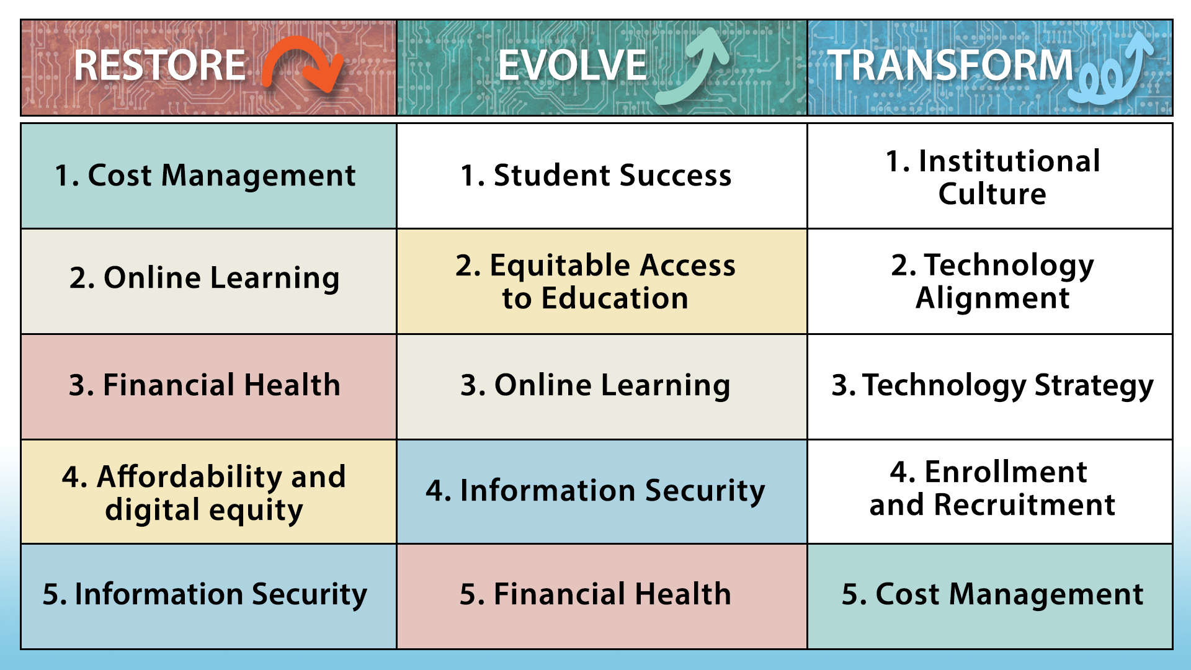
Reducing institutional costs and increasing workforce efficiency
Advancing student support services to help students attain academic and career goals
Contributing to a culture of transformation
Strengthening online and hybrid education
Providing technologies, support, and policies for diverse users
Applying digital strategies and innovations
Revising budget models and IT governance
Progressing from emergency remote teaching to online learning
Developing an enterprise architecture that keeps pace with strategic change
Providing increased support for students’ technology needs and enabling technology availability
Developing a cybersecurity operations strategy
Exploring and implementing creative holistic recruitment solutions
Providing information security leadership
Developing new funding sources
Focusing on digital transformation
Notes:
And here they are. As you scan this table, look at all the overlap between the Restore and Evolve issues. They have four issues in common.
Of course, details under each common issue are very different. When we walk through each issue, you’ll be able to see those differences more clearly.
Now look at the issues in Transform. They really stand on their own, don’t they? And collectively they cover a strategic approach to using technology to transform the institution.

Slide 17
Three Paths for Higher Education’s Emergence from the Pandemic
Restore
Evolve
Transform
Notes:
What will be left and what will we face on the other side of COVID, and what role will technology play in higher education’s recovery?
Put yourself, for the next few minutes, in the post-pandemic future and reflect with the IT Issues panel on what it might bring.

Slide 18
The Top IT Issues
Restore What to do to get back to where we were before the pandemic
Notes:
Now we don’t have a ton of time today, and I think it’ll get a little tedious if I try to walk through all 15 issues. The Restore issues are focused on getting back to where we were before the pandemic

Slide 19
Restore: Extinction Event?
Percentage of institutions that fit the Restore scenario for each area of institutional focus
Notes:
So we’ll just breeze through them today. You can always read the IT Issues article for the details.
The Restore theme is a story of institutional survival. The biggest focus in restore was on the institution’s pre-pandemic financial health.
Look at the issues under Restore -- two finance-related issues – cost management and financial health – and you’ll see soon that even the information security issue is qualified by the need to be “budget conscious.”
The institutions at greatest financial risk may also be those whose students are struggling the most. Institutions choosing the Restore version of issues were also focused on helping their students gain access to institutional resources and learning anywhere, anytime.

Slide 20
Panelist Perspective
1. Cost Management
Reducing institutional costs and increasing workforce efficiency through process redesign and automation, data and analytics, and other technology solutions
Melissa Kramer Cresswell
Director of Client Engagement
& Planning
Bryn Mawr
Notes:
We might be able to use the video clip for this one
Start @5:07
End @ 5:52

Slide 21
Panelist Perspective
2. Online learning
Strengthening online and hybrid education by providing on-demand support for course development and delivery and advocating for processes, policies, and support structures to increase student and institutional readiness
Rebecca Frost Davis
Associate Vice President for Digital Learning
St. Edward’s University
Notes:
We might be able to use the video clip for this one
Start @5:07
End @ 5:52

Slide 22
Panelist Perspective
3. Financial health
Revising budget models and IT governance to preserve critical IT operations and capacities in the face of institutional financial challenges
Cynthia Herrera Lindstrom
Assistant Vice Chancellor & CIO
University of Illinois Chicago
Notes:
We might be able to use the video clip for this one
Start @3:36
Stop @4:29

Slide 23
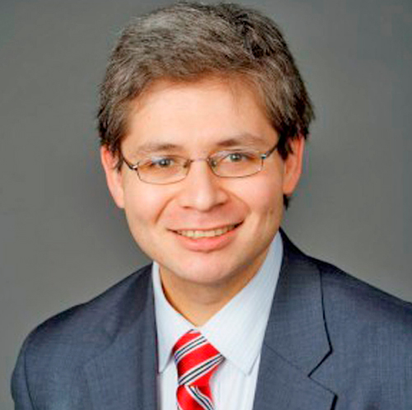
Panelist Perspective
4. Affordability and digital equity
Providing increased support for students’ technology needs and enabling technology availability from anywhere, particularly off campus
Greg Pitter
Director of Application Services
Portland Community College
Notes:
We might be able to use the video clip for this one
Start @ 6:43
Ends @ 7:29

Slide 24
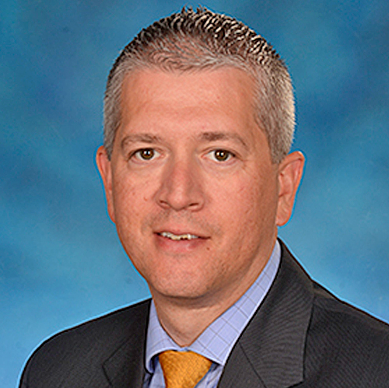
Panelist Perspective
5. Information security
Providing information security leadership that supports faculty, students, and staff returning to campus, while being budget-conscious and ensuring a safe and secure recovery
Brian Coats
Associate Vice President,
Technology Operations and Planning
University of Maryland, Baltimore
Notes:
We might be able to use the video clip for this one
Start @ 6:43
Ends @ 7:29

Slide 25
The Top IT Issues
Evolve Adapting to the
new normal
Notes:
Let’s look at the Evolve scenario now, and spend a little more time with these issues

Slide 26
Evolve Adaptive Evolution to Meet Post-Pandemic Students Where They Are
The Top IT Issues
Notes:
The set of Evolve issues describe a student-centric institution that is managing its primary risks. These are institutions that will choose to incorporate the impact and lessons of the pandemic into their culture and vision.
Three of the Top Five Evolve issues emphasize the student experience. This type of institution is adapting to students’ needs instead of expecting students to adapt to the institution. Three pillars of student experience are represented – attaining academic and career goals, equity and access, and best practices in technology-enabled teaching and learning
The two remaining Evolve issues focus on managing two pervasive institutional risks: information security and financial health. Information security concerns subsided a bit in the early weeks of the pandemic, but began to intensify in the latter months of 2020. This is a risk that can’t be overcome or neglected.

Slide 27
1. Student Success Advancing student support services to help students attain their academic and career goals by integrating data systems, user interfaces, policies, and guided pathways
What will evolve?
Interest in using additional personal and situational data about students
Bottom line
Student success efforts must be holistic and comprehensive
Challenges
Affording new investments
Students’ situations will be more precarious
Notes:
Institutions’ student success focus has evolved during the pandemic. There’s more emphasis on how important digital infrastructure is. Students are using technology more and in more ways now. And advisors ramped up use of online video advising, chat, and other technology solutions to reach students when face-to-face contact wasn’t possible.
All that is producing new and more data about students, and THAT offers new opportunities to understand students’ progress and give them feedback and support.
Just remember that using more data about students will increase privacy challenges!
In 2021, many students will be in worse condition to continue their education, let alone thrive. Those who were worst off before the pandemic will have suffered the most. Even though institutions will have fewer resources, students will need them more than ever before.

Slide 28
What if the pandemic continues beyond 2021?
Financial challenges will increase
Helping the students at greatest risk will become even harder
Online services may expand and improve, as reliance on them continues
Notes:
In many ways, the pandemic has just accelerated the change that was already underway. All of the challenges, and also the heavy reliance on technology. Some institutions were already planning a strong move to online advising and student services and they are now embracing it much faster than planned. A prolonged pandemic will just continue the accelerated pace of change.

Slide 29
Panelist Perspective
When I think of the new normal, what I think of opportunities to empower students, and to create more accountability, especially for the adult learner.
As we’ve moved to online, and everything’s become a little bit more trackable and transparent, I’m hoping that we really empower students in the new pathways.
Shannon McCarty
Associate Vice President
Center for Innovation in Learning National University
Notes:
We might be able to use the video clip for this one
Start @ 6:43
Ends @ 7:29

Slide 30
2. Equitable Access to Education Providing technologies, support, and policies for diverse users and equitable access to bridge the digital divide and reduce equity gaps
What will evolve?
Recognition of institutions’ responsibility for ensuring equitable access to education
Bottom line
Providing equitable access extends far beyond network connectivity and requires understanding the full range of challenges students face
Challenges
Institutions’ existential struggles overshadowing making-things-better struggles
Empathy deficits, induced by pandemic exhaustion
Diversity of needs and situations
Notes:
Institutional leaders have evolved from treating student success as a student responsibility to treating it as an institutional responsibility. A similar shift is now happening with equitable access to education. Rather than assuming that students have access, leaders are recognizing that it is the institution’s job to provide that access.
The pandemic has shown just how deep the digital divide is, and how many people are on the wrong side of it. Equitable access to education means equitable access to a baseline level of technology and connectivity. This may be a time when many stakeholders across our ecosystem partner to address them.

Slide 31
What if the pandemic continues beyond 2021?
The pandemic reality will become the new normal
Educational equity initiatives will be incorporated into student success initiatives
Partnerships and legislative support may increase
Notes:
A prolonged pandemic will motivate institutions to instill more permanent solutions. Students’ digital equity needs will need to be understood and accommodated based on their circumstances and their educational goals. Students in degree programs that require laboratory access or other learning environments that aren’t possible to simulate digitally will need different accommodations.

Slide 32
Panelist Perspective
What can we do because of this crisis that we wouldn't have otherwise been able to do?
I think that some partnerships are now going to be possible because it's become clear to everybody just how severe these problems are and how much we need to bring people together and make sure that there is a much greater level of equity.
Jay Rozgonyi
Associate Vice Provost for
Innovation and Effectiveness
Fairfield University
Notes:
We might be able to use the video clip for this one
Start @ 15:35 (maybe start with the “make lemonade out of lemons” @16:50 and go from there)
End @ 17:18

Slide 33
3. Online Learning Progressing from emergency remote teaching and learning to online learning by advancing best practices in technology-enabled teaching and learning
What will evolve?
Applications of technology to teaching and learning will become more connected to pedagogy and more integrated with classroom-based learning
Bottom line
Teaching and learning will never be the same
Challenges
Stakeholders pressuring for the primacy of face-to-face learning
Change management
Notes:
The pandemic has forced faculty, instructional technologists, librarians, and others to interrogate every aspect of teaching and learning to identify what matters most. They will be ready to help build the 2020+ era of higher education.
Institutions need to reconceive learning experiences to leverage the strengths and minimize the weaknesses of digital and physical and blend them to maximize learning.
This change will not happen on its own. Faculty will need continued help transitioning their courses to meet their students’ expectations. And learning environments will need to adapt too. The pandemic fostered new and deeper collaborations among instructional technologies, digital pedagogy experts, librarians, faculty, and others. They will help institutions evolve and adapt to the new normal.

Slide 34
What if the pandemic continues beyond 2021?
Financial challenges will put pressure on continuing some academic programs
More and more learning experiences and scholarly services will move online, but as cheaply as possible
A wave of faculty and staff retirements
Notes:
Accommodations to the pandemic may simply begin to feel like business as usual, but with much more severely-constrained resources. Academic leaders will carefully analyze which courses and academic programs will reward the effort to move online, which warrant the risks and overhead of remaining face-to-face, and which can no longer be continued at all.

Slide 35
Panelist Perspective
We’re entering the interactive and on-demand era of education. In the 2020+ era, our students are expecting an on-demand interactive multimedia experience.
We need to transform our courses to meet the needs of the current students using the technologies and methodologies that they're used to using.
D.P. Harris
Vice President and
Chief Information Officer
Loma Linda University
Notes:
We might be able to use the video clip for this one
Start @ 34:20
End @ 35:34

Slide 36
4. Information Security Developing a cybersecurity operations strategy that effectively detects, responds to, and mitigates security threats regardless of where students, faculty, and staff are located
What will evolve?
Completely remote education, research and work will become permanent in many aspects
Bottom line
Additional leadership, infrastructure and services are needed to support expanded off-campus activities
Challenges
Rethinking security and privacy strategies
Continued and expanding data harvesting by solution providers
Notes:
The toothpaste is out of the tube. Faculty and staff will expect to continue to be able to work from home and other off-campus locations. To evolve to the new normal, institutions should consider adding infrastructure and services to support secure collaboration and learning tools and to keep track of all the places data may be stored, transmitted or used.
Many institutions still lack a full-time dedicated information security lead, or CISO. This really has to change. A CISO provides more than just additional staffing; they bring the expertise and focus needed to develop and implement a security strategy that is risk-based and proactive.

Slide 37
What if the pandemic continues beyond 2021?
Provisional practices and protocols will need to be reviewed and upgraded or revised
Notes:
And If the pandemic is not resolved in 2021, Information security will need to support off-campus uses of data in a more comprehensive and permanent way.

Slide 38
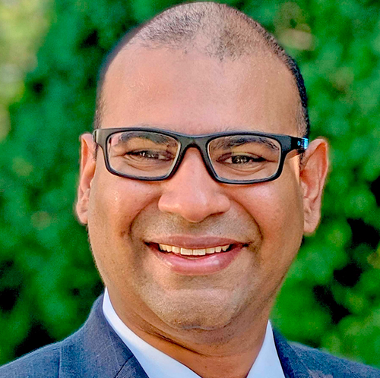
Panelist Perspective
In 2021, we will be building up the strengths and weaknesses that we observed while rapidly responding to the pandemic in 2020. We will ensure that our operations continue to be secure by employing new techniques that involve dark web tracing or social media accounts, as well as keeping track of where all of our data is, lives, and goes, and ensuring that we have things such as leakage prevention of data.
Niranjan Davray
Chief Information Officer
Colgate University
Notes:
We might be able to use the video clip for this one (excellent video res, but lots of “ums” and some kid noise in the background)
Start @ 21:00
End @ 22:25

Slide 39
5. Financial Health Partnering with advancement, research, and other institutional areas to develop new funding sources and partnerships
What will evolve?
Financially creative ways to fund technology
Bottom line
Institutional leaders have increased understanding of the value of technology
Challenges
Managing the risk of partnerships
Finding the energy for entrepreneurism
Intense competition
Notes:
Leaders will need a lot of financial creativity to meet the demand for technology in 2021. IT leaders at some institutions are already collaborating. That might be with alumni relations or on specific research initiatives to fund the development and delivery of new services and capabilities. Grants, support from technology solution providers and other companies, and partnerships with local communities and employers are all potential sources of funds and income.
Of course everyone will be competing at the same time for the same partnership and funding opportunities. The competition will be even more intense now. The opportunities may be there, but in limited supply.

Slide 40
What if the pandemic continues beyond 2021?
Financial problems may exceed the capacity of partnerships and new funding sources to make a difference
Innovation related to financial health will become essential
Institutions’ local reputations may save – or condemn – them
Notes:
If the pandemic continues through 2021
Institutions’ and students’ financial problems will deepen, perhaps beyond recovery. On a hopeful note, maybe community colleges and other local institutions that have a long track record of involvement and support of their local city or region will find them stepping up to play an active role in advocating and raising funds for their survival.

Slide 41
Panelist Perspective
Whenever we’re partnering with advancement or research, we’re looking for new revenue streams. IT has a lot of assets and knowledge which are leverageable, not only inside the institution, but externally as well. So, by working together, we can create and generate a new revenue stream or reduce costs for other businesses, if they’re willing to share or trade an offer in order to get better offerings for our campus.
Geoffrey Cirullo
Director of Technology Services
California State University, Stanislaus
Notes:
We might be able to use the video clip for this one
Start @ 22:25
End @ 23:10

Slide 42
The Top IT Issues
Transform Redefining our institution and taking an active role in creating the new future in higher education
Notes:
And now, on to the Transform scenario. Some institutions plan to use the pandemic to launch or accelerate an institutional transformation agenda. The world around them has changed, and so must they.

Slide 43
The Top IT Issues
Transform Epigenetic change fueled by technology
Notes:
Institutions focused on these issues are starting with culture. Technology issues are heavily represented in the Transform theme but always in the context of technology’s role and relationship with institutional priorities and ambitions.
Students and their importance to the institution appear as an enrollment and recruitment issue in the Transform scenario. As one panelist said, “This issue is at the heart of what defines an institution and its ability to deliver on its mission.” Institutions taking a transformative approach to enrollment and recruitment plan to make advanced uses of technologies and analytics to recruit students and to help them succeed.
The Transform scenario is not without its financial issue, cost management. Institutions with transformational ambitions plan to make cost management a core objective of digital transformation.

Slide 44
1. Institutional Culture Contributing to a culture of transformation by modeling agility and future thinking when designing IT programs and services
What will transform?
Institutions’ ability and commitment to respond to new circumstances and needs
Bottom line
COVID has primed institutions to become more agile and innovative
Challenges
Developing a holistic strategy to address today’s numerous disruptive forces
COVID fatigue
Notes:
COVID is an accelerator. It jolted institutional leaders out of their ideation and slow, marginal innovations into rapid and ongoing transformation. Resistance was futile or quickly overcome because the lives and the future of institutions was at stake. The COVID culture has been a culture of transformation, future-thinking, and agility. It has primed institutions to continue in that mode, although hopefully much less frantically.
Institutions don’t do the hard work of innovation, people do. Transformation, agility, and future-thinking will be up to people, and those people will begin 2021 exhausted and strung out by 2020. That’s not the greatest mindset to take on transformative change.

Slide 45
What if the pandemic continues beyond 2021?
The need for and pace of transformation will accelerate
Cost reductions will become speed bumps (at best)
The academic business model will be in need of transformation to retain financially-strapped students
Notes:
If the pandemic continues institutional leaders will have no choice but to accelerate transformations they’ve got underway, because economic pressures will become even more intense. And students will need more help than ever before to enroll, stay enrolled, and successfully complete their degrees. Institutions may restructure their credential offerings, in collaboration with accreditation organizations, to provide more flexible, lower cost credential opportunities.

Slide 46
Panelist Perspective
In a lot of ways, COVID was an accelerator. It made us do things that we just weren't getting around to.
Post-COVID that change won't stop. There are other things in our society that are occurring that will continue to keep the momentum on change in higher education. And therefore, the IT culture will be very important to the ability to leverage innovation.
Joe Mancini
Executive Director, IT
Montgomery County
Community College
Notes:
We might be able to use the video clip for this one
Start: 12:10
End: 13:03

Slide 47
2. Technology Alignment Identifying and applying digital strategies and innovations that are sustainable, and driven by the institution’s ambitions and transformational goals
What will transform?
The role of IT as a strategy driver and transformation leader
Bottom line
COVID put institutions on the path of digital transformation. Now they need to decide whether to stay on that path.
Challenges
The pace and uncertainties of 2020 will continue in 2021
Change leadership
IT governance
Notes:
The pandemic put colleges and universities on the path of digital transformation, a path that for many was unthinkable at the beginning of 2020. One of the biggest and perhaps most lasting changes from the pandemic has been to elevate the role of IT as a strategic partner, and, in many ways, a strategy driver. IT leaders need to retain that role in 2021 and beyond to help institutions transform teaching, learning, research, administration, and their business models. That kind of change is what’s needed for higher education to remain a public good and yet survive.
But the pace won’t slow in 2021, and leaders will have many decisions to make, and make quickly. Deciding which pandemic-induced innovations to continue may be controversial. Leaders will have to set forth a strong vision and rationale for transformation, and make sure they have strong change management in place.

Slide 48
What if the pandemic continues beyond 2021?
2020’s provisional measures will need to be hardened
Resistance to transformation and change may diminish as people experience the pandemic as normal life
Notes:
And if the pandemic is not resolved in 2021, the technology, process, and policy choices and changes made in 2020 that were provisional and stop-gap will need to be adapted and improved for long-term use, if that didn’t already happen in the latter parts of 2020.

Slide 49
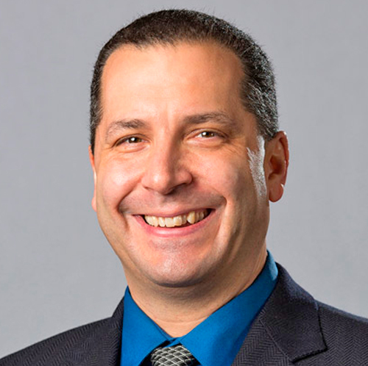
Panelist Perspective
IT really is like having robust utilities, but ones that can innovate and transform how we do teaching, learning and research at scale. IT shouldn't be just at the table, in some cases we should be leading the discussion, we should be leading the transformation of education and research. IT needs to be ahead of the curve, offering solutions for problems that maybe our faculty, staff and students don't know exist yet.
Sol Bermann
CISO & Executive Director of Information Assurance
University of Michigan-Ann Arbor
Notes:
We might be able to use the video clip for this one
Start: 5:43
End: 6:48

Slide 50
3. Technology Strategy Developing an enterprise architecture to enable business outcomes, manage data to enable decision-making and future opportunities, streamline business processes, and enable digital resources to keep pace with strategic change
What will transform?
The application of enterprise architecture to advance both strategy and efficiency
Bottom line
This is enterprise architecture’s moment
Challenges
New funding will have to show a clear and compelling ROI
Inability to focus on strategy
Notes:
Enterprise architecture can be limited to architecting technology solutions, but as an IT organization’s Enterprise architecture practice matures, CIOs will use it to align IT with strategic business outcomes and make the IT spend more effective for the institution. This is the level of Enterprise architecture that institutional leaders focused on transformative change will aspire to.
Institutions whose EA depended on campus-based access had to develop architectures that enabled people to do work from anywhere. A work from anywhere organization provides a new opportunity for diversity and inclusion in the faculty, staff, and student populations. That is new and that will last.

Slide 51
What if the pandemic continues beyond 2021?
Digital transformation efforts will focus on cost reduction and income generation
IT spend will need to focus on the most important services, which may require discontinuing less critical services.
Notes:
If the pandemic continues in 2021, reliance on IT capabilities and staff will continue. Institutions should try to avoid directly cutting IT budgets to afford additional investments to support remote or hybrid operations. IT budget managers will need to shift IT spending to areas that need it most and away from services and initiatives that can be retired or paused.

Slide 52
Panelist Perspective
We need to be able to create strategies and develop the technologies and architectures that make us even more efficient and more effective.
Where could we remove some of the excess of business processes? How can we automate things to make life a little better, streamline how data flows, things like that?
Kirk M. Anne
Director of Research Computing Rochester Institute of Technology
Notes:
We might be able to use the video clip for this one
Start: 15:20
End: 15:58

Slide 53
4. Enrollment and Recruitment Holistic solutions for recruitment, analytics-based marketing around student career outcomes, technology-enabled transfer agreements and partnerships, and social media to build student communities
What will transform?
The strategic application of technology and data to enrollment and recruitment
Bottom line
Enrollment and recruitment practices and strategies are in a great deal of flux
Challenges
Developing a new playbook
Finding the best uses of technology
Adapting to NACAC’s changed Code of Ethics and Professional Practices
Notes:
Enrollment and recruitment practices and strategies are in a lot of flux now. A lot of what has happened over the past 10-15 years had a bit of a kitchen sink approach. Most institutions have used new technologies in all kinds of ways including analytics tools and techniques, targeted social media, and a richer online experience for applicants who can’t get to campus.
At this particular moment sophisticated and evolved recruitment strategies supported by technology couldn’t be more important. And institutions that have gone the ‘kitchen sink’ route need to hone in on where to invest and focus.
Students and more often their families, are looking for metrics that point to the probability of their students’ long-term personal success from attending a particular institution. Most institutions have not yet figured out how best to seamlessly demonstrate success after college as part of their recruitment strategy beyond pointing to some charts and tables.

Slide 54
What if the pandemic continues beyond 2021?
Institutions will need to use technology in ways that come closest to the impact of campus visits (which will probably not happen by digitizing a campus visit)
Notes:
If the pandemic continues, institutions will need to break through the campus visit barrier to successful recruiting. They will have to get creative about using technology to replicate the intimacy of a campus visit. Direct translation will probably be less successful than a reimagining of the social and emotional recruitment journey that capitalizes on digital strengths.
Online-only institutions know how to do this. It will be time for all institutions to master it.

Slide 55
Panelist Perspective
Fundamentally how we recruit—at its very heart—hasn’t changed much in decades. It remains a ‘cast a very big net and see what you can catch’ approach.
There is an opportunity to get creative with much more than just doing what you’ve always done. There is an opportunity to imagine a different strategy entirely and layer those efforts with analytics.
Carrie Rampp
Vice President and Chief Information Officer
Franklin & Marshall College
Notes:
(No video for this one.)

Slide 56
5. Cost Management Digital transformation efforts and IT service delivery, helping the institution maximize value and reduce overhead
What will transform?
Digital transformation will transform cost management strategies
Bottom line
The pandemic has primed institutional stakeholders for digital transformation
Challenges
Financial struggles may sabotage strategic investments
Risk aversion may increase, just when institutions most need to take calculated risks
Notes:
Institutions embracing digital transformation to guide cost management are working to increase agility and reduce redundancy. They are hoping to reduce the time it takes to change solutions and introduce services from years to months or even sometimes weeks. Effective techniques include reducing customizations, selecting one solution that is good enough for most instead of several that are ideal for all, and standardizing on one set of solutions to provide a streamlined user experience, as well as a more maintainable architecture.
The pandemic has helped institutional leaders recognize the ways in which technology can directly benefit their work. They’re more aware now of the ongoing investments an effective digital infrastructure needs. Leadership commitment to digital transformation is essential, because it’s not a one-and-done. It’s a series of initiatives, and higher education is still very early in its journey.

Slide 57
What if the pandemic continues beyond 2021?
Government support for higher education may become a make-or-break issue
Technical debt will grow
Once-revolutionary uses of technology will become standard practice
Notes:
And if the pandemic is not resolved in 2021? IT leaders have been provisioning students, faculty, and staff for remote learning and work. There’s no clear funding source or strategy, especially for institutions that haven’t prioritized among in-person, hybrid, and fully online modes. This is not sustainable at current or inevitably reduced funding levels.

Slide 58
Panelist Perspective
We’ve got six modes of teaching right now, which is not anything we've ever had before. And the instructor can pick any one of those six.
So maybe our traditional classrooms don’t need to be as equipped as they used to be in the past. We can shift those funds to keep some of those new modes of teaching that are actually the way the students do want to learn.
Donna Liss
Chief Information Officer
Truman State University
Notes:
We might be able to use the video clip for this one
Start @ 29:20
End @ 30:39

Slide 60
Wrap up
Notes:
I have a few thoughts to help you prepare for 2021 and how the EDUCAUSE IT Issues might help.

Slide 61
Avoid
binary
thinking
Notes:
IMAGE SOURCE: https://dev.to/hamza/coding-in-binary-code--a-thing--5bck
Binary thinking is the fallacy that any question has one of only two possible answers. If the pandemic has taught us anything in 2020, it’s the perils of binary thinking. The pandemic presented a risk that needed nuanced management. Not every location was a hot spot. Few institutions were either completely shut down or 100 percent open and operating normally. Regardless of the decisions made at the institutional level, individual students, faculty, and staff had to make individual decisions about where to learn or teach or work based on their own personal set of risks and circumstances.
The pandemic has demonstrated the usefulness of online learning, not as the alternative to classroom learning, but as a modality to infuse into pedagogy. The hy-flex option is popular these days because it gives both instructors and students a lot of flexibility about when to learn and how to learn, class by class instead of course by course or program by program. Hy-flex will certainly be succeeded by something even richer and better. XR technologies and artificial intelligence are just two examples of maturing innovations that will provide options that making today’s digital learning and teaching options seem as primitive as overhead projectors or chalkboards. Binary thinking suggests that the application of technology to teaching and learning is good or bad, effective or ineffective. That kind of mindset ignores reality and leads to poor choices.
Work location also needs to become a non-binary issue. Staff want a kind of hy-flex working environment. Managers and HR leaders need to consider how to structure such working conditions in ways that increase both staff engagement and productivity and maybe even reduce expenses.

Slide 62
You won’t find your institution
within a single scenario
Replace this slide with the next one
Notes:
Don’t forget our third assumption: Very few institutions will see themselves within a single scenario. Our scenarios describe archetypal approaches to pandemic recovery. You will most probably find your institution across two or all three of the scenarios. Consider the issues that best describe the approach you think your institution might most likely take to shape its post-pandemic future, and then ask how the future might turn out differently if your institution took one of the other approaches.
Using correlation analysis, we found patterns in how respondents chose issues within and across scenarios. For example, people who rated the Restore version of cost management particularly highly (or lowly) for their institution were significantly more likely to also rate the Evolve version of equitable access to education highly (or lowly). There was a great deal of cross-over between Restore and Evolve issues. We found the least crossover between the Restore and Transform themes and within issues in the Evolve theme.

Slide 63
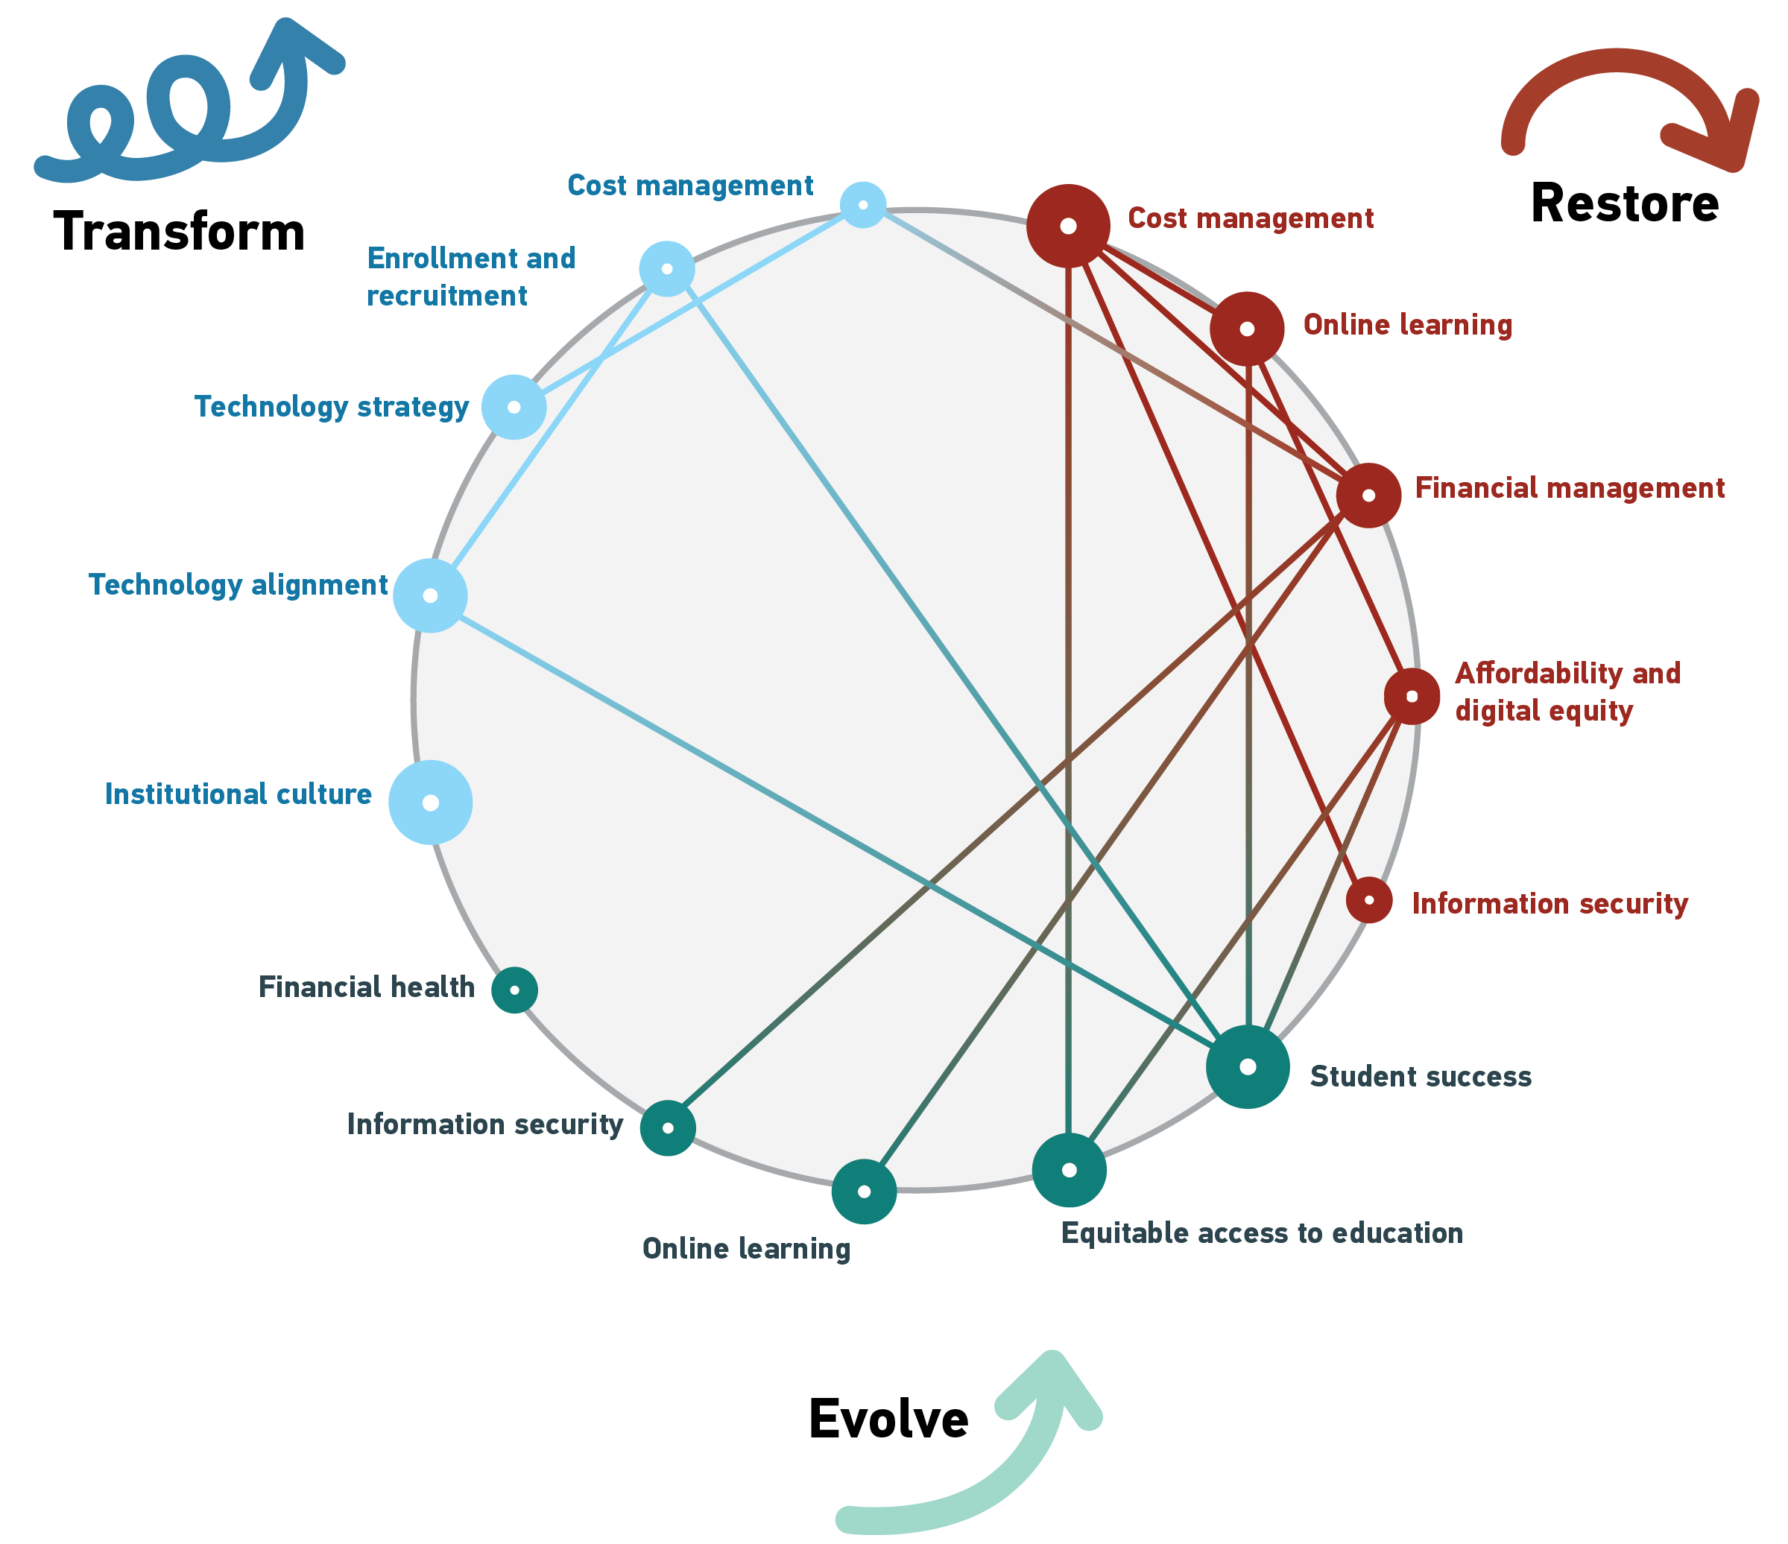
You won’t find your institution
within a single scenario
Notes:
Don’t forget our third assumption: Very few institutions will see themselves within just one of the scenarios. Our scenarios describe archetypal approaches to pandemic recovery. You’ll most probably find your institution across two or all three of the scenarios. This diagram shows the patterns in how respondents chose issues within and across scenarios.

Slide 64
You won’t find your institution
within a single scenario
Notes:
For example, people who rated the Restore version of cost management particularly highly (or lowly) for their institution were significantly more likely to also rate the Evolve version of equitable access to education highly (or lowly). There was a lot of cross-over between Restore and Evolve issues. And we found the least crossover between the Restore and Transform themes and within issues in the Evolve theme.
Consider each version of all the issues, and what combinations of issues and scenarios might work best. Find the issues that best describe the approach you think your institution might most likely take to shape its post-pandemic future, and then ask how things might turn out differently if your institution took one of the other approaches.

Slide 65
Two meta-issues
Notes:
Now, as we close, I want to mention two themes that came up again and again in the panel’s conversations. The first is diversity, equity, and inclusion. Two issues hint at it – Affordability and Digital Equity in Restore, and Equitable Access to Education in Evolve. But the panelists also felt the diversity, equity and inclusion, or DEI, is so important that it transcends all the themes. Ensuring equity of access and outcomes for higher education, having a workforce that is diverse in many, many ways and that can reflect the diversity of our students and faculty and citizens, and fostering inclusion so no one feels marginalized or maltreated. We need to keep these basic human rights in mind and in deed as we lead and manage technology professionals and as we work with and support students, staff, faculty, and the community we work and live in.
The second theme is burn-out. We all feel it, and there’s no sign that things will slow down or ease up. Let’s listen to our final panelist perspective from Dave Seidl.

Slide 66
Panelist Perspective
The marathon question is a big one. I've been telling my staff for three months that we need to treat this like a marathon, but we keep sprinting because we keep running into things that we need to sprint for. And that's going to be really challenging.
We're on month six of incident response. And none of us are prepared for six months of incident response.
David Seidl
Vice President for Information Technology and CIO
Miami University
Notes:
We might be able to use the video clip for this one
Start @ 27:52
End @ 28:52

Slide 67
What role will your institution play in higher education’s new future?
Restore
Evolve
Transform
Notes:
Nothing that happened during 2020 was particularly novel or surprisingly. It has been a year when many trends and risks accelerated. COVID has vaulted us several years ahead in digital transformation, adoption of online learning, working from home, need to replace business models, public scrutiny of the costs and value of higher education, and cultivation of agility in decision-making. Racial injustice, our current political polarization, and the unfair and uneven impact of the pandemic on people of different ethnicities and means have forced broader and deeper awareness of the many inequities in our world, particularly within the United States. None of these facts were hidden or are new. But higher education’s leaders can no longer shirk their accountability. It is not for us alone to address these challenges, but neither can we afford any longer to lean back and let others do the hard thinking and work. Instead of shrugging and saying, “what are ya gonna do,” ask yourself, what are you going to do? Answer the question and start moving forward.

Slide 68
Thank you
Susan Grajek
Vice President, Communities and Research
sgrajek@educause.edu
Notes:
Have your we people post the slides PDF and create a SHORT URL people can easily write down.

