Slide 1
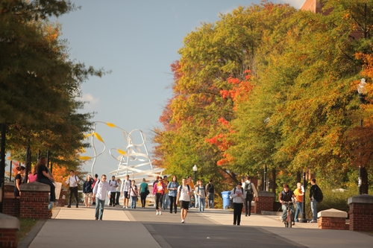


Big Data Enables Student Retention: Student Success & SAP HANA
James David Hardison, DMD, MBA
Industry Principal, Higher Education
Vince Kellen, Ph.D.
Senior Vice Provost Academic Planning, Analytics and Technologies

Slide 2

Key Learning Objectives
Introduction
SAP HANA Overview
Applications of HANA in Higher Education

Slide 3












Notes:
The information we see in the lower right image exists in the upper left, but we don’t se it – do we? Handling copious amounts of data to access the data that really matters is just one of the more daunting challenges we all face/

Slide 4











What if you could…
?
?
?
Manage Large Data Volumes Cost Effectively
Have Immediate Answers to Any Question
Always Have Current & Complete Information
Notes:
In an ideal world – we should be able to
Manage the “Information Explosion” cost effectively
Always have access to all the information we need on-demand
Be able to use that information to answer any question
Simple – right?
Reality is that we can only meet 1 or 2 at the most of these requirements simultaneously.
For example
We can manage large amounts of data, in fact it easy to manage petabytes but is near impossible to access any of this information in a reasonable amount of time
To have “current & complete” information, the simplest thing to do is to run reports against the transactional systems
Immediate Answers? Only way to do that is to pre-compute (i.e. summarize) the data ahead of time
Well, …..

Slide 5
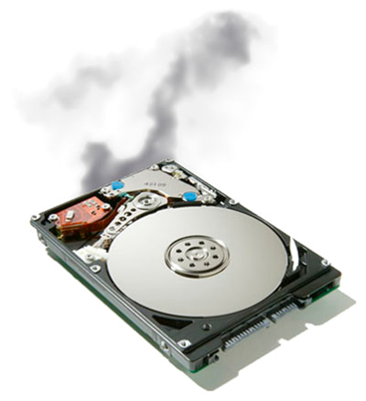
Why Is This So Hard?
30 Year-Old Database Design Principles
Slow Disks & CPUs
I/O Bottleneck
Expensive Memory
Optimized for Transactions
BI is an Afterthought
Notes:
It is hard to solve today’s problems with yesterday’s technology.
The reason is simple. We are limited by the speed at which our systems can serve information.
Today’s information systems are based on disk technology which was designed for transactional systems and not business intelligence.
The solution is silo-ed and layered architecture which is now considered a best practice
-------------------------------
Background speaking points:
Bottleneck is Input/Output (I/O)
I/O Bottleneck creates Latency & Inefficient CPU Usage
RDMS Technology was designed for writing transactions (OLTP)
Data is not “stored” in a way that business users ask questions
80% of BI queries use less than 20% of data returned in row-based queries

Slide 6
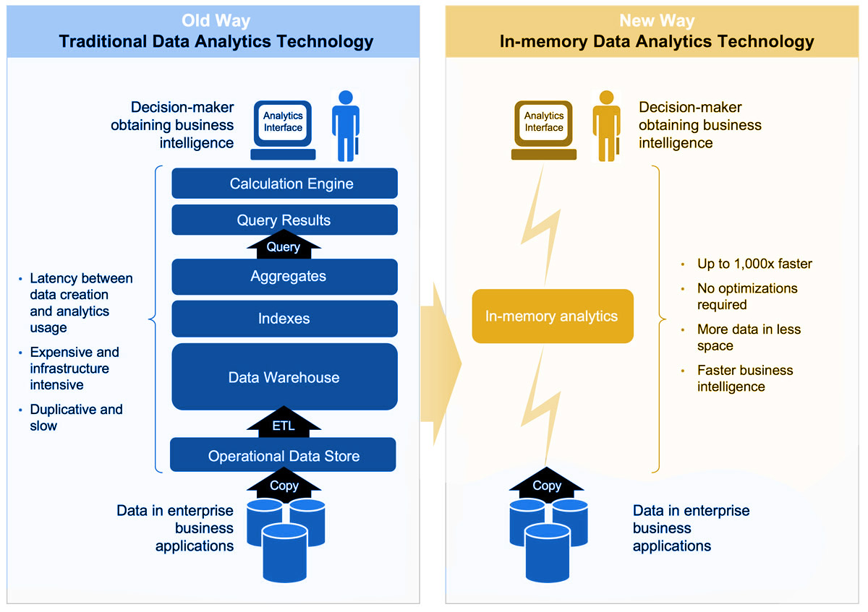
Notes:
Here is an example of BI today
All we want is to run some reports against our transactional systems. We need some simple queries and results. <click>
Well, it is not that simple. You definitely don’t want to run against the transactional system so as not affect performance. So, we extract data and create an operational data store <click>
The problem is that the operational data store is good for simple reports but does not let us run complex reports. For example, sales vs. inventory vs.open orders. To do that, we need a DW that lets us report against multiple subject areas <click>
Of course, to make DW’s perform, we need indices <click> BTW, indices are responsible for 60% of the size of most modern DWs. Staggering isn’t it?
That’s not all. For complex queries to perform, we need to pre-compute results <click> Nice, but that leads to blind spots. The devil is always in the detail, isn’t it?
This is modern DW architecture. It is slow, painful and expensive and difficult to change because data is being replicated across all these layers.
BTW., I am not even depicting additional layers on top of the DW, like data marts or OLAP cubes. That’s an extra level of complexity. <click>

Slide 7
Key Learning Objectives
Introduction
SAP HANA Overview
Applications of HANA in Higher Education

Slide 8
SAP HANA (High Performance ANalytic Appliance)
A next-generation platform ... that can process and analyze … structured and unstructured data … providing insight into the lowest level of detail … with a quick time to value … and the ability to ask more questions to drive informed decisions.

Slide 9
More than just a database…
Real-time
analytics
Real-time
apps
SAP HANA
Info Composer &
Modeling Studio
Application Services
Text Search
Planning and
Calculation Engine
Predictive &
Business Libraries
R & Hadoop
Integration
Columnar Storage
In-memory Database
Row Storage
Spatial Engine
SAP Business Suite
Third-party systems

Slide 10
Key Learning Objectives
Introduction
SAP HANA Overview
Applications of HANA in Higher Education

Slide 11
HANA for Higher Education through University Alliances
  SAP donates licenses to more than 1300 universities and provides materials for professors
  1.2 M Students educated on HANA
  Students can access online courses and SAP Certifications
  Members can take part in our competitions and contests, send students to our Innojams, Codejams and Design Thinking events, get involved with our Co-Innovation projects or research and the development of new SAP solutions

Slide 12
What is the difference between how did students do and how are they doing?
Notes:
The difference is the timeliness of being access to the information we need to influence performance.

Slide 13
Newton’s First Law of Motion
An object at rest stays at rest, and an object in motion stays in motion with the same speed and in the same direction unless acted upon by an unbalanced force.
Application:
Students at risk are not likely to change their behavior (their trajectory) without intervention.
Notes:
Left undisturbed “in the wild”, what is going to make a student change their behavior pattern? What about those students who need help not because of behavior patterns, but because of addressable deficiencies, missing skills, etc. What pattern do we want – work leading to success or struggling leading to failure?

Slide 14
Newton’s Second Law of Motion
The acceleration of an object as produced by a net force is directly proportional to the magnitude of the net force, in the same direction as the net force, and inversely proportional to the mass of the object.
Application:
The earlier intervention occurs, the easier it should be.
Notes:
I learned a lot of physics from cartoons. Not all of the physics I learn works in the real world, but some of it does. What happens when a snowball rolls downhill? It gathers more snow; gets bigger and bigger; and becomes almost impossible to stop. Could the snowball have been stopped or deflected onto a different path a short distance from the top of the hill? Yes. What about after it has been on an unaltered path for a while? Not very easily.

Slide 15
We need a change
"If you always do what you always did, you will always get what you always got."
- Tony Robbins
- Moms Mabley (other sources cite Henry Ford and Mark Twain)

Slide 16

Using Fast Analytics to Help Improve Student Retention
(and more)
Vince Kellen, Ph.D.
Senior Vice Provost
Academic Planning, Analytics and Technologies
University of Kentucky vkellen@uky.edu
October, 2013

Slide 17
What we have done and what we would like to do
First steps over the past year
  Mobile micro-surveys: Learning from the learner
  Student enrollment, retention, demographics, performance, K-Score, facilities utilization, instructor workload and more
  High speed, in-memory analytics architectural differences
  Open data and organizational considerations
Coming down the road?
  Micro-segmentation tool to enhance user and IT productivity, develop personalized mobile student interaction/intervention
  Models for learner technographics, psychographics, in addition to behaviors, performance, background
  Advanced way-finding for streaming content like lecture capture
  Content metadata extraction and learner knowledge discovery
  Real-time measures of concept engagement and mastery
  Real-time learner recommendations and support engine
  Use graphing algorithms to perform more sophisticated degree audit what ifs

Slide 18
Model | Description
Enrollment | Enrollment in a class, midterm and final grades, credit hours attempted and earned, instructor teaching the class
Student retention and graduation | Student demographics and cohort identification (e.g., John Doe is in the 2009 entering first-year student cohort)
Student demographics | Demographics, such as age, high school GPA, entrance test scores (SAT, ACT) and subcomponent scores. Also, in a secure location, additional personally identifiable demographic details such as name, address, email, etc.
Student performance | Present the enrollment data in such a way as to easily show the student’s performance for each term, including credit hours earned, term GPA, cumulative GPA for that term, etc.
Student academic career | Keep a list of the majors and minors for each student and degrees awarded. Also, include details on students who transfer in and out, including transfer institution, credit hours transferred in, etc.
Productivity | The room utilization model contains every building, every potential classroom and lets users analyze the room capacity and enrollments for the class or event in the room at five minute intervals. The faculty stats per term model pulls together the number of students and sections taught per term and will contain other important data such as research expenditures per term and grant proposals submitted and won.
Micro-surveys | Capture questions and answers from the My UK Mobile micro-survey feature
Student involvement | Interaction history with various applications including the learning management system, clickers, course capture and playback, academic alerts. Provide the basis for calculating the student’s K-Score.

Slide 19
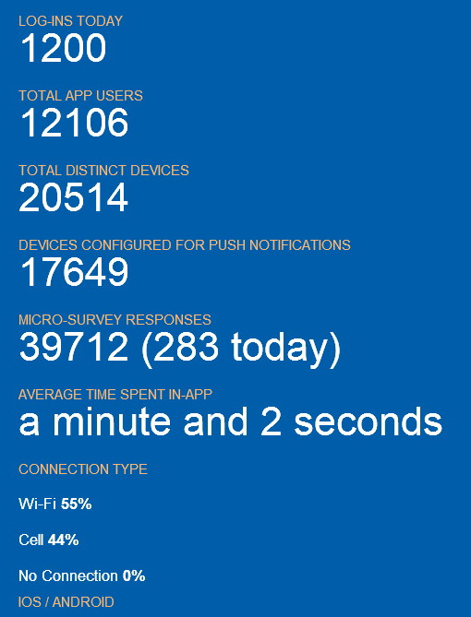

Slide 23
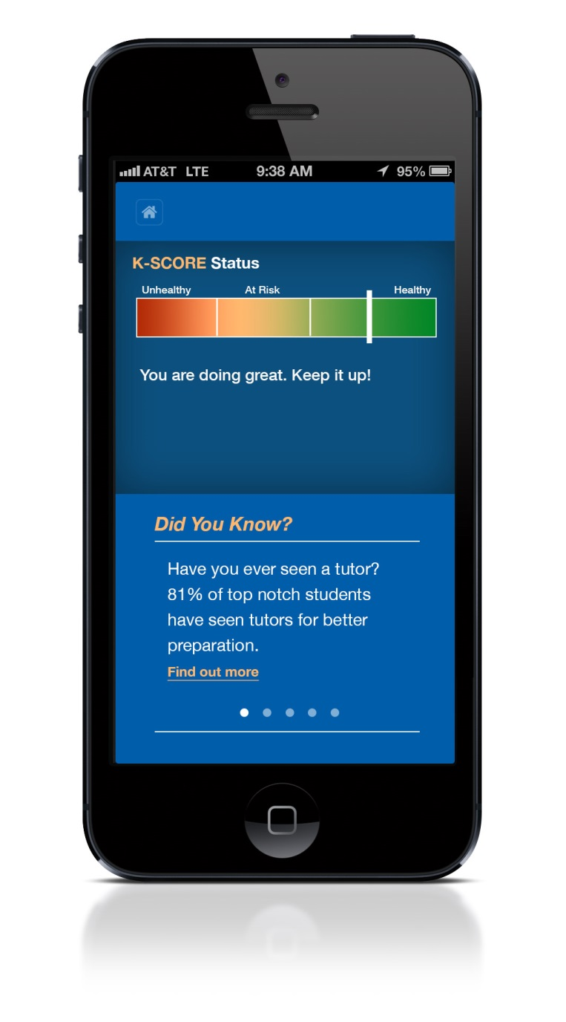
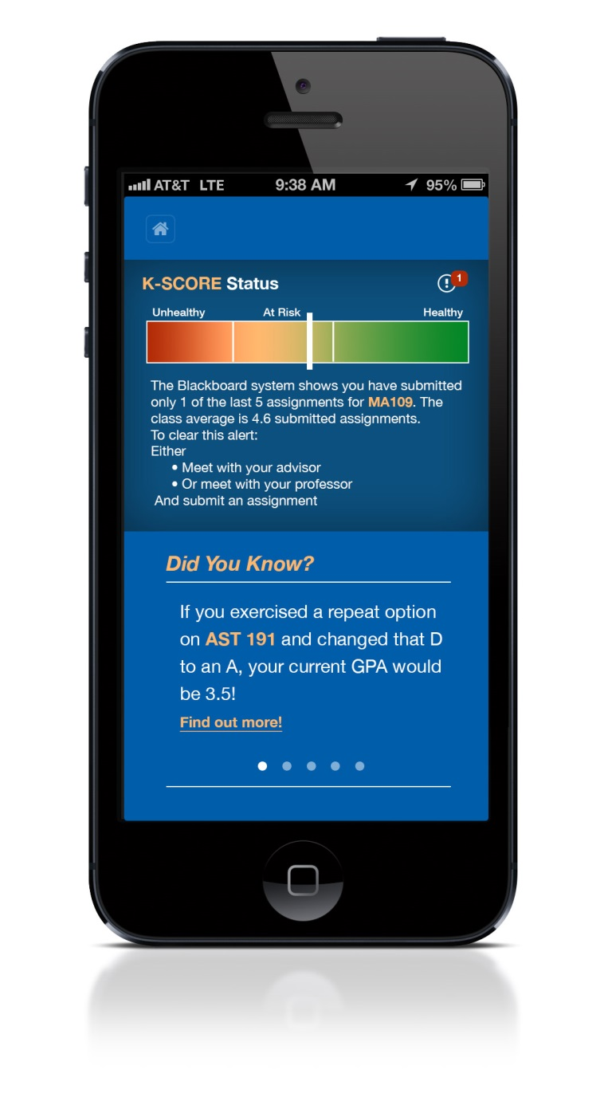
Academic Health Notifications:
View in student mobile app

Slide 26
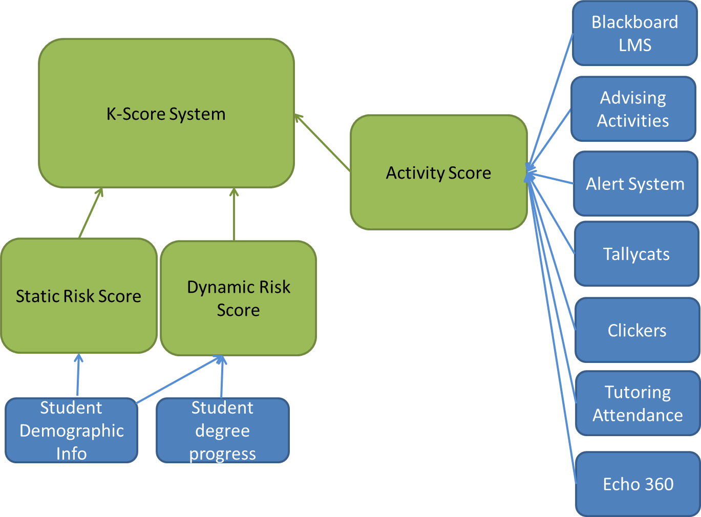

Slide 27
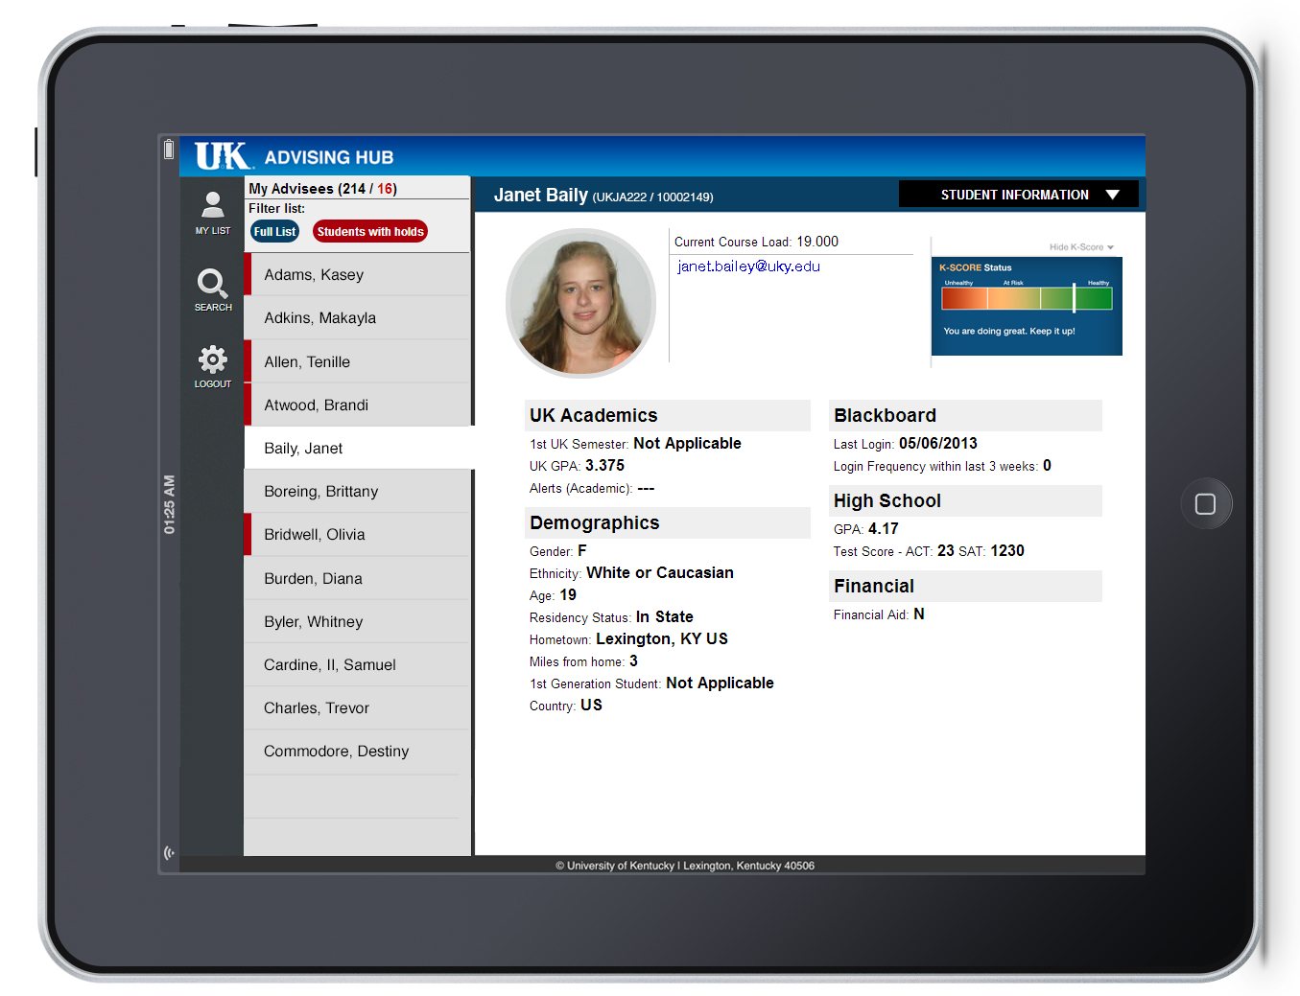

Slide 28
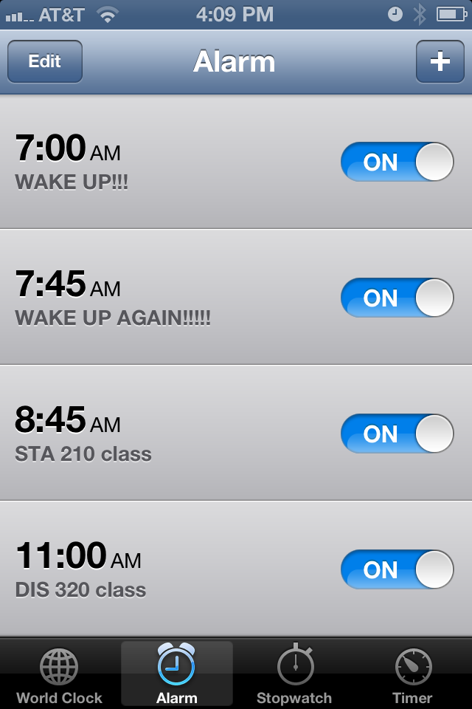
WAKE UP! GET TO CLASS!
Who sets alarms for themselves?
Why not automatically set alarms for students around their schedule?
Why not have automated wake-up calls?
Why not suggest wake up times based on class attendance?
Why not consider manipulation of reminders as a form of engagement?
Can we ascertain student prospective memory capability and personalize based on it?

Slide 29
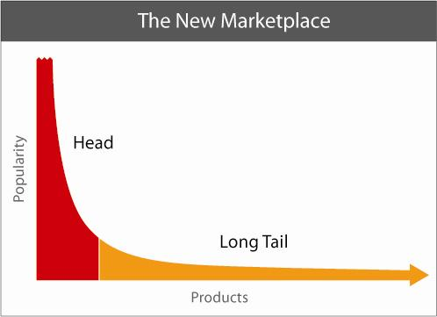
Déjà vu?
Large lectures
MOOCs
PHI 698
???
http://www.thelongtail.com/conceptual.jpg

Slide 30
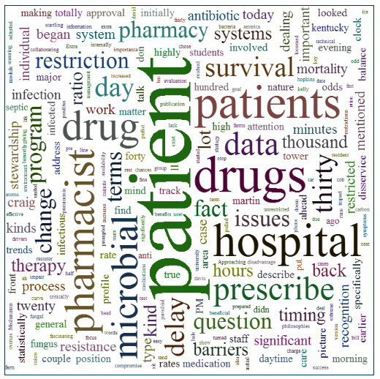
Taxonomy? Automatic metadata? Automatic atomic metadata?
Let learners navigate an audio/visual stream
Let the system learn what are top terms. Let the system map terms to concepts. Let instructional designers lightly ‘bump’ the taxonomy, post production
Record student engagement with specific terms / concepts
Deliver personalized messages to students
See http://p.uky.edu

Slide 31
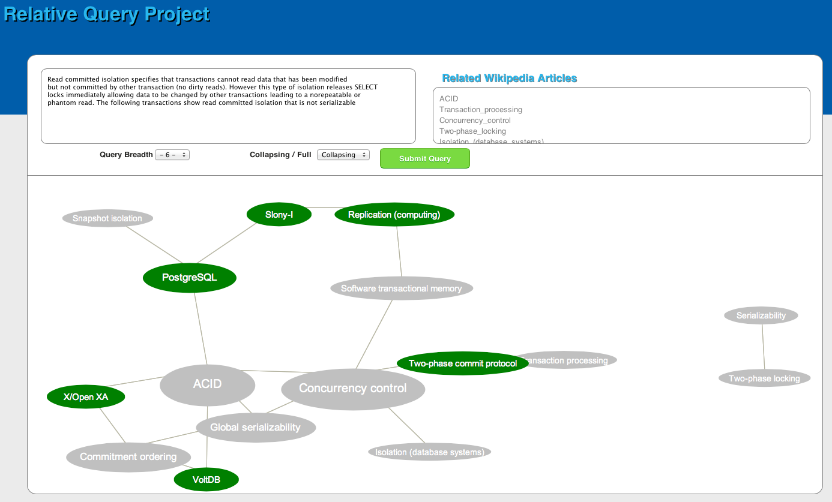

Slide 32

University of Kentucky

Slide 33
Class slides take a central position.
The audio/video and slide content is synchronized.

Slide 34
The note pad allows recording and
sharing of notes.

Slide 35
Personalized recommendations are a guide thru the material.
Feedback on engagement and mastery assist in gauging understanding.
Resources and tutors are also provided if a little assistance is needed.

Slide 36
A lecture concept map helps to put the lecture in a visual context.
The map is generated from analysis of the text and ‘bumped’ into shape by a course designer or instructor.
Concepts can be rated to collect perception of usefulness and improve future versions.
Jump to the media segment by clicking on the tag.
Test knowledge with small quizzes – ace the quizzes and you’re in good shape!

Slide 37
A one-stop-shop for searching.
Keywords from the video, slides, trends, notes and conversations will appear.

Slide 38
Key questions
Can the audio and slides be reliably transcribed into ‘useful’ text?
Can a concept map be derived automatically from the text generated or easily edited by an instructor?
How easy will it be for designers-instructors to create a quiz and place it in the right location in the video?
Can we personalize the recommendations to reflect prior knowledge, student ability and individual differences in information processing?
Can the interface support real-time integration with analytic back-ends (e.g., HANA)?
This is just one conceptualization.
What other interface designs exist today? How effective are they?

Slide 39
University of Kentucky

Slide 40
Organizational considerations
Integrated IR and BI teams. Added three Ph.D. level data scientists. Had some turnover.
Translated all old architectures to HANA and retiring old IR data warehouse. Making everything ‘automatic’ like IPEDS cohort determinations, enrollment reporting. Moving as much as possible to self-service. Agnostic on the front end tools.
Opened data. Many have access. Personal data is protected. Established a data community of practice. Used an ‘always beta’ mode of development. Measuring data quality. Providing data quality process improvements to the teams.
Started to raise skill sets in colleges and units. Provide support. Encourage ad-hoc learning opportunities. Help units with job descriptions and selection of talent.

Slide 41
Be safe and secure. Respect the acceptable use of information policies and guidelines the university has in place. Please have good passwords and secure your laptop, desktop and other devices appropriately. Treat private student and UK information appropriately
Be collegial. University data is a community asset and a community of people steward the data. Use and share the data with the best interests of the university community in mind. Since parts of our data analysis environment is designed to allow for greater transparency, analysis will potentially be able to see other unit data. While we will make private to a unit what absolutely needs to be private, the way the university runs it's business often involves multiple colleges and units at the same time. Don't use your access to take unfair advantage of another unit.
Help improve data quality. If you see data that doesn't appear to be correct, let someone know. We have a team of staff dedicated to helping improve data quality. This team can work with colleges and units on any data entry and data management processes that might need to be changed to improve data quality.
Be open-minded and inquisitive. Data can be represented in multiple ways at the same time. While the teams are taking great care to enable multiple views of the data to support the community, you might have a valid and unique perspective. In time, we can accommodate more ways of looking at the same data while not interfering with other views or taxonomies.
Share. The main benefit from open analytics is the power of a community of analysts learning from each other rather than a few select individuals hoarding knowledge or access. As the community improves its knowledge and skill with the data, the university can improve accordingly.

Slide 42
Personalize learning and support in one architecture
Real-time personalized interactions
  Target on-demand peer tutoring based on student’s profile
  Deliver micro-surveys and assessments to capture additional information needed to improve personalization
  Give students academic health indicators that tell students where they can improve in study, engagement, support, etc.
  Let students opt their parents in to this information so the family can support the student
  Tailor and target reminder services, avoid over messaging, enable timing of message delivery based on user temporal proclivities
Allow for open personalized learning
  How content gets matched to students is psychologically complex
  Several theories of how humans learn give many insights
  Students differ in the following abilities and attributes: visual-object, visual-spatial, reasoning, cognitive reflection, need for sensation, need for cognition, various verbal abilities, confidence, persistence, prospective memory, etc.
  We need an open architecture to promote rapid experimentation, testing and sharing of what works and what doesn’t
University of Kentucky

Slide 43
How technology can help in student success
High effectiveness
MOOC + PT + F2F
Small F2F class
MOOC + PT
Scale vs quality tradeoff
Current MOOC approach
Broadcast class
Low effectiveness
F2F = Face-to-face
PT = Personalization technology, adaptive learning technology
Low volume
High volume

Slide 44

Questions?

Slide 45
Thank you! Please complete an evaluation
James David Hardison, DMD, MBA
Industry Principal, Higher Education
SAP America, Public Services
james.hardison@sap.com
Vince Kellen, Ph.D.
Senior Vice Provost Academic Planning, Analytics and Technologies
University of Kentucky
@vkellen

