Slide 1
Building Academic Websites (in the Real World)
Brian Farr, Systems Manager | Valerie Forrestal, Web Services Librarian
College of Staten Island, City University of New York

Slide 2

Objectives
Clear, concise and logical navigation
Simple, elegant design
Advertise news and upcoming events
Central search box for finding resources
Repository for forms, policies, hours and contact information
Notes:
Job interview presentation
Best practices
Initial expectations
Desired infrastructure

Slide 3
Before you get started
Site organization
  Will your page groupings make sense to users?
  Deep hierarchical design may require extra navigation, such as secondary nav menus and/or breadcrumb links
  Folder structure will also affect how links look
How many templates? (1 vs. 2 column design – how will mobile handle side column? Drop it? Stack it?)
What kind of navigation? What set of links should go on every page
External links? Deep footer?

Slide 4
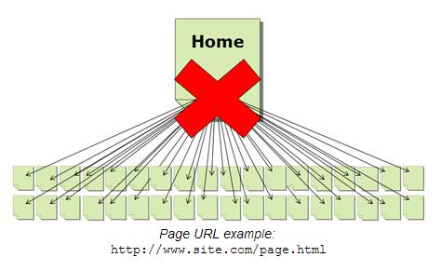
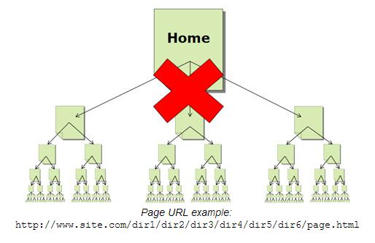
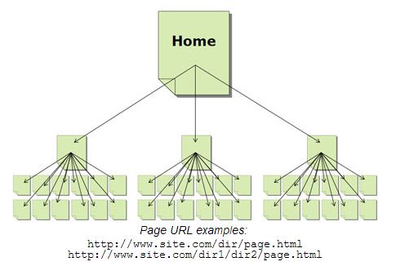
Source:
“How to Create a Directory Structure Search Engines Rock To”
by Stoney deGeyter
(http://www.searchengineguide.com/stoney-degeyter/how-to-create-a-directory-structure-sear.php)
Notes:
Flat vs. Hierarchical organization of pages
Flat design can lead to a sprawling, out of control site.
Will your page groupings make sense to users?
Deep hierarchical design may require extra navigation, such as secondary nav menus and/or breadcrumb links
Folder structure will also affect how links look

Slide 5
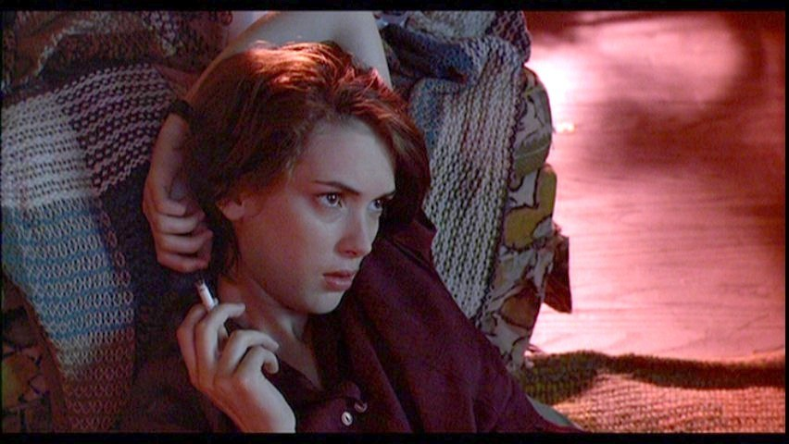
Reality Bites
Notes:
Reality of the situation
Outdated cms
Shortened timeline
Remove user-testing from priorities

Slide 6

How did we get here?
Notes:
Joomla legacy
Hackers (Turkish escorts!)
No web librarian for 2 years
Forms stopped working – joomla form plugin code on mail server
Vulnerable faculty sites

Slide 7
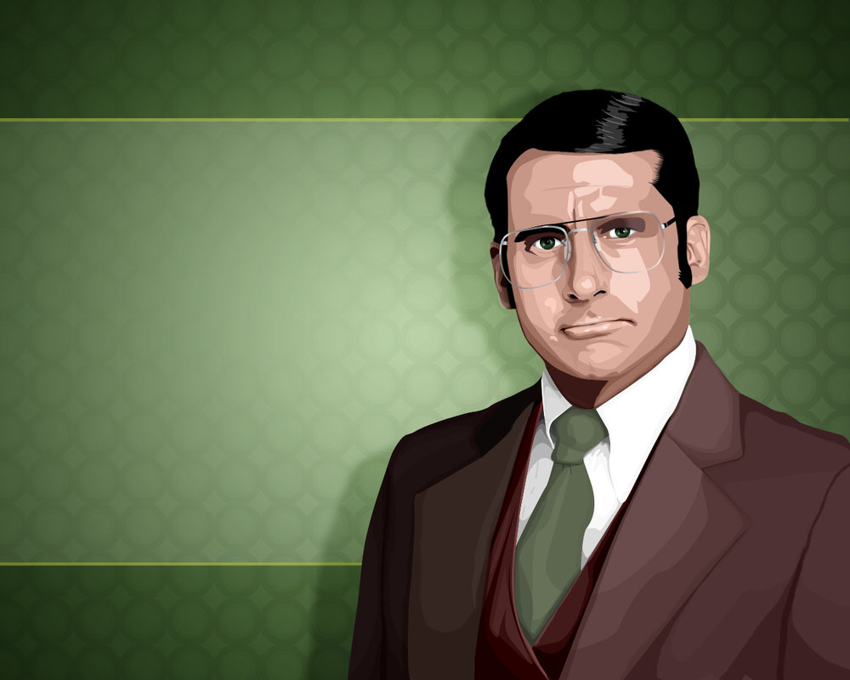
I LOVE LAMP
Notes:
New hardware
L – ubuntu because frequent updates
A – apache because easy, well-documented
M – mySql because database
P – php because wordpress
Library department only!
New CMS

Slide 8
Joomla:
Customizations prevented updates
Needs:
Shallow learning curve
WordPress:
Any CMS will do what we need
Messy back-end/admin interface
Old, vulnerable plugins
Do we really need user accounts?
Will it continue to be supported?
Server requirements/Back end code
Leanest/Easiest
Least intimidating to librarians
Better separation between code & content

Slide 9
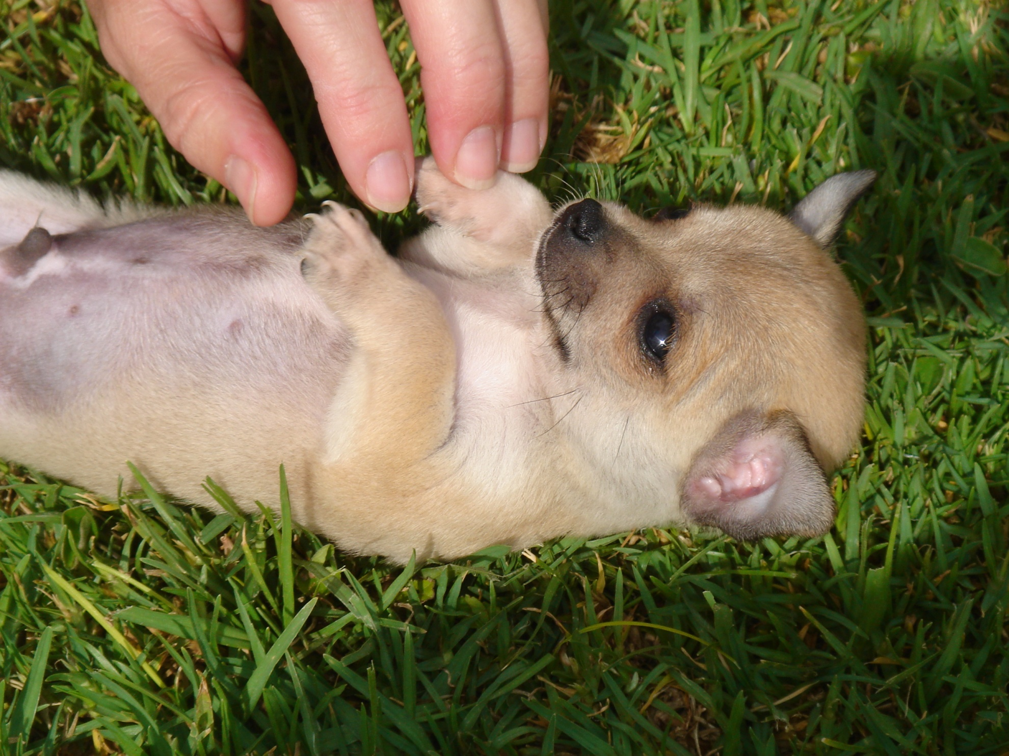
Development environment
Notes:
This is where valerie and brian fight
When you have only 1 developer, you don’t need a dev server
Windows work station
WAMP
Dreamweaver/fireworks/gimp/illustrator

Slide 10
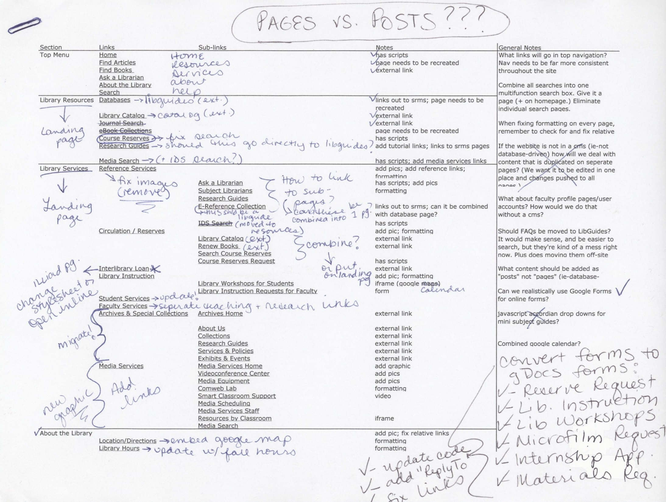
Notes:
Create annotated sitemap for old site
Eliminate unnecessary content
Pages vs. Posts (learn the WordPress loop!)
Identify content that needs additional sub menus that template(s) don’t provide
Identify content to be pushed into 3rd party software (like LibGuides/Google forms)

Slide 11
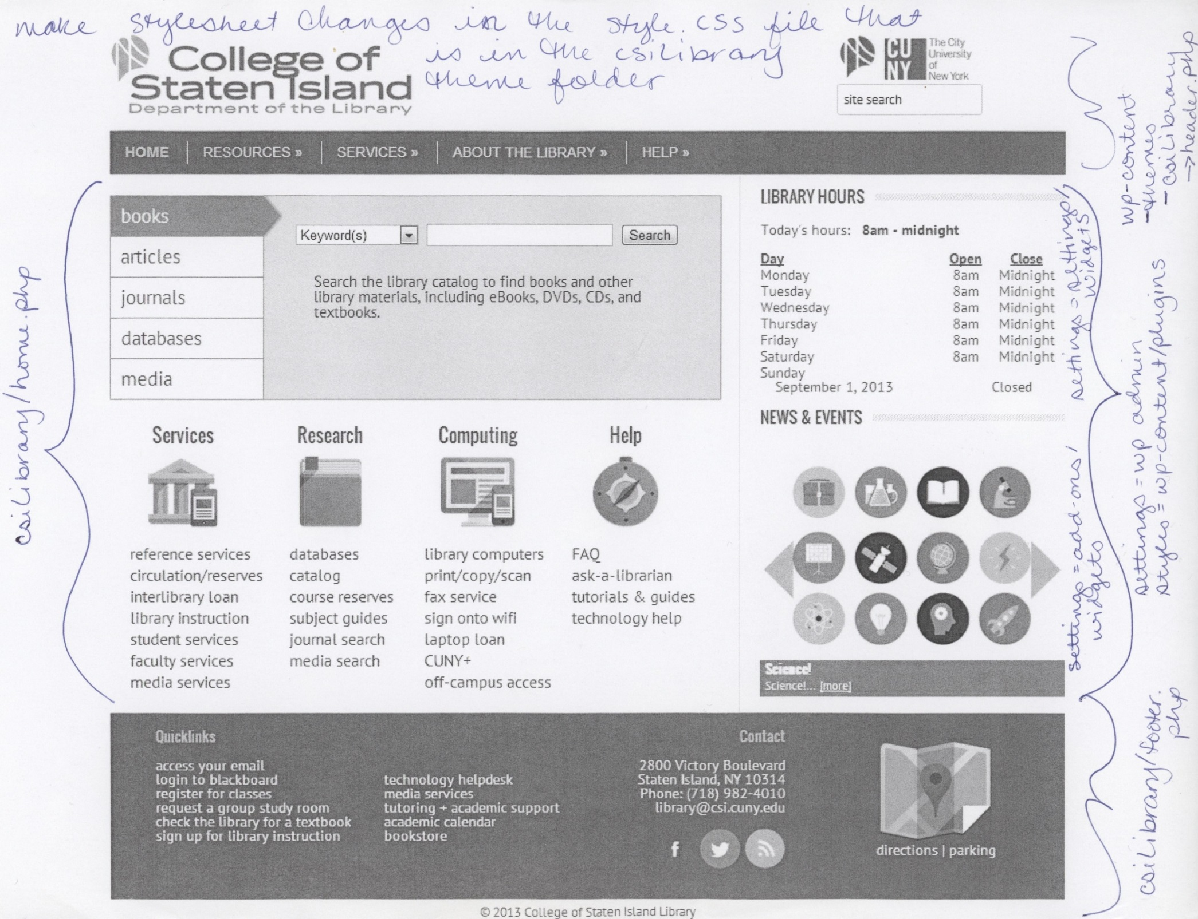
Notes:
Create simple graphic mockup
Find a template as close to your mockup as possible
Comment up code to make changes easier and save time later, when feedback comes in
Get familiar with common WordPress php calls (stylesheet_directory vs. template_directory)
Homepage will take up much of your dev time (and when done, so is the header/footer that forms the template for most of your other pages)
Testing/feedback/redesign
Development/Design time about 3 months (1 summer)

Slide 12
Important WordPress PHP calls:
relative page/post links: <?php echo get_permalink(#); ?>
(where # is the page or post number. they’re all unique, so it doesn’t matter if it’s a page or a post)
image links, where images are in a folder in the child theme folder: <img src="<?php bloginfo('stylesheet_directory'); ?>/images/image.jpg">
includes where file is in parent theme: <?php include (TEMPLATEPATH . '/file.php'); ?>
includes where file is in child theme: <?php include (STYLESHEETPATH . '/file.php'); ?>

Slide 13
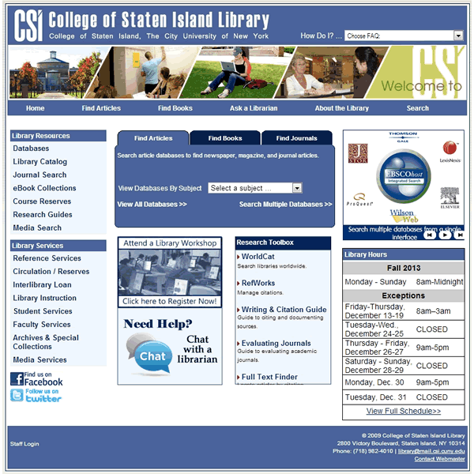

Slide 14


Notes:
New site:
Driven by analytics instead of user testing
Lean design/dev team
Trust your developer
Give them something to look at

Slide 15
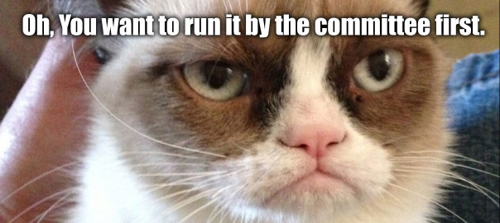
Lessons learned
Notes:
Old site:
Designed by committee
Cluttered homepage
Dumb shit on menus
Too many plugins

Slide 16
Free software!
Time isn’t free
Coffee isn’t free
So many features!
What features do you need?
What features will distract users?
A plugin for everything!
Plugins tend to be vulnerable
Plugins break/become unsupported
Everyone can collaborate!
Too many cooks
The web 2.0 lie
MIGRATE ALL THE CONTENT!
Some of your content is bad and should be thrown away
This is your chance to update and edit
Notes:
THE REALITY: A SUMMARY

Slide 17

For questions or more info:
brian.farr@csi.cuny.edu
valerie.forrestal@csi.edu
Site @ www.library.csi.cuny.edu
Slides & additional resources @ vforrestal.com

