Slide 1
Open Textbooks and Open SUNY Textbooks
Cooperative Strategies for Reducing the Cost of Textbooks
Stephen Weiter
SUNY ESF
Mary Jo Orzech
SUNY Brockport
Kate Pitcher
SUNY Geneseo
This work is licensed under a Creative Commons Attribution-NonCommercial-ShareAlike 4.0 International License
Except commercial websites cited in notes..

Slide 2
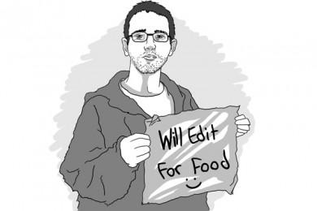
Why? Steve
Why Does any of this matter and why were we so keen to participate?
Notes:
Two levels of Why this is important. 1. Textbook costs. 2. Library value added Service

Slide 3

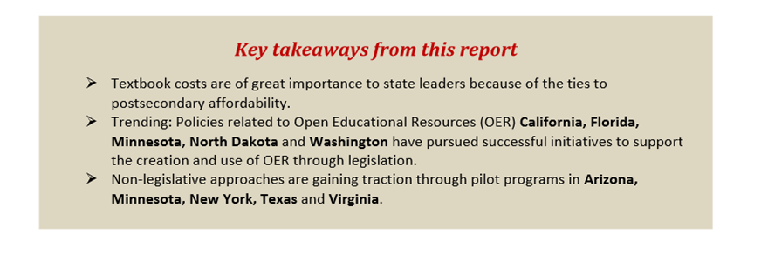
http://www.ecs.org/clearinghouse/01/14/37/11437.pdf

Slide 4
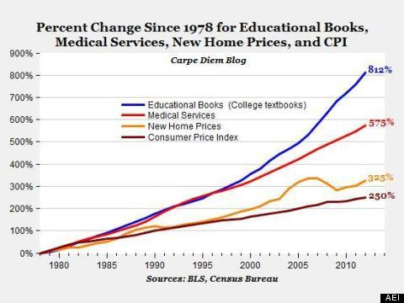
How can we add value and demonstrate our commitment to the institutional mission?

Slide 5
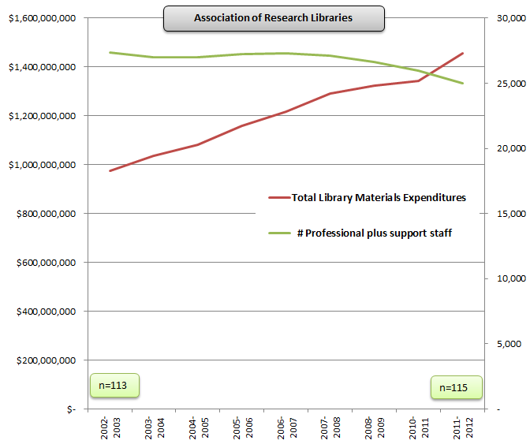
Why transform scholarly communications? # & $
We see an annual cost increase of about 5-8% for academic content, sometimes particular titles increase over 30%.
Milne Library spends over $1/2 M on subscriptions
Moon Spends $900K
Academic content: Unsustainable cost for colleges at a time when college costs increasingly seen as unsustainable.
Content is integral to the future of higher education’s need to control cost & scale up...
If we shift from procurement to production.
Notes:
This is trending at all levels, not just at the top (ARL Libs)

Slide 6
The conversation
Librarian: Are you happy with the Library?
Professor: Oh yes, they’re absolutely wonderful!
Librarian: That’s great to hear. So what are they doing that you really like?
Professor: Um, well, when I contact them they respond right away, and they get me whatever I want. They can track down anything. They are diligent, responsive, just really nice people.
Librarian: Great well, is there anything you’d like to see the library do more or better?
Professor: gosh no, I can’t think of anything… They’re just terrific!
Canick, Simon “Library Services for the Self-Interested Law School: Enhancing the Visibility of Faculty Scholarship”, Law Library Journal, V. 105 #2 2013 p. 179)

Slide 7
Will that conversation serve us well when the Provost is told:
“You have to find $2 million dollars to cut out of the Academic Affairs budget next year.”
Well, we are terrific afterall so that should save us, right?

Slide 8
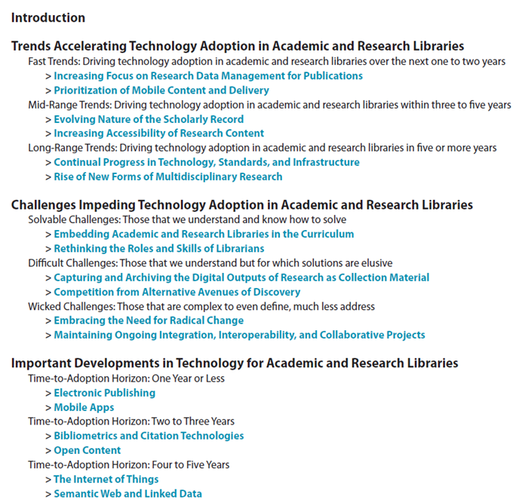
NMR Horizon Report 2014 Library Edition
Notes:
The immediate (bottom) changes reflect a need to adopt e-publishing and OER content. Solvable changes (middle) includes library roles and tasks

Slide 9
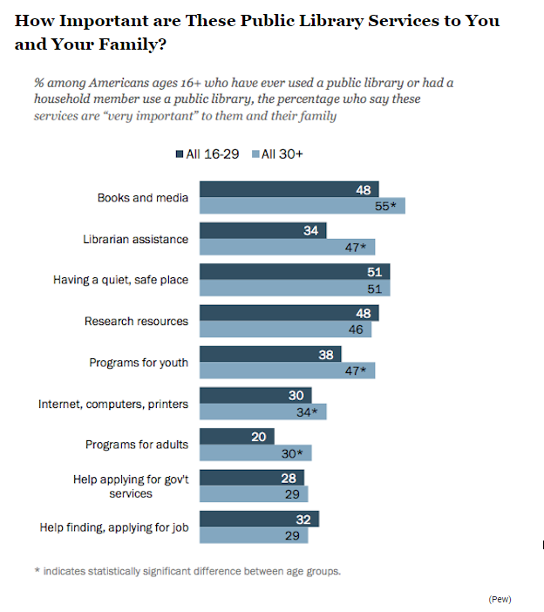
Notes:
This is a study of public library trends but the Millennials (most users) behave the same way in academic library settings

Slide 10
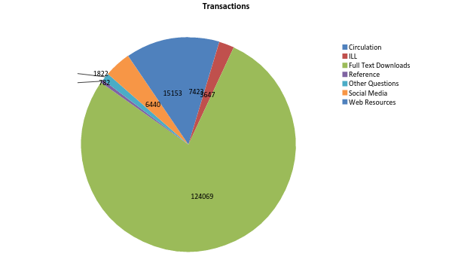
How ESF uses the Library
Notes:
nearly 91% of use of library is use of electronic resources in some form

Slide 11
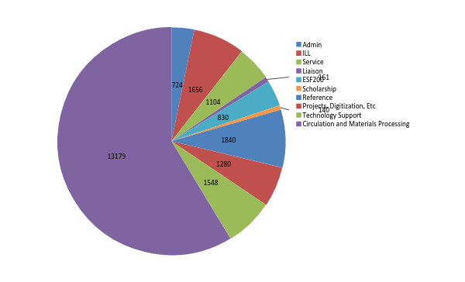
Staff Hours Spent on Various Activities
Notes:
72% of Library Effort is still focused on providing traditional print resources.

Slide 12

Our Staff is Our Most Valuable Resource
We need to redeploy that resource
We can’t maintain positions to provide services/access that no one is using heavily or finds valuable.

Slide 13
What’s Different Now?
Over 20 years we have dramatically changed the TOOLS we provide library services with but we haven’t significantly changed SERVICES
Our Efforts are still centered around the use of physical “stuff.”
Research/Learning is no longer centered around physical “stuff” and that’s reflected in the usage of the library as shown.
It is Time for new services to evolve.
We can no longer do more with less – but we can do something different.
And that different may keep us from having to do with less.

Slide 14
Skills and Tasks
Metadata creation and management
If we can catalog we can tag
Scanning and processing digital info
If we can scan and photocopy we already have this skill
Support of Teaching
If we can create libguides and pathfinders we can embed Open Educational Resources into Blackboard
Library as Publisher
If we can assign barcodes we can assign DOIs, ISSNs, and ISBNs
If we can READ, We can copy edit, we can seek reviewers
We can (and do) support the visibility of faculty scholarship – and we should BUILD on that

Slide 15
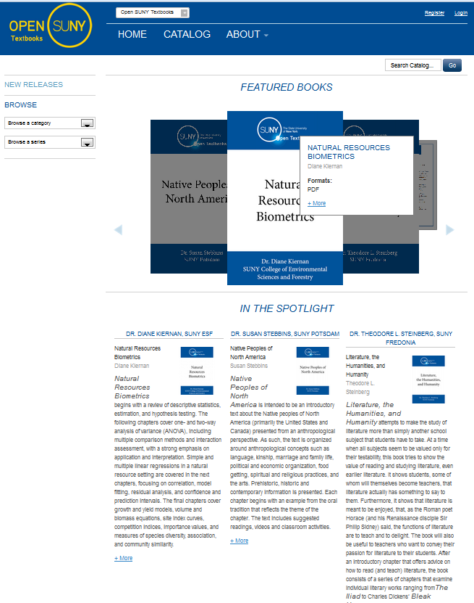
Open SUNY Textbooks
Three major goals of project:
Reduce the costs of textbooks to students.
Create opportunities for teaching and learning.
Libraries collaborate and learn how to publish textbooks.
Notes:
A SUNY Libraries & Innovative Instruction Technology Grant funded open textbook publishing program
9 Participating SUNY Libraries, others supporting the project; additional SUNY libraries, SUNY Press, & others.
Building a sustainable academic friendly publishing model with faculty & libraries
Started in July 2012 (~2 years)
publishing since October 2013

Slide 16
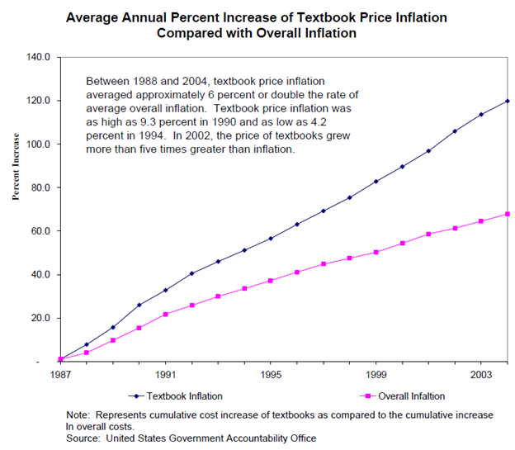
GOAL #1:
Reduce costs to students
US GAO 2005 reported that spending on course materials in 2003 totaled: ~ $6.49 billion dollars; today $12B
2013 GAO reported an 82% cost increase for textbooks from 2002-2012
2012 Student Debt Reaches $1 Trillion
2012 Florida Student Textbook survey
64% students didn’t buy textbook, 49% took fewer courses, 45% didn’t register for course, and 27% dropped a course. Survey n=22K+
Cost of textbooks impacts learning
High return on investment
Notes:
College Board reports students or parents spend $1,200 per year on textbooks & supplies
Students are not happy to spend more money on textbooks, and more on tuition without the prospect of a great return on investment – we cannot guarantee a job after they get their Bachelors, Masters, or PhD. According to the College Board, student and parents spend $1,200 / year – well in asking our students what is really happening, would it surprise you to know that some students aren’t buying and reading their textbooks, some even select courses on the basis of the cost of textbooks. The GAO report raises concerns of wholesalers, retailers, and some public interest groups that the textbook revision cycle - how frequently a textbook is revised and older editions no longer relevant (3-4 years is common), may be limiting the used ‘discount’ market for textbooks. Where there is a problem, there may be a solution…
It would be easy to blame publishers for the problem of textbooks, however, that ignores the reality and opportunity colleges and universities have. Alternatives textbooks such as low-cost or free open textbooks have had a long tradition. Faculty works, never published, but copied and sold at cost by copy centers or given out free online have been around for a long time. Strategies are evolving, open textbooks have a host of new platforms and services, as do alternative textbooks - which are often incorporating free and library subscribed readings into the research and development of course materials. Students want solutions, and they are prepared to make serious decisions about their future based on the challenges they see in higher education. The cost is significant all around…
http://www.gao.gov/products/GAO-05-806 and http://www.gao.gov/assets/660/655066.pdf
Meredith Morris-Babb and Susie Henderson, An Experiment in Open-Access Textbook Publishing: Changing the World One Textbook at a Time, Journal of Scholarly Publishing, January 2012, doi:10.3138/jsp.43.2.148
Florida Study: http://www.openaccesstextbooks.org/pdf/2012_Florida_Student_Textbook_Survey.pdf
http://www.newyorkfed.org/regional/Brown_presentation_GWU_2013Q2.pdf
Student Debt reached $1 Trillion

Slide 17
GOAL #2: Create opportunities for teaching and learning.
Online Learning Environment
Shared, reusable digital assets or learning objects
Text
Audio
Video
Interactive (Quizzes, etc.)
Learning Analytics
Online & Hybrid Learning
MOOC
Learning Management
Systems
Open Textbooks
Notes:
The reason to be integral to the solution is because open textbooks have so much to do with the future of higher educations – libraries as publishing service can help transform the connections between faculty and student to provide a new kind of environment that is academic friendly, reducing the cost to students and for higher education. Helping to curate the new learning environments ensures libraries continue to be a solution to the challenges faced by higher education and the learners.
Future of learning environments & higher education needs fewer hurdles, reduction of barriers, and a variety of learning engagement strategies and tools.
http://news.temple.edu/news/temple-faculty-experiment-alt-textbooks
What is the role for librarians here?

Slide 18
Open SUNY Textbooks Pilot 1 & 2 in progress
6 Participating libraries in Pilot 1
9 Participating libraries in the Pilot 2
SUNY College of Environmental Science and Forestry
SUNY Fredonia
SUNY Geneseo
SUNY Monroe Community College
SUNY Morrisville
SUNY Oswego
The College at Brockport
Upstate Medical University
University at Buffalo
& SUNY Press
With support from 7 other SUNY libraries & growing…
  NYS College of Ceramics at Alfred University, Buffalo State University, Delhi, Jefferson Community College, Plattsburgh, Potsdam, Stony Brook University…
  and open invitation to 64 campuses
Total Investment (Direct Cost)
SUNY Innovative Instruction Technology Grant: $80,000
SUNY Libraries: $40,000
$120,000*
* Does not include personnel and other support from SUNY Geneseo, Milne Library.
Goals
2014
15 open textbooks
2015
15 open textbooks
Outcomes today
5 high quality open textbooks published
25 in progress
Adapting to scale up

Slide 19
GOAL #3: Libraries collaborate and learn how to publish textbooks.
$20K IITG Grant awarded from SUNY to 5 libraries
  SUNY Geneseo, SUNY Brockport, SUNY ESF, UB, & Upstate Medical .
  Fredonia joined Jan. 2013.
  SUNY Press consultant on project.
Call for authors sent to SUNY Faculty
  Offered $3,000 to Authors
In 2 weeks, 38 proposals Grant funding limited to 4 titles. Libraries add ~$40K to fund 15 Open Textbooks
  Selection by Directors & Librarians
15 Open Textbooks selected
6 published as of today
1 in Anthropology
1 in Business
2 in Computer Sciences
2 in Education
3 in English
2 in Mathematical Sciences
1 in Music Education
3 in Sciences
Some interactivity; multiple choice, etc.
Notes:
First round of Open SUNY Textbooks began in July of 2012 with $20,000 funded from an Innovative Instructional Technology Grant.
Open SUNY Textbooks: http://opensuny.org/omp/index.php/SUNYOpenTextbooks

Slide 20
Editorial workflow managed by libraries
5
Managing Editor finalizes comments & sends to Author
4
Copy Editor works with Word (track changes) or hard copy
3
Author responds to Reviewer Comments; provides revised manuscript
2
Peer reviewer provides author & editor feedback
1
Author sends Manuscript (Word or LaTeX/PDF)
6
Author reviews changes; revises, accepts, declines changes
7
Text Layout
Managing Editor + Production Editor
8
Final Proof
Author & Proofreader reviews and approves to publish
Librarians find peer reviewers
Librarians
or
Freelance
Librarians
or
Freelance
Notes:
Editorial workflow managed by libraries. Collectively, we provide Instructional Design support (Librarians & Consultant), Copyediting & Proofreading (Librarians or Freelance), Graphic design & layout (Milne Library), etc.
Copyediting skills: Brockport, ESF, Fredonia, Geneseo, Morrisville, UB, & increasing…
Professional duties, university service, or extra service pay?

Slide 21
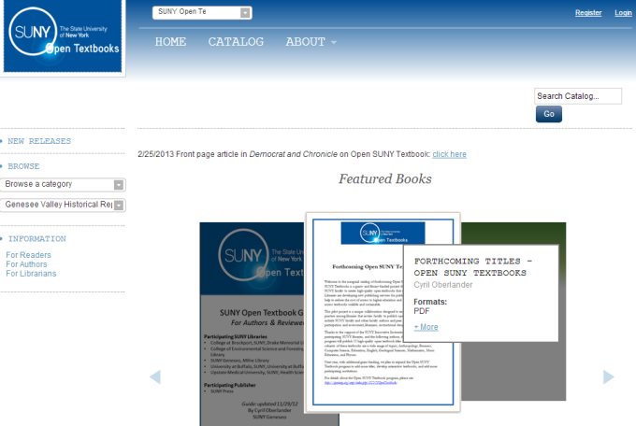
Distributing content
Host: FREE online Open Textbooks as PDF & ePub on Open Monograph Press (PKP)
Discover: Catalog in OCLC WorldCat, Minnesota Open Textbook Catalog & Merlot.
Print: Print on Demand offered to authors via CreateSpace. Pilot 1 & 2 use CC BY NC SA; authors get 100% royalties.
Marketing & Adoption
Role for librarians?
http://opensuny.org
PDF
ePub3
Multimedia & Interactivity
Print
On Demand (optional)

Slide 22
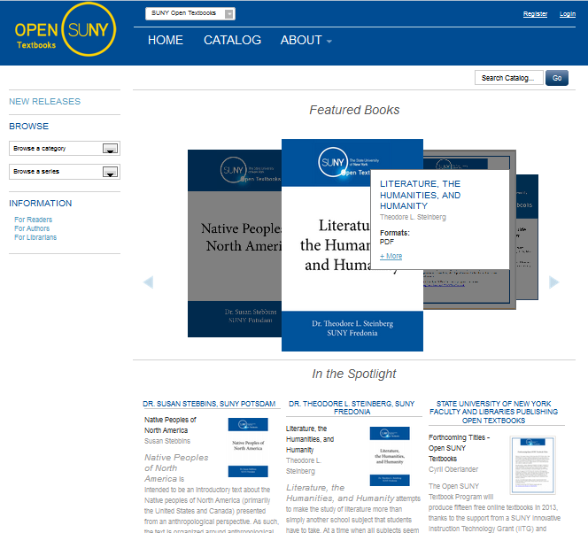
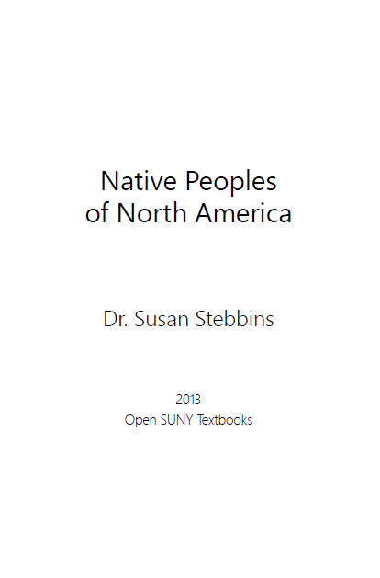
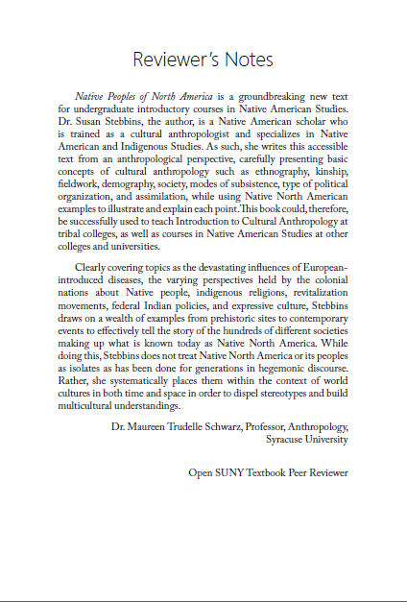
Peer review key to adoption
Peer reviewer’s summary included inside textbook
Notes:
Peer Review is key to adoption

Slide 23
Round II: revised selection & marketing process
Call for Authors Proposals due
Selection Review
Approval or Revise & Resubmit
46 proposals received, funded to publish 15
Selection Process
Abstract Blind Review & Questionnaire sent to faculty in corresponding disciplines & in consultation with librarians at 14 Institutions.
Sample questions:
  Clear Abstract?
  How likely you would select this textbook for a course?
  Strengths of this proposal?
  What courses might this textbook be useful for?
  What are crucial features for this textbook?
  Would you be willing to serve as a peer reviewer?
Results of process
Market Analysis for adoption & a pool of potential peer reviewers for the textbooks.
Notes:
Pilot 2 Revised Selection & Marketing Process
Opportunity for engaging discussions about OERs

Slide 24
Possible librarian roles in OST
Writing Phase: 3/25/2014 – 1/15/2015
Author writing
Services
Librarians, Instructional Designers, Templates, etc.
Author provides manuscript
Editing Phase: 6/1/2014 – 6/1/2015
Peer Reviews
Author Revision
Copy Editing
Author Revision
Text Layout & Proofing
Access & Marketing Phase: 9/1/2014 – 9/1/2015
Publish
Catalog
OCLC, Merlot, Open Textbook Catalog
Market Adoption & assessment
Notes:
Librarians demonstrated we can administer the whole publishing process

Slide 25
Outcomes so far…
Reduced cost to students already shown…
TITLES # students
Natural Resources Biometrics 41
User’s Guide to Planet Earth 144
@ avg. cost of a book $83.59 YBP…
Spring semester students saved: $15,464.15
Organizational Development
9 Participating SUNY Libraries , plus
SUNY Press
Established a recognized brand:
Open SUNY Textbooks
Established role for libraries as publishers, and librarians as editors, and other roles
Developing curriculum for professional development and certification for librarians as copy editors, proof readers, etc.
Developing infrastructure; BaseCamp, OMP, etc.
Lots of interest from faculty across SUNY and beyond, including variety of disciplines, and corporate interest.
Notes:
6 currently published so far…
Pilot 1 2013-2014: 15 Open Textbooks
1 - Anthropology
1 - Business
2 - Computer Sciences
2 - Education
3 - English
2 - Mathematical Sciences
1 - Music Education
3 - Sciences
Pilot 2 2014-2015: 14 Open Textbooks
1 - Anthropology
1 - Biology
1 - Chemistry
2 - Communication
1 - Education
3 - English
1 - Engineering
1 - General Education
1 - Mathematical Sciences
1 - Philosophy
1 - Public Administration
1 - Social Work
Manuscripts from 27 of 64 institutions
Marketing & News
Scholarly Societies, local news, local, regional, and national presentations, 2 chapters in forthcoming books…

Slide 26
Additional outcome:
Outstanding proposals in Pilot 1 & Pilot 2 from across SUNY
Author Institution | # Proposals
Albany | 4
Binghamton | 3
Brockport | 5
Empire State College | 2
ESF | 1
FIT | 2
Fredonia | 5
Geneseo | 3
Maritime | 1
Old Westbury | 2
Oneonta | 1
Oswego | 2
New Paltz | 1
Plattsburgh | 2
Potsdam | 1
Schenectady C. C. | 1
Stony Brook | 1
Univ. of Buffalo | 1
Total | 38
Author Institution | # Proposals
Adirondack | 1
Albany* | 1
Binghamton | 6
Brockport | 4
Broome Community College | 1
Cobleskill | 1
Corning Community College | 2
ESF | 4
Farmingdale | 1
FIT | 3
FLCC | 1
GCC | 2
Geneseo | 5
Hudson Valley Community College | 1
New Paltz | 2
Niagara Community College | 1
Oneonta | 1
Oswego | 8
Stony Brook | 1
Univ. of Buffalo | 1
Total | 46
SUNY Faculty from 27 of 64 Institutions interested in publishing open textbooks
* Approved from Pilot 1
Notes:
* Approved from Pilot 1

Slide 27
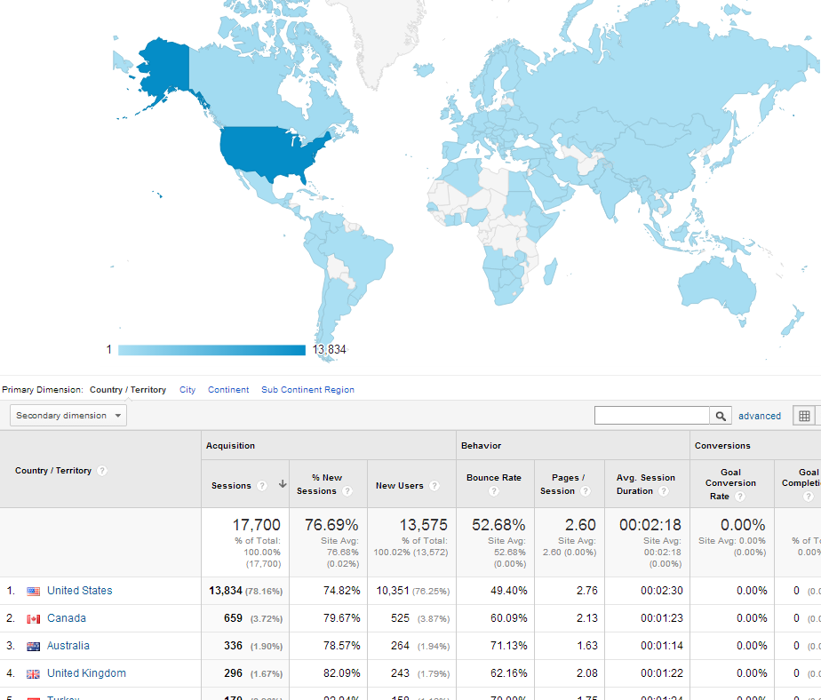
Interest in Open SUNY Textbooks…
July 1, 2013 – Sept. 28, 2014 Over 19,000 unique viewers
  Literature, the Humanities, and Humanity, published Oct. 22 2013
  Native Peoples of North America, Oct. 22, 2013
  Natural Resources Biometrics, Jan. 22, 2014
  A Story of Real Analysis, Feb. 18, 2014
  The Information Literacy User’s Guide, April 4, 2014
  The Missing Link, July 1, 2014
  Instruction in Functional Assessment, August 15, 2014

Slide 28

Adoption is key
Open textbooks to Teaching Faculty
  Value: High Quality, Bookstore Like Workflow, Quizzes, Ease to Assign/Use
Publishing to Authoring Faculty
  Value: Familiar, Peer Reviews, Instructional Design, Copy Editing, Platform, Templates
Open textbooks to Students
  Value: Reduce Cost, Engaged Reading, Improve Learning
New publishing role for Librarians & Libraries
  Roles: Editor, Press Manager, Copy Editors, Proof Readers, Marketing, Metadata, Resource & Pedagogy Specialists, etc.
  Value: Reduce Cost, Engage Faculty (Authors & Teachers) to Empower Teaching & Learning

Slide 29
Adoption of Open SUNY Textbooks
Feedback from OST authors and instructors…
The Information Literacy User’s Guide
“All of the librarians that teach UL100 at Emporia State have switched to the textbook. We have 8 or 9 sections of a two credit hour course that are now using it for supplementary readings, etc. I’d be happy to answer follow-up questions, but it might be better to wait until Dec. or Jan. after we’ve had a full semester using the text.” – librarian at Emporia State
Natural Resources Biometrics
“…as many students in her statistics and forestry classes and the majority cannot afford any sort of books. She struggles to provide some sort of teaching material, and asked me if I could help in any way. I wondered if Open SUNY textbooks would consider ‘adopting’ her biometrics class and allow them free access to my Forest Biometrics book.” – author Diane Kiernan

Slide 30
Sustainability and future of Open SUNY Textbooks
Option A
Each library go about publishing independently.
Problems: scale and financial resources
Option B
Collaborate & partner to share infrastructure and incentives.
Opportunities: scale and ability to network resources

Slide 31
What can sustain the program long-term?
Possible revenue source #1
Print –On-Demand with royalty share contracts in place for authors and program
Possible revenue source #2
Sell platform convenience in the marketplace – for example, Kindle, Google Books, iTunes ebooks cost $, but the .pdf is free at opensuny.org
Notes:
Check Assumptions about Open Access…
Is Revenue OK?
Revenues can sustain the program long-term
Selling Print on Demand with Royalty Share contracts with authors
Current contracts for Open SUNY Textbooks; authors get all royalties if they choose to sell print on demand.
Beyond the pilot, to sustain the program, SUNY Counsel is reviewing contracts with royalty share: 50% Author / 50% Program
Anyone see a better publishing contract?
Selling platform convenience
Open Access is free online at opensuny.org
We can also sell eReader / marketplace convenience, i.e.: Kindle Editions, Google Books, iTunes, Kubos, etc.?
How comfortable are we with revenue?
Important question given the need for higher education to control cost and increasingly diversify revenue sources.

Slide 32
How does this benefit libraries and our institutions?
Constituents | Value/Benefit
Libraries | Free infrastructure to host open and affordable textbooks Financial incentives for open access publishing Organization and funding of professional development (e.g. Workshops and scholarships for librarians) Aid in creating highly valued role for libraries on campus Ability to pay authors, and incentivize & reward our faculty
Authors | Provides incentive and library publishing services Boosts academic reputation Academic freedom
Teaching Faculty | Accessible high quality content Low textbook costs encourages students to take class Improves student-teacher interaction
Students | Affordable high quality textbooks Print and digital option Student paid internships at participating libraries
Notes:
How will this company benefit it’s constituents?
What is the value proposition for libraries?
Incentives for Open Access publications at campuses.
Scholarships and professional development for publishing
Partnership to support the growth and sustainability for the Open SUNY Textbook program.
Potential Funds: SUNY Student Tech Fees: $5 fee / student / semester

Slide 33
Open textbooks team organizational structure
Editorial Review
Librarian
Librarian
Librarian
Team is organized around a Coordinator (s) (currently from Open SUNY Textbooks team) who works with librarians from own institution or across network.
Library with textbook author at their campus OR library volunteers become responsible for obtaining peer review.
Librarians work with faculty on their campus to find experts in the field for peer review. Work with campuses to find out

Slide 34
Open textbooks team organizational structure
Professional Development
Libraries
Librarian
Librarian
NY3Rs Association
Trainer
Team is organized around a Coordinator (currently from Open SUNY Textbooks team) who will work with NY3Rs Association.
Develop a relationship with NY3Rs association to provide continuing education and professional development opportunities for librarians and staff working in the participating libraries.
Libraries and NY3Rs will develop curriculum and training, bringing in trainers and speakers who will provide librarians with training to develop competencies and skills in areas such as instructional design, copyediting, layout and design.
Trainer

Slide 35
Open textbooks team organizational structure
Marketing & Adoption
SUNY
Librarian
Faculty
Team is organized around a Coordinator(s) (currently from Open SUNY Textbooks team) who works with volunteers from own library and across network.
Members of marketing and adoption team work on marketing to faculty and students, as well as the adoption strategies on their campuses.
Librarians work with faculty & students on their campuses to find develop marketing plans and communications, send out press releases, gather feedback and input to give to Editorial Review team.
Librarian
SUNY

Slide 36
Open SUNY Textbooks Partners
Thanks to the 6 Participating libraries in Round I & 9 libraries in Round II of IITG funding
SUNY College of Environmental Science and Forestry
SUNY Fredonia
SUNY Geneseo
SUNY Monroe Community College
SUNY Morrisville
SUNY Oswego
The College at Brockport
Upstate Medical University
University at Buffalo
& SUNY Press
With support from 7 other SUNY libraries & growing…
  NYS College of Ceramics at Alfred University, Buffalo State College, Delhi, Jefferson Community College, Plattsburgh, Potsdam, Stony Brook University…

Slide 37
Questions? http://openSUNY.org

