Slide 1


Competency-Based Assessment with eLumen
September 30, 2014

Slide 2
eLumen
is a SaaS Cloud platform that empowers higher education institutions to perform data collection, management and analytics around student learning outcomes assessment.
We generate insights from outcomes

Slide 3
“Can you help us understand patterns of student learning?”
When a new client conversation starts with…
We’re going to have a GREAT conversation.
“Can you help us do SLOs?”
I know I have some work to do: students are taking a back-seat to binder-building. We get it: you HAVE to do it, but let’s reframe this…

Slide 4
When you have to… we’ve made it easy for you to comply with your accreditation reporting requirements (and program review)
We know a bolder vision is possible; our foundations are Competency-Based
When you want to… enrich your institution’s understanding and/or use of student outcomes data:
Per-Student Assessment
Remediation Strategies
Cohort Tracking
Competency-Based Approaches

Slide 5

















We have a variety of schools — but mostly VERY BIG
Community Colleges.
(our avg. is 12K+ students…)

Slide 6
We think community colleges can be the big innovators in competency-based education.
And we think they’ll transform the power of outcomes assessment in higher education.

Slide 7
So: what can you do with SLOs?
Start with: Accreditation and Program Review.
Then add:
Co-Remediation
Retention Risk Management
Completion with Job-Ready Skills
Equity Strategies & Reporting
Articulation and Transfer
Let’s go on an Outcomes Journey…

Slide 9
“So… How do you make that possible?”

Slide 10
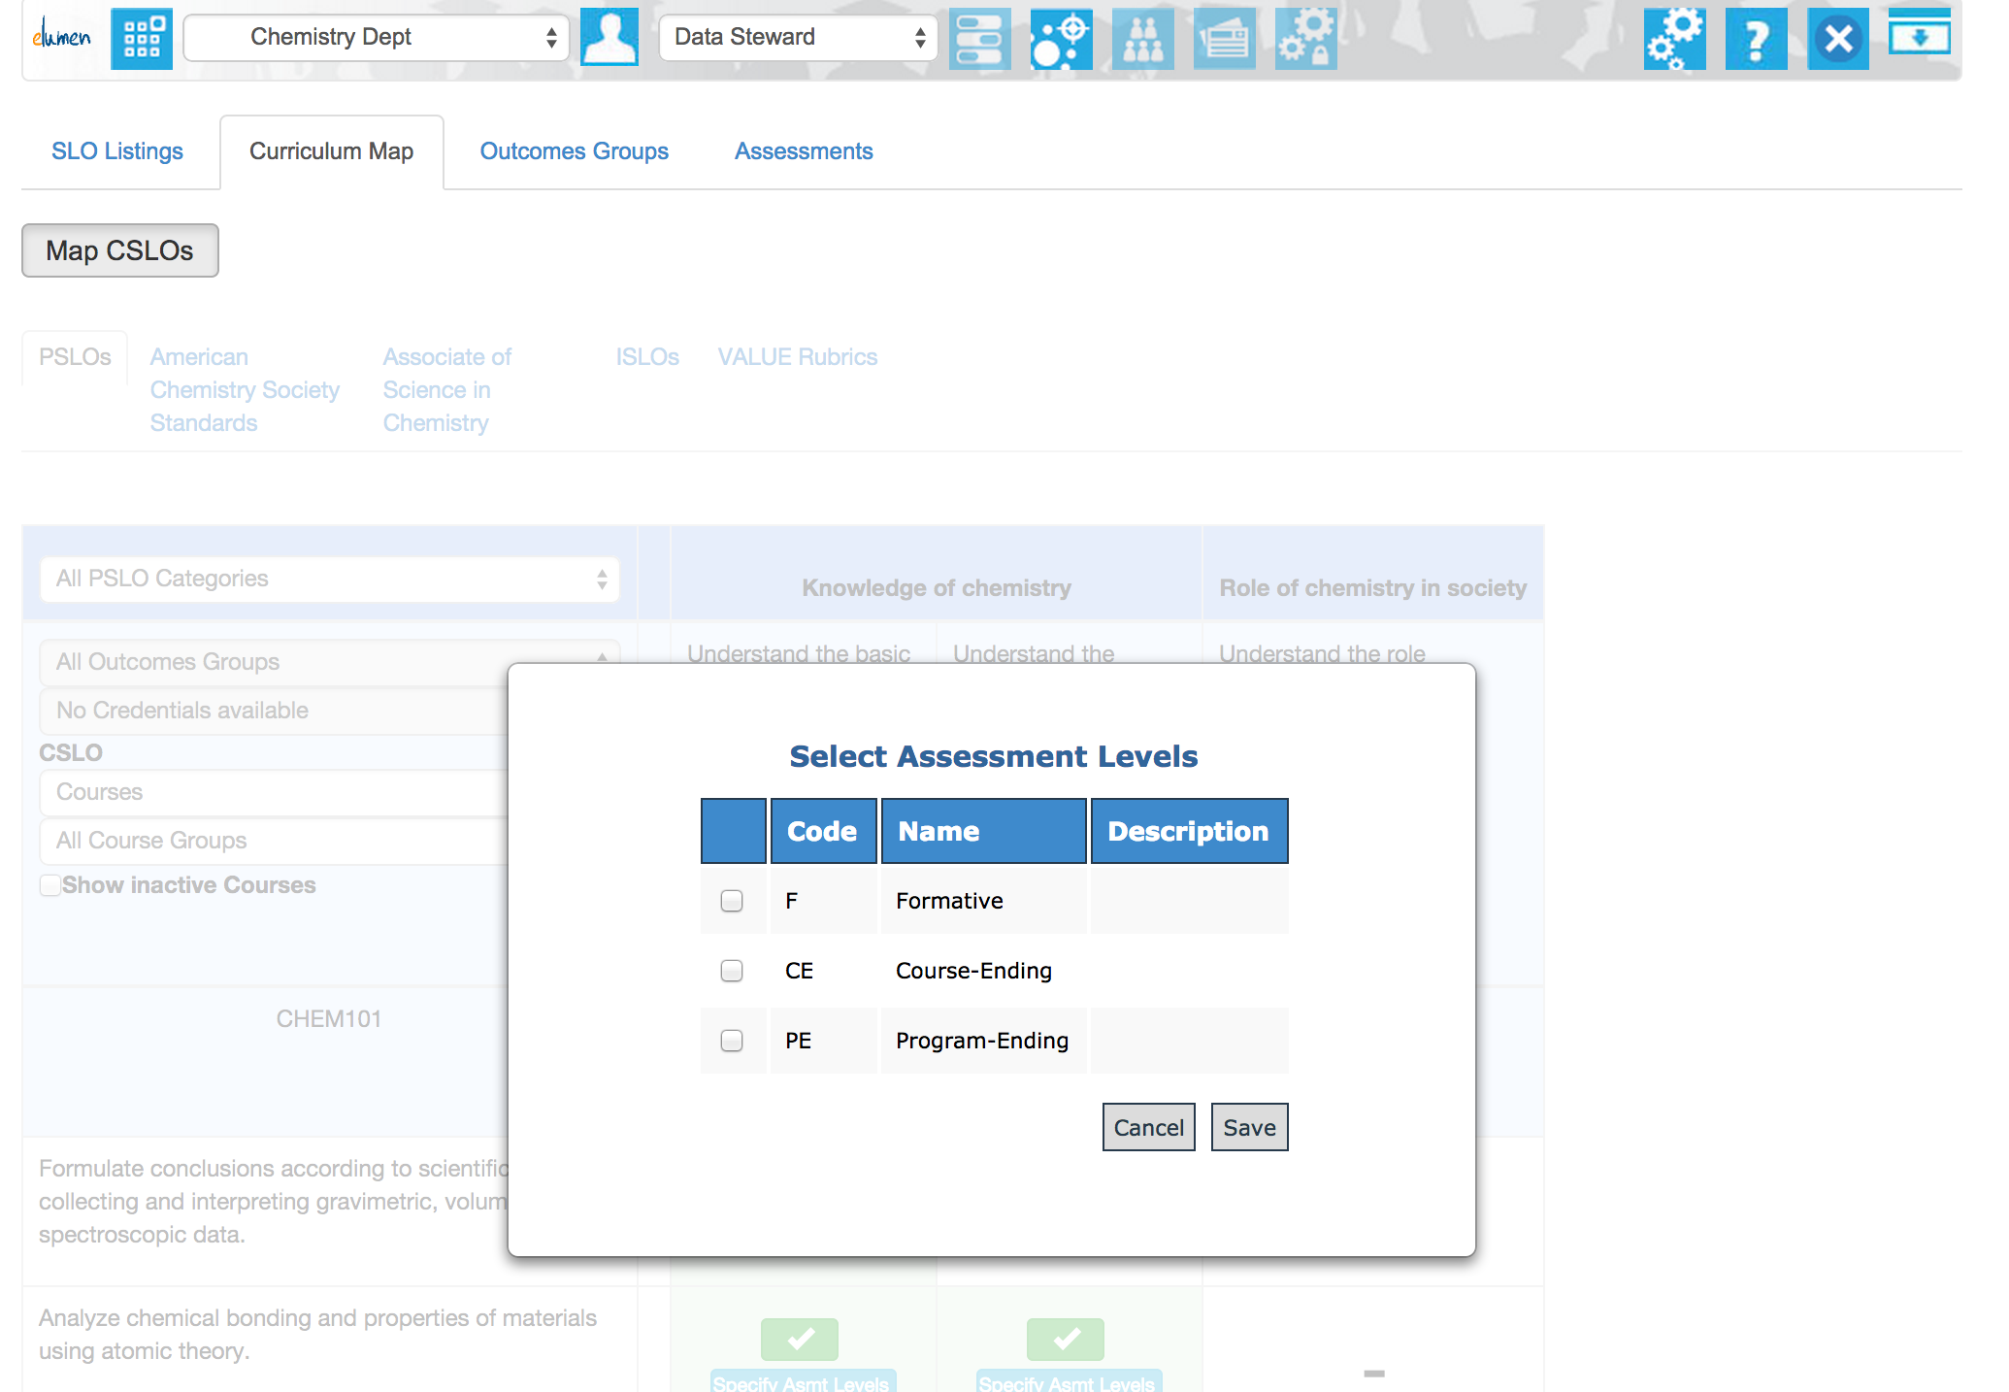
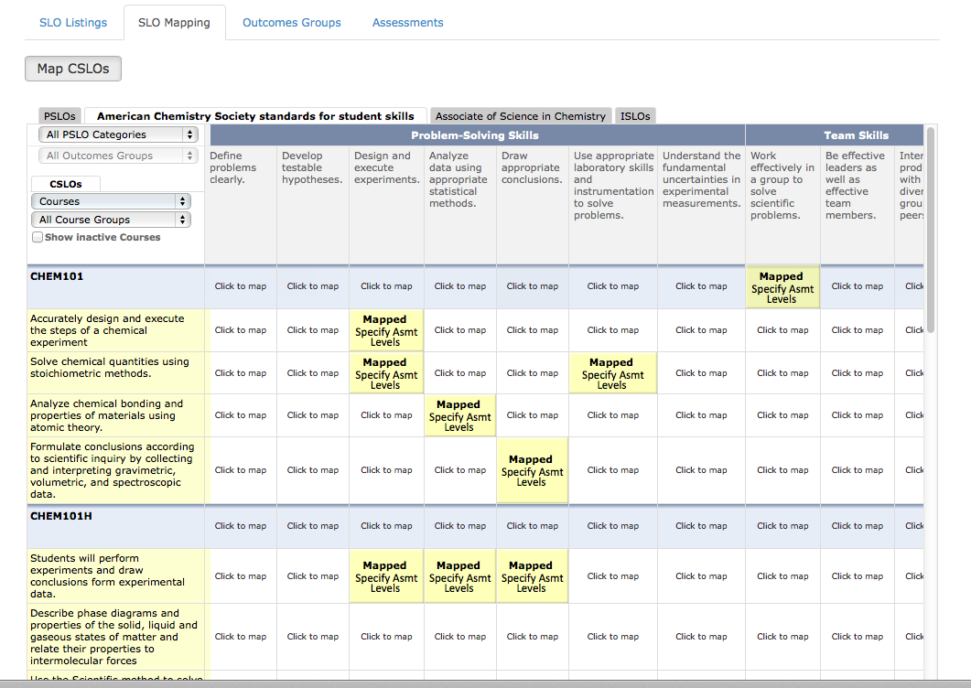
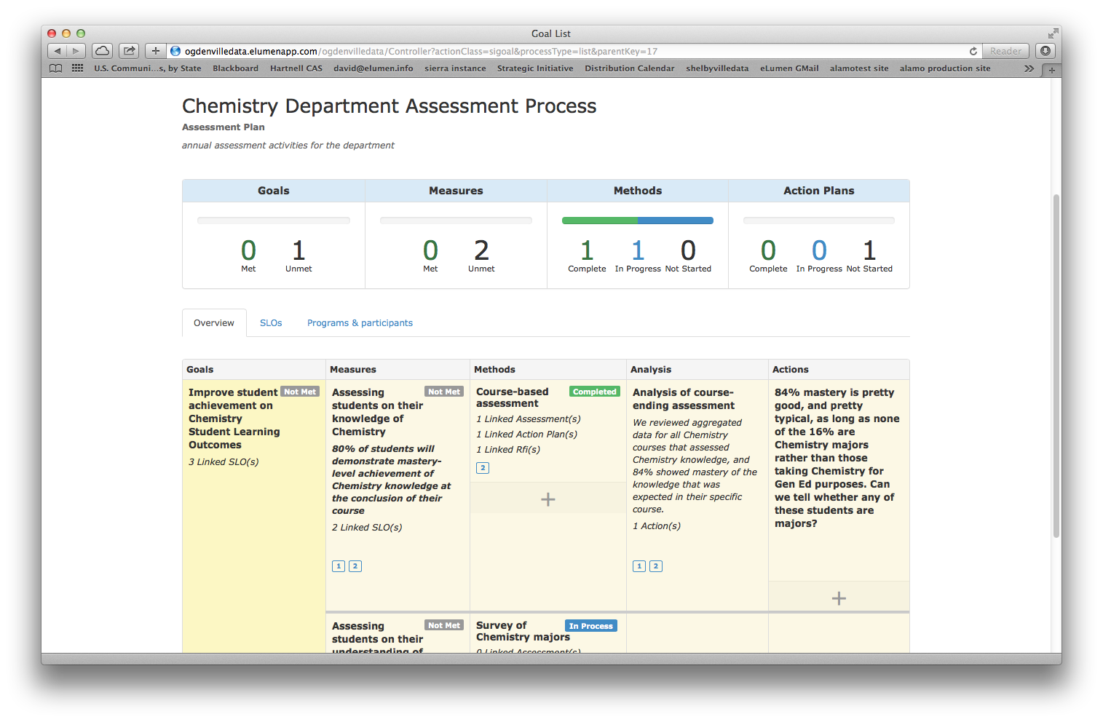
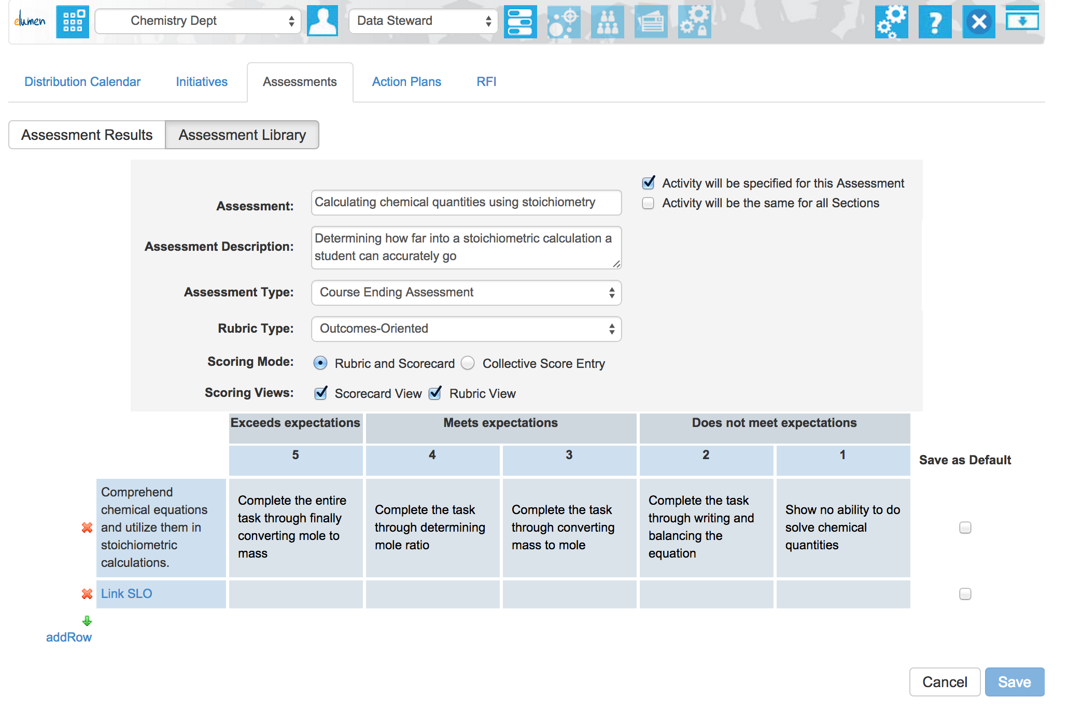
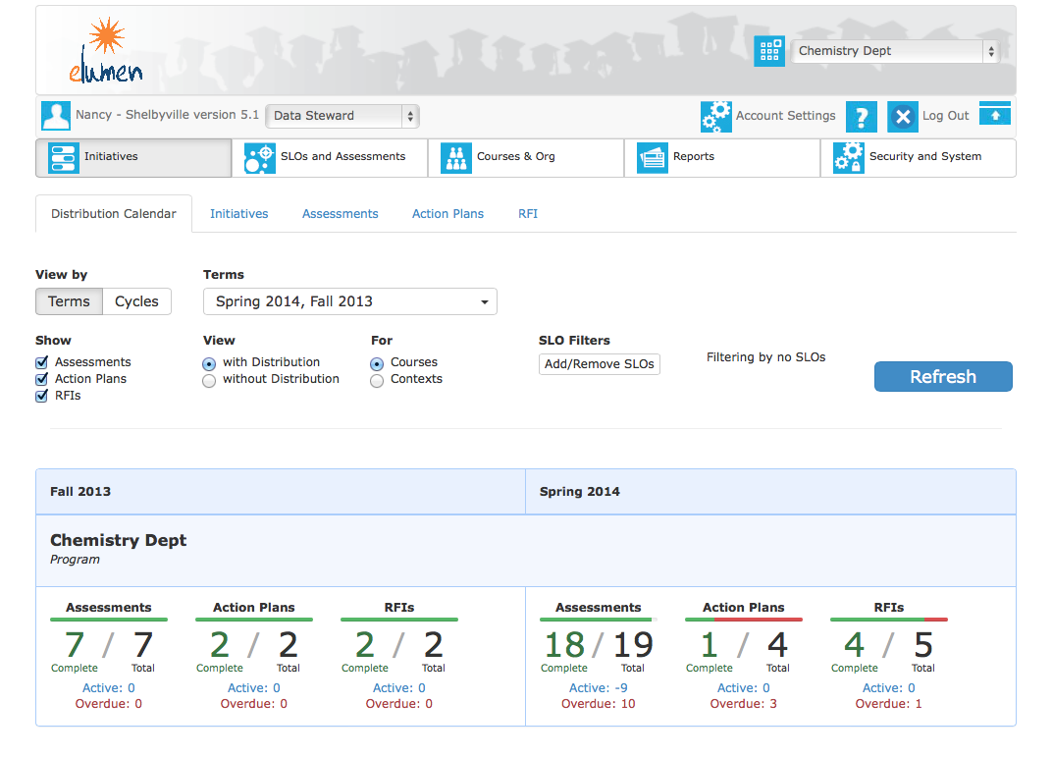
Competency-Modeling
eLumen is the most-powerful tool available.
Great screen shot #1: Curriculum Map
Great screen shot #2: SI
Great screen shot #3: Distribution Calendar
Painlessly align course SLOs to program and institutional SLOs (including VALUE Rubrics
and Program Standards)
Assign Achievement Expectations: Formative, Course-Level, or Program-Ending
Design Weighted Rubrics with Assessment Modality, Activity Type, and Evidence Collection

Slide 11
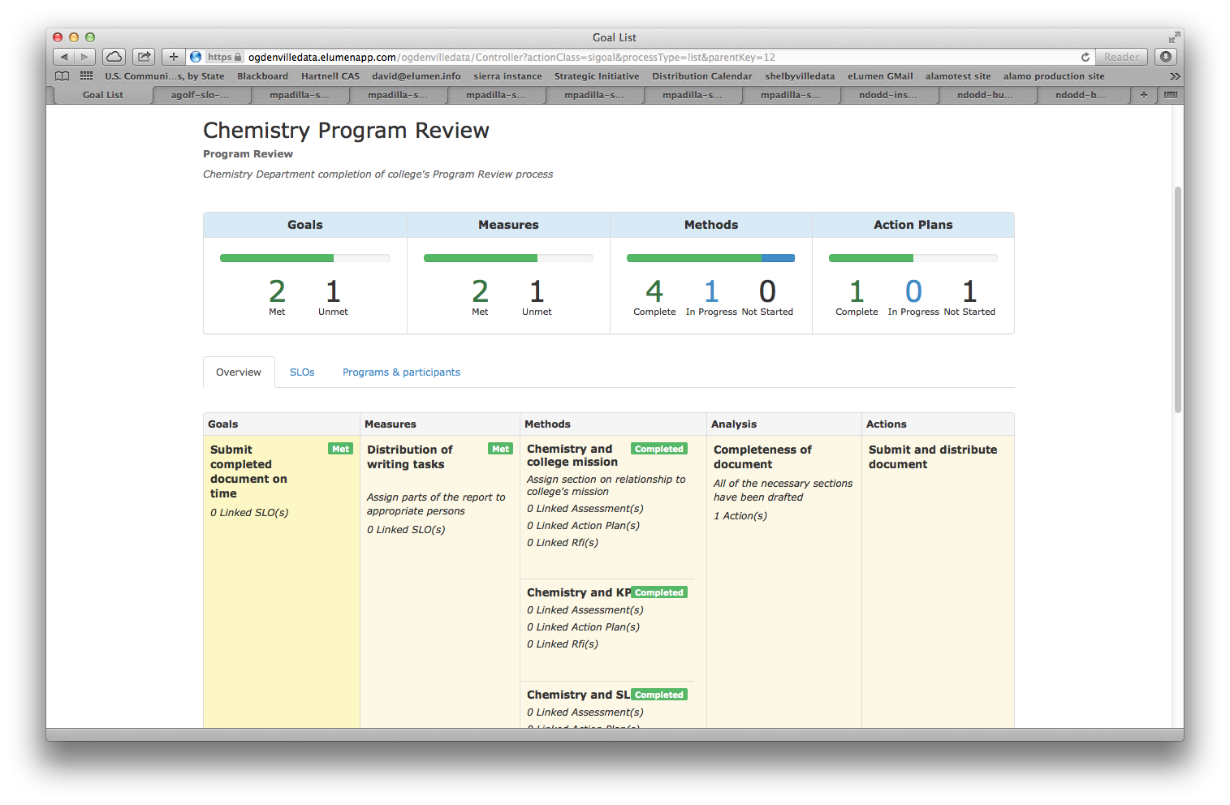
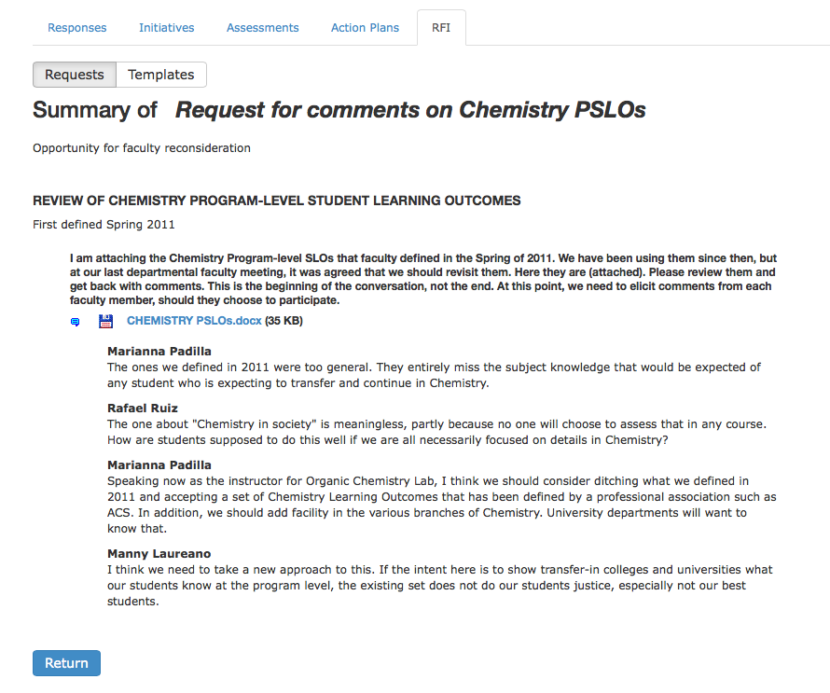
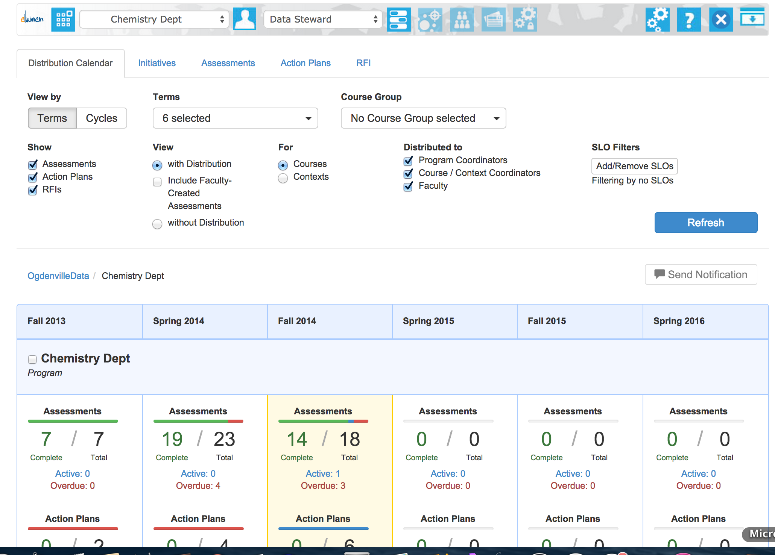
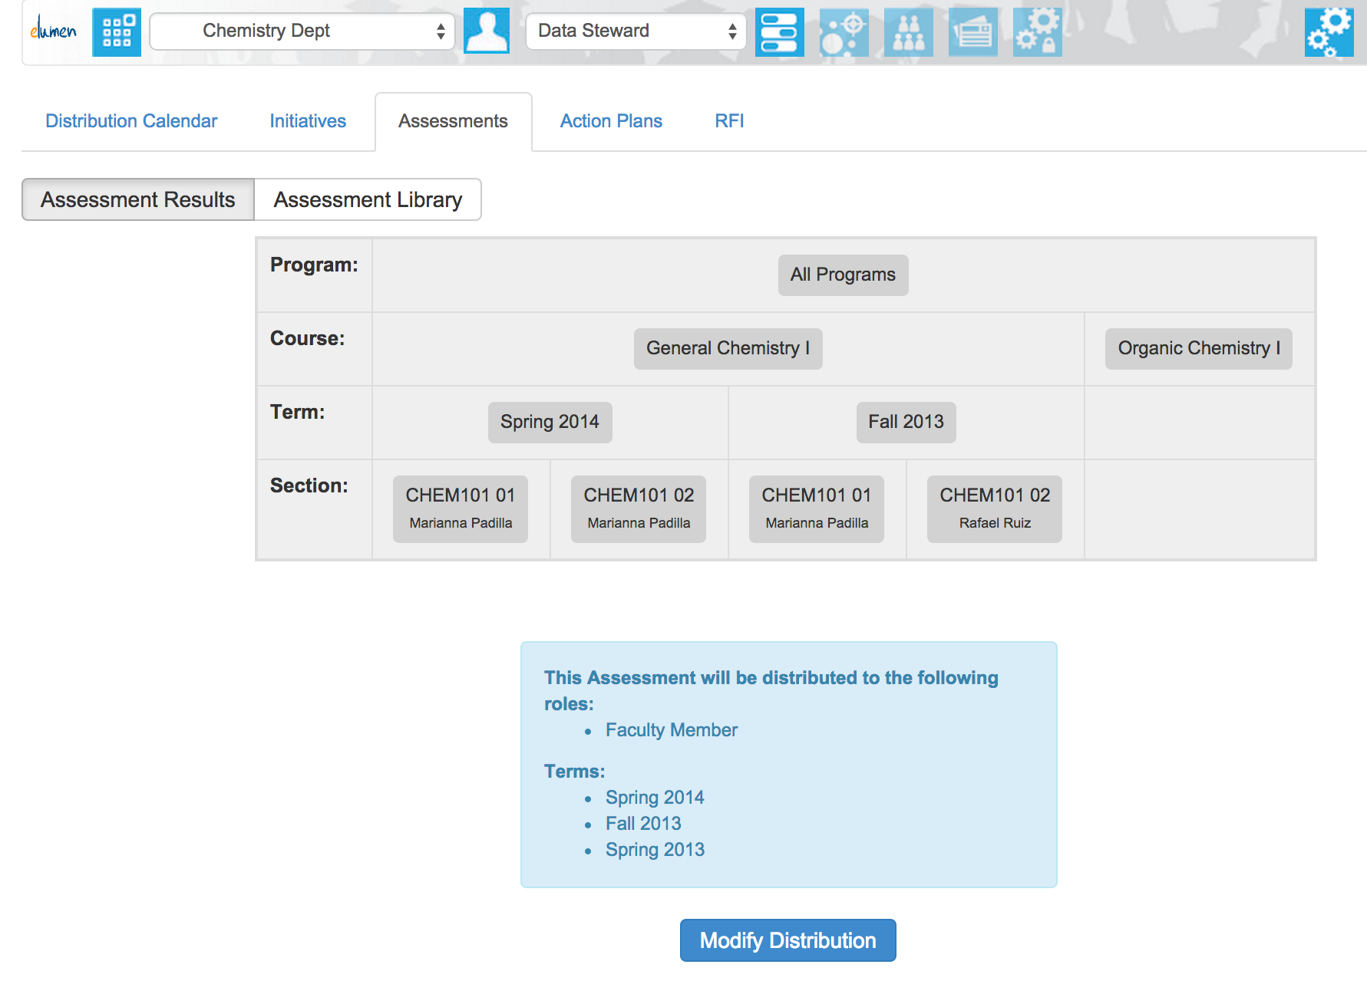
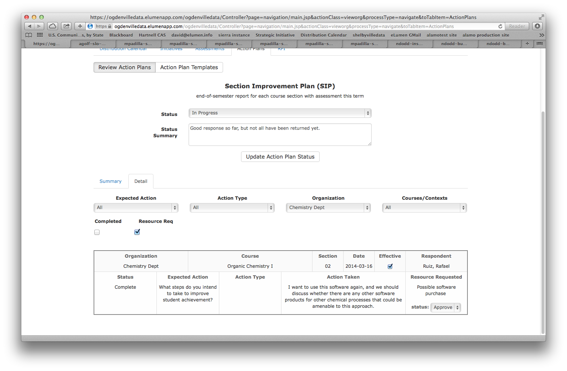
Aligning to Strategies
Continuous Improvement is a Process (not a Template)
Great screen shot #1: SI
Great screen shot #2: Purpose Built RFI
Great screen shot #3: Action Plan detail
Align all activities that feed program review in a single view
Distribute Assessment instruments and Action Plans/Reflections
Monitor Activity and Completion on Campus

Slide 12
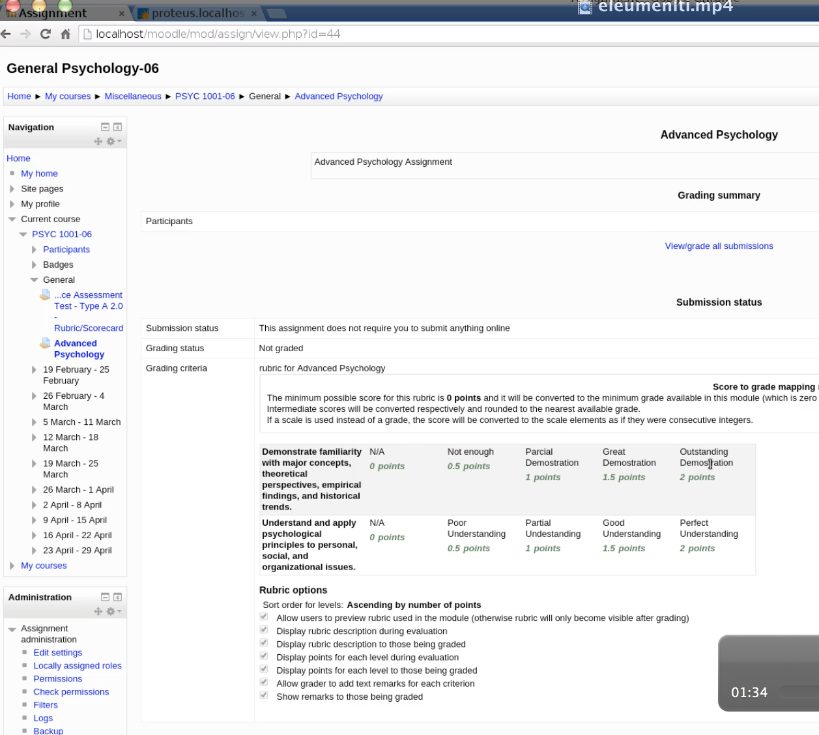
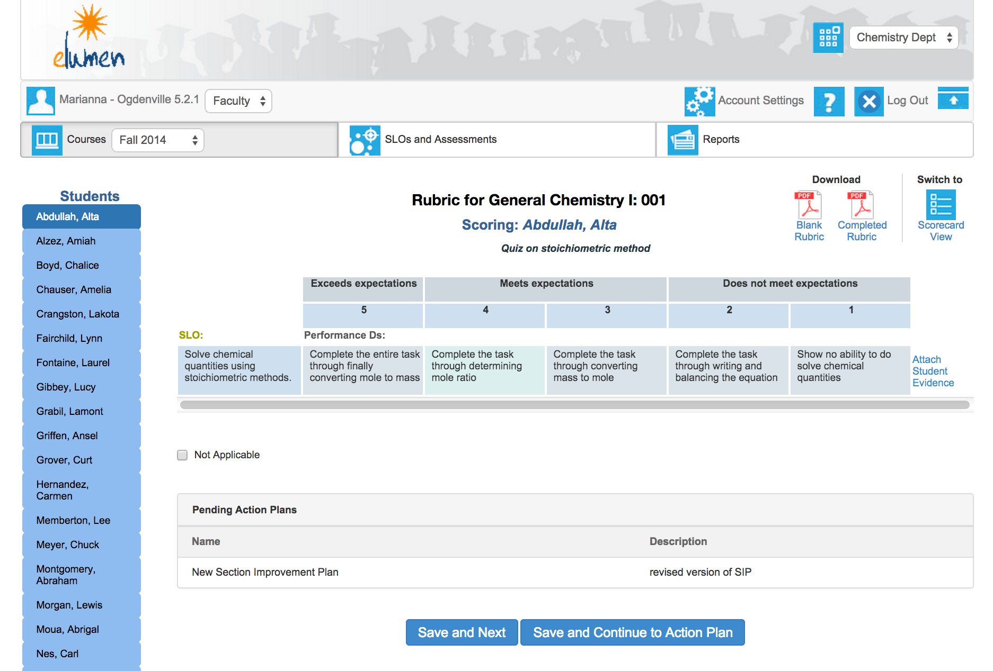
Faculty Experience is Key
Student Data Stays with Student, not Section
Great screen shot #1: SI
Great screen shot #2: Purpose Built RFI
Great screen shot #3: Action Plan detail
Scoring Assessments is Simple; Evidence Collection is Easy
LTI enables real-time integration with LMS (Moodle is seamless)
Action Plans and Reflections can be tied to Assessments

Slide 13
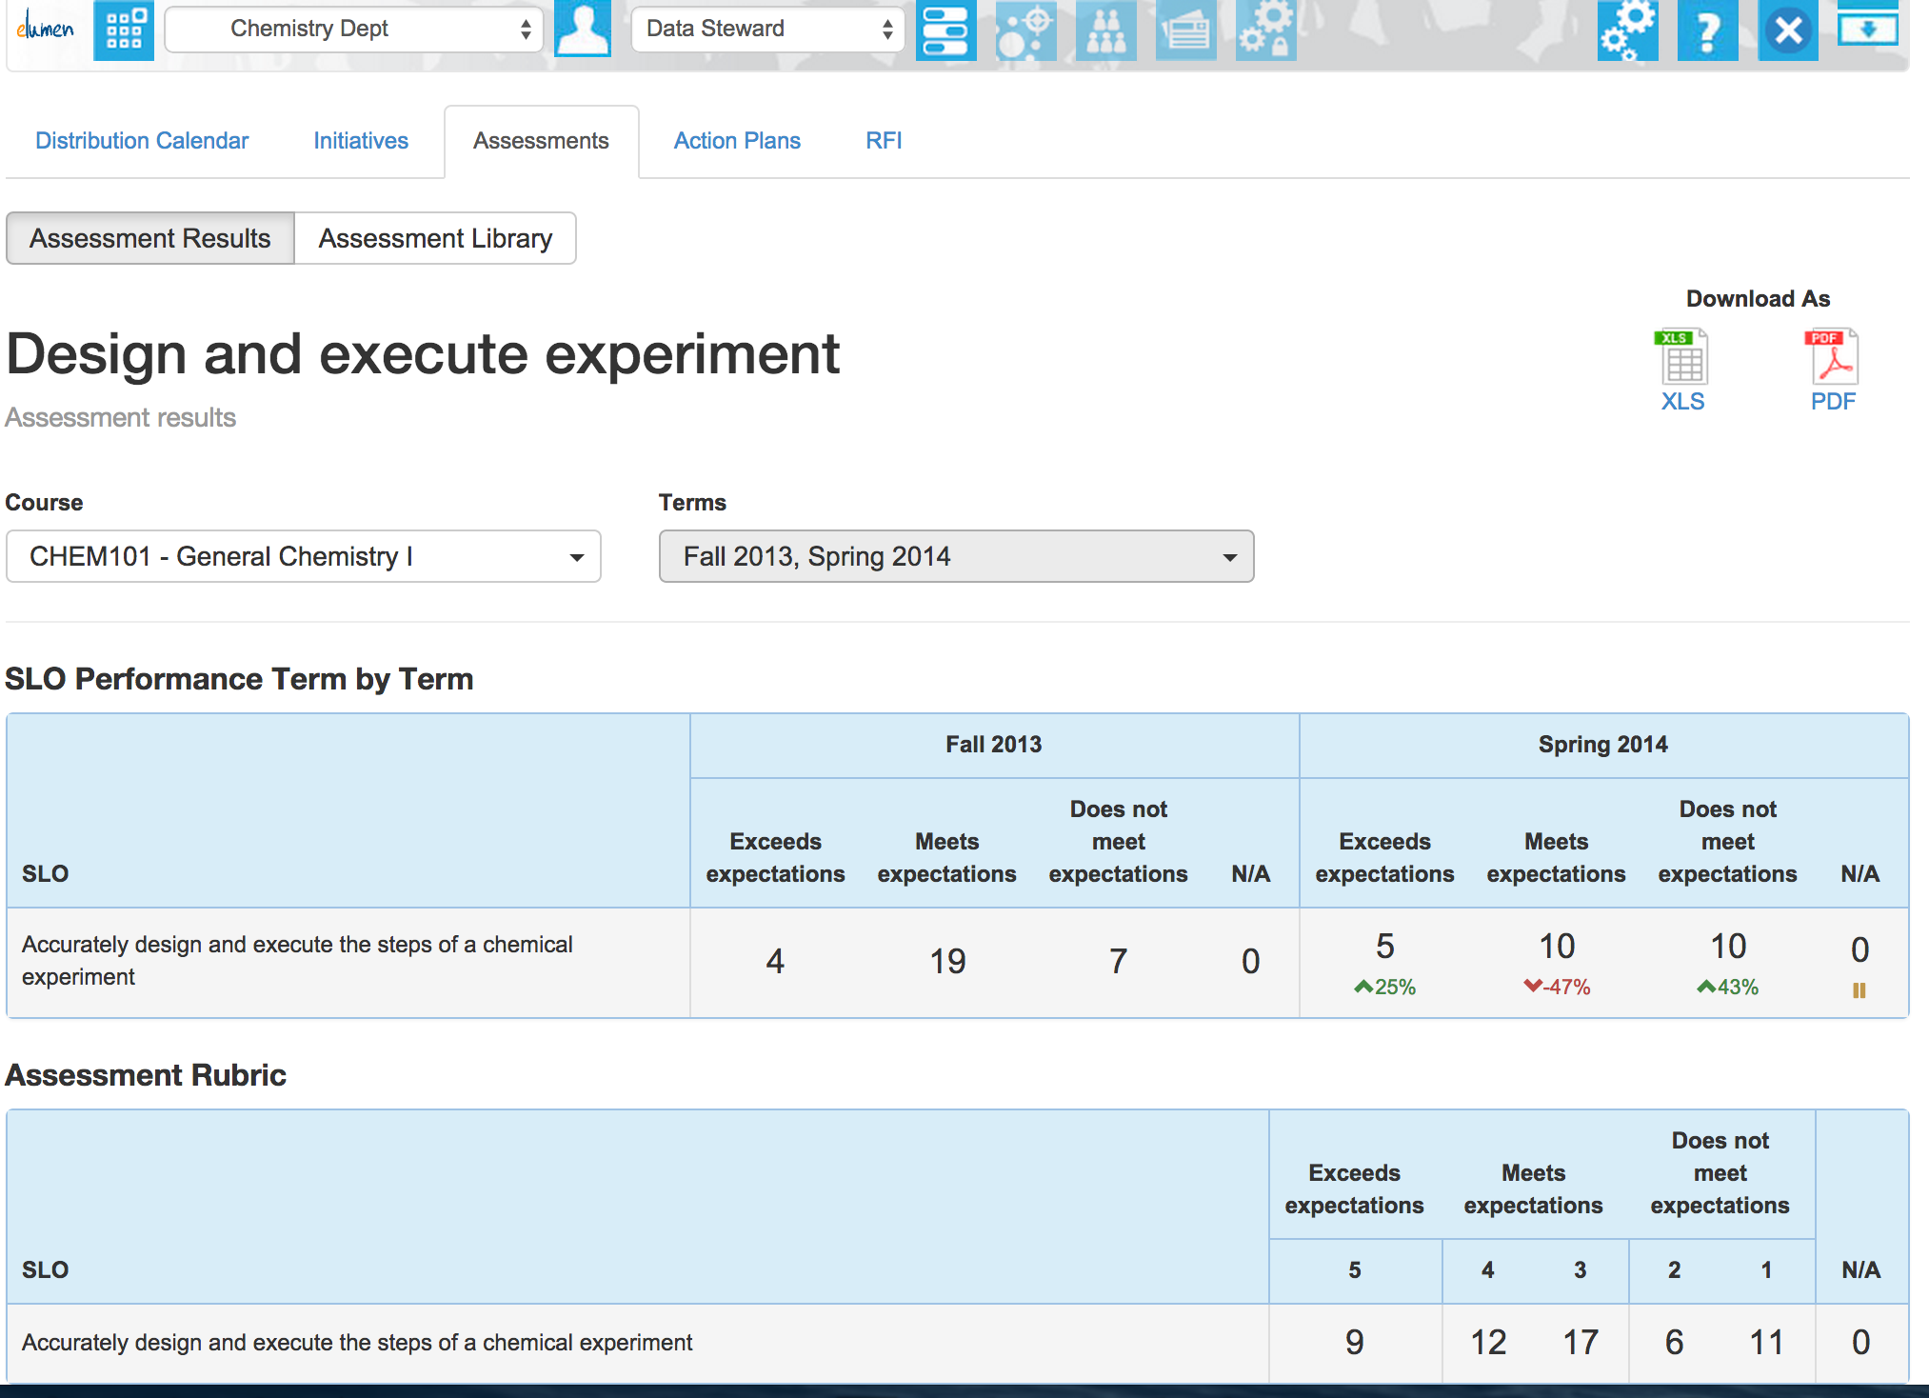
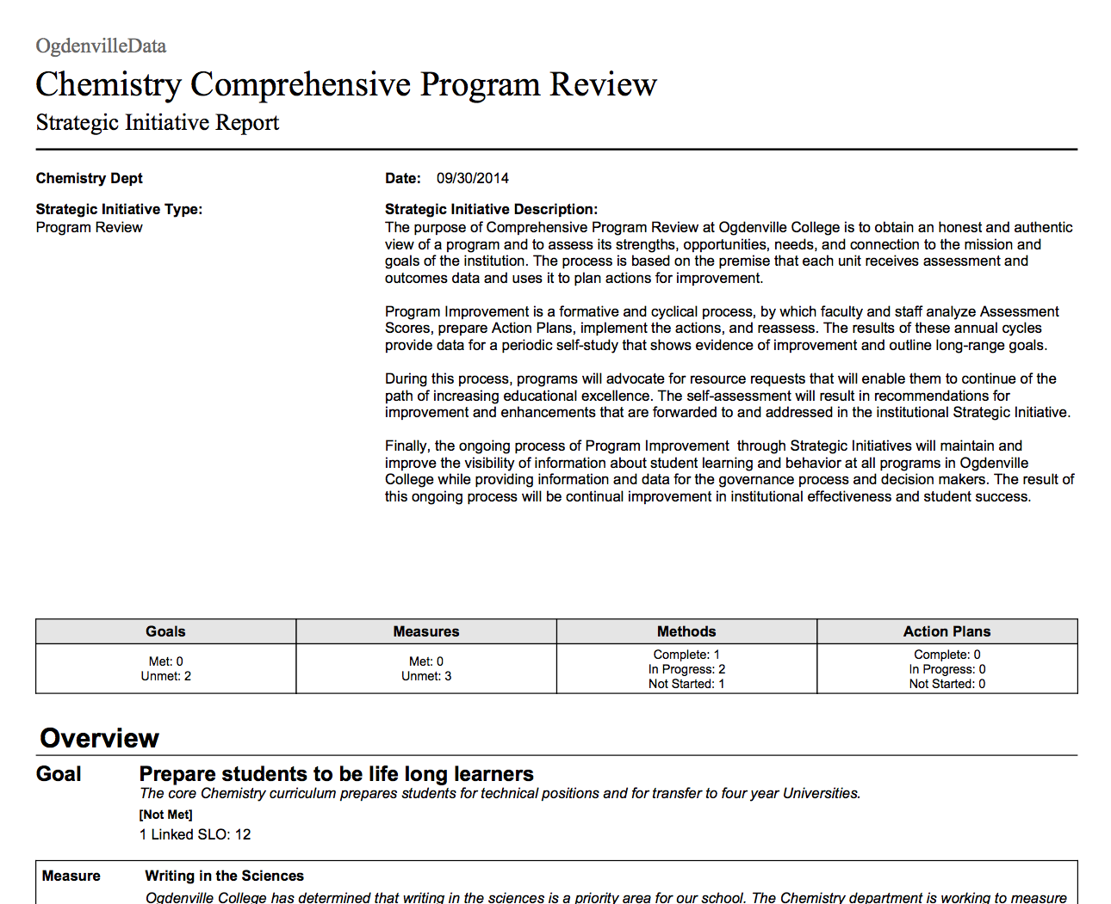
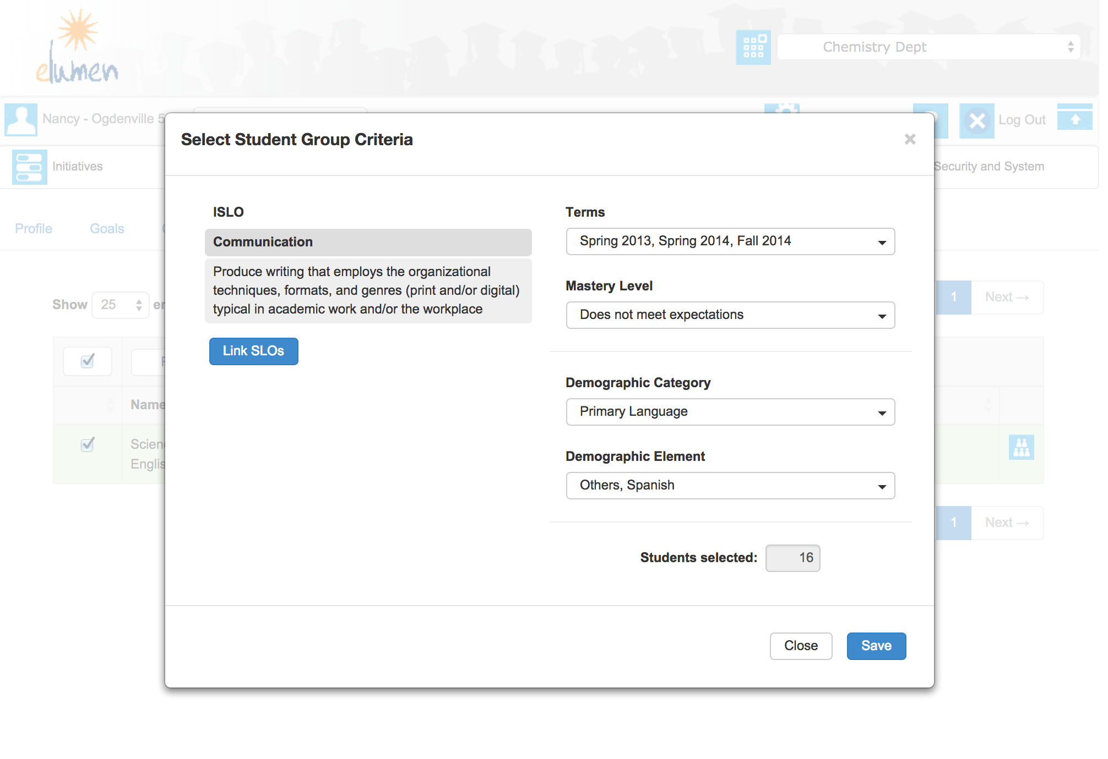
Course-Embedded Assessment
Changes the Game on Your Campus
Great screen shot #1: SI
Great screen shot #2: Purpose Built RFI
Great screen shot #3: Action Plan detail
Assessment Patterns can be Discovered in Real-Time
At-Risk Cohorts Automatically Inserted in Remedial Settings
Program Review and Accreditation are One-Click Report Options

Slide 14
Let’s Imagine…
A New Conversation About Learning Outcomes
Accreditation and Program Review are first-order NECESSITIES (made easy).
Institutional strategies for Remediation, Retention, and Skills-Readiness become POSSIBLE
Faculty can engage Learners in their Outcomes Journeys with tools they own, on THEIR terms.
eLumen can make that possible—while meeting you where you are today.

Slide 15

Let’s Talk.
Joel Hernandez
Chief Executive Officer
joel@elumen.info
612.501.4250

