Slide 1
Seminar 08A – Leading Transformational Change:
Applied Change Management in Higher Education
TJ Rains • Cory Falldine

Slide 2
Agenda for the Morning…

Slide 3
Agenda
Welcome / Introduction
(Transformational) Change Defined
Developing a Plan for Change
Kotter’s Steps 1 through 4
Break
Kotter’s Steps 5 through 8
Final Thoughts

Slide 4
References
Kotter, J. P. (2012). Leading Change. Harvard Business Review Press, Boston, Massachusetts.
Bridges, W. (2009). Managing Transitions. Nicholas Brealey, Boston, Massachusetts.

Slide 5
Case Study Approach
Separate into table groups.
As a group, identify a change you’d like to use as a case study.
Will use this as a case study for discussion and working through Kotter’s eight stages for leading change.

Slide 6
Download A Plan for Change Template!
https://goo.gl/EUvBLW

Slide 7
(Transformational) Change Defined…

Slide 8
Transformational Change Defined
A shift in organizational culture resulting from a change in underlying strategy and processes that an organization has used in the past.
A transformational change is designed to be organization-wide and is enacted over a period of time.
http://www.businessdictionary.com/definition/transformational-change.html

Slide 9
Rate of Change is Increasing
40% of companies worldwide do not expect business to return to “normal”.
A survey of 300 large companies reported that 82% consider transformation as being of vital importance. Higher Education is no different.
The most significant reason for transformation project failure is a lack of adequate attention to the people-related aspects of organizational change.
Effective transformation management involves much more than the mere application of processes, tools, and techniques.

Slide 10

Higher Education is currently going through a significant change cycle due to multiple internal and external pressures for increased performance, improvements in quality of programs and services with reduced budgets and resources.
As these organizational and market realities adjust, institutions of higher education must be flexible and agile enough to change along side.

Slide 11
Common Reactions to Change
Denial
Continue to Work as if Nothing has Changed.
Passive Aggressive.
Refusal to Come to Grips with the Change and the Required Personal Adjustments.

Slide 12
Common Reactions to Change
Resistance
Active Resistance
Passive Aggressive Resistance
Determined to favor tried methods over new ways of doing things.

Slide 13
Common Reactions to Change
Exploration
Begin Looking Forward with Caution.
Identification of Benefits of the Change and Ways to Implement.
Opening Up to the Idea of Change.

Slide 14
Common Reactions to Change
Engagement
Completely Commit to the Change
Excited, Energetic and Enthusiastic
Become an Agent of Change

Slide 15
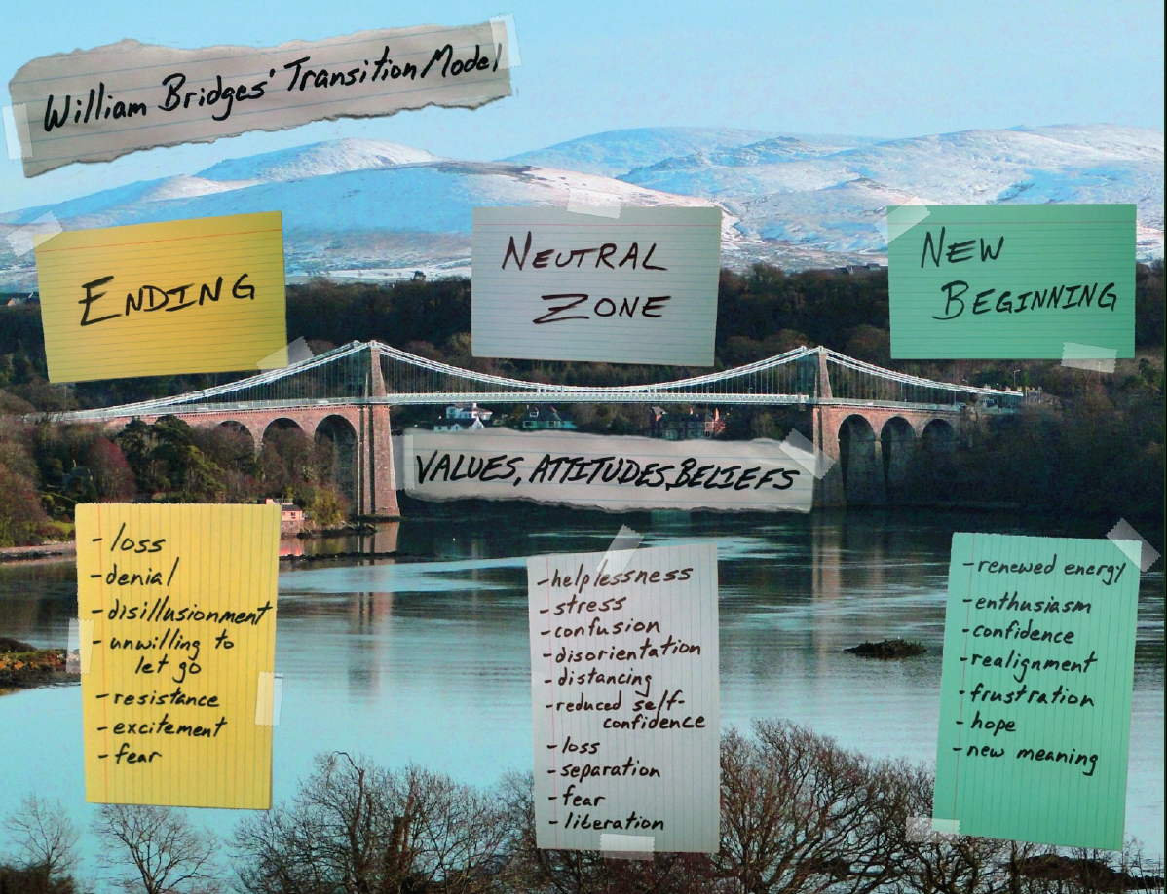
As change agents, it is our responsibility to lead stakeholders through the transition.

Slide 16
One Approach to Leading Change:
Kotter’s Eight Stages…

Slide 17
1: Establishing a Sense of Urgency
Complacency
State where people fail to react to signs that action must be taken, telling themselves and each other…
  "Everything is Fine."

Slide 18
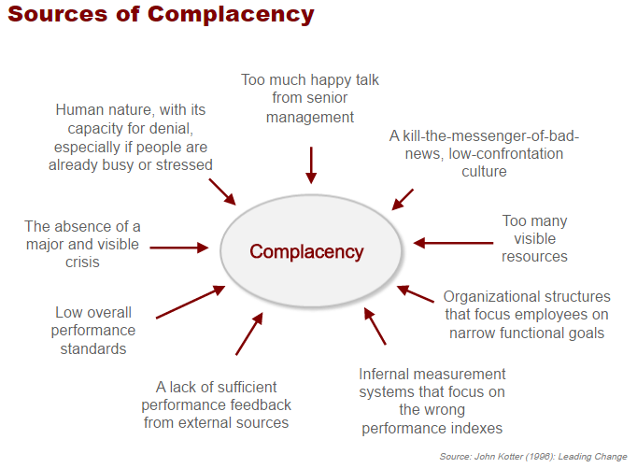
1: Establishing a Sense of Urgency

Slide 19
1: Establishing a Sense of Urgency
False Urgency
  People are busy working-working-working
  Actions don’t result in helping the institution succeed in achieving their goals.
  Leading to unproductive results and burnout.

Slide 20
1: Establishing a Sense of Urgency
1: Establishing a Sense of Urgency
True Urgency
  People are clearly focused on making real progress every single day.
  Driven by the belief that the world contains great opportunities… and great hazards.
  Inspires gut-level determination to move, and win, now!

Slide 21
1: Establishing a Sense of Urgency
1: Establishing a Sense of Urgency
How to Create True Urgency
  Aim for the heart!
  Connect to the deepest values of staff and leadership.
  Create a case for change. Make it come alive with the human experience, positive and negative impacts.
  Imaginative, simple and clear.

Slide 22
GROUP WORK!

Slide 23
2: Creating a Guiding Coalition
Potential Pitfall: Failing to Create a Sufficiently Powerful Guiding Coalition.
Put together a group with enough power to lead the change.

Slide 24
2: Creating a Guiding Coalition
No one person, no matter how competent, is capable of single handedly:
    Developing the right vision
    Communicating it to vast numbers of people
    Eliminating all obstacles
    Generating short term wins
    Managing dozens of change projects
    Anchoring new approaches deep in culture

Slide 25
2: Creating a Guiding Coalition
  4 Qualities of an Effective Guiding Coalition
    Position Power: Enough key players should be on board so that those left out cannot block progress.
    Expertise: All relevant points of view should be represented so that informed intelligent decisions can be made.
    Credibility: The group should be seen and respected by those in the institution so that the group’s pronouncements will be taken seriously by other employees.
    Leadership: The group should have enough proven leaders to be able to drive the change process.

Slide 26
GROUP WORK!

Slide 27
3: Developing a Vision and Strategy
Why?
  Clarifies a direction
  Motivates individuals to action
  Coordinates actions in a common direction
Leadership (vs. Management)

Slide 28
3: Developing a Vision and Strategy
An effective vision is:
  Imaginable
  Desirable
  Feasible
  Focused
  Flexible
  Communicable

Slide 29
3: Developing a Vision and Strategy
Potential Pitfall: Under-estimating the power of vision.
Keys:
  Creating a vision to help direct the change effort
  Developing strategies for achieving that vision

Slide 30
GROUP WORK!

Slide 31
4: Communicating the Change Vision
Goal: A shared sense of a desirable future
  Far beyond just change leadership / guiding coalition
7 principles – Effective Communication
  Simplicity
  Metaphors & Analogies
  Multiple forums, forms
  Repetition, Repetition, Repetition, …
  Leadership by Example
  Explanation of seeming inconsistencies
  Give-and-take, 2-way communication

Slide 32
4: Communicating the Change Vision
Potential Pitfall: Under-communicating the vision by a factor of 10 (or 100 or even 1,000)
Keys:
  Using every vehicle possible to constantly communicate the new vision and strategies
  Having the guiding coalition role model the behavior expected of employees

Slide 33
GROUP WORK!

Slide 34
Break: 15 Minutes

Slide 35
5: Empowering Employees for Broad Based Change
Potential Pitfall: Permitting Obstacles to Block the New Vision
Remove as many barriers as possible, unleashing people to do their best work.

Slide 36
5: Empowering Employees for Broad Based Change
Structural Barriers
  Misaligned organizational structures, processes and red tape.
  Don’t be afraid to question alignment and adjust to support change efforts.

Slide 37
5: Empowering Employees for Broad Based Change
Troublesome Supervisors
  May not actively undermine the effort, but may not be wired to go along with the change.
  No easy solution exists.
  Rather than ignoring this issue, best course of action is to conduct an honest dialog regarding the change vision and their role.

Slide 38
5: Empowering Employees for Broad Based Change
Empowering people to effect change
    Communicate a sensible vision
    Make structures compatible with the vision.
    Provide the training employees need.
    Align systems to the vision.
    Confront supervisors who undercut needed change.

Slide 39
GROUP WORK!

Slide 40
6: Generating Short Term Wins
Potential Pitfall: Failing to Create Short Term Wins
Create visible, unambiguous success as soon as possible.
Short term wins are essential to motivating further success… especially in long term change efforts.
Such wins provide evidence that the sacrifices are paying off.
Reward change agents with positive feedback.

Slide 41
6: Generating Short Term Wins
Undermine the cynics.
Clear improvement in performance make it difficult for people to block the needed change.
Build momentum that turns neutral people into supporters… and reluctant supporters into active helpers.

Slide 42
6: Generating Short Term Wins
Planning not Praying
  Short-Term Wins rarely “just happen”.
  Carefully planned projects and initiatives directly tied to operational performance measures.
Pressure to Perform
  Clearly adds a great deal of pressure to an institution undergoing a transformation effort.
  Can increase the sense of true urgency.

Slide 43
GROUP WORK!

Slide 44
7: Consolidating Gains and Producing More Change
Resistance is always lurking, waiting to reassert itself.
Behavior is easier to change than culture.
Interdependence within organizations works against change

Slide 45
7: Consolidating Gains / Enabling More Change
Use credibility gained by short-term wins to take on bigger projects
More help – broader effort
Leadership from senior management – keep urgency levels up, clarify of purpose
Leadership from below (management)
Reduce unnecessary interdependencies

Slide 46
7: Consolidating Gains and Producing More Change
Potential Pitfall: Declaring victory too soon.
Keys:
  Using increased credibility to change all systems, structures, and policies that don’t fit together and don’t fit the transformation vision
  Hiring, promoting, and developing people who can implement the change vision
  Reinvigorating the process with new projects, themes, and change agents

Slide 47
GROUP WORK!

Slide 48
8: Anchoring New Approaches in the Culture
Culture includes:
  Behavioral Norms
  Shared values
Must change behavior first, attitude/values come next, culture last…

Slide 49
8: Anchoring New Approaches in the Culture
Culture change:
  Comes last, not first
  Depends on visible, effective results
  Requires lots of support
  May require turnover in staff
  Makes decisions on succession planning crucial

Slide 50
8: Anchoring New Approaches in the Culture
Potential Pitfall: Neglecting to anchor changes firmly in the culture.
Keys:
  Creating better performance through customer- and productivity-oriented behavior, more and better leadership, and more effective management
  Articulating the connections between new behaviors and organizational success
  Developing means to ensure leadership development and succession

Slide 51
Why Change Efforts Fail
Did Not Establish a Great Enough Sense of Urgency
Failed to Create a Powerful, Unified Guiding Coalition
Lack of a Vision
Under-communicating by a Factor of Ten
Not Removing Obstacles to the New Vision
Not Planning for and Creating Short Term Wins
Declaring Victory Too Soon
Not Anchoring Changes in the Company’s Culture

Slide 52
Help Us Improve and Grow
Thank you for participating
in today’s session.
We’re very interested in your feedback. Please take
a minute to fill out the session evaluation found within
the conference mobile app, or the online agenda.

Slide 55
Level 1
  Level 2
    Level 3
      Level 4

