Slide 1
Six Secrets for Evaluating Online Teaching
Thomas J. Tobin Coordinator of Learning Technologies Center for Teaching and Learning Northeastern Illinois University | Ann H. Taylor Director Dutton e-Education Institute Penn State University
© 2015 Thomas J. Tobin and Ann H. Taylor. Shared under a CC BY-NC-SA license.

Slide 2
Six Secrets for Evaluating Online Teaching
Know your context.
Study the foundations of evaluation & analytics.
Implement formative data & evaluation first.
Automate summative methods next.
Create a holistic campus plan for implementation.
Implement and cycle the analytics plan.

Slide 3
Whose Online Course is Better?
Mel Ted Butter, Film Studies 101
Sal Monella, Food Safety 101
©2011 Gerry Lauzon. Used under Creative Commons BY license from Flickr.com.

Slide 4
A First Look
Handout 1: Mel
©2011 Michael Graziano. Used under Creative Commons BY-NC-SA license from Flickr.com.

Slide 5
A First Look
Handout 2: Sal
©2010 Northern Alberta Institute of Technology. Used under Creative Commons BY-ND license from Flickr.com.

Slide 6
What Did You See?

Slide 7
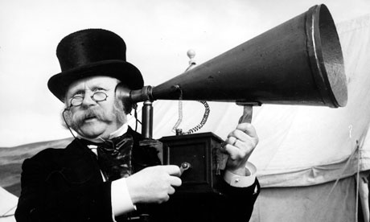
Your Goals for Our Time Together

Slide 8
Integrating Data Analytics
What problem do you hope to address with data analytics?
What impact does this challenge have on your institution?
How will you know if data analytics are meeting your goal?
What data do you need to address your challenge?
What’s the institutional value if data analytics can solve problems?
What system will store, analyze, and access your data?
What resources, info, tech do you need to implement data analytics?
How will you implement your data analytics model?

Slide 9
Six Secrets for Evaluating Online Teaching
Know your context.
Study the foundations of evaluation & analytics.
Implement formative data & evaluation first.
Automate summative methods next.
Create a holistic campus plan for implementation.
Implement and cycle the analytics plan.

Slide 10
Overview
The evaluation of online teaching raises unique questions that administrators, faculty, and IT leaders often don’t have guidance or experience in resolving.
Most learning management systems (LMS) now record every click that students and faculty members make.
We will discuss a 6-stage campus-wide program for evaluating online teaching.

Slide 11
Overview
This workshop will help you
determine what online practices “count” as teaching behaviors,
separate hype from useful information about data analytics in the LMS, and
develop campus policy & procedures to use online data for teaching evaluation.

Slide 12
The Challenge
How do you support online faculty in a meaningful way that is simultaneously effective and efficient?

Slide 13
Complicating the Challenge
Growing online programs:
High ratio of faculty teaching online in relation to online support personnel
Increasing reliance on an adjunct-faculty population
Emphasis on faculty support to increase instructional quality

Slide 14
Complicating the Challenge
New online programs:
Lack established support structures
Minimal expertise or experience in online teaching
Limited resources

Slide 15
What elements can you add to our goals list? What items already there need emphasis and underlining?

Slide 16
The Ultimate Goal

Slide 17
amazingness happens
teaching
students demonstrate concrete cognitive, affective or behavioral outcomes
learning
=

Slide 18
Learning is Messy

Slide 19
Quality Assurance

Slide 20
Gauge Quality via Learning Outcomes

Slide 21
Gauge Quality via Teaching

Slide 22
Measuring Instructional Quality
“Teaching without learning is just talking.”
-- Angelo & Cross (1993), p. 3

Slide 23
Principles of Effective Teaching
Online
Face-to-Face
Engaging
Timely
Relevant
Applied
Responsive

Slide 24
Face-to-Face

Slide 25
Online

Slide 26
Six Secrets for Evaluating Online Teaching
Know your context.
Study the foundations of evaluation & analytics.
Implement formative data & evaluation first.
Automate summative methods next.
Create a holistic campus plan for implementation.
Implement and cycle the analytics plan.

Slide 27
Principles of Good Practice
Encourage student-faculty contact.
Develop reciprocity & cooperation.
Use active learning techniques.
Give prompt feedback.
Emphasize time-on-task.
Communicate high expectations.
Respect diverse talents and ways of learning.
Chickering & Gamson (1987), Chickering & Ehrmann (1996)

Slide 28
Best Practices for Online Teaching
Make learning goals and paths clear to students.
Use deliberate practice and mastery learning strategies.
Provide prompt, constructive feedback.
Provide a balance of challenge and support.
Elicit active, critical reflection.
Link inquiries to issues of high interest to the learners.
Develop learners’ effectiveness as learners.
Support & encourage institutional inquiry environment.
UMUC Office of Evaluation, Research and Grants (formerly Institute for Research and Assessment)

Slide 29
Faculty Competencies for Online Teaching
Attend to unique challenges of distance learning.
Be familiar with unique learning needs.
Master course content, structure and organization.
Respond to student inquiries.
Provide detailed feedback.
Penn State Competencies for Online Teaching Success

Slide 30
Faculty Competencies for Online Teaching
Communicate effectively.
Promote a safe learning environment.
Monitor student progress.
Communicate course goals.
Provide evidence of teaching presence.
Penn State Competencies for Online Teaching Success

Slide 31
Penn State 10 Principles of Effective Online Teaching (and how to operationalize them)

Slide 32
Advantage of Online Teaching
Teaching Analytics

Slide 33
Teaching Analytics
data analytics
academic analytics
learning analytics
The process of evaluating and analyzing teaching artifacts received from
the university,
the classroom, or
the learning management system
for informing decision-making.

Slide 34
The value of analytics is tied directly to the ability of data to help institutions make better decisions… smarter, faster decisions that result in better use of resources.

Slide 35
Teaching Analytics & Community of Inquiry
teaching presence
social presence
cognitive presence
Instructional presence is established through traces of behavioral evidence in the online classroom.

Slide 36
Online Teaching Artifacts
number of announcements per module
number, quality of contributions to discussion boards
timeliness in posting student grades
timeliness, quality of feedback on student work, questions
quality of instructional supplements
frequency of logins to the online course environment

Slide 37
What artifacts “count” as teaching indicators?

Slide 38
Model of Teaching Analytics
Data Indicators:
Faculty training rating
Final student grades
Student completion
Student persistence
Grade variance
Student end-of-term ratings
Student engagement factor
Value:
Quantitative model utilizes multiple LMS indicators to establish average faculty performance scores by course.
Efficient quantitative rank allows for timely identification of faculty at both ends of the performance continuum.

Slide 39
Operationalizing Online Teaching Competencies
Identify key competencies
Identify available data
Determine scope of data
Determine time & resource allocation
Align data to relevant competencies

Slide 40
Select 5 teaching competencies relevant at your institution. Brainstorm a list of teaching behaviors in the online classroom that demonstrate each competency.

Slide 41
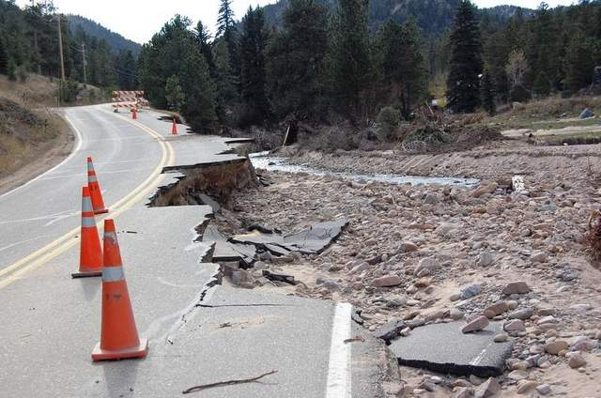
Limits of Teaching Artifacts

Slide 42
Types of Teaching Artifacts
Quality Indicators
quality of contributions to discussion board
Behavioral Data
number of posts to discussion board
feedback
instructional supplements
number of days logged into course
time spent in online classroom

Slide 43
Quality Indicators
Requires added qualitative analysis to be meaningful.
Rich, full data.
Behavioral Data
Evidence provides quick, easy quantitative data.
Baseline snapshot.
Requires investment of resources and/or time.
Requires minimal time or resources once dashboard is in place.
Limited by LMS capacities.
Effective for detailed, deep review of behavior.
Needs external reviewer to make meaningful.
Effective for quick review and feedback.

Slide 44
Example
Operationalizing “active engagement” using LMS analytics:
time instructor spends logged into the online classroom
number of instructor posts to the discussion board
quality of instructor posts to the discussion board

Slide 45
Analysis of example
 | Time Investment | Data Availability | Institutional Requirements | Observed
time an instructor spends logged into the online classroom | low | report | baseline expectations
number of instructor posts to the asynchronous discussion board | low | report | baseline expectations
quality of instructor posts to asynchronous discussion board | high | analysis required | quality of instruction

Slide 46
Behavioral Data = Baseline Identification Only!

Slide 47
Minimum Quality Expectations
Activity
Response time
Discussion participation
Grading timeliness

Slide 48
Activity
Response time
Grading delay
Delay between postings and instructor response
Number of logins to LMS
Delay between student submission & instructor feedback
Discussion participation
Ratio or number of instructor posts in discussion forum

Slide 49
What teaching artifacts are available through your LMS? In an ideal world, what teaching artifacts would you like to have access to?

Slide 50
Integrating Teaching Analytics
Teaching Artifacts
Student Ratings
Peer Review
Complementary Teaching Artifacts

Slide 51
Analytics in Context
Active engagement
Combine analytic data on the number of instructor posts to the discussion board with student rating data, highlighting students’ perception of the value of instructor’s posts to promoting learning.

Slide 52
Analytics in Context
Combine analytic data on average instructor response time for grading students’ assignments with a peer evaluation of the quality of feedback for a randomly selected sample of artifacts.
Prompt and useful feedback

Slide 53
Analytics in Context
Combine analytic data on number of instructor posts and number of student posts in an asynchronous discussion thread.
Foster student engagement

Slide 54
Footprint Analysis
What data are available?
How easy are the data to track?
What data could be available?
What reporting structures exist to make data meaningful?
What data systems easily integrate and communicate?

Slide 55
Examples of system integration
Competency:
Gives prompt feedback
Institutional expectation:
Instructors provide feedback to students within 7 days
Baseline behavioral data:
Time delay between student submission of assignment and instructor submission of grade/feedback
System integration:
Daily LMS report highlights courses, instructor 7+ days; via faculty services database, automatically emails instructors a reminder to grade student work.
If 3+ reminders to individual faculty, system notifies instructor to join faculty development initiative to enhance grading & feedback.

Slide 56
Examples of system integration
Competency:
Encourages student-faculty contact
Institutional expectation:
Instructor posts in the discussion threads at a minimum 1/7 ratio
Baseline behavioral data:
Ratio of instructor to student discussion posts
System integration:
Weekly report of instructor-student ratio for discussion posts; via faculty services database, automatically emails instructors a reminder to be active in discussion.
If 3+ reminders to individual faculty, system notifies instructor to join faculty development initiative to foster interaction in discussions.

Slide 57
A Second Look
Handout 1: Mel
©2011 Michael Graziano. Used under Creative Commons BY-NC-SA license from Flickr.com.

Slide 58
A Second Look
Handout 2: Sal
©2010 Northern Alberta Institute of Technology. Used under Creative Commons BY-ND license from Flickr.com.

Slide 59
What Did You See This Time?

Slide 60
Six Secrets for Evaluating Online Teaching
Know your context.
Study the foundations of evaluation & analytics.
Implement formative data & evaluation first.
Automate summative methods next.
Create a holistic campus plan for implementation.
Implement and cycle the analytics plan.

Slide 61
Deciding on Formative Criteria
Who: Under instructor guidance & discretion.
What: Improve specific aspects of online teaching.
When: Short, frequent feedback throughout a course.
Where: In time to adjust to benefit current students.
Why: Desire to improve online teaching.

Slide 62
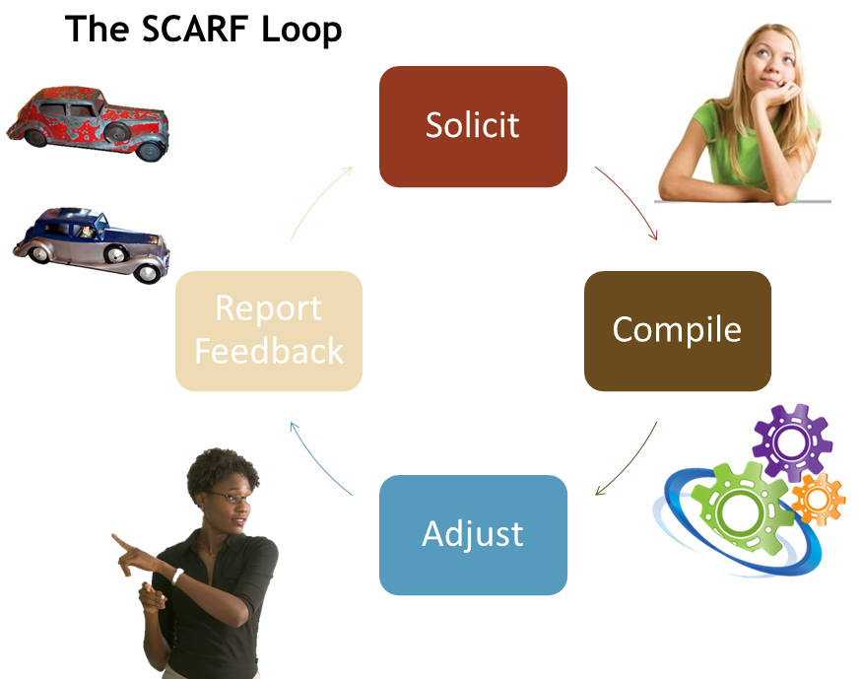
Formative Evaluation
Image ©2014 Thomas J. Tobin. Used under Creative Commons BY-SA license.
Notes:
Action steps for implementing changes online

Slide 63
In what ways could you integrate formative teaching analytics to improve the quality of online teaching?

Slide 64
Data Analytics: What can numbers do?
Pinpoint struggling students & instructors
Target learning materials
Create personalized learning pathways
Target professional-development materials
Tailor personal faculty communications
Proactively improve instructional quality
Notes:
Pinpoint struggling instructors to prioritize instructional coaching opportunities
Target the development of professional development materials to address issues that are widespread across all faculty
Tailor personal communication with faculty based on their individual instructional behavior patterns
Invest increased time on proactive interactions to foster increased instructional quality rather than reactive issues based on poor performance.

Slide 65
Self-evaluation
improve the educational experiences provided to students,
identify professional education to develop teaching capacity,
prepare for performance review,
assess readiness to apply for promotion and tenure.
Image ©2011 F Delventhal. Used under Creative Commons BY license from Flickr.com

Slide 66
Create a self-assessment strategy for faculty to make analytic teaching data meaningful.

Slide 67
Six Secrets for Evaluating Online Teaching
Know your context.
Study the foundations of evaluation & analytics.
Implement formative data & evaluation first.
Automate summative methods next.
Create a holistic campus plan for implementation.
Implement and cycle the analytics plan.

Slide 68
Teaching Behaviors
Instructional interactions done in the online classroom:
Announcements
Discussion
Grading & Feedback
Instructional Supplement
Administrative Tasks
©2009 John Amis. Used under Creative Commons BY-NC license from Flickr.com.

Slide 69
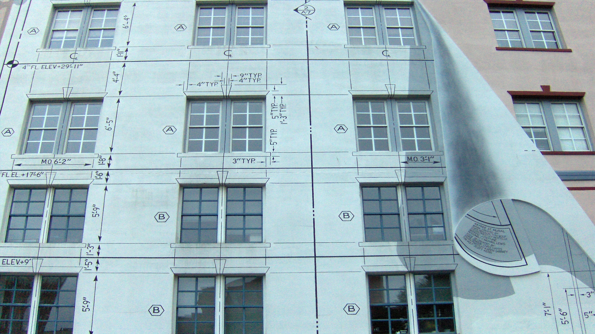
Course Content & Design
Instructional content, materials, and resources in the online course shell independent of interaction:
Lectures
Directions
Assignments
Resources
Materials
©2009 “Joe Shlabotnik.” Used under Creative Commons BY-NC-SA license from Flickr.com.

Slide 70
Effective Teaching Behaviors
Facilitation
Timely
Frequent
Instruction
Multimodal
Applied
Grading & Feedback
Specific
Immediate
Engaging
Relationship-Building
Ongoing
Interactive
Administration
Current
Clear
Proactive
Rubric-Driven
Student-Oriented
Student-Centered
Timely
Policy-Driven
Synchronous
Asynchronous
Elaborative
Individualized
Personalized
Detailed
Aligned

Slide 71
Summative Evaluation
Summative evaluation happens after learning is completed, to support employment-related decisions.
Student Ratings
Administrative Review
Analytic Metrics
Use of Multiple Data Sources
Image © 2013 Mathematical Association of America, used under CC-BY license from Flickr.com

Slide 72
Student Ratings
What factors are students qualified to rate (and are those online teaching behaviors)?
Course organization & structure
Instructor communication skills
Instructor-student interactions
Course difficulty & workload
Assessment and grading
Student learning gains
decide based on numerical data, never solely on open feedback.

Slide 73
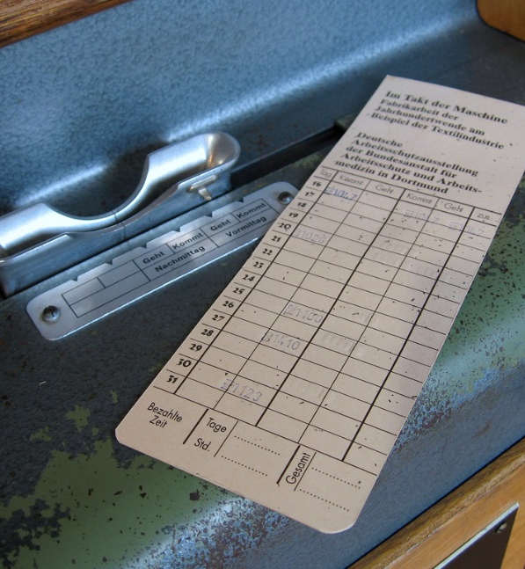
Analytic Metrics
LMS data can help with summative evaluation, but be careful!
Select metrics that measure student learning outcomes.
Avoid measures that are not login-dependent.
Time in LMS ≠ quality of learning.
Best used in comparison with other information.
Image © 2006 Marcin Wichary, used under CC-BY license from Flickr.com

Slide 74
Use Multiple Data Sources
Summative evaluation pretty much requires multiple sources of data to make employment decisions.
Pattern
Corroboration
Repeatability
Consistency
Image © 2012 Keoni Cabral, used under CC-BY license from Flickr.com

Slide 75
Measurable Online Teaching Behaviors
Log-in frequency
Personal & contact info
Announcement frequency
Student-question answer speed
Discussion frequency & quality
Assignment feedback speed & quality
(Piña and Bohn, 2014)

Slide 76
Observational Bias
Work to counteract these “invisible biases” that privilege the face-to-face classroom:
Good teaching is embodied.
It is intuitive.
It happens in real time.
It appears effortless.
It can be measured equivalently in all modalities.
… and an online one, too: quantity bias.
Image © 2005 US Department of Education, used under CC-BY license from Flickr.com

Slide 77
Administrative Review
Especially for administrators who have not taught online themselves, consider some online-specific concerns:
What communication is allowed with observed faculty?
How far beyond the e-classroom can observers go?
Set observation scope & duration.
Who can assist the observer?
Define teaching behaviors.
Know who created what. Look in live or post-facto?

Slide 78
Six Secrets for Evaluating Online Teaching
Know your context.
Study the foundations of evaluation & analytics.
Implement formative data & evaluation first.
Automate summative methods next.
Create a holistic campus plan for implementation.
Implement and cycle the analytics plan.

Slide 79
The Teaching-Learning Lifecycle
Integrate analytics to continuously gauge and foster effective online instruction (minus the wires).
Image ©2006 Glogger~commonswiki. Used under Creative Commons BY-SA license from Wikimedia.com

Slide 80
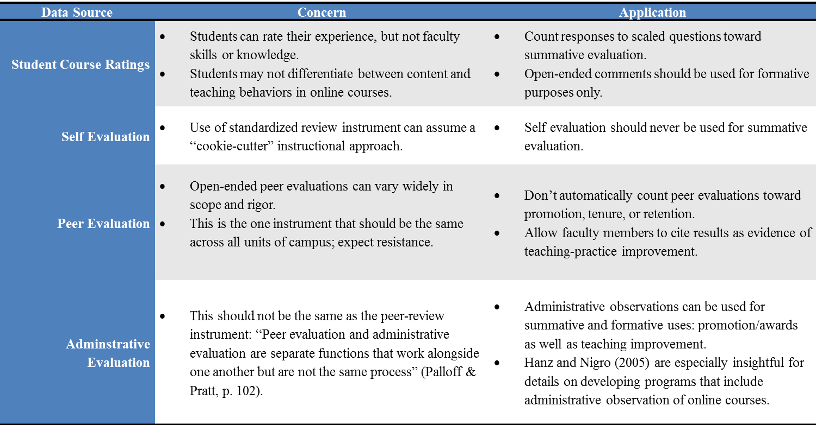
The Teaching-Learning Lifecycle

Slide 81
Campus Policy
Annual Review, Merit Pay
Student ratings
Self-ratings
Teaching scholarship
Administrator ratings
Promotion and Tenure
Administrator ratings
Teaching portfolio
Program Decisions
Student ratings
Exit and alumni ratings
Employer ratings
Create campus policies and procedures for using online data for summative teaching evaluation.

Slide 82
How can you integrate data analytics as a component of a holistic evaluation of online teaching at your institution?

Slide 83
Six Secrets for Evaluating Online Teaching
Know your context.
Study the foundations of evaluation & analytics.
Implement formative data & evaluation first.
Automate summative methods next.
Create a holistic campus plan for implementation.
Implement and cycle the analytics plan.

Slide 84
The Future of Teaching Analytics
Advances in LMS dashboards extends opportunities for “just in time” formative evaluation:
Quantity
Quality
Trends

Slide 85
The Possibilities of Predictive Modeling
Word and thematic analysis
determine the validity and relevance on instructor-student interactions
Predictive dashboards
which faculty need support or would benefit from training & mentoring
Faculty quality and retention
focus evaluation on faculty actively struggling to impact learning situation

Slide 86
The Possibilities of Predictive Modeling
Student-instructor matching
pinpoint how particular faculty members can best teach to meet specific student needs
identify disciplinary differences in value & effectiveness of various online instructional behaviors
Disciplinary evaluations

Slide 87
Create an action plan to implement data-driven evaluation of online teaching at your institution.

Slide 88
Enhancing the Quality of Online Teaching
Pinpoint struggling instructors.
Prioritize instructional coaching opportunities.
Develop professional development materials.
Address issues that are widespread across all faculty members.
Tailor personal communication with faculty based on their individual instructional behavior patterns.
Invest increased time on proactive interactions.
Foster increased instructional quality rather than reaction based on poor performance.

Slide 89
Six Secrets for Evaluating Online Teaching
Know your context.
Study the foundations of evaluation & analytics.
Implement formative data & evaluation first.
Automate summative methods next.
Create a holistic campus plan for implementation.
Implement and cycle the analytics plan.

Slide 90
A Last Look
Handout 1: Mel
©2011 Michael Graziano. Used under Creative Commons BY-NC-SA license from Flickr.com.

Slide 91
A Last Look
Handout 2: Sal
©2010 Northern Alberta Institute of Technology. Used under Creative Commons BY-ND license from Flickr.com.

Slide 92
What Can Analytics and Observation Do?

Slide 93
Questions and Comments

Slide 94
Thank You!

Slide 95
Let’s Continue the Discussion
Thomas J. Tobin
t-tobin@neiu.edu
Ann H. Taylor
anntaylor@psu.edu

