Slide 1

Setting Up a Project for Success:
Engaged, Inclusive Business Case Development
Cindy Mitchell and Robin Sherman
April 1, 2015

Slide 2

Presenter Information
Cindy Mitchell
Associate CIO for Policy Planning and Leadership
cindy@maine.edu, 207-973-3282
Robin Sherman
Director, IT Project Management Office
robin.sherman@maine.edu, 207-973-3288
Link to UMS IT Project Management Office website
http://www.maine.edu/its/project-management-office/

Slide 3

University of Maine System (UMS)
7 universities
8 outreach centers
31 course sites
29,613 students
5,366 employees

Slide 4
Agenda
What is a business case?
When do I need one?
Stakeholder engagement
Business case review & prioritization
Policies supporting the business case
Quick exercise in business case development

Slide 5
Why Build a Business Case?
To ensure:
a clear understanding of the value of the initiative.
a clear understanding of the desired outcomes.
a clear understanding of the resources required to implement and maintain it.
all stakeholders are collaborating.
as few surprises as possible.
there is commitment.
the institution is working on the right projects at the right time.

Slide 6

What is a Business Case?
States the purpose of the project.
Demonstrates business need and value added to the University.
Provides analysis and requirements but does not pinpoint a specific solution.
Provides the roadmap for how the project would be resourced, implemented, and supported.

Slide 7
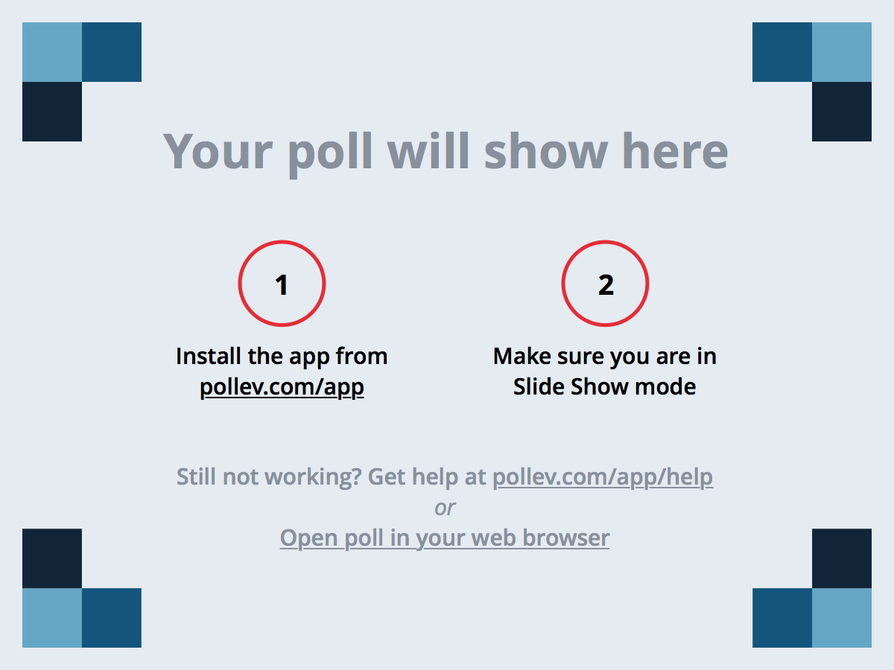
Notes:
Poll Title: This is where my institution stands in the use of business case development:
https://www.polleverywhere.com/multiple_choice_polls/L11MGMqQbiOHj7c

Slide 8
When Do We Need a Business Case?
Investment of $50,000 or higher is expected.
Impacts a high number of users.
Includes access to, processing, transmitting or storing highly sensitive or compliant data.
Requires data from existing systems.
When the technology is proposed in a grant application and will impact existing financial, human resources or student administration processes/activities.

Slide 9

What Happens Before the Business Case?
AN IDEA IS BORN!
Key stakeholders come together to:
Identify business need, impact, legal/regulatory requirements, risks, proposed timeline, Sponsor.
Submit a Project Initiation Form (PIF)
  PMO uses PIF for initial review & classification, and to determine if business case is required.

Slide 10
Business Case Template
The template ensures required information is provided, but does not dictate format.
Sponsors & collaborators
Executive Summary
Project Description
Alternative Analysis
Risks
Contingencies & Dependencies
Cost Estimates
Funding
Return on Investment
Staffing
Funding
Who will need training
Success Evaluation

Slide 11

Sponsors and Collaborators
Strategic leaders:
  CFO, CAO, CIO, Dean, Enrollment Manager, HR Director, President….
  Commitment from those who will provide personnel and funds.
IT resources, functional leaders, procurement.

Slide 12
Sponsor/Collaborator Activities
Articulate the challenge or opportunity.
Describe requirements.
Conduct informal vendor consultations and presentations.
Consult with peer institutions.
Consider different ways to solve the problem, or achieve the opportunity.

Slide 13
Executive Summary
Identifies the challenge or opportunity.
Recommends the solution.
Explains why the solution is needed now.
Tells how it aligns with strategic mission.
Tip - Make it compelling, clear, and concise.

Slide 14
Alternative Analysis
Examples:
  Manual
  Hire
  Modification
  Upgrade
  Business process reengineering
  Buy new

Slide 15

Examples of Risks
Lack of resources.
Lack of stakeholder engagement.
Length of time to complete.
Lack of adoption.

Slide 16
Cost Estimates
One-time costs such as license fees and implementation fees.
Anticipated annual maintenance or licensing fees for the duration of contract.
Value of personnel and/or IT effort spent on the project and on-going support.
Cost of organizational impact.
Infrastructure investments:
  One-time and on-going

Slide 17
Facilities Project Cost Estimates
Consultants/Project Manager $350,000
Hardware Licensing $11,879
Software Licensing $314,325
Vendor Travel and Living Costs $145,200
UMS Staff Travel Costs $10,000
Vendor charge for Interface with PeopleSoft $46,400
Vendor charge for SciQuest Integration $50,000
Business Process Design/Standards Development/Planning $159,800
Data Conversion $102,000
ITS Support $492,199
Initial Training $70,100
Setup andConfiguration $153,800
Testing $37,600
Report Creation $32,000
Staff augmentation $50,000
Contingency $197,993
Total Implementation Costs $2,223,296
Total Ongoing Costs $319,228

Slide 18
Return on Investment
Reduced manual effort? Reduced employee FTE?
Anticipated retention: retain 1% more students?
Years to recover cost?
Reduced maintenance on multiple systems, upgrades, hardware?
Reduced integrations?
Increased enrollment?

Slide 19
Example of Recruitment System ROI
Goal: Increase applications by 100.
Yield: 28%
Instate/Out of State Ratio: 10 to 1
Instate Tuition: $253 per credit hour
Out of State Tuition: $665 per credit hour
Number of credit hours used: 24 to reflect to 12 hour semesters
If USM were to increase the number of applications by 100, the expected yield would be as follows:
Number of deposits: 28
Number of in-state deposits: 26
Number of out of state deposits: 2
Total in-state tuition revenue: $157,872
Total out of state tuition revenue: $31,920
Total increase in tuition revenue: $189,792

Slide 20

Success Evaluation
What results, if achieved, would make this a successful project?
  Increased revenue.
  Increased enrollment.
  More efficient business processes.
  Decreased employee FTE.
How will you measure success?

Slide 21
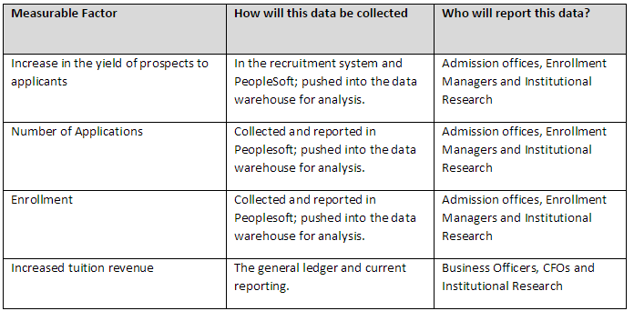
Success Evaluation - Example

Slide 22
Review: Engagement with Stakeholders
Idea/Opportunity/Challenge
Alignment with institutional mission/goals.
Description.
Alternatives.
Risks.
Funding.
ROI.
Success Criteria.
Signing on the dotted line.
Commitment to integrate into on-going work.

Slide 23
Business Case Review & Prioritizing
Projects that require a business case are significant.
They require:
  Careful planning.
  Strong commitment.
  Sufficient resources (financial & human).

Slide 24
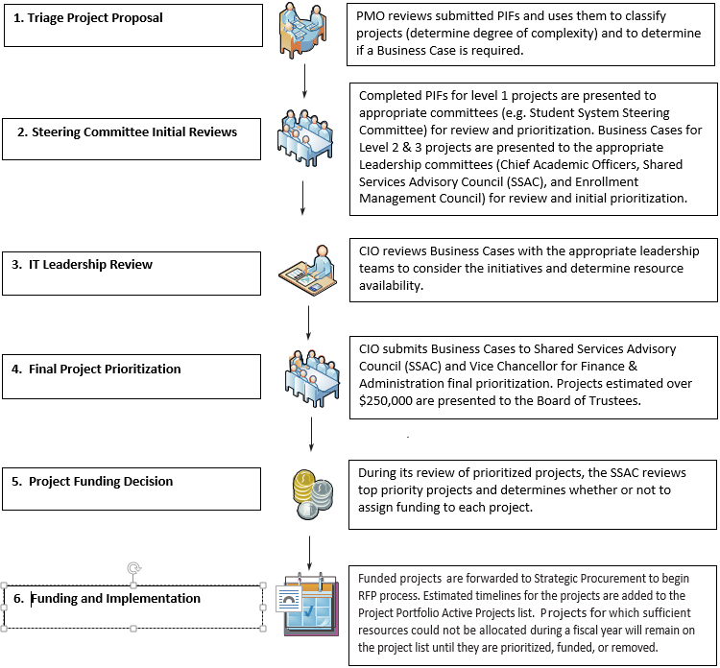

Slide 25
Policy Links
UMS IT Business Case Administrative Practice Letter (APL)
http://www.maine.edu/wp-content/uploads/2015/03/VI-A-Business-Case-Process-7-1-14.pdf
CIO Waiver APL
http://www.maine.edu/wp-content/uploads/2014/07/VI-D-CIO-Waiver-7-1-14.pdf

Slide 26
A Business Case Development Exercise
Your HR Office wants to replace your current Human Resources technology in order to drive more to self service.

Slide 27

Questions That Build a Business Case
What is the need or opportunity?
What have you seen that has been successful?
Is staying where we are an option?
Are there things we can do to improve our current state?
Is this a people or technology problem?
Is this a business process problem?

Slide 28
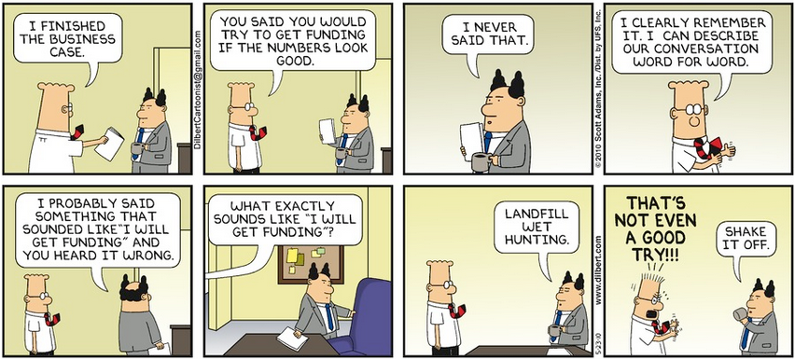

Slide 29
Resources Included
Facilities (IWMS) business case
Recruitment System business case
Policies (Business Case and CIO Waiver)
Business Case template
Business Case guide

