Slide 1
Legal Structure and the Security Professional May 4, 2015
Patrick J. Feehan Director, IT Policy and Cybersecurity Compliance Montgomery College | Steven J. McDonald General Counsel Rhode Island School of Design

Slide 2
Introduction - Agenda
Legal System Structure and Landscape; Working with Lawyers
The Privacy
Policy
Clauses That Matter
1
2
3
4
5
Contracts Overview
The Reasonable
Security Professional

Slide 3
Peak of Inflated Expectations
SIEM
Deployment
Plateau of Productivity
Patrick
Steve
Slope of
Enlightenment
Trough of Disillusionment
Gartner Hype Cycle
Applied to Attorneys

Slide 4
We are all risk managers
With Different Histories

Slide 5
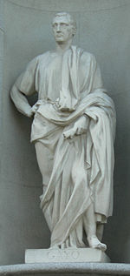
Roman Lawyer Gaius AD 130 - 180
"Lex est quod populus iubet atque constituit"
"The law is what the people order and establish"

Slide 6

UNIVAC I – 1953 Computing begins
Notes:
In 1953, General Electric became the first non-government entity to order a UNIVAC I, receiving the eighth one built. Installed to run the payroll at GE's facility in Louisville Kentucky. In those days, Philadelphia was the center of the technology universe. Grace Hopper created first compiler …

Slide 7
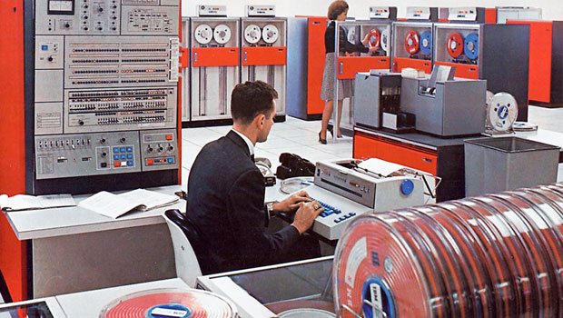
1964
IBM System/360

Slide 8
1975
"Data Processing" Department
  Did custom software development
  Procured and managed exotic and expensive hardware
  Used punch cards and magnetic tape for "batch" processing
  No networking, or just simple low-speed connections
  Isolated and mysterious – no one outside of the organization had a clue about what went on within it
  "Phreakers" arrive – precursor to hackers – made free phone calls
Notes:
In 1975 when I first started in the IT field …

Slide 9
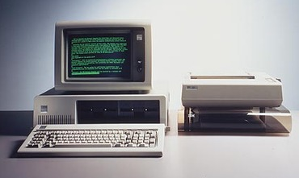
1981
IBM PC

Slide 10

1984
John Gage
Chief Researcher and Director of the Science Office
Sun Microsystems
"… the big mainframes are going to disappear. …We'll build systems of computers. It will be a whole bunch of micros, and they'll all call each other
up and talk."
Rear Admiral Grace Hopper

Slide 11
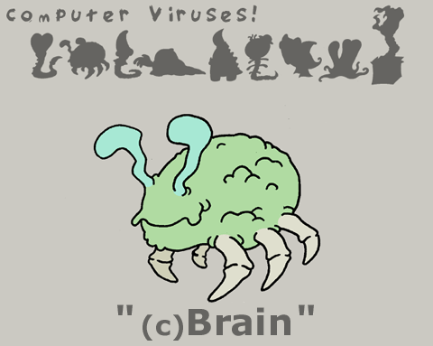
1986 – First IBM PC Virus - Brain
First Known IBM PC Virus
Welcome to the Dungeon
(c) 198Welcome to the Dungeon
(c) 1986 Basit & Amjad (pvt) Ltd.
BRAIN COMPUTER SERVICES
730 NIZAB BLOCK ALLAMA IQBAL TOWN
LAHORE-PAKISTAN PHONE :430791,443248,280530.
Beware of this VIRUS….
Contact us for vaccination………… $#@%$@!!

Slide 12
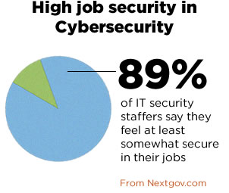
1986 – Computer Fraud and Abuse Act
Information Security
- Legal recognition - is Born
1988 – CERT Advisories Begin

Slide 13
Change Impacts Risk
CLOUD
CLOUD
Mainframe
"THEM"
Technology Advancement
Dissatisfaction
Increasing Expectations
Technology Advancement
Dissatisfaction
Increasing Expectations
Mobile Devices
"WEEEEEE!"
Minicomputer
"US"
1953
2011
2007
1965
Technology Advancement
Dissatisfaction
Increasing Expectations
Technology Advancement
Dissatisfaction
Increasing Expectations
Internet and the Web
"WE"
1991
1977
Personal Computer
"ME"
1983
Local Area Networks
"US"
Technology Advancement
Dissatisfaction
Increasing Expectations
Technology Advancement
Dissatisfaction
Increasing Expectations

Slide 14
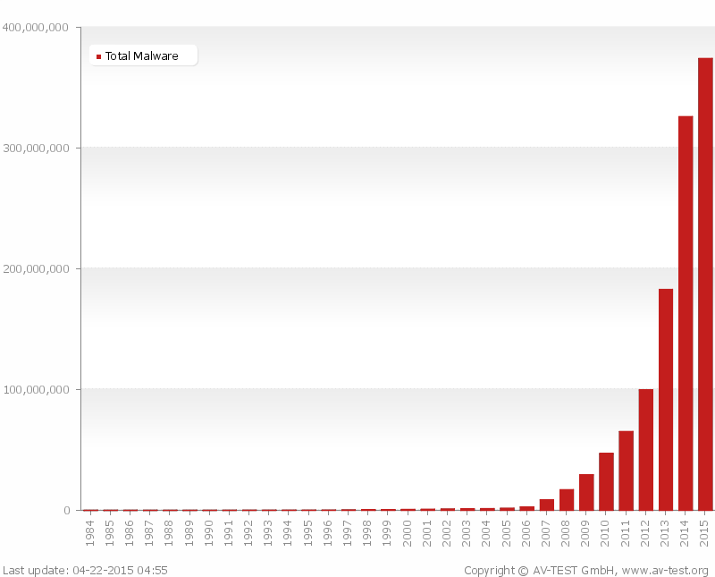
Threats Grow Exponentially
400 Million total
malware - 2014
390,000 new malicious
programs every day

Slide 15

Threats X Vulnerability X Impact = Risk

Slide 16
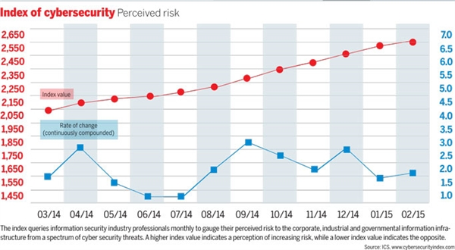
Even Perceived Risk Grows Steadily

Slide 17
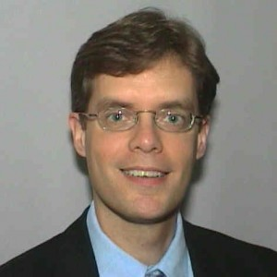
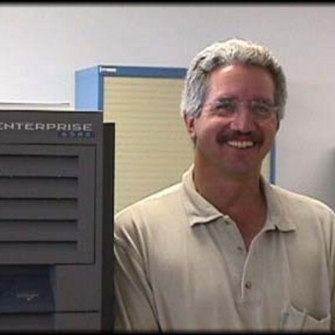
Risks Meet at the Contract
Attorney
Security Professional

Slide 18
Legal System Structure and Landscape; Working with Lawyers
Steve McDonald, RISD

Slide 19
Yes, We're Lawyers
The problem with lawyer jokes is that lawyers don't think they're funny, and nobody else thinks they're jokes . . . .
99% of the lawyers make the rest of us look bad . . . .

Slide 20
Law: A Taxonomy

Slide 21
Federal v. State Law
Federal law: Law established by the federal government
Sources
  United States Constitution
  Congress
  Federal court decisions
  Regulations enacted by executive branch agencies

Slide 22
Federal v. State Law
Examples
  First and Fourth Amendments
  Patent and Copyright Statutes
  ECPA
  DMCA
  FERPA

Slide 23
Federal v. State Law
State law: Law established by state constitutions, legislatures, courts, or agencies
Examples
  State data breach notification laws
  State public record laws
  Contract and tort law
"Uniform" state laws

Slide 24
Federal v. State Law
A "federal" system, with "dual sovereignty"
  National law for national issues
  The "laboratory of the states" for state issues
Preemption: Federal law is the "Supreme law of the land" and trumps conflicting state law
  For example: If state public records law requires disclosure of records that FERPA protects, then . . .
    FERPA wins!

Slide 25
Types (Levels) of Law
Constitutional law
  Legal foundation for how law is created and interpreted
  Federal and state constitutions govern the respective governments
  Federal constitution also governs the relationship between the federal government and the states

Slide 26
Types (Levels) of Law
Statutory law
  Usually what we think of when we refer to "laws"
  Law enacted by legislative bodies – federal, state, or local
  Tends to be reactive, and sometimes hasty

Slide 27
Types (Levels) of Law
Common law
  Law that has developed through court decisions, sometimes over centuries
  Slow, deliberate, incremental process
  Deference is given to previously decided cases that establish what is referred to as precedent
  Primarily state law
  Examples: contract and tort law

Slide 28
Types (Levels) of Law
Administrative/regulatory law
  Law established by administrative agencies to which rulemaking authority has been delegated, including (at the federal level) the Department of Education, the Federal Communications Commission, and the Federal Trade Commission
    Net neutrality
  Through a rulemaking process, they enact regulations that govern the behavior of organizations over which they have enforcement power

Slide 29
Types (Kinds) of Law
Civil
  Law governing disputes between two parties, in which the "loser" must make the "winner" whole, for example through financial compensation
  Civil law suits are (generally) filed by private parties

Slide 30
Types (Kinds) of Law
Criminal
  Law governing criminal activity and the resulting punishments, such as fines and jail time, for criminal offenses
  Criminal law suits are filed by the government

Slide 31
Types (Kinds) of Law
Contract (private) law
  An agreement between two or more people that is not created by law, but that is enforceable by law
  A means of regulating private affairs beyond what the law requires, but in a way that will be backed up by law

Slide 32
Whose Law is it, Anyway?
Public
  Subject to laws governing government
  Examples: Constitutional law, public records statutes, sovereign immunity
Private
  First Amendment? Not my problem!
Both

Slide 33
Speaking of Law:
Juris-diction

Slide 34
Will of the WISP
Massachusetts Standards for Protection of Personal Information of Residents
  "The provisions of this regulation apply to all persons [wherever located] that own or license personal information [in any format] about a resident of the Commonwealth."
  "Owns or licenses" = "receives, stores, maintains, processes, or otherwise has access to personal information in connection with the provision of goods or services or in connection with employment"
  Must develop, implement, and maintain a comprehensive, written information security program (WISP)

Slide 35
And the Beat(ing) Goes On
  Must designate responsible official
  Must conduct complete inventory and risk analysis
  Must implement "administrative, technical, and physical safeguards to ensure the security and confidentiality" of personal information
  Must include security policies for storage, access, and transportation of personal information off-premises
  Must encrypt all personal information traveling across public or wireless networks and on laptops or other portable devices
  Must have ongoing employee training
  Must monitor compliance
  . . .

Slide 36
Can They Do That?
(Do I Have to Do That?)
It depends
If China adopted such a law, would we blindly assume we had to comply?
Then why do we do so with respect to Massachusetts?
Two more questions . . .

Slide 37
Can They Enforce That?:
Judicial Jurisdiction
Subject matter jurisdiction
  Jurisdiction over the case
    Type of case
    Amount in dispute
Personal jurisdiction
  Jurisdiction over the parties
    Originally a matter of pure geography . . .

Slide 38
Judicial Geography

Slide 39
Internet Geography

Slide 40
Where do you want to be sued today?

Slide 41
A Really Big Shoe
"[D]ue process requires only that in order to subject a defendant to a judgment in personam, if he be not present within the territory of the forum, he have certain minimum contacts with it such that the maintenance of the suit does not offend 'traditional notions of fair play and substantial justice.'"
– International Shoe Co. v. Washington

Slide 42
And Another
"We find that Sullivan, as the producer and master of ceremonies of 'The Ed Sullivan Show,' entered Arizona by producing the play entitled 'A Case of Libel' in New York City. . . . [T]he telecast of the show . . . in Arizona [was] voluntary, purposeful, reasonably foreseeable and calculated to have effect in Arizona . . . ."
– Pegler v. Sullivan

Slide 43
You May Ask Yourself:
How and why did you obtain personal information about a Massachusetts resident?
Did you "reach into" Massachusetts in some voluntary, purposeful, reasonably foreseeable, and calculated way?
Or did the Massachusetts resident "bring" it to you?

Slide 44
Choice of Law and Jurisdiction
Back to contracts, where you have a choice:
  Yours v. theirs
  Limitations on state institutions
  Delete it and defer the argument till later
  Suit must be filed in defendant's jurisdiction

Slide 45
Can They Implement That?:
Legislative Jurisdiction
"A State does not acquire power or supervision over the internal affairs of another State merely because the welfare and health of its own citizens may be affected when they travel to that State." – Bigelow v. Virginia
"[I]t would be impossible to permit the statutes of Missouri to operate beyond the jurisdiction of that State . . . without throwing down the constitutional barriers by which all the States are restricted within the orbits of their lawful authority and upon the preservation of which the Government under the Constitution depends." – New York Life Ins. Co. v. Head

Slide 46
State of Mine
Massachusetts has legislative jurisdiction over you if (and only if?):
  You are located in Massachusetts
  You are organized as a Massachusetts corporation, even if located elsewhere
  You are registered to do business in Massachusetts as a foreign corporation
  You are otherwise operating in Massachusetts

Slide 47
BREAK!

Slide 48
Lawyers: A User's Manual
Steve McDonald, RISD

Slide 49
The Office of No?

Slide 50
Can: What is Possible
May: What is Permissible
Must: What is Required

Slide 51
You Make the Call
The good news:
  The law gives us considerable discretion
  We get to make a choice
The bad news:
  The law gives us considerable discretion
  We have to make a choice
Not making a choice is making a choice, to accept the status quo

Slide 52


Can: What is Possible
May: What is Permissible
Must: What is Required

Slide 53
Can: What is Possible
May: What is Permissible
Should: What is Advisable
Must: What is Required

Slide 54
Decisions, Decisions
Law
Risks
Benefits
Costs
Values
Relationships
Public Relations
Practicalities
. . .

Slide 55
Finding Your Inner Lawyer

Slide 56
Risky Business
Risk is something to be managed, not avoided
  Risk includes not only the bad things that might happen if you proceed, but also the good things that won't happen if you don't proceed
Gray areas are just as gray from the other side, and therefore just as risky for the other side
  Why cede that whole space to the other side?
"Pigs get fed, but hogs get slaughtered"

Slide 57
Advise and Consent
Lawyers give advice, not orders
Ask not: Can (may) I do X?
Administrators make decisions and choices
Ask: How can (may) I do X?
Lawyers don't make your decisions.
Lawyers help make your decisions better.

Slide 58
Advise and Dissent
Your lawyer really isn't trying to botch your work for you by raising issues
A lawyer's job is to be a professional pessimist, for your protection
Ultimately, most issues are questions of business and of risk management, and you make the call

Slide 59
Getting to Know You
Lawyers and IT professionals should work together and educate each other, before there's a problem
Just as you need to know about common law, jurisdiction, FERPA, and so forth, we need to know about LDAPs, SSO, encryption, and the like
None of us is as smart as all of us

Slide 60
Contracts:
A Survival Guide

Slide 61
Dedication
"Could you just take a quick look at this [15-page, single-spaced, 8-point font, form] contract [that's been on my desk for the last three months, but that I haven't read] and let me know whether it's OK [before the vendor comes in 30 minutes from now to pick it up]?"
– Numerous clients who will for their and my protection remain anonymous

Slide 62
What is a Contract?
[A trap]

Slide 63
What is a Contract?
An agreement between two or more people that is enforceable by law

Slide 64
What is a Contract?
[Dense legalese]
[A letter]
[Memoranda of understanding and letters of intent]
[Handbooks]
[Terms of service]
[Incorporated terms]
[Purchase orders and invoices]
[A marriage]
[A handshake]
[The ultimate contract]

Slide 65
What Does it Take to Make a Contract?
Offer: I'll do/pay X if you do/don't do Y
Acceptance: OK (in any form)
Consideration: X and Y
In other words, there must be a bargain (in the sense of an agreed, mutual exchange), but it need not be a "bargain" (in the sense of an equal exchange or good deal)

Slide 66
What Doesn't it Take to Make a Contract?
A negotiation
  Non-negotiable forms (like EULAs) are still enforceable
  Courts will strike out terms of non-negotiable contracts only if they are "unconscionable"
A written document (usually)
A written document that is consistent with your negotiations
A written document that you have read
A written document that you understand
A signature (usually)
Terms that are "fair" and "reasonable"

Slide 67
What Doesn't it Take to Make a Contract?
All that matters is that you have "manifested your mutual assent" to the contract

Slide 68
What Should be in a Contract?
[An owner's manual]

Slide 69
What Should be in a Contract?
Who: the parties
What: the rights and duties of the parties
Where: the place of performance
When: the term(s) of the contract; deadlines
Why: any relevant background
How: the method of performance
How much: amount and terms of payment
What if: termination rights and remedies

Slide 70
A Contract is, First and Foremost, a Business Document
"You've got to be very careful if you don't know where you're going, because you might not get there." – Yogi Berra
If you don't know and specify what it is you want to receive, you're going to get only what the vendor wants to provide
You don't get what you deserve; you get what you negotiate." – Dr. Charles L. Karrass

Slide 71
Everything (almost) is Negotiable

Slide 72
What Should be in a Contract?
There is no real "magic language" – the key is just to be as clear and complete as possible, to avoid misunderstandings and disputes
If there is a dispute, it's not what you think the contract says, it's what an outside, objective observer (i.e., the court) thinks the contract says, usually by looking only "within the four corners" of the contract itself
"But it's organic – we can't specify details now"
  So is compost, which is a process of deterioration
"We're important to them, so they'll take care of us"
  Trust, but verify

Slide 73
BREAK!

Slide 74
Contract Clauses Which Should Interest You
Patrick Feehan

Slide 75
So Many Clauses, So Little Time
Warranties
Liability
Security
1
2
3
4
5
Merger Clause
Termination

Slide 76
You Are The SME (maybe) – What Are We Buying?

Slide 77
You Are The SME (maybe) – What Are We Buying?

Slide 78
Warranties
1. This is a large issue in any contract.
2. What is the warranty of the vendor?
3. Their form will typically exclude most if not all warranties.

Slide 79
Warranty Disclaimer
Disclaimer. Except as set forth above, Patrick makes no warranties to Customer or to any third party, whether express, implied, or statutory regarding or relating to the Software, the Documentation, any Deliverable or any materials or services furnished or provided to Customer under this Agreement, including Maintenance and Support. PATRICK HEREBY DISCLAIMS ALL IMPLIED WARRANTIES OF MERCHANTABILITY, NONINFRINGEMENT AND FITNESS FOR A PARTICULAR PURPOSE WITH RESPECT TO THE SOFTWARE, DOCUMENTATION, DELIVERABLES AND SAID OTHER MATERIALS AND SERVICES, AND WITH RESPECT TO THE USE OF ANY OF THE FOREGOING. PATRICK DOES NOT WARRANT THAT OPERATION OF THE SOFTWARE IS ERROR-FREE OR THAT ITS OPERATION WILL BE UNINTERRUPTED AND HEREBY DISCLAIMS ALL LIABILITY ON ACCOUNT THEREOF.

Slide 80
Warranties – Weak, But Real
"Patrick does not warrant that its Services are or will be error free. Patrick further does not warrant that its electronic files containing information pertaining to Customer and/or Customer's students are not susceptible to intrusion, attack, or computer virus infection, but given the confidential nature of much of this data, Patrick will use commercially reasonable efforts to insure and safeguard the security of this data."

Slide 81
Warranties – Minimum or SLA's
Consulting Services. Consulting Services shall be completed in a professional, workmanlike manner, with the degree of skill and care that is required by sound professional procedures and practices.
If a third party asserts a claim against Client that a Service acquired under this Agreement infringes a patent or copyright, vENDOR will defend Client against that claim and pay amounts finally awarded by a court against Client or included in a settlement approved by Vendor.

Slide 82
Merger and Integration Clause
Merger and Amendments. This Agreement may not in any way be modified, changed or amended except by a written instrument duly executed by the parties hereto. This Agreement, when executed, and the exhibits attached hereto, constitutes the entire, final, complete and exclusive agreement between the parties and supersedes any prior negotiations, understanding or agreements whether oral or in writing, concerning the subject matter, hereof.

Slide 83
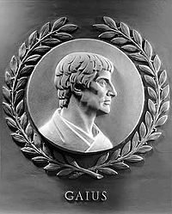
Merger and Integration Clause
Remember my Roman Lawyer?
That is how old this clause is.
We merge, we integrate to avoid
something out there , oral or
in writing, which makes a
different promise.

Slide 84
Liability/Indemnification
Liability is usually pro forma.
Your College's Terms and Conditions may call for specific insurance to cover the transaction. You may call for specific indemnity. Most Vendors will avoid putting insurance language in the contract.
Left to its own devices the Vendor will disclaim liability as much as it can; or certainly limit the liability.

Slide 85
Limiting Liability
You will often see this tactic:
  Limitation of Liability. VENDOR SHALL NOT BE LIABLE FOR ANY AMOUNT EXCEEDING THE TOTAL PORTION OF THE CONTRACT PRICE ACTUALLY PAID BY CLIENT DURING THE THEN CURRENT TERM.

Slide 86
Limiting Liability – In Other Words
The Vendor is saying:
  It does not matter how bad we screw up…
  Even if we lose ALL of your data and you are on the front page of the Washington Post.
  The most you can recover from us is 12 months of service fees.

Slide 87
Termination of the Agreement
How do you terminate the contract?
Often times you will see your own College's Terms and Conditions call for "Termination for Budget Reasons" or even "Termination at the Convenience of the College President."
Vendors hate those.
You need the Contract to reflect what your College needs.

Slide 88
The Language in Your Contract
Determines the standard of care between the parties.

Slide 89
What is the standard of Care?
The watchfulness, attention, caution and prudence that a reasonable person in the circumstances would exercise. If a person's actions do not meet this standard of care, then his/her acts fail to meet the duty of care which all people (supposedly) have toward others. Failure to meet the standard is negligence, and any damages resulting therefrom may be claimed in a lawsuit by the injured party.

Slide 90
What does that mean for us as IT Security Professionals?
Let's Look at a Cloud Contract as an example.

Slide 91
An Actual Contract Paragraph
Smith warrants that (i) Smith will not share any records processed and stored by the Customer within Smith's system to any other person or entity and (ii) Smith will use commercially reasonable efforts to fulfill its obligations under this Agreement.

Slide 92
Commercially Reasonable Efforts
That sounds reasonable to me.
What does it mean to you?
Would this change if I remove the word commercially?

Slide 93
"Reasonable"
Smith warrants that (i) Smith will not share any records processed and stored by the Customer within Smith's system to any other person or entity and (ii) Smith will use reasonable efforts to fulfill its obligations under this Agreement.

Slide 94
Reasonable Efforts
That sounds reasonable to me too.
What does it mean to you?
Has the standard of care changed from "Commercially Reasonable"?
Would the standard of care change if remove the word "reasonable" and insert the word "best"?

Slide 95
"Best"
Smith warrants that (i) Smith will not share any records processed and stored by the Customer within Smith's system to any other person or entity and (ii) Smith will use best efforts to fulfill its obligations under this Agreement.

Slide 96
Best Efforts
That sounds reasonable to me too. Is it the best?
What does it mean to you?
Has the standard of care changed?

Slide 97
Let's Rate Which Is The Highest Standard
Reasonable Efforts
Commercially Reasonable Efforts
Best Efforts
______ effort (nothing stated about the type of effort)
Which places the highest standard of care on a vendor?

Slide 98
Next – Reasonable Effort
Reasonable means using sound judgment - exercising a sensible view. The test of reasonableness is an objective test that will assess what other reasonable persons would have done in the same circumstances.

Slide 99
Next -Commercially Reasonable
Reasonable commercial efforts involved making a business judgment and the particular correctness of the judgment was not relevant to whether the standard had been met.
Efforts which use a standard of reasonableness defined by what a similar person would do as judged by the standards of the applicable business community.
If it is reasonable to business – it is reasonable.

Slide 100
Now – One I Received Last Week
Smith shall provide general system security including general physical security of the hosting location, general network and internal systems security and the protection of licensee's data, as well as general plans for managing disaster recovery.
How does "general" fit with reasonable, commercially reasonable or best efforts?

Slide 101
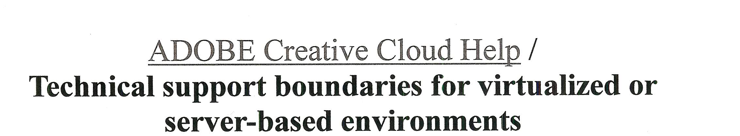
Very Recent Example - Adobe

Slide 102
Fact Pattern – You Are The Judge
Patco Construction v. Ocean Bank.
Hackers stole CFO of Patco's login credentials and initiated a series of transfers throughout the week starting on May 9 that totaled over $588,000. Patco discovered the fraud on May 13, when one of its co-owners found a notice from Ocean Bank in his mailbox, stating that several recent transfers had been rejected. Patco notified the bank on the morning of May 14. While the bank attempted to rescind the transfers, Patco was ultimately out at least $345,000 in stolen funds.

Slide 103
Who Is At Fault?
The Bank claimed that Patco was responsible for the loss.
They cited a banking related rule, signed by Patco, which stated: customers who use automated clearinghouse (ACH) transactions on their commercial accounts "assume all liability and responsibility to monitor those accounts on a daily basis" and "[i]n the event you object to any ACH debit, you agree to notify us of your objection on the same day the debit occurs."

Slide 104
Patco Claimed Bank Was At Fault
Patco claims that Ocean Bank is responsible for the loss, arguing that the bank breached its duty to provide a commercially reasonable security system because it only provided a single-factor authentication system for wire transfers.
Ocean Bank did not provide a commercially reasonably secure security system, because it elected not to implement several parts of the security software it purchased, which included notifying Customer when the risk score of a transaction exceeded a certain level.

Slide 105
Who Do You Think Should Win?
Factual questions to be answered will include: the extent to which Ocean Bank represented and agreed that it would implement security measures to protect the funds of customers; whether Ocean Bank fulfilled its representations and promises in that regard; whether Ocean Bank acting responsibly in light of its position of trust and in light of reasonable industry standards; and whether Ocean Bank should have been on notice of improper criminal conduct based on the facts.

Slide 106
Security Measures Matter
In the Patco case, the critical question, before Ocean Bank can claim any safe harbor from liability for the fraud damages is did Ocean Bank offer a commercially reasonable security procedure to Patco?
The object lesson of this lawsuit is not necessarily what the ultimate outcome will be based on its unique facts. The real point is that causes of action do exist in the law that can make a third-party, like a bank, potentially responsible for harm suffered by others at the hands of Cyber criminals.

Slide 107
Language Matters
Read yours
Do not be afraid to challenge vague language – to ask for specifics. If the language calls for reasonable secuerity measures, ask what that means.
Be Aware of the Upsell:

Slide 108
Security is Like A liquor License
"Security is like a liquor license to a restaurant -- an opportunity to up-sell each customer with a high-profit margin product to balance out the dismal or loss-leading margins of the core product. Security is the single most profitable differentiator that a service provider can add to IaaS to have any hope of making money.."
  -PC World, March 20, 2011

Slide 109
The Privacy Statement – Read It
Patrick Feehan

Slide 110
HR Had a Problem
They had an employee who was spending 4 hours a month doing employee income verifications.
They had a solution.
A Vendor would take over that task for the College.
All it required was 8 hours every other week of IT personnel time.

Slide 111
To Do This – Data Had to Be Transferred
Employer Company Code
Employee Name
SSN User ID PIN
As of Date
Most Recent Hire Date
Original Hire Date
Job Title
Employee Status
Date of Termination (if applicable) Pay Frequency

Slide 112
To Do This – Data Had to Be Transferred
Current Pay Rate
YTD gross Base pay
YTD gross Over-time pay
YTD gross Bonus pay
YTD gross Commission pay
YTD gross Other income
YTD gross Total

Slide 113
To Do This – Data Had to Be Transferred
Employee Home Address
Pay Period End Date
Date Paid/Check Date
Total Hours worked for pay period
Gross wages for pay period
Net Pay for pay period

Slide 114
Patrick – they said – Do You Approve This?
"No", I said.
"Read their privacy statement"

Slide 115
Privacy Statement Said
TO WHOM WE MAY DISCLOSE THE INFORMATION WE COLLECT
We take reasonable precautions to be sure that nonaffiliated third parties and affiliates, to whom we disclose your personally identifiable information are aware of our privacy policy and will treat the information in a similarly responsible manner. Our contracts and written agreements with nonaffiliated third parties that receive information from us about you prohibit those parties from transferring the information other than to provide the service that you obtain from us.

Slide 116
Privacy Statement Said
Agents and contractors: Our contractors sometimes have access to your personal information in the course of assisting in operating our business and providing products or services to you. These contractors include vendors and suppliers that provide us with technology, services, and/or content for the operation and maintenance of our site. Some of these relationships may be with companies that co-brand portions of their site and services, or that provide services to you on our behalf. Co-branded sites may have their own privacy policies posted on their sites

Slide 117
And Ironically…
EFFORTS WE MAKE TO SAFEGUARD YOUR PERSONAL INFORMATION
We are committed to protecting the security of your information …by taking these steps:
We limit access to your personal information to employees having a reasonable need to access this information to provide products and services to you and to our customers. Employees who misuse information are subject to disciplinary action, including termination.
We have reasonable physical, technical and procedural safeguards to help protect your personal information.

Slide 118
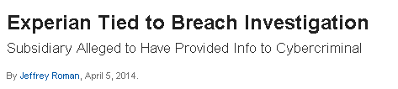
And Finally…

Slide 119


